Slide 1
FINA 1303 THE SELL-SIDE: COMMERCIAL BANKS
Veronique Lafon-Vinais
Associate Professor of Business Education - Department of Finance

Slide 2
Course Map
Overview
Foundations of
Interest Rates
Financial Institutions
Pricing of Financial Assets
Regulations
DCF
Sell Side
Buy Side
Stock
Valuation
Banking Regulation
Basics of
Interest Rates
Commercial Banking
Traditional Institutional Investors
Asset
Pricing
Models
Monetary Policy
Investment Banking
Alternative Investors
2

Slide 3
Course map
Overview
Financial Institutions
What are Commercial Banks?
Bank Management
Types of Risk in Banking
Measuring Bank Performance
Current Issues
Sell Side
Commercial Banking

Slide 4
Banks as financial intermediaries
Bank
Saver/
Lender
$
Borrower
$
Deposit
Account
Loan
Contract
Asset transformation
Notes:
(US definition, source Mishkin)
Financial intermediaries are financial institutions that engage in financial asset transformation.
Financial intermediaries purchase one kind of financial asset from borrowers (generally a long term loan contract whose terms are adapted to the specific circumstances of the borrower) and sell a different kind of financial asset to savers, generally some kind of relatively liquid claim against the financial intermediary (eg deposit account).
Unlike brokers and dealers, financial intermediaries typically hold financial assets as part of an investment portfolio rather than as an inventory for resale.
In addition to making profits on their investment portfolios, financial intermediaries make profits by charging relatively high interest rates to borrowers and paying relative low interest rates to savers (margin income).
Types of financial intermediaries include:
depository institutions (commercial banks, savings and loans, mutual savings banks, credit unions)
Contractual savings institutions (life insurance companies, fire and casualty insurance companies, pension funds, government retirement funds)
Investment intermediaries (finance companies, stock and bonds mutual funds, money market mutual funds)

Slide 5
Commercial Banks
Financial Institutions
Financial Intermediaries
Depository Institutions
Commercial Banks
Retail Banking
Corporate & Investment Bank
Consumer Finance
Retail/Consumer
Banking
Wholesale
Banking
Trading, Treasury & Markets
Credit Cards
Private Banking/
Asset Management

Slide 6
Class discussion
What products and services do commercial banks offer to retail clients?
Who are the banks competitors?
What is the business model for retail banking v. wholesale banking?

Slide 7
Banking discussion: retail products & services
Lending
Deposits
Credit cards
Wealth management
Currency exchange
Insurance
Mortgage
Stock trading
Transfer services
Branches
Education services about finance
Checking and savings account
CDs
Utility functions: safe deposit boxes; travelers checks
ATM
Advisory services for investments
Customers include SMEs

Slide 8
Banking discussion: bank competitors
Fast lending services
Crypto currencies
Fintech companies: Paypal, Square (banks are too slow)
Online B2B platforms
Online companies like Alipay in China, Ant Financial
Retailers like Starbucks
Start ups providing solutions for SMEs to consolidate credit
Finance companies like UA
Financial companies that provide substitute to deposits
All companies that provide installment loans
Securities companies (apps for stock trading)
Companies offering their own credit cards
Investment banks
Credit unions
Corporates have investment banking/corporate finance
Government departments?
Buy Now Pay Later

Slide 9
Banking discussion: retail v. wholesale banking
Customers are different: individual v. companies, large corporates, governments
Different size of transactions
Interest rate based for retail; fee based for wholesale
Using deposits for corporate lending
Brokerage services
Wholesale much bigger scale; retail give loans to individuals
Different objectives
Can offer discount based on scale
Different value proposition: convenience, more dispersed services (retail)
Higher customer intimacy – customer relationship (wholesale)
Corporate finance advice (wholesale)
Collaborate with other banks
High origination costs

Slide 10
Commercial Banking
Retail banking
Wholesale banking
Clients = Retail (individuals)
Provide residential and consumer loans
Accepting small deposits
Clients = Corporates and Institutionals (large size → wholesale)
Provide commercial and industrial loans
Funded with deposits and purchased funds

Slide 11
Mortgages in HK: what types of mortgages do banks offer? What are typical terms? Could we have a subprime crisis in HK?
Group 1
Video
https://www.youtube.com/watch?v=cP7IjoeMcZw
Article
https://www.moneyhero.com.hk/blog/en/mortgage-lesson-4-types-of-mortgages-in-hk#:~:text=Mortgage%20plans%20in%20Hong%20Kong,(3)%20Deposit%2Dlinked

Slide 12
Forces shaping International Banking
Changes in the structure of banking
New entrants
Globalization
Reduction in profit margins
Disintermediation
Technological changes
Increased competition
Ongoing product & process innovation
Innovation
Transformation of regulatory framework
Regulation/
Deregulation

Slide 13
Commercial Banks
Traditional products and services:
New products and services
Deposit accounts
Credit services
Payment and collection services
Trade services
FX services
Credit enhancement or payment guaranty
Agent or fiduciary services
Investment banking services
Consulting services
Risk management services
Broker/dealer services
Insurance services
Asset management
Notes:
Deposit accounts - 2 basic types:
Demand deposit accounts (DDAs) (also known as checking accounts) = a method by which an account holder uses a financial institution to transfer funds to a third party
Time deposit accounts. Time deposits must be held at a bank, thrift or credit union for a specified period. They include:
CDs = negotiable or non-negotiable obligations of a bank offered at either fixed or variable interest rates. Sold to individuals or companies, maturities 7 days to several years
Negotiable CDs = generally sold in blocks of $1 million to companies, MM funds and other large investors. Maturities 14 days to 5 years
Retail CDs = non-negotiable CDs sold to individual investors in amounts varying from institution to institution, maturities 3 months to 5 years
Savings accounts or passbook accounts = accounts that pay interest on balances
Other interest-bearing accounts, for example accounts that have some features of both demand and time deposit accounts e.g.
Money market deposit accounts = accounts that pay an unregulated rate of interest determined by the bank and allow limited check writing transfers and electronic withdrawals
NOW (Negotiable Order of Withdrawal) accounts = offer unlimited check writing and pay unregulated rates of interest. Available only to individuals, sole proprietorships, not-for-profit orgs and government entities

Slide 14
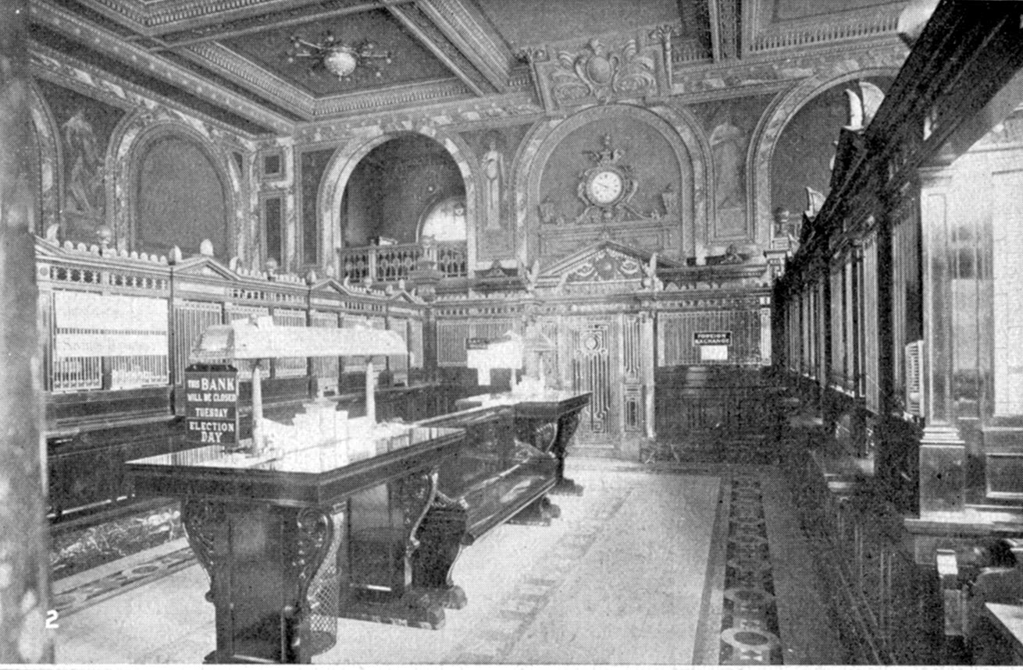
Banks in the old days

Slide 15

Banks today

Slide 16
Multiple Role of Banks
Borrower
Lender
Liquidity
Providers
Banks
Payment
Channel
Credit
Enhancement
Custody Agents
Conduit for
Monetary Policy
Trustees

Slide 17
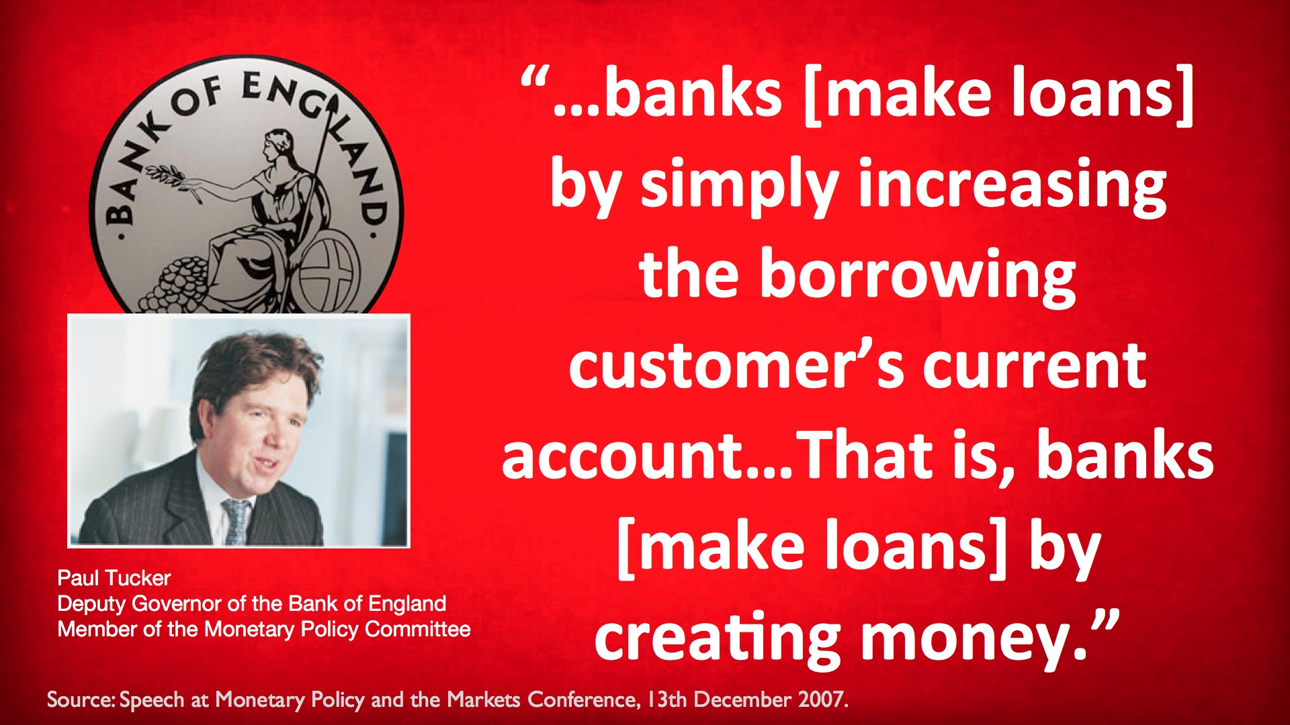
The very special role of banks: money creation

Slide 18

Money creation: how it works
The loan is an asset for the bank
The deposit is a liability for the bank
The bank makes a loan to the business
The bank deposits the money from the loan into a deposit account for the business
Bank deposits are part of the money supply

Slide 19
Banks in Hong Kong: digital banking developments and implications
Group 2
Video
https://drive.google.com/file/d/10q84pxiGauRLVrAv2oVCBGiKpyY-7ScK/view
Article
https://blog.startupr.hk/virtual-banking-in-hong-kong/

Slide 20
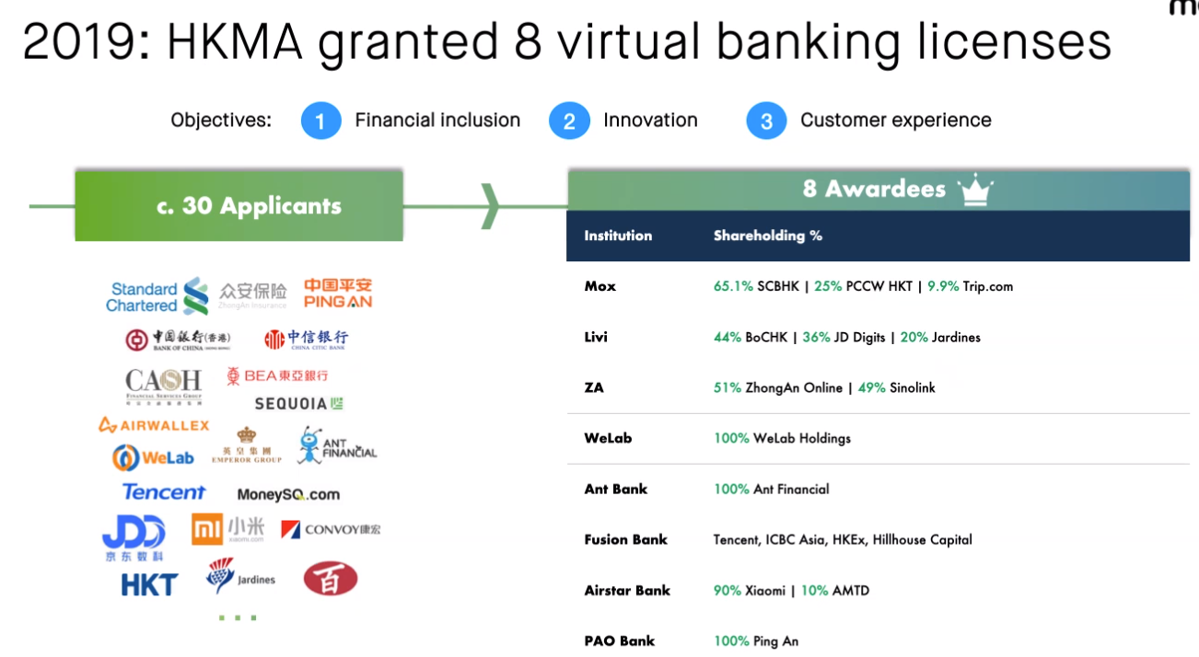
Source: Mox FCCIHK presentation 2 Feb 21
Notes:
Source: Mox FCCIHK presentation 2 Feb 21 by Edwin Hui

Slide 21
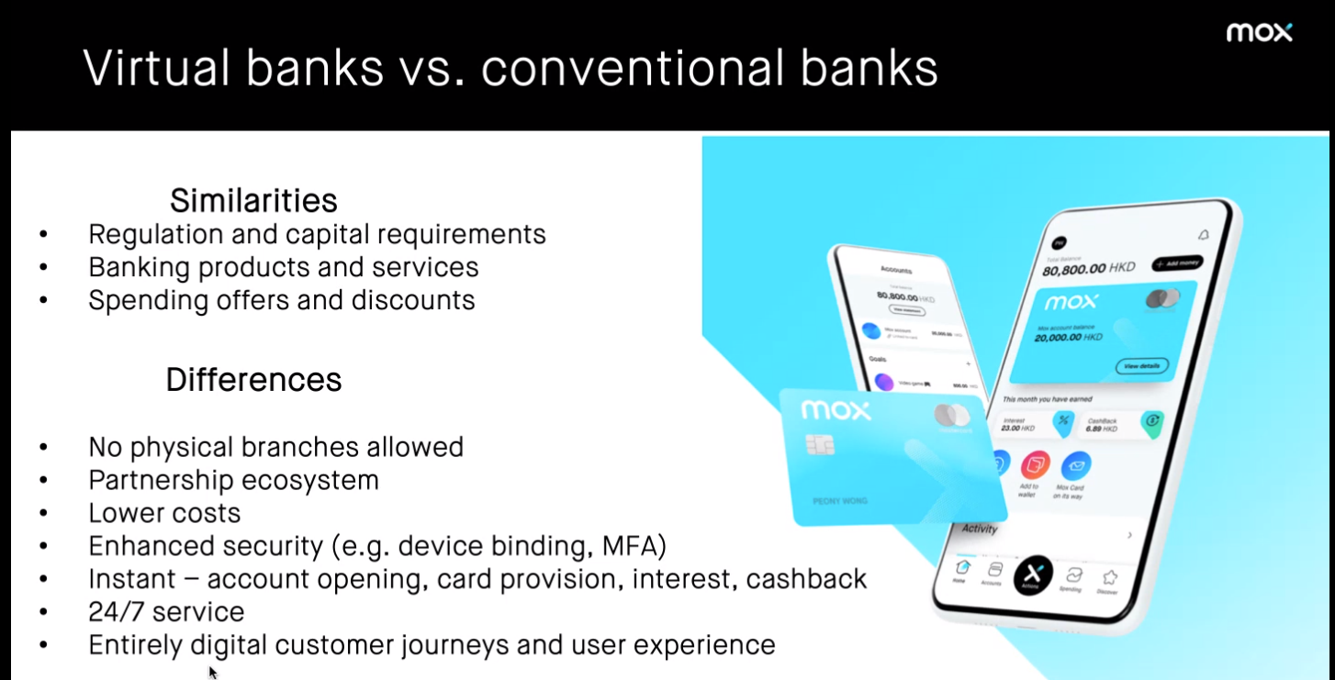
Source: Mox FCCIHK presentation 2 Feb 21
Notes:
Source: Mox FCCIHK presentation 2 Feb 21 by Edwin Hui

Slide 22
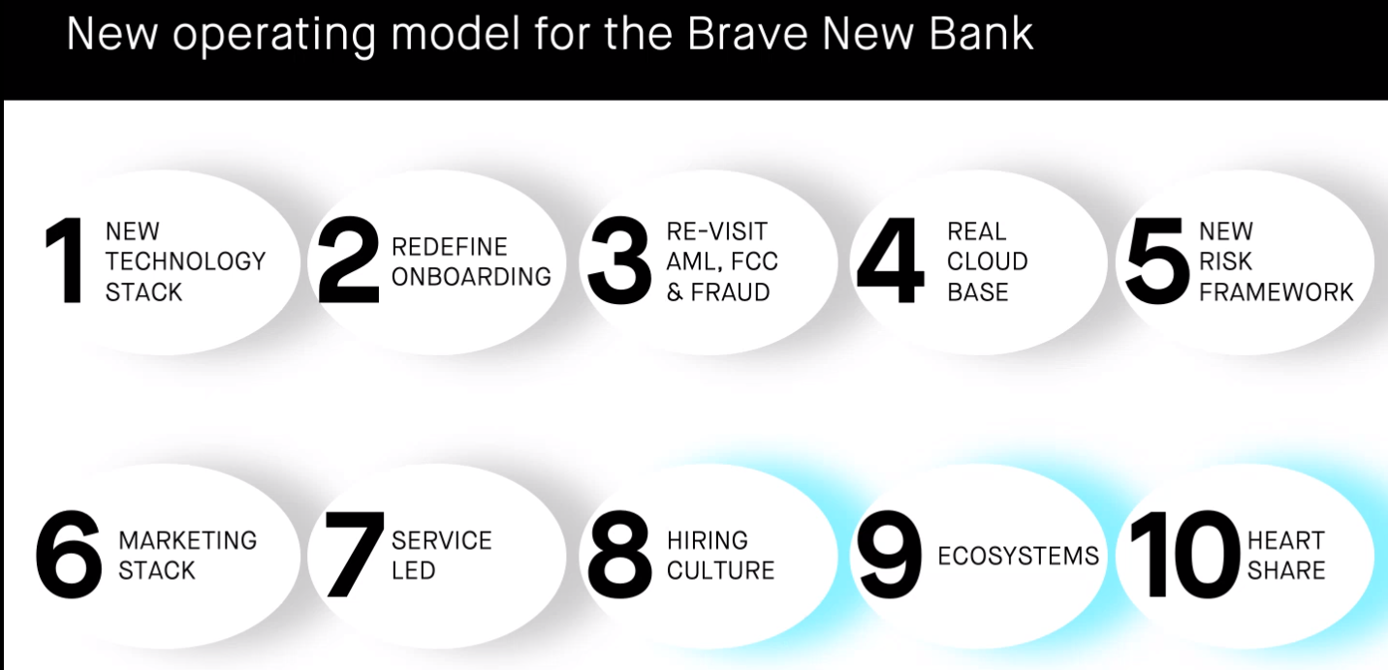
Source: Mox FCCIHK presentation 2 Feb 21
Notes:
Source: Mox FCCIHK presentation 2 Feb 21 by Edwin Hui

Slide 23
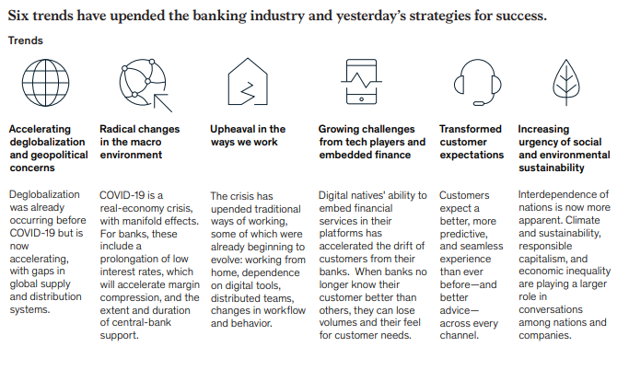
Trends in banking industry
Source: McKinsey Global Banking report 2020
Notes:
Source: McKinsey Global Banking report 2020 https://www.mckinsey.com/industries/financial-services/our-insights/global-banking-annual-review

Slide 24
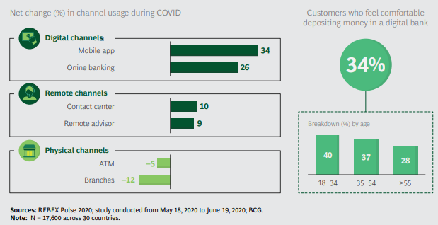
Customers are increasingly turning to digital banking
Source: BCG Dec 2020
Notes:
Source: BCG Dec 2020 https://web-assets.bcg.com/33/41/c8a334f74926921d5aa9296ea6cc/bcg-the-sun-is-setting-on-traditional-banking-nov-2020.pdf

Slide 25
Banks in China: will digital banking replace traditional banking?
Group 3
Video
https://www.youtube.com/watch?v=s4tSP9-o7ZQ
Article
https://www.ft.com/content/196cfd50-46d9-11e7-8d27-59b4dd6296b8

Slide 26
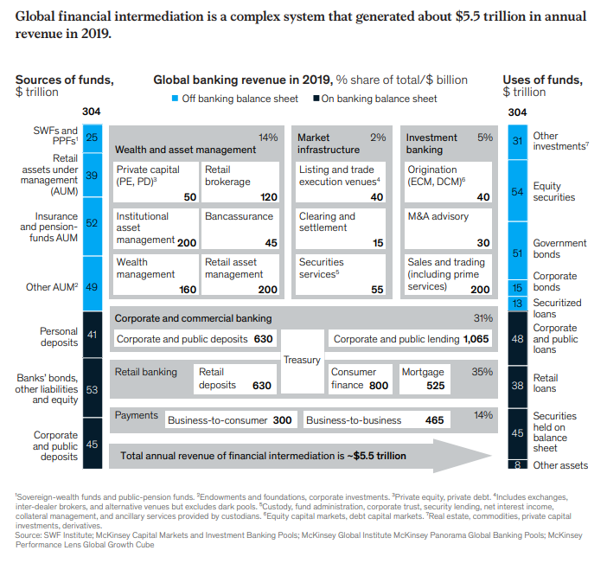
Global Financial Intermediation
Source: McKinsey Global Banking report 2020
Notes:
Source: McKinsey Global Banking report 2020 https://www.mckinsey.com/industries/financial-services/our-insights/global-banking-annual-review

Slide 27
SUMMARY (KLOs)
What are commercial banks
What they do (basic business models)
Competitors
Money creation

Slide 28
Course map
Overview
Financial Institutions
What are Commercial Banks?
Bank Management
Types of Risk in Banking
Measuring Bank Performance
Current Issues
Sell Side
Commercial Banking

Slide 29

Class discussion
Imagine that you are the CEO of a large bank
(pick one and name it)
What keeps you awake at night and why?

Slide 30
Bank Management
4 primary concerns of bank managers: | Aspects of bank management:
Make sure bank has enough cash to pay deposit outflows | Liquidity management
Pursue an acceptably low level of risk by acquiring assets with low default rate and diversifying asset holdings | Asset management
Acquire funds at low cost | Liability management
Decide the amount of capital the bank should maintain and acquire this capital | Capital management
ALM
Notes:
3 major aspects of bank management:
Liquidity Management (management of reserves so the bank stays liquid to meet deposit outflows)
ALM i.e. Assets and Liabilities Management (management of balance sheet for profits i.e. cheap sources of funds and high income producing assets)
Capital Management (management of solvency): Bank capital prevents bank failure; necessity to maintain balance between high capital (high solvency) and low capital (higher return to shareholders measured by ROE Return on Equity = Net Profits over Equity Capital). More refined way would be RAROC (Risk Adjusted Return on Capital)

Slide 31
Liquidity Management Scenario 1
Bank A (Reserve Requirement = 10% of Deposits)
Assets |  | Liabilities
Reserves | $20 mil | Deposits | $100 mil
Loans | $80 mil | Capital | $10 mil
Securities | $10 mil
Reserve req.
= $10 mil
Excess reserves
= $10 mil
Deposit outflow of $10 mil
Bank A (Reserve Requirement = 10% of Deposits)
Assets |  | Liabilities
Reserves | $10 mil | Deposits | $90 mil
Loans | $80 mil | Capital | $10 mil
Securities | $10 mil
Reserve req.
= $9 mil
Excess reserves
= $1 mil
Notes:
Liquidity Management : When bank receives deposits, reserves ↑ by equal amount; when bank loses deposits, reserves ↓ by equal amount.
Assume that bank has to keep 10% of total deposits as required reserves. In this case Bank A has reserves of $20 million therefore it has excess reserves of $10 million.
Question to Students: What is liquidity risk?
Answer: The risk that a bank may not be able to fund increases in assets or meet obligations as they fall due without incurring unacceptable losses.
Question to Students: why is liquidity management extremely important?
Answer: Because lack of liquidity can trigger bank run.
10% reserve requirement is applied to total amount of deposits in this case 10% of 100 million is 10 million
If a bank has ample reserves a deposit outflow does not necessitate changes in other parts of its balance sheet

Slide 32
Liquidity Management Scenario 2
Bank B (Reserve Requirement = 10% of Deposits)
Assets |  | Liabilities
Reserves | $10 mil | Deposits | $100 mil
Loans | $90 mil | Capital | $10 mil
Securities | $10 mil
Reserve req.
= $10 mil
Excess reserves
= none
Deposit outflow of $10 mil
Bank B (Reserve Requirement = 10% of Deposits)
Assets |  | Liabilities
Reserves | $0 mil | Deposits | $90 mil
Loans | $90 mil | Capital | $10 mil
Securities | $10 mil
Reserve req.
= $9 mil
Shortfall of res.
= $9 mil

Slide 33
Liquidity Management 4 Possible actions for Bank B
Borrow from other banks or corporations
Sell securities
Assets |  | Liabilities
Reserves | $9 mil | Deposits | $90 mil
Loans | $90 mil | Capital | $10 mil
Securities | $10 mil | Borrowings | $9 mil
Assets |  | Liabilities
Reserves | $9 mil | Deposits | $90 mil
Loans | $90 mil | Capital | $10 mil
Securities | $1 mil
Source: Mishkin/Eakins
Notes:
The bank can acquire reserves by borrowing from other banks in the fed funds market or borrowing from corporations by issuing CDs or CP.
It can sell of its securities to cover the deposit outflow; however some securities may be illiquid, and there will be brokerage and other transactions costs

Slide 34
Liquidity Management 4 Possible actions for Bank B (Cont)
Borrow from the FED
Call in or sell off loans
Assets |  | Liabilities
Reserves | $9 mil | Deposits | $90 mil
Loans | $90 mil | Capital | $10 mil
Securities | $10 mil | Discount loans | $9 mil
Assets |  | Liabilities
Reserves | $9 mil | Deposits | $90 mil
Loans | $81 mil | Capital | $10 mil
Securities | $10 mil
Source: Mishkin/Eakins
Notes:
The bank can borrow from the Fed at the discount window – it will pay the discount rate, which is set by the Fed and is normally higher than interbank rates
It can also sell some of its loans
Conclusion: excess reserves are insurance against above 4 costs from deposit outflows
Calling in loans = not renewing them when they come due
Selling off loans = secondary sale of loans

Slide 35
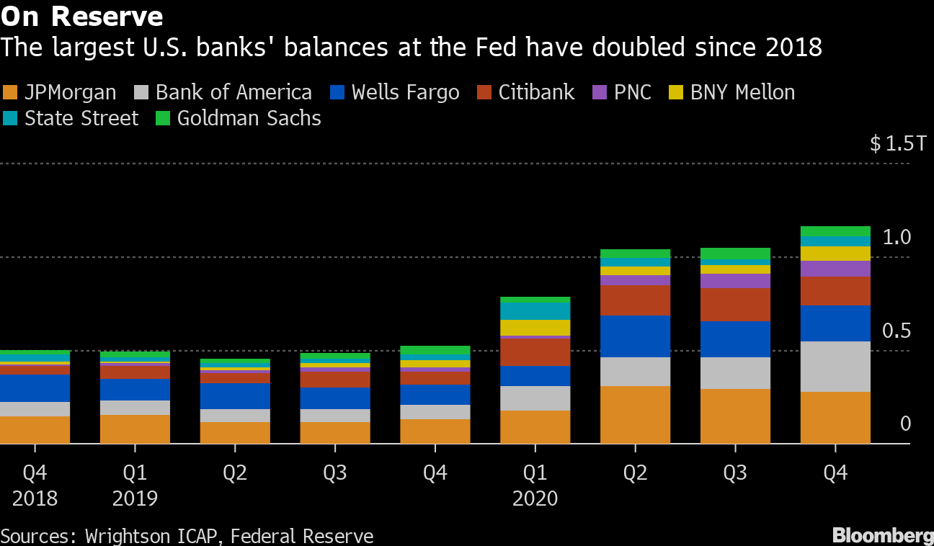
Reserves
Source: Bloomberg 15 March 21
Notes:
Source: Bloomberg 15 March 21 https://mail.google.com/mail/u/0/#inbox/WhctKJWQjnCLMlpqRJVHNpdTHDtZZzgqHfGfcdrDkQJLZhzKVrwwCqlBSWpgPrDBVzVSfqB?projector=1
Supplementary leverage ratio (SLR)
The supplementary leverage ratio is the US implementation of the Basel III Tier 1 leverage ratio, with which banks calculate the amount of common equity capital they must hold relative to their total leverage exposure. Large US banks must hold 3%. Top-tier bank holding companies must also hold an extra 2% buffer, for a total of 5%. The SLR, which does not distinguish between assets based on risk, is conceived as a backstop to risk-weighted capital requirements.

Slide 36
ALM: Asset and Liability Management
Asset Management
Get borrowers with low default risk, paying high interest rates
Buy securities with high return, low risk
Diversify portfolio
Manage liquidity by holding liquid assets and managing reserves
Liability Management
No longer primarily depend on deposits
When see loan opportunities, borrow or issue CDs to acquire funds
Notes:
To maximize its profit, a bank must simultaneously seek the highest returns possible on loans and securities, reduce risk, and make provisions for liquidity by holding liquid assets.
ALM : Diversification of
Asset portfolio (shoot for high returns and low risks) and
Sources of funds
(Decrease in cheap deposits as source of funds for banks since the 60s  new ways to fund business includes borrowings i.e. CDs, CP, etc…). One measure of bank profitability is ROA (Return on Assets = net profits over total assets).
Before the 1960s, over 60% of the sources of funds of the banks were obtained through checkable (demand) deposits that by law could not pay interest => cheap funding cost for banks. Banks could not compete for the deposits so their amount was a given for any individual bank. Also the interbank market was not well developed.
Starting in the 60s, large money center banks in key financial sectors (NY, Chicago, SF) began to explore ways in which the liabilities on their balance sheets could provide them with reserves and liquidity  development of the o/n interbank market (fed funds) and money market instruments such as CDs  shift of emphasis on liability management as a way to fuel expansion and growth.

Slide 37
Off-Balance-Sheet Activities
Fee income from:
Foreign exchange trades for customers
Servicing mortgage-backed securities
Guarantees of debt
Backup lines of credit
Trading in and of:
Financial futures and options
Foreign exchange
Interest rate swaps
Loan sales
Off-balance sheet activities involve trading financial instruments and generating income from fees and loan sales, activities that affect bank profits but do not appear on bank balance sheets
(source: Mishkin)
Contingent
liabilities
All these activities involve RISK
Notes:
Loan sales = asset sales = secondary loans involves a contract to sell all or part of a cash stream from a specific loan and removes the loan from the balance sheet.
Off balance sheet activities involving guarantees of securities and backup credit lines increase the risk a bank faces. Even though a guaranteed security does not appear on a bank’s balance sheet, it still exposes the bank to default risk and if the issuer of the security defaults, the bank if left holding the bag and must pay the security owner.. Back up credit lines also expose the bank to risk because the bank may be forced to provide loans when it does not have sufficient liquidity or when the borrower is a poor credit risk.
Banks attempts to manage IR risk led them to trading in financial futures, options for debt instruments and interest rate swaps. They also engaged in FX trading. All transactions in these markets are off balance sheet because they do not have a direct effect on the bank’s balance sheet.

Slide 38
Capital Adequacy Management
Tradeoff between safety (high capital) and return (ROE)
Banks also hold capital to meet capital requirements
Strategies for Managing Capital
Sell or retire stock
Change dividends to change retained earnings
Change asset growth (increase or shrink balance sheet by acquiring or selling off assets)
Source: Mishkin/Eakins
Notes:
Bank capital benefits the owners in that it makes their investment safer by reducing the likelihood of bankruptcy; but it is costly because the higher the amount of capital, the lower the return on equity for a given return on assets => in determining the amount of capital, bank managers have to decide how much safety they are willing to trade off against return.
Banks hold capital because they are required to do so by regulatory authorities. Generally bank management want to hold less capital than required by authorities due to cost of capital.
Banks experiencing capital shortfalls who are not able to issue new stock or reduce dividends will shrink their balance sheet by selling off assets (eg FNBC in 1984)

Slide 39

Test Your Understanding
What is the theoretical background for capital adequacy requirements
More capital increases cushion for losses
More capital provides incentive for shareholders to monitor management
None of the above
All of the above

Slide 40
SUMMARY (KLOs)
Understand the key aspects of bank management
Liquidity risk and how to manage it
Role of off-balance sheet activities

Slide 41
Course map
Overview
Financial Institutions
What are Commercial Banks?
Bank Management
Types of Risk in Banking
Measuring Bank Performance
Current Issues
Sell Side
Commercial Banking

Slide 42
Risk Management Basics
Identify
1) Eliminate
2) Keep
3) Mitigate
4) Increase
Quantify
Manage
1) Probability
2) Severity
Verify

Slide 43

Types of Risk in Banking
Credit
Liquidity
Market
Operational
Legal & Reputational
Notes:
Credit risk arises from potential that a borrower or a counterparty to a transaction will fail to perform an obligation
Liquidity risk is the potential that an institution will be unable to meet its obligations as they come due because of an inability to liquidate assets or obtain adequate funding (funding liquidity risk) or that it cannot easily unwind or offset specific exposures without significantly lowering market prices because of inadequate market depth or market disruptions (market liquidity risk)
Market risk is the risk to a financial institution’s condition resulting from adverse movement in market rates or prices, such as interest rates, foreign exchange rates or equity prices
Operational risk arises from the potential that inadequate information systems, operational problems, breaches in internal controls, fraud or unforeseen catastrophes will result in unexpected losses
Legal risk arises from the potential that unenforceable contracts, lawsuits, or adverse judgments can disrupt or otherwise negatively affect the operations or condition of a banking organization
Reputational risk is the potential that negative publicity regarding an institution’s business practices, whether true or not, will cause a decline in the customer base, costly litigation, or revenue reductions.

Slide 44
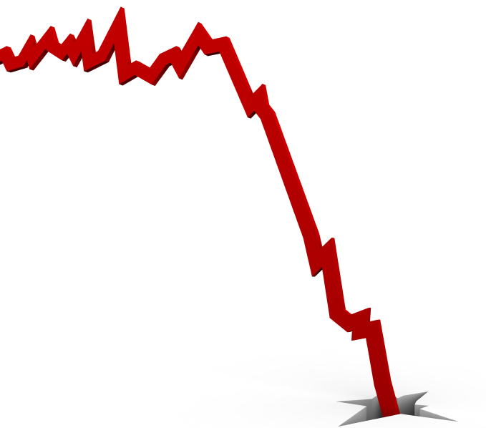
Credit risk
The ability and willingness of a borrower to pay when due
Components: default risk and recovery risk
Within a given level of default risk, recovery risk can vary widely
Recovery highly dependent on position in capital structure e.g. higher recovery for secured debt and on type of issue e.g. recovery higher for loans than bonds
Remedy: liquidate or work-out?

Slide 45
Credit Risk
Types
Mitigation
Borrower
Counterparty
Country
Industry
Consumer
Settlement risk
Credit policy
Credit limits
Concentration limits
Credit scoring
Netting
Credit bureau
Ratings
Notes:
Settlement risk is the risk of loss due to a counterparty’s failure to perform on its obligations after an institution has performed on its obligations under a contract on a settlement date. Settlement risk frequently arises in international transactions due to time zone differences. This risk is only present in transactions that do not involve DVP and generally exists only for a short time.

Slide 46
Credit risk in Asia: what is the level of NPLs (non performing loans) for banks in Asia? How has it evolved over time? Implications?
Group 4
Video
https://www.bloomberg.com/news/videos/2020-02-27/buying-non-performing-loans-in-southeast-asia-arena-management-says-video
Article
https://www.spglobal.com/ratings/en/research/articles/200406-for-asia-pacific-banks-covid-19-crisis-could-add-us-300-billion-to-credit-costs-11359063

Slide 47
Market risk
Types
Mitigation
Interest Rate risk
FX risk
Equity risk
Commodity risk
ALM policy
Hedging
Risk management policy and limits

Slide 48
Liquidity Risk
Types
Mitigation
Funding liquidity risk
Market liquidity risk
ALM policy
Conservative funding policy
Conservative ratios
“Liquidity is an illusion. It’s always here when you don’t need it, and rarely there when you do”
Michael Milken
Notes:
Liquidity risk is the risk of loss due to failure of an institution to meet its funding requirements or to execute a transaction at a reasonable price.
Market liquidity risk is the risk that an institution may not be able to exit or offset positions quickly, and in sufficient quantities, at a reasonable price. This inability may be due to inadequate market depth in certain products, market disruption, or inability of the bank to access the market (eg downgrading of the institution or major counterparty)
Funding liquidity risk is the potential inability of the institution to meet funding requirements because of cash flow mismatches, at a reasonable cost. With respect to derivatives, such funding requirements may arise from cash flow mismatches in swap books, exercise of options, implementation of dynamic hedging strategies.

Slide 49
Operational Risk
Types
Mitigation
Inadequate information systems
Operational breakdown
Breaches in internal control
IT security breakdown
Unforeseen catastrophes
Fraud
Risk management policy
Back up and recovery plans
Segregation of duties
Outsourcing
Audits
“West LB’s equity trading loss soars; trading investigation launched”
FT 31 August 07
“Jail for ex-NAB rogue forex dealers”
FT 5 July 06
Notes:
Operational risk is the risk of loss occurring as a result of inadequate systems and control, deficiencies in information systems, human error or management failure.

Slide 50
Operational risks in banks in Asia: find recent incidents, what happened, consequences
Group 6
Video link
https://www.youtube.com/watch?v=2WV3sIcWNxE
Article
https://finance.yahoo.com/news/hong-kong-slaps-record-fine-093000692.html

Slide 51
Legal & Reputational Risks
Types
Mitigation
Regulatory risk
Money Laundering
Conflicts of Interest
Non-enforceability of contracts
Non-compliance with corporate governance laws
SEE issues
Implement SOX and related corporate governance policies
KYC Policies
Legal & Compliance Dpts reporting to CEO
Audits
SEE audits (environmental and corporate governance)
Notes:
Legal risk is the risk of loss arising from contracts which are not legally enforceable (eg the counterparty does not have the power or authority to enter into a particular type of transaction) or documented correctly
Regulatory risk is the risk of loss arising from failure to comply with regulatory or legal requirements
Reputation risk is the risk of loss arising from adverse public opinion and damage to reputation

Slide 52
Reputational Risk for Financial Institutions: do we care? Examples in Asia
Group 7
Video
https://www.youtube.com/watch?v=G40P66-vTDI
Article
https://www.jocpr.com/articles/research-on-reputation-risk-management-of-commercial-banks-in-china.pdf

Slide 53
Test Your Understanding
What is recovery risk?
The risk of the borrower not paying
The risk of how much the lender can recover in a case of default
How do banks help prevent money laundering (which type of policy?)
ALM policy
KYC policy
Credit policy

Slide 54
SUMMARY (KLOs)
Basics of Risk Management
Credit risk dimensions and mitigation
Understanding market risk
Market risk mitigation strategies
Understanding operational risk
Operational risk mitigation strategies
Understanding legal & reputational risk and mitigation strategies

Slide 55
Course map
Overview
Financial Institutions
What are Commercial Banks?
Bank Management
Types of Risk in Banking
Measuring Bank Performance
Current Issues
Sell Side
Commercial Banking

Slide 56
Measuring Bank Performance
Income statement
Operating Income: the income that comes from a bank’s ongoing operations =
Interest income = interest on the bank’s assets
Non-interest income = service charges and fees, plus revenues from off-balance sheet activities
Operating Expenses : expenses incurred in conducting the bank’s ongoing operations =
Interest expense = interest on bank’s liabilities
Non-Interest expense = operational costs e.g. wages
Provision for loan losses
Net Operating Income (NOI)
Source: Mishkin/Eakins
Notes:
When a bank has a bad debt or anticipates that a loan might become a bad debt in the future it can write up the loss as a current expense in its income statement under the provision for loan losses. This is directly related to the loan loss reserves because when a bank wants to increase its loan loss reserve account it does so by increasing the provision for loan losses. By increasing expenses when losses have not yet occurred, earnings are being set aside to deal with losses in the future.
Net operating income is closely watched as an indicator of how well bank is doing on ongoing basis.
Net income before taxes or profit before taxes is the NOI adjusted for gains/losses on securities sold and net extraordinary items.

Slide 57
Key Indicators
Profitability | Size & Market Share | Other Financial | Other
Operating income Net income EPS ROA ROE ROEC RAROC Customer profitability | Total Assets Market Cap Funds under management League Tables Volume estimations | VAR Share Price Ratings | Awards Customer satisfaction Employee turnover Lawsuits
Notes:
Measures of bank performance:
Net profit (ROA)
Operational income
ROE (Return on Equity)
ROAC (Return on Adjusted Capital)
ROCE (Return on Capital Employed)
RAROC (Risk Adjusted Return on Capital)
Additional tools of bank management:
LOB profitability and VAR
Customer profitability
Importance of looking at the numbers on a historic comparison basis as well as industry basis (ratios don’t mean anything on an absolute basis)  see trends

Slide 58
Key Constituencies
Rating Agencies
Regulators
Suppliers
Management
Shareholders
Creditors
Employees
Competitors
Customers

Slide 59
Bank Organization
Matrix management
Lines of business/lines of products
CRM and implications
Shifting strategies
Impact of bank mergers
Impact of bank regulation/deregulation

Slide 60
Matrix Management
Markets
 | US | EMEA | ASPAC | LATAM
FX
MM
DCM
ECM
Derivatives
M&A
LOB
Notes:
This is a basic matrix with geographies and products; nowadays evolving to customer centric models, can be tri-dimensional matrices with customer segments/markets/lines of business. Reporting lines become increasingly complex, with some specialists having multiple hierarchical reporting lines.

Slide 61
Derivatives in Asia: what is the level of development of derivatives market (on exchange and OTC) across Asia? What about China? What are the issues? Implications?
Group 5
Video
https://www.cnbc.com/video/2020/05/19/70percent-to-80percent-of-asia-investors-trades-are-in-derivatives-td-ameritrade.html
Article
https://www.institutionalinvestor.com/article/b18jf346frjd1v/the-growing-influence-of-asia-in-derivatives-trading

Slide 62
SUMMARY (KLOs)
Understanding the various types of performance indicators
Understanding matrix management

Slide 63
Course map
Overview
Financial Institutions
What are Commercial Banks?
Bank Management
Types of Risk in Banking
Measuring Bank Performance
Current Issues
Sell Side
Commercial Banking

Slide 64
Current issues in banking
Regulatory pressure
New entrants
Technology/FinTech
Shadow banking

Slide 66
FINA 1303 THE SELL-SIDE: INVESTMENT BANKS
Veronique Lafon-Vinais
Associate Professor of Business Education - Department of Finance

Slide 67
Course Map
Overview
Foundations of
Interest Rates
Financial Institutions
Pricing of Financial Assets
Regulations
DCF
Sell Side
Buy Side
Stock
Valuation
Banking Regulation
Basics of
Interest Rates
Commercial Banking
Traditional Institutional Investors
Asset
Pricing
Models
Monetary Policy
Investment Banking
Alternative Investors
67

Slide 68
Course map
Overview
Financial Institutions
Sell Side
What are Investment Banks?
What do Investments Banks do?
Investment Banks vs. Commercial Banks
Investment Banking

Slide 69

Main Street v. Wall Street

Slide 70
Class Discussion
What is investment banking? What do Investment Banks do?

Slide 71
Disclaimer
This material is intended solely for information purposes and is not to be construed, under any circumstances, by implication or otherwise, as an offer to sell or a solicitation to buy or sell or trade in any commodities or securities herein named. Information is obtained from sources believed to be reliable, but is in no way guaranteed. No guarantee of any kind is implied or possible where projections of future conditions are attempted. In no event should the content of this material be construed as an express or implied promise, guarantee or implication that you will profit or that losses can or will be limited in any manner whatsoever. All investments are subject to risk, which should be considered prior to making any investment decisions.

Slide 72
Securities Firms & Investment Banks
Securities Industry
Corporate Finance:
Assisting firms in raising capital and providing advice about M&A, corporate restructuring and finance
Brokerage and market making:
Sale and trading of securities
Primary Market
Secondary Market
Investment banks
Securities Firms (Brokers and Dealers)
Notes:
Source: http://www.iii.org/financial2/securities/overview/
The securities industry consists of securities brokers and dealers, investment banks and advisers, and stock exchanges. Together, these entities facilitate the flow of funds from investors to companies and institutions seeking to finance expansions or other projects. Firms that make up the securities sector may specialize in one segment of the business or engage in a wide range of activities that includes brokerage, asset management and advisory services, as well as investment banking. As part of their asset management activities, some firms sell their own and others’ annuities.
Investment banking involves the underwriting of new debt securities (bonds) and equity securities (stocks) issued by private or government entities to finance new projects. Investment banks buy the new issues and, acting essentially as wholesalers, sell them, primarily to institutional investors such as banks, mutual funds and pension funds. Investment banks are sometimes referred to as securities dealers or broker/dealers because many also participate in the financial market as retailers, selling to individual investors. The primary difference between a broker and dealer is that dealers buy and sell securities for their own account, whereas brokers act as intermediaries for investors who wish to purchase or sell securities. Dealers make money by selling at a slightly higher price than they paid. Like underwriters and wholesalers, they face the risk that the securities in their inventory will drop in price before they can resell them.

Slide 73
Bank v. Investment Bank v. Investment Banking
Bank
Commercial Bank
Investment Bank
Private
Bank
Asset Management
Global Markets
Investment Banking
Support Functions
Sales & Trading (Equity; FICC; Derivatives)
Research
Corporate Finance
(Coverage; Execution)
M&A
ECM
DCM
Rating Advisory
Legal, Compliance, Credit Risk, Market Risk, Operations, Finance,….
Notes:
Bank (say UBS) = Investment Bank + Private Bank + Asset Management (often regrouped with Private Bank into Wealth Management)
Investment Bank = Global Markets + Investment Banking + Supporting functions (Legal, Compliance, Credit Risk, Market Risk, Operations, Finance,….)
Global Markets (outside the wall) = Trading and sales of equity, fixed income, commodities, derivatives of the above + research, equity and fixed income (inside the research information barrier)
Investment Banking (inside the wall) = Corporate finance coverage (Countries and Sectors), M&A, ECM (often a JV equity but inside the wall and PAID by Investment Banking), DCM (often a JV with Fixed Income but inside the wall and PAID by Investment Banking), Corporate Finance execution pool, Hybrids, Rating Advisory

Slide 74
Securities Brokers & Dealers
Securities Brokers
Securities Dealers
Full Service Brokers offer clients research and investment advice, but usually charge a higher commission on trades.
Discount Brokers provide facilities to buy/sell securities but offer no advice
Hold inventories of securities on their own account
Provide liquidity to the market by standing by ready to buy or sell securities (market maker)
Merrill Lynch is the largest full service brokerage house in the US
Charles Schwab is the best known discount broker
Source: Mishkin/Eakins
Notes:
Many on-line discount brokerage firms do have significant research available
The Securities Industry and Financial Markets Association (SIFMA) groups broker/dealers into four categories. The first and largest category, "major firms", consists of national full line companies, which are full service broker/dealers with an extensive national and international branch network system. This category also includes large investment banks and the largest U.S. broker/dealer subsidiaries of global financial holding companies. The major firms provide a broad array of financial services and products to households and institutions.
The second category is regional brokers. Operating on a somewhat smaller scale than the major firms, they offer a range of investment services based on their size and business specialty. Because of their regional expertise, these brokers participate in underwriting securities for businesses that are centered in their region.
New York City (NYC) area regionals, the third category, are mostly broker/dealer subsidiaries of U.S. and foreign banks and securities organizations, excluding those that fall into other listed categories, and are generally institutionally oriented. The fourth category is discounters, broker/dealers primarily engaged in the discount brokerage business.
Only a small percentage of the companies in these four categories are included in the "total firms" column of the chart below. "Total firms" consists of all New York Stock exchange broker/dealers doing public business. It is used by SIFMA as a proxy for the total industry as it accounts for approximately 60 to 80 percent of revenues, capital and assets of all brokers/dealers in the U.S.

Slide 75
Quick Quiz!
Corporate finance is:
Primary market
Secondary market
Full service brokers offer
Only brokerage service
Also offer advice
Which provides liquidity?
Broker
Dealer

Slide 76
Course map
Overview
Financial Institutions
Sell Side
What are Investment Banks?
Investment Banks vs. Commercial Banks
What do Investments Banks do?
Investment Banking

Slide 77
What is the difference between investment banks and commercial banks?
Merchant banks and investment banks
Origins of US investment banks
Basic frameworks for financial services organization

Slide 78






From Merchant to Investment Banks
Notes:
Barings Bank, previously known as Baring Brothers & Co., was the oldest merchant banking company in England, having been founded in 1762 by Sir Francis Baring.
Rothschild: Mayer Amschel Rothschild's role as Court Agent to the local Landgrave in the early years of the 19th century, watching and understanding the money markets, seeking out new investment opportunities.
Samuel Montagu was absorbed by Midland Bank and is now part of HSBC
SG Warburg & Co Limited founded in London in 1946 was absorbed by SBC in 1994, SBC later merged into UBS
Merchant bank = A bank that deals mostly in (but is not limited to) international finance, long-term loans for companies and underwriting. Merchant banks do not provide regular banking services to the general public. “Their knowledge in international finances make merchant banks specialists in dealing with multinational corporations.” (Source: Investopedia)
In banking, a merchant bank is a United Kingdom term for an Investment Bank. It is also used to describe the private equity activities of banking. This article is about the history of banking which originated with merchants, and has nothing to do with the use of the term today. Merchant banks, now so called, are in fact the original "banks". These were invented in the middle ages by Italian grain merchants. (Source: Wikipedia)

Slide 79
Investment Banks
Investment banks were essentially created in the U.S. by the passage of the Glass-Steagall Act (1933). Prior to this, investment banking activities were part of large, money-center commercial banks
The lines between investment banks and commercial banks again begins to blur as legal separation between investment banks and commercial banks is no longer required
Following the Citi-Travellers merger in 1998, the Gramm-Leach-Bliley Act (1999) effectively repealed Glass-Steagall
Source: Mishkin/Eakins

Slide 80

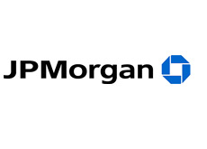
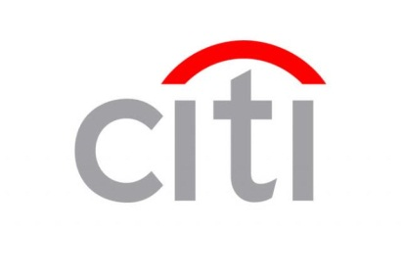




Investment vs. Commercial Banks: Is there a difference?

Slide 81
Basic framework for Banking & Securities
Global Banks
Universal banking
Financial Supermarket (FHCs and BHCs)
Legal separation
Banks can provide a full range of financial services (incl. insurance, securities, real estate) under same legal entity
Banks can provide a full range of financial services (incl. insurance, securities, real estate) but each different activity must be carried out under a different legal entity
Banks are prohibited from engaging in securities activities and other financial services such as insurance
Notes:
Spurred by the passage of the Gramm-Leach-Bliley Financial Services Modernization Act of 1999 (GLB), many leading financial services companies are now doing business across sectors. GLB permits banks, securities firms and insurance companies to affiliate with each other through the financial holding company (FHC) structure. FHCs can engage in activities other than banking as long as they are financial in nature. The most important of these are securities underwriting and dealing, insurance underwriting, insurance agency activities and merchant banking, a form of equity financing. The first step in electing FHC status is becoming a bank holding company (BHC), a company that owns one or more banks. BHCs must meet certain eligibility requirements in terms of capital, management and community investment to become an FHC. GLB allows existing BHCs that have opted for FHC status to acquire full service securities firms and insurance companies. It also permits insurers and securities firms to buy a bank and thus become a BHC eligible for FHC status. One example is Met Life, which purchased a bank and became a FHC. GLB also allowed banks owned by BHCs to expand into financial services activities by creating financial subsidiaries. Income from these subsidiaries’ activities flows up to the BHC parent, and is reported as income by the parent. But the activities permitted banks are not as broad as for FHCs. Financial subsidiaries of banks may not engage in insurance underwriting. In addition, they may not engage as a principal in providing or issuing annuities or in real estate development and investment, merchant banking or insurance investment activities. Before passage of GLB, BHCs could be involved in the securities business, but what they were permitted to do was strictly limited by law.

Slide 82
Current issue: Should Glass-Steagall be reinstated? Pros and cons of narrow banking
Pros
Cons
Protect depositors
Simplify regulation of depository institutions
More transparency for depository institutions customers
Lessens systemic risk
Restricts financial innovation
Limits profit opportunity and competition
Banks will find loopholes, just like in the past
Notes:
Source: http://www.businessweek.com/magazine/content/09_06/b4118030606341.htm?chan=magazine+channel_news, How Banking Diversification Steered Us Wrong by Amar Bhide

Slide 83
Summary (KLOs)
Differentiating securities firms & investment banks
Understanding corporate finance
Commercial banking v. investment banking
brokers and dealers
Regulation of investment banks:
Glass-Steagall Act
Gramm-Leach-Bliley Act
Basic framework
Narrow Banking

Slide 84
Test Your Understanding
Core investment banking activities such as corporate finance advisory and IPOs underwriting take place in the
Primary market
Secondary market
Which legislation gave birth to the first investment banks (e.g. Morgan Stanley)?
Gramm Leach Bliley Act
ERISA
Glass Steagall Act

Slide 85
Course map
Overview
Financial Institutions
Sell Side
What are Investment Banks?
Investment Banks vs. Commercial Banks
What do Investments Banks do?
Investment Banking

Slide 86
What do investment banks actually do?
Products and Services of investment banks
Actors in investment banks

Slide 87
Products and Services of Investment Banks
Advisory
Underwriting
Securities
(Debt & Equity)
Broker/Dealer
M&A
Origination
ECM
Selling
Capital Raising
Syndication
DCM
Trading

Slide 88
Trading: Client vs. Risk-driven revenues
Measuring client value remains more an art than a science
“Flow” trading => Client-driven revenues = fees and commissions, markups and spreads as measured through sales and production credits
“Prop” trading => Risk-driven revenues = dedicated proprietary trading that is delinked from customer business, and substantial residual revenue between sales and production credits
For most players, capital markets are primarily a client business, not a proprietary trading business => client franchise building and delivery are critical
The “Volcker rule” (part of Dodd-Franck Act) prohibits “prop” trading in banks in the US but is in the process of being repelled
Notes:
Some banks are undoubtedly shifting a portion of their risk taking and revenue outside of capital markets to areas such as proprietary investments. Moreover, measuring client value remains more an art than a science, with many institutions seeking to improve the consistency of their methodology. But neither of these factors begin to explain the dominance of client revenues. For most players, it would seem, capital markets are primarily a client business, not a proprietary trading shop. Client franchise building and delivery should be a central strategic imperative for any leader in capital markets. Although client volumes and risk performance are both inherently volatile, a deeper question arises as to whether capital markets activities actually generate revenue streams that are more stable than usually assumed. Indeed, if the implied downside of risk revenues is not as great as everyone thinks, do capital markets not merit higher P/E multiples than the market is currently awarding them?

Slide 89

Chinese Walls & Information Barriers
Everybody Else
Corporate Finance
M&A
Bankers
Notes:
Chinese Walls are a key ingredient of investment banking. They apply whether the entity is an “investment bank” or a “commercial banks” as long as it carries out investment banking activities such as M&A and equity IPOs. In market parlance, being “inside the wall” means having access to priviledged information which could be used for “insider dealing”. Many rules and compliance policies deal with this aspect of the job, including more recent rules governing the separation of research and investment banking post –Spitzer settlements.

Slide 90
Chinese Walls & Information Barriers
Client
Trading
Corporate
Finance
Execution
Group
Sales
Bankers
ECM
Derivatives
Client
Derivatives
Risk
Management
M&A
Client
DCM
Credit
Research
Notes:
Corporate Finance generally performs 2 different functions: M&A advisory and underwriting I.e. shepherding the process of raising capital for the company.
Purple is the product specialists such as ECM, DCM and Derivatives.
Blue is the support groups: Research, Credit, Risk Management and Corporate Finance Execution.
Red circle represents the investment banking or corporate finance group. It includes bankers, corporate finance and M&A, ECM and DCM (origination and syndication) and derivatives structurers who work on specific deals. M&A has a specific sub-Wall with more restrictive rules than corporate finance, they operate strictly on a need-to-know basis. Credit and research have their own Chinese walls to prevent info being leaked prior to publication.
For a particular client, a “Client Service Team” will typically be assembled, including the banker, CFE personnel and relevant product specialists
Red circles and red lines represent Chinese Walls.

Slide 91
Investment banks in Asia: recent trends, issues, implications?
Group 8
Video link
https://www.youtube.com/watch?v=dThut_z5LOY
Article link
https://www.bloomberg.com/news/articles/2021-02-24/credit-suisse-ubs-move-bankers-to-mainland-china-from-hong-kong

Slide 92
Test Your Understanding
Financial institutions like Schwab which simply execute clients orders are an example of:
Full service brokers
Discount brokers
Investment banking boutiques
What is the purpose of Chinese Walls?
Preventing insider trading
Preventing leakage of price sensitive information
Both of the above
None of the above

Slide 93
Summary (KLOs)
Understanding the core services of IBs
Flow trading vs. Prop trading
information barriers (Chinese Wall) - purpose

Slide 94
Actors in I-Banks
Relationship Banker
Product Specialists
Corporate Finance & IB
Sales
Trading
Other Key Players : Research, Credit, Risk Management, ALCO

Slide 95
Relationship Banker
Client
Research
Product
Specialist
Banker
Client
Product
Specialist
Client
Product
Specialist
Credit
Notes:
Simplified version of interaction between banker and others.
Bankers will generally report to head of investment banking/corporate finance (in IB) or head of corporate banking (CB) which is generally a geographical role, and may have a dotted line to global head of IB or corporate banking.
Reporting lines may be more complex if bank arranged in industry groups.
Typically some of the functions will be in different geographical locations, necessitating cross-time lines coordination (e.g. US banks).
There will typically be regional banking teams and industry banking teams.
In ML, the banker draws on resources form corporate finance execution which is a big component of corporate finance.
The banker should prove to the customer that:
He understands the customer’s business very well (big picture)
He is very pro-active
He is available at any time

Slide 96
Product Specialists
Banker
Research
Sales team
Product
Specialist
Traders
Banker
Risk
Management
Banker
Market
Clients
Credit
Notes:
All the lines in the diagram above are not applicable to all product specialists, for example M&A specialists won’t deal with sales teams or traders.
Product specialists typically have multi-reporting lines: locally to country head and globally to product head. It can be further complicated depending on organizational structure.
Product specialists may also have portfolios of “single product” clients i.e. customers that only buy one type of product from the bank and therefore don’t need a relationship banker assigned to them.

Slide 97
Product Specialists
Investment Banks:
Commercial Banks
M&A
Equity Capital Markets
Debt Capital Markets
Securitization (ABS, MBS)
Derivatives
FX and MM
Syndicated Loans & Asset Sales
Project & Structured Finance
Debt Capital Markets
Securitization (ABS, MBS)
Derivatives
FX and MM
Syndicated Loans & Asset Sales
Project & Structured Finance
Cash Management
Trade Finance
Notes:
Information sources needs will vary according to the product specialisation.
We focus on the needs of originators, but ECM and DCM include originators and syndication; in investment banks, the traders and sales teams are separate and are not considered product specialists as such. Traders and sales are “outside the wall” for Chinese wall purposes.

Slide 98
Deal dynamics
BUY SIDE
SELL SIDE
Issuers
Bankers
Product specialists
Sales
Investors

Slide 99
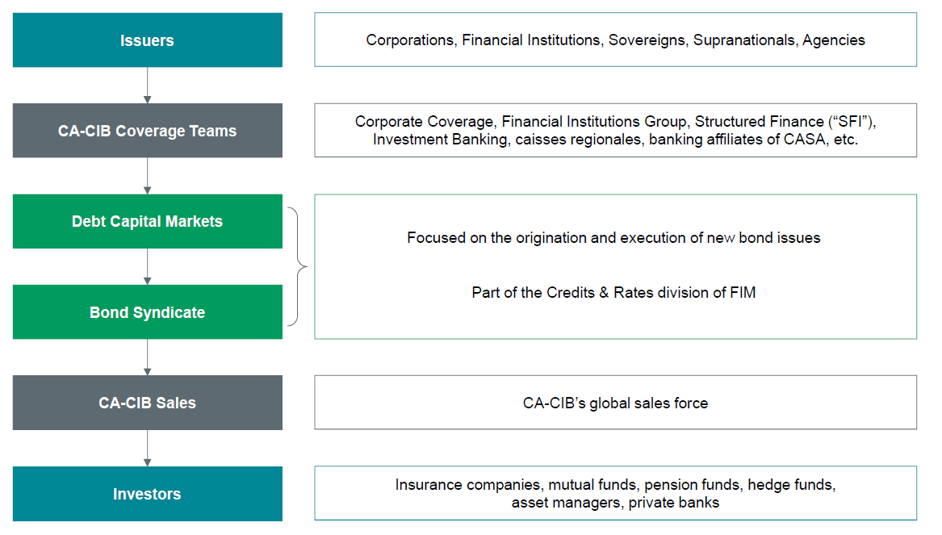
Deal dynamics at CA-CIB
Source: CA-CIB – Ben Lamberg

Slide 100
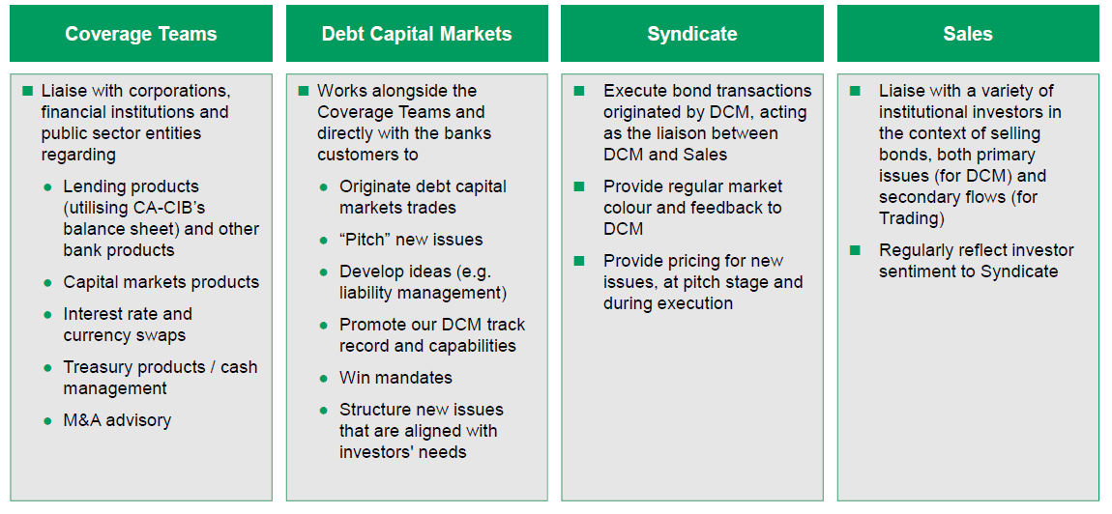
The role of actors in deal development
“Bankers”
“Origination”
“Underwriting”
“Sales”
Source: CA-CIB – Ben Lamberg

Slide 101
Corporate Finance Execution (CFE)
CFE Head
Geographical Team A
1 Director
1-2 VP
Associates
Analysts
Geographical Team B
1 Director
1-2 VP
Associates
Analysts
Geographical Team C
1 Director
1-2 VP
Associates
Analysts
Notes:
What do they do? Provide support to the bankers and product specialists in:
Preparing pitch books (includes gathering info from all parties, translation, presentation, printing, dispatching)
Crunching numbers (financial analysis, pro-forma forecasting, pro-forma valuation, C/F forecasting, sensitivity analysis, etc…)
Following up with product specialist on behalf of banker
Organization of roadshows (includes carrying suitcases!)
Taking notes in meetings and preparing call reports
Preparing weekly information reports for super-core or core clients (e.g., every week compiling a report to be sent by banker to client summarizing any news that may be of interest to client, for example, M&A deal in same industry in other geographical area)
The CFE head allocates resources according to urgency and client priority: e.g. if a banker needs something done for a super-core account, its top priority.
Teams are geographically allocated and situated: e.g. Team A maybe South-East Asian clients and based in Singapore, team B HK and Taiwan based in HK, Team C Mainland China and based in Shanghai, Team D Korea and based in Korea….
Typical organization is highly hierarchical, very structured:
the “grunts” are the analysts, typically BA educated, fresh from university; they spend between 1 and 4 years as analysts before heading back to get an MBA. Essentially they do all the work, have no private life and are paid a pittance compared to higher ranks. They get a base salary, minimum benefits and a bonus which is a function of peer review assessment, hierarchy assessment, and department pool. Main motivation is survive and perform well enough to climb the ranks.
Associates and above are typically MBAs; they will supervise a pool of analysts according to a strict hierarchical structure. For example, the executive summary in the pitchbook is drafted by the analysts, reviewed by each step of the hierarchy in expanding circles until ready to be sent to the banker and/or product specialist. It would be inconceivable for a banker to go to an analyst directly without going through the hierarchy.
Associates and above have a base salary and benefits according to title and experience, and a bonus based on peer review assessment, hierarchy assessment, and department pool.
Main motivation is to move up the ranks to the coveted position of relationship banker or product specialist (generally M&A).
The “grunts” get no recognition and no status; some of the higher ranked CFE executives might get recognition but rarely do they get status.

Slide 102
From the website of one investment bank, describing their analyst program:
In most divisions during this time you can expect:
A period of induction and initial training
Individual rotations in most functional areas
Exposure to senior management both on the floor and at social functions
An opportunity to network amongst your peers at numerous cross-divisional events throughout the summer
Small participant numbers ensure individual attention, a degree of flexibility to meet the individual's interests and strengths and mentoring throughout the Program

Slide 103
A Day In The “Life” Of A CFE Analyst…

Slide 104
A Day In The “Life” Of A CFE Analyst…

Slide 105
Number Crunching
Credit/Financial Analysis & the use of financial ratios
Forecasting cash flows, pro-forma financial statements & financial modeling
Capital budgeting & project evaluation
Market valuation
CAPM

Slide 106
Pitch Books
Deal structure & pricing
Rationale for the deal
Deal structure
Pricing information
Impact of deal on company’s financial structure
Proposed placement strategy & market impact
Consensus of analysts
Shareholder analysis
Comps:
Industry comparisons
Financial ratios
Market cap and stock prices
Industry reports
Deal comparisons
Pricing
After issue performance
League Tables
Other relevant bank info (market share, analyst ranking & publications,…)
Executive Summary!
=>Why iBank Is The Most Suited To Deliver Your Landmark Transaction?
Just Give Us The Mandate, and please, NO Co-Lead!

Slide 107
League Tables
For marketing purposes
For internal purposes
For performance evaluation

Slide 108
Sales
Client
Research
Client
Sales
Traders
Client
Client
Client

Slide 109
Trading
Product
Specialists
Market
counterparties
Traders
Risk
Management
Sales
Credit

Slide 110
Research
Client
Media
Research
Client
Information
Providers
Client
CFE
Industry
Sources
Client

Slide 111
Other Players
The hidden players
Corporate finance execution
Credit & Risk Management
Research (Credit & Equity)
Risk management
Others (e.g. systems)
What do they do?
Who are they?
What makes them tick?

Slide 112
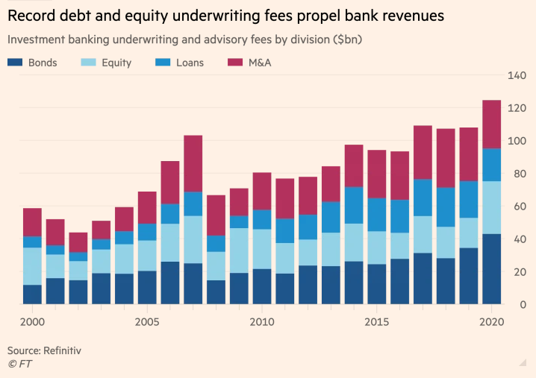
Investment Banking Fees (2000-2020)
Notes:
Source: FT 28 Dec 2020 https://www.ft.com/content/c7bbdc4e-2fc9-424b-ab0b-a3acd8f20557?segmentId=114a04fe-353d-37db-f705-204c9a0a157b

Slide 113
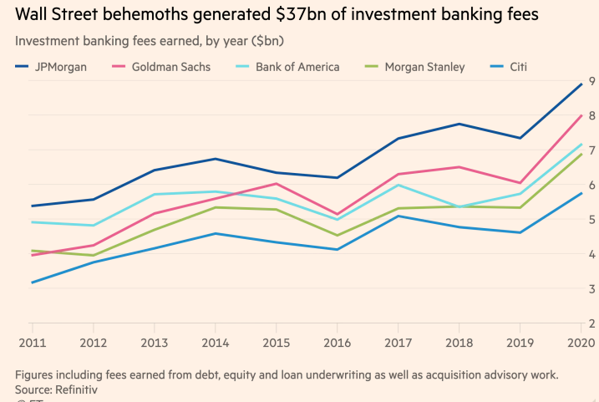
Investment Banking Fees (2011-2020)

Slide 114
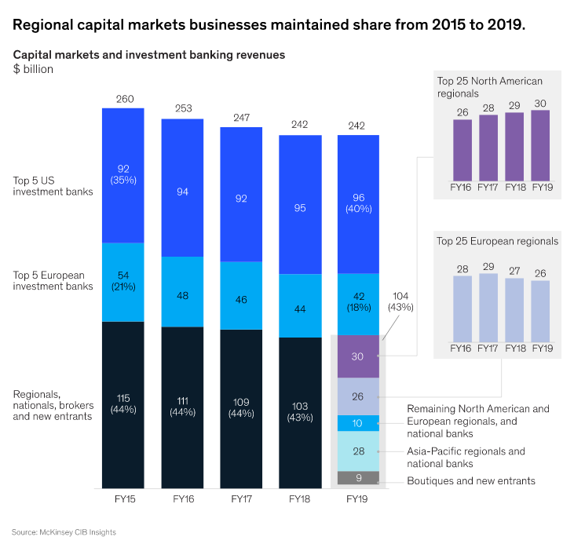
Regional capital markets businesses
Source: McKinsey Nov 2020
Notes:
Source: McKinsey Nov 2020 https://www.mckinsey.com/industries/financial-services/our-insights/tackling-the-performance-challenge-in-regional-capital-markets-businesses

Slide 115
The rise of electronic trading: will human traders disappear?
Group 9
Video link
https://www.youtube.com/watch?v=OqJySkJ_Erw
Article link
https://becominghuman.ai/can-the-ai-trader-beat-the-human-trader-afabce77e933

Slide 116
Summary (KLOs)
Understanding the actors in IB:
relationship banker
product specialist
Analysts (pitch book, league tables…)
Support functions
Understand deal dynamics
From the sell side to the buy side
role of actors in deal development

Slide 118
FINA 1303 PRICING OF FINANCIAL ASSETS
Veronique Lafon-Vinais
Associate Professor of Business Education - Department of Finance

Slide 119
Course Map
Overview
Foundations of
Interest Rates
Financial Institutions
Pricing of Financial Assets
Regulations
DCF
Sell Side
Buy Side
Stock
Valuation
Banking Regulation
Basics of
Interest Rates
Commercial Banking
Traditional Institutional Investors
Monetary Policy
Investment Banking
Alternative Investors

Slide 120
Course Map
Overview
Pricing of Financial Assets
Students will develop an understanding of:
What are Shares
Basics of Stocks
The Dividend Discount Model “DDM”
Stock
Valuation

Slide 121
What Are Shares
Shares (or stocks) represent a piece of ownership in a corporation
Shareholders rights:
Voting at shareholders meetings,
Dividends (if any),
Pro-rata of net assets in liquidation, i.e. residual claim once all debt has been paid,
There are sometimes different classes of shares: Common Shares and Preferred Shares…as well as Founders Shares
Different rights in respect of voting, dividends, claim on net assets.

Slide 122

Stock Price Quote for Cathay Pacific http://www.google.com/finance?cid=671410
Ticker: 0293
D = dividend payment
EPS = earnings per share
P/E = price to earnings ratio
Mkt cap= market capitalization
Stock Basics

Slide 123
Shareholders Votes and Shareholders Meetings
Annual Meeting: once a year shareholders vote on directors and other proposals as well as ask managers questions. All shareholders have the right to attend the annual meeting and cast their shares directly (in accordance with their voting rights).
Proxy: a written authorization for someone else to vote your shares
Proxy Contest: when two or more groups are competing to collect proxies to prevail in a matter up to shareholders vote (such as the election of directors)
There are two main types of voting
Straight Voting: shareholders vote for each director separately, with each shareholder having as many votes as shares held
Cumulative Voting: each shareholder is allocated votes equal to the number of open spots multiplied by his/her number of shares (shareholder can allocate his vote to all or only some of the directors)
Stock Basics

Slide 124
Application: The Snap IPO
https://finance.yahoo.com/quote/SNAP/
http://www.reuters.com/article/us-snap-ipo-idUSKBN1683BP?utm_source=Twitter&utm_medium=Social
Key facts:
Snapchat’s parent Snap listed on the NYSE at a price of $17 per share raising $2.6Bn and valuing the company at ~$24Bn
The price “popped” up to $24.48 a share at the close of the opening day, going up as much as $27
The company made no profits and didn’t expect to in the near future; it had negative free cash flow of $677 million
The shares sold to the public have no voting rights at all; Snap is the only company listed in NYSE with no voting rights
Stock Basics

Slide 125
Preferred v. Common Shares
Preferred Stock: stock with preference over common shares in payment of dividends and in liquidation
Cumulative versus Non-Cumulative Preferred Stock:
cumulative = preferred stock where all the missed dividends must be paid before any common dividends can be paid;
non-cumulative = preferred stock where the missed dividends do not accumulate. Only the current dividend is owed before common dividends can be paid
Preferred Stock: Equity or Debt?
Generally no voting rights
Priority over common shareholders for payments of dividends and in liquidation
Behind bondholders & creditors in liquidation
Dividends paid after tax (US)
Stock Basics

Slide 126
The Mechanics of Stock Trades
Video: How NYSE works: https://www.youtube.com/watch?v=XRJBZIQrQAY
NYSE floor trading: https://www.youtube.com/watch?v=G_IK0Q1FCnk
Market Order = order at market (no specified price)
Limit Order = order at specific price
Round Lot = 100 shares
Most exchanges today are fully electronic; NYSE is one of the very few that still has floor trading: specialists hold trading licenses and make markets in some securities: floor brokers represent customers orders on the floor
Remember each exchange has its own rules! Before you start trading, check out the rules of the exchange!
Stock Basics

Slide 127
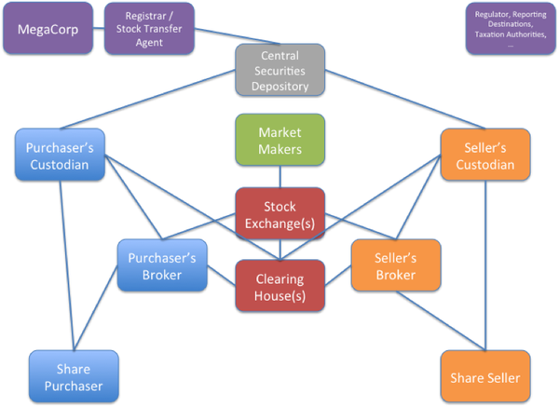
How trades work
Stock Trades
Notes:
Source: https://gendal.me/2014/01/05/a-simple-explanation-of-how-shares-move-around-the-securities-settlement-system/

Slide 128
Equity Valuation: the Dividend-Discount Model “DDM”
How do we value listed shares or stocks?
We will apply what we learned from DCF to cash flows arising from shares/stocks

Slide 129
DDM
With a 1 year time horizon, an investor buys a listed stock today (time=0) at market price P₀, gets a dividend Div₁ after 1 year and sells the stock at then market price P₁,
So the cash flows consist of Div₁ the dividend
and P₁ the sale price of the stock
Discounting the cash flows with the expected return r_{E} leads to:
Notice that the price of the stock P₀ is the PV of the expected cash flows from the stock (we are simply applying what we learned in DCF !)

Slide 130
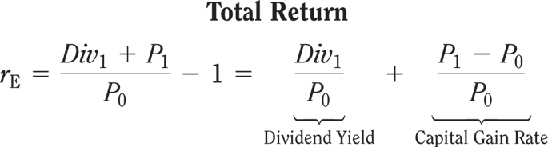
DDM
Dividend Yields, Capital Gains, and Total Returns
Dividend Yield: expected annual dividend of a stock divided by its current price = % return an investor expects to earn from the dividend paid by the stock
Capital Gain: the amount by which the selling price of the stock exceeds the purchase price
Capital Gains Rate: capital gain as % of initial price of the stock
Total Return: stock’s dividend yield plus capital gain rate

Slide 131
DDM
So when buying that stock at P₀, the expected return r_{E} can be broken down as:
If expected Dividend Yield + expected Capital Gain Return ≥ expected return (hurdle rate) of the investor, then the investor should buy that stock.

Slide 132
Example: Stock Prices and Returns
Suppose you expect Funky Gold Company (FGC) to pay an annual dividend of $0.56 per share in the coming year and to trade at $45.50 per share at the end of the year.
If investments with equivalent risk to FGC’ stock have an expected return of 6.80%, what is the most you would pay today for FGC’s stock?
What dividend yield and capital gain rate would you expect at this price?

Slide 133
Example : Stock Prices and Returns
Solution:
We solve for the beginning price we would pay now (P₀) given our expectations about dividends (Div₁=$0.56) and future price (P₁=$45.50) and the return we expect to earn to be willing to invest (r_{E}=0.068).
We can calculate the dividend yield and capital gain rate

Slide 134
Example : Stock Prices and Returns
Execute:
We see that at this price, FGCs’ dividend yield is Div₁/P₀ = 0.56/43.13 = 1.30%.
The expected capital gain is $45.50 - $43.13 = $2.37 per share, for a capital gain rate of 2.37/43.13 = 5.50%.

Slide 135
Example : Stock Prices and Returns
Evaluate:
At a price of $43.13, FGCs’ expected total return is 1.30% + 5.50% = 6.80%, which is equal to its equity cost of capital (the return being paid by investments with equivalent risk to FGCs’).
This amount of $43.13 is the most we would be willing to pay for FGCs’ stock.
If we paid more, our expected return would be less than 6.8% and we would rather invest elsewhere.

Slide 136
Your Turn!
Problem:
Suppose you expect Koch Industries to pay an annual dividend of $2.31 per share in the coming year and to trade at $82.75 per share at the end of the year.
If investments with equivalent risk to Koch’s stock have an expected return of 8.9%, what is the most you would pay today for Koch’s stock?
What dividend yield and capital gain rate would you expect at this price?
FINA 5120 – DDM
Copyright ©2015 Pearson Education, Inc. All rights reserved.

Slide 137
Test Your Understanding
The stock price we are willing to pay is:
69.5
78.11
85.9
The dividend yield is:
2.96%
5.94%
8.90%
The capital gain rate is:
2.96%
5.94%
8.90%

Slide 138
Solution
We can solve for the beginning price we would pay now (P0) given our expectations about dividends (Div1=2.31) the future price (P1=$82.75) and the return (rE=8.9%) we expect to earn to be willing to invest.
We can calculate the dividend yield and capital gain.
Copyright ©2015 Pearson Education, Inc. All rights reserved.

Slide 139
Solution
Execute:
At this price, Koch’s dividend yield is Div₁/P₀ = 2.31/78.11 = 2.96%.
The expected capital gain is $82.75 - $78.11 = $4.64 per share, for a capital gain rate of 4.64/78.11 = 5.94%.
At a price of $78.11, Koch’s expected total return is 2.96% + 5.94% = 8.90%, which is equal to its equity cost of capital (the return being paid by investments with equivalent risk to Koch’s).
This amount is the most we would be willing to pay for Koch’s stock. If we paid more, our expected return would be less than 8.9% and we would rather invest elsewhere.
Copyright ©2015 Pearson Education, Inc. All rights reserved.
Notes:
Evaluate:
At a price of $78.11, Koch’s expected total return is 2.96% + 5.94% = 8.90%, which is equal to its equity cost of capital (the return being paid by investments with equivalent risk to Koch’s).
This amount is the most we would be willing to pay for Koch’s stock. If we paid more, our expected return would be less than 8.9% and we would rather invest elsewhere.

Slide 140
Test Your Understanding
Expected share price (P₁): $50
Expected dividend (Div₁): $0.50
Expected rate of return (r_{E}): 5%
Calculate P₀
The correct answer is:
49.5
48.10
55

Slide 141
Test Your Understanding (ctd)
Calculate the dividend yield :Div₁ / P₀
Possible answers:
1.05%
1.04%
1.03%
Calculate capital gain P₁ - P₀
Possible answers
1.8
1.9
2.1

Slide 142

Test Your Understanding (ctd)
What is the capital gain return (capital gain/ P₀ )?
Possible answers:
3.81
3.96
4.10
From the answers above, calculate the total return/expected return (dividend yield + capital gain rate)
Possible answers:
4.5%
5%
5.5%

Slide 143
DDM
With 2 years time horizon, an investor buys the stock today at P₀, gets dividends Div₁ & Div₂ in years 1 & 2, and then sells the stock at P₂ in year 2,
Discounting the cash flows with the expected return r_{E} leads to:
not different from applying the 1 year calculation twice

Slide 144
DDM
Buying a stock at P₀ and selling at P_{n} in year n, collecting dividends in between, the DCF formula applies:
Considering that investors buying the stock at P_{n} in year n follow the same logic, we can push it to infinity leading to a valuation of:
The stock price is the Present Value of all the expected future dividends

Slide 145
DDM – Constant Dividend Growth
When the dividend growth g is constant, the DCF calculation is simpler:
Simplified calculations lead to the Constant Dividend Growth Model (when r_{E} > g): (notice this is exactly what we learned before for perpetuals!)

Slide 146
Example : Valuing a Firm with Constant Dividend Growth
Suppose Great China Inc (GCI) plans to pay $2.30 per share in dividends in the coming year.
If the expected rate of return is 7% and dividends are expected to grow by 2% per year in the future, estimate the value of GCI’s stock today.

Slide 147
Example : Valuing a Firm with Constant Dividend Growth
Solution:
Because the dividends are expected to grow perpetually at a constant rate, we can calculate the price P₀ of GCI.
The next dividend (Div₁) is expected to be $2.30, the growth rate (g) is 2% and the expected return (r_{E}) is 7%.

Slide 148
Example : Valuing a Firm with Constant Dividend Growth
Execute:
You would be willing to pay $46, that is to say 20 times this year’s dividend of $2.30, to own GCI stock today because you are buying claim to this year’s dividend and to an infinite growing series of future dividends.

Slide 149
Your Turn!
Problem:
Suppose Target Corporation plans to pay $0.68 per share in dividends in the coming year.
If its equity cost of capital is 10% and dividends are expected to grow by 8.4% per year in the future, estimate the value of Target’s stock.
Copyright ©2015 Pearson Education, Inc. All rights reserved.

Slide 150
Test Your Understanding
Target’s stock price (P₀ ) is:
42.50
53.45
68.59

Slide 151
Solution
Because the dividends are expected to grow perpetually at a constant rate, we can value Target.
The next dividend (Div₁) is expected to be $0.68, the growth rate (g) is 8.4% and the equity cost of capital (r_{E}) is 10%.
Copyright ©2015 Pearson Education, Inc. All rights reserved.

Slide 152
Solution
Execute:
Evaluate:
You would be willing to pay 62.5 times this year’s dividend of $0.68 to own Target stock because you are buying claim to this year’s dividend and to an infinite growing series of future dividends.
Copyright ©2015 Pearson Education, Inc. All rights reserved.

Slide 153
Test Your Understanding
Problem:
Suppose Gold Trading Company (GTC) plans to pay $0.50 (Div₁ ) per share in dividends in the coming year.
If the expected rate of return (r_{E} ) is 8% and dividends are expected to grow (g) by 4% per year in the future, estimate the value (P₀) of GTC’s stock today.

Slide 154
Test Your Understanding
Calculate P₀
Possible answers:
11.60
12.50
13.45

Slide 155
Limitations of the Dividend-Discount Model
Value Drivers and the Dividend-Discount Model
The dividend-discount model includes an implicit forecast of the firm’s profitability which is discounted back at the firm’s equity cost of capital
Uncertain Dividend Forecasts
The dividend-discount model values a stock based on a forecast of the future dividends, but a firm’s future dividends carry a tremendous amount of uncertainty
Remember to question the assumptions you make when doing your forecasts.
Practitioners will typically run sensitivity analysis on key assumptions

Slide 156
DDM – What To Keep In Mind
Constant Dividend Growth Model formula applies only when r_{E} > g,
The expected return from a stock investment over 1 year is
for listed companies there is a trade-off between increasing dividends and growth rate, assuming unchanged earnings, it depends on
a) dividend payout rate and
b) number of shares outstanding (share repurchases)
For stocks with uncertain dividend or paying no dividend, DDM is of limited help.

Slide 157
In summary: the Dividend-Discount Model
Copyright ©2015 Pearson Education, Inc. All rights reserved.

Slide 158
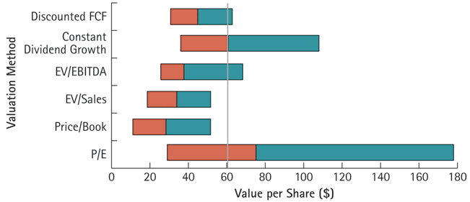
Range of Valuations for Nike Stock Using Various Valuation Methods
Comps
Copyright ©2015 Pearson Education, Inc. All rights reserved.

Slide 159
Your Turn!
NoGrowth Industries presently pays an annual dividend of $1.20 per share and it is expected that these dividend payments will continue indefinitely. If NoGrowth's equity cost of capital is 10%, then the value of a share of NoGrowth's stock is closest to ________.
A) $9.60
B) $14.40
C) $13.20
D) $12.00
Answer D

Slide 160
Solution to Question 1
The value of a share of NoGrowth's stock is closest to $12.

Slide 162
FINA 1303 THE BUY-SIDE: INSTITUTIONAL INVESTORS
Veronique Lafon-Vinais
Associate Professor of Business Education - Department of Finance

Slide 163
Course Map
Overview
Foundations
of
Interest Rates
Financial Institutions
Pricing of Financial Assets
Regulations
DCF
Sell Side
Buy Side
Stock
Valuation
Banking Regulation
Basics of
Interest
Rates
Commercial
Banking
Traditional Institutional Investors
Asset
Pricing
Models
Monetary Policy
Investment Banking
Alternative Investors
163

Slide 164
The Buy-Side
Traditional Institutional Investors:
Insurance Companies
Pension Funds and Retirement Schemes
Mutual Funds & Funds Management
Alternative Investors:
SWF
Hedge Funds
VC Firms & Private Equity

Slide 165
Course Map
Overview
Financial Institutions
Sell Side
Buy Side
Insurance Companies
Pension Funds and Retirement Schemes
Mutual Funds and Fund Management
Commercial Banking
Traditional Institutional Investors
Investment Banking
Alternative Investors
Spring 10

Slide 166
Insurance Companies
Definition
Fundamentals of insurance
Business model and organization of insurance industry
Types of insurance
Insurance in HK

Slide 167
Definition of insurance
Insurance provides indemnification against loss or liability from specified events and circumstances which may occur or be discovered during a specified period (FASB 113)
The essence of insurance is the transfer of risk from the insured to one or more insurers
Insurance companies are financial intermediaries who collect premiums and invest them in securities and other financial assets
Notes:
Insurance companies assume the risk of their clients in return for a fee, called the premium
Primary function is to compensate individuals and corporations (policyholders) if a pre-specified adverse event occurs
Most people purchase insurance because they are risk-averse - they would rather pay a certainty equivalent (the premium) than accept a gamble
How much risk a contract actually transfers proved to be at the heart of the controversy.
This issue arose most clearly in reinsurance, where the use of Financial Reinsurance to reengineer insurer balance sheets under US GAAP became fashionable during the 1980's. The accounting profession raised serious concerns about the use of reinsurance in which little if any actual risk was transferred, and went on to address the issue in FAS 113, cited above. While on tis face, FAS 113 is limited to accounting for reinsurance transactions, the guidance it contains is generally conceded to be equally applicable to US GAAP accounting for insurance transactions executed by commercial enterprises

Slide 168
Definition of Insurance
Benefit provided by a particular kind of indemnity contract, called an insurance policy
Issued by one of several kinds of legal entities, any of which may be called an insurer
In which the insurer promises to pay on behalf of or to indemnify another party, called a policyholder or insured
That protects the insured against loss caused by those perils subject to the indemnity in exchange for consideration known as an insurance premium
Notes:
What is Insurance?
(Source: http://www.hkfi.org.hk/en_tips.htm)
The idea of insurance is that if a large number of people each pays some money into a pool, then sizeable sums of money can be drawn from the pool to ease the hardship of those who might suffer losses. In short, insurance is the science of spreading risks.
In practice, insurers manage the money (called 'premium') paid by policyholders. In good years when claims are few, insurers are able to build up substantial reserves of money to cater for bad years when claims are heavy. Insurers are responsible for managing their business carefully so that they remain financially sound to pay out claims at all times.

Slide 169
Fundamentals of Insurance
Seven basic principles all insurance companies are subject to:
There must be a relationship between the insured and the beneficiary. Further, the beneficiary must be someone who would suffer if it weren’t for the insurance.
'Insurable Interest' is the right of the policyholder to effect insurance, arising out of certain relationships that may exist between the policyholder and the subject matter insured. Generally speaking, if the policyholder suffers direct losses arising from the subject matter's meeting with misfortune, then Insurable Interest exists. Without Insurable Interest, insurance protection would be speculative in nature, and not be enforceable under the law
Source: Mishkin/Eakins

Slide 170
Fundamentals of Insurance (Cont)
2. The insured must provide full and accurate information to the insurance company.
The insurer trusts the policyholder to give precise and true details of the subject matter to be insured. This is called the principle of 'Utmost Good Faith'
3. The insured is not to profit as a result of insurance coverage
By the principle of 'Indemnity', an insurance policy compensates the policyholder only to the extent of the value of the property which he has lost, hence a policyholder should not expect to make any profit from a claim.
4. If a third party compensates the insured for the loss, the insurance company’s obligation is reduced by the amount of the compensation
For policies to which 'Indemnity' applies, the purchase of several policies to cover the same subject matter will not result in the obtaining of claims payments of several times the value of the subject matter. The insurers simply 'contribute' to make up the amount payable as if only one policy had been issued.
Source: Mishkin/Eakins
Notes:
What is Insurance?
(Source: http://www.hkfi.org.hk/en_tips.htm)
The idea of insurance is that if a large number of people each pay some money into a pool, then sizeable sums of money can be drawn from the pool to ease the hardship of those who might suffer losses. In short, insurance is the science of spreading risks.
In practice, insurers manage the money (called 'premium') paid by policyholders. In good years when claims are few, insurers are able to build up substantial reserves of money to cater for bad years when claims are heavy. Insurers are responsible for managing their business carefully so that they remain financially sound to pay out claims at all times.
Insurance contracts are based on trust. The insurer trusts the policyholder to give precise and true details of the subject matter to be insured. This is called the principle of 'Utmost Good Faith'. Care should always be taken to tell the whole truth so that insurance companies can be fair in their assessment of risk. Equally, having effected an insurance policy the policyholder should read all the documentation very carefully to ensure that he understands the exact nature of the policy he has bought and the risks it does and does not cover.
Insurable Interest
'Insurable Interest' is the right of the policyholder to effect insurance, arising out of certain relationships that may exist between the policyholder and the subject matter insured. Generally speaking, if the policyholder suffers direct losses arising from the subject matter's meeting with misfortune, then Insurable Interest exists. Without Insurable Interest, insurance protection would be speculative in nature, and not be enforceable under the law.
The most common example of Insurable Interest is the ownership of property. There are many other examples, such as being an employer of workers, or a custodian of assets.
Sometimes during the term of an insurance policy, the policyholder might end the relationship with the subject matter insured. If this happens, Insurable Interest ceases and the insurance cover also automatically ends. A common example might be the sale of a car or a flat. The policyholder should take care to notify the insurer of such changes promptly.
Indemnity
By the principle of 'Indemnity', an insurance policy compensates the policyholder only to the extent of the value of the property which he has lost, hence a policyholder should not expect to make any profit from a claim.
Indemnity applies to all classes of insurance but is not always easily discernable in certain classes like 'Personal Accident' or 'Life Assurance'. In theory, human life is invaluable but with Accident and Life coverage the insurers will review circumstances of the applicants to determine the amount of coverage that they can reasonably issue to cover any projected loss.
For the insurance of property, if the insured subject matter has depreciated in value at the time it is lost, the insurer pays the policyholder only the depreciated value. This is called 'Indemnity Basis'. There is an alternative arrangement called 'Reinstatement Value Basis' which pays for the new replacement value at the time of loss without deducting depreciation.
Contribution
For policies to which 'Indemnity' applies, the purchase of several policies to cover the same subject matter will not result in the obtaining of claims payments of several times the value of the subject matter. The insurers simply 'contribute' to make up the amount payable as if only one policy had been issued.
For policies to which 'Indemnity' does not apply, the contribution factor does not apply either.

Slide 171
Fundamentals of Insurance (Cont)
Large number of homogeneous exposure units
The insurance company must have a large number of insured so that the risk can be spread out among many different policies (to apply the law of large numbers) – but there are exceptions to this rule (e.g. Satellite Launch insurance )
Calculable loss: the loss must be quantifiable
For example, an oil company could not buy a policy on an unexplored oil field
The insurance company must be able to compute the probability of the loss occurring
The law of large numbers says that when many people are insured, the probability distribution of the losses will assume a normal probability distribution, which allows accurate predictions
Source: Mishkin/Eakins
Notes:
The law of large numbers says that when many people are insured, the probability distribution of the losses will assume a normal probability distribution, which allows accurate predictions.
The existence of a large number of homogeneous exposure units allows insurers to benefit from the so-called “law of large numbers”, which in effect states that as the number of exposure units increases, proportionally the actual results are increasingly likely to become close to expected proportions

Slide 172
Summary
definition of insurance
7 basic principles of insurance

Slide 173
Test your understanding
Which principle of insurance most distinguishes insurance from derivatives?
Insurable Interest
Utmost Good Faith
Indemnity
Which principle of insurance explains why you can buy health insurance cheaper through your employer than individually?
Insurable Interest
Law of Large Numbers
Indemnity

Slide 174
Why get insured?
Premiums are likely to be more than the expected loss → why get insurance?
If there is no insurance:
Need to set aside reserves for losses
Reserves cannot be invested long term as need to be immediately accessible in case of loss (liquidity) => low return
Worry that level of reserves may not be adequate to cover the loss
Most people are risk-adverse: they would rather pay a certainty equivalent (the insurance premium) than accept the gamble that they will lose their house/car → insurance allows peace of mind that a single event can have only a limited financial impact
Trade-off: cost of premium vs. probability of occurrence and likely loss

Slide 175
Adverse Selection & Moral Hazard in Insurance
Adverse selection
Moral hazard
= which policies to accept
Solutions:
Screening and fraud prevention investigations
Health insurance policies require a physical exam
Preexisting conditions may be excluded from the policy
= when the insured fails to take proper precautions (or takes on more risk) to avoid losses because losses are covered by the insurance policy
Solution:
Insurance companies use co-insurance, deductibles and restrictive provisions to help control this problem
A deductible is the amount of any loss that must be paid by the insured before the insurance company will pay anything
Source: Mishkin/Eakins
Notes:
Restrictive provisions discourage policy holders from engaging in risky activities that make an insurance claim more likely, or may require certain behavior on the part of the insured that makes a claim less likely. Similar to restrictive covenants in debt contracts.
Co-insurance is when a policyholder shares a percentage of the losses along with the insurance company.

Slide 176
How do insurance companies make profits?
Profit = earned premium + investment income - incurred loss - underwriting expenses
Insurers make money in two ways:
Through underwriting, the process by which insurers select the risks to insure and decide how much in premiums to charge for accepting those risks;
An insurer's underwriting performance is measured in its combined ratio which is the ratio of losses and expenses to premiums. A combined ratio < 100 % indicates underwriting profitability, while anything over 100 indicates an underwriting loss. A company with a combined ratio over 100% may nevertheless remain profitable due to investment earnings
By investing the premiums they collect from insured parties
Insurance companies earn investment profits on “float”. “Float” or available reserve is the amount of money, at hand at any given moment, that an insurer has collected in insurance premiums but has not paid out in claims
Notes:
Source: Wikipedia http://en.wikipedia.org/wiki/Insurance#Principles_of_insurance
The most complicated aspect of the insurance business is the underwriting of policies. Using a wide assortment of data, insurers predict the likelihood that a claim will be made against their policies and price products accordingly. To this end, insurers use actuarial science to quantify the risks they are willing to assume and the premium they will charge to assume them. Data is analyzed to fairly accurately project the rate of future claims based on a given risk. Actuarial science uses statistics and probability to analyze the risks associated with the range of perils covered, and these scientific principles are used to determine an insurer's overall exposure. Upon termination of a given policy, the amount of premium collected and the investment gains thereon minus the amount paid out in claims is the insurer's underwriting profit on that policy. Of course, from the insurer's perspective, some policies are "winners" (i.e., the insurer pays out less in claims and expenses than it receives in premiums and investment income) and some are "losers" (i.e., the insurer pays out more in claims and expenses than it receives in premiums and investment income); insurance companies essentially use actuarial science to attempt to underwrite enough "winning" policies to pay out on the "losers" while still maintaining profitability.
An insurer's underwriting performance is measured in its combined ratio [6] which is the ratio of losses and expenses to premiums. A combined ratio of less than 100 percent indicates underwriting profitability, while anything over 100 indicates an underwriting loss. A company with a combined ratio over 100% may nevertheless remain profitable due to investment earnings.
Insurance companies earn investment profits on “float”. “Float” or available reserve is the amount of money, at hand at any given moment, that an insurer has collected in insurance premiums but has not paid out in claims. Insurers start investing insurance premiums as soon as they are collected and continue to earn interest or other income on them until claims are paid out. The Association of British Insurers (gathering 400 insurance companies and 94% of UK insurance services) has almost 20% of the investments in the London Stock Exchange [7].

Slide 177
Insurance industry organization
Distribution
Independent agents may sell the insurance products of a number of different insurance companies
Exclusive (captive) agents only sell the products of one company
Nowadays most insurance companies use multiple distribution channels, including banks, professional organizations, and market places
In the US, since 1999 other financial institutions have started competing directly with insurance companies to provide insurance service (e.g. bancassurance)
Underwriting
An underwriter reviews each policy prior to its acceptance to determine if the risk is acceptable.
Claims
The claim adjuster undertakes a thorough investigation of each claim, usually in close cooperation with the insured, determines if coverage is available under the terms of the insurance contract, and if so, the reasonable monetary value of the claim, and authorizes payment.
Notes:
Source: Marianne Purushotham, “The Impact of Distribution on the Individual Life and Annuity Industry,” The Actuary newsletter, June 2006.
Decline in full-time affiliated agents (LIMRA estimates)
In 1989: about 262,000
In 2001: about 178,000
In 2004: about 160,000
More than ¾ of independent agents began their careers as affiliated agents
In 2004 stockbrokers and banks wrote about 40% of new individual annuity premium but less than 10% of new individual life premium

Slide 178
Summary
reasons to get insured
adverse selection & moral hazard in insurance
business model for insurance companies

Slide 179
Test Your Understanding
How do insurance companies make profits?
Paying out less in claims then they receive in premiums
Investing the float to generate income
Premiums less claims paid plus investment income less operational expenses
None of the above

Slide 180
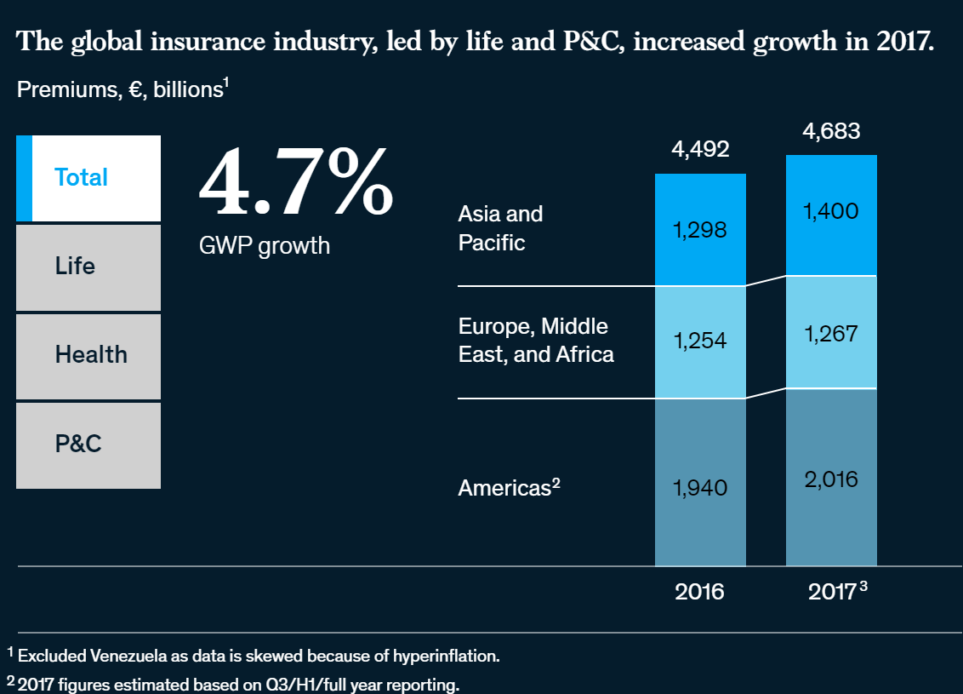
Global Insurance Market
Source: McKinsey 2019 Report on Global insurance
Notes:
Source: https://www.mckinsey.com/industries/financial-services/our-insights/2019-global-insurance-trends-and-forecasts

Slide 181
Life Insurance
Basic products of life insurance
Life Insurance: pays off if the insured dies
Term Life: the insured is covered while the policy is in effect, usually 10–20 years – no savings element
Whole Life: similar to term life, but allows the policyholder to borrow against the policies cash value. When the term of policy expires, the insured can get the cash value of the policy
Universal Life/Endowment Life/Variable Life: includes both a term life portion and a savings portion (savings component)
Disability: pays off if the insured becomes unable to continue working due to illness or accident
Annuities: pays a benefit to the insured until death, to cover retirement years
Life insurance companies can provide retirement benefits as well as life insurance: source of convergence of financial institutions
Source: Mishkin/Eakins
Notes:
Life insurance companies can provide retirement benefits as well as life insurance: the premium combines the cost of the life insurance with a saving program
Annuity: for an initial fixed sum or a stream of payments, the insurance company agrees to pay you a fixed amount for as long as you live => if you live very long, the insurance company pays out more than expected, but if you die early, it pays out less.
Term life: as insured ages, cost of policy rises; decreasing term policies have a constant premium but the amount of insurance coverage declines every year. The closest to pure life insurance. As long as premiums are up to date, beneficiary receives a payout at the time of the insured deaths during the coverage period. If insured lives beyond term of contract, policy expires along with any rights/benefits.
Whole life policies usually require the insured to pay a level premium for the duration of the policy. Protects individual during an entire lifetime rather than for a specified coverage period. In the beginning the insured pays more than for a term policy; this overpayment accumulates as cash value that can be borrowed by the insured at reasonable rates. Survivorship benefits also contribute to the accumulated cash values. When members of the insured pool die, any remaining cash values are distributed among the survivors. If the policyholder lives until the policy matures, it can be surrendered for its cash value. This cash value can be used to purchase an annuity. In the late 70s whole life policies fell out of favor because the rates of return earned on the policy premiums were well below rates available on other investments.
Universal life combine the benefits of the term policy with those of the whole life policy. Major benefit is that the cash value accumulates at a much higher rate. Structured to have 2 parts: one for the term life insurance and one for savings. Interest earned on the savings portion is tax-exempt until withdrawn. Cash value of the policy cannot exceed the death benefits. Universal life allows the insured to change both the premium amounts and the maturity of the life contract, unlike traditional policies that maintain premiums at a given level over a fixed contract period.
Endowment Life guarantees a payout to the beneficiary of the policy if death occurs during some endowment period (e.g. prior to reaching retirement age). A person who lives to the endowment date receives the face value of the policy
Variable life invests fixed premium payments in mutual funds of stocks, bonds and MM instruments. Policyholders can choose investments to reflect their risk profile. Variable life provides an alternative way to build savings compared to the more traditional policies such as whole life because the value of the policy increases/decreases with the asset returns of the funds in which premiums are invested.
Annuities can be viewed as insuring against life, basically the risk of outliving the retirement funds. Purchasing annuities guarantees payments as long as the beneficiary lives. Most annuities are sold to members of large groups where all employees covered by a particular pension plan automatically receive their benefit distribution by purchasing an annuity from the insurance company.

Slide 182
Life Insurance
Three basic classes
Ordinary Life
Term Life
Whole Life
Endowment Life
Variable Life
Universal Life and Variable Universal Life
Group Life
Credit Life
Three major other activities of life insurance companies:
Sales of annuities
Private pension plans
Accident and health insurance
Annuities represent the reverse of life insurance. They involve different methods of liquidating a fund over a long period of time, such as paying out a funds’ proceeds to the beneficiary.
Source: Saunders/Cornett
Notes:
Annuities represent the reverse of life insurance principles. While life insurance involves different contractual methods to build up a fund and the eventual payout of a lump sum to the beneficiary, annuities involve different methods of liquidating a fund over a long period of time, such as paying out a funds’ proceeds to the beneficiary. Different types of annuity contracts have been developed. They can be sold to an individual or a group and on either a fixed or variable basis by being linked to the return on some underlying investment portfolio. Individuals can purchase annuities with a single payment or payments spread over a number of years. Payments can be structured to begin immediately or they can be deferred (e.g. to start at retirement)
Fixed annuities guarantee that a specific sum of money will be paid each period, generally on a monthly basis, regardless of fluctuations in the value of the annuity issuer’s underlying investments.
Variable annuity payments are based on the portfolio of stocks in which the issuer invests; therefore the monthly payment may fluctuate, depending on whether the value of the investments goes up or down.
Annuities may also be classified as immediate, which begin to pay as soon as the premium is received, or deferred, which accumulate assets before payments begin, generally at retirement.
The equity index annuity is a hybrid annuity product. A specified rate of interest guarantees a fixed minimum rate of interest as with traditional fixed annuities. At the same time, additional interest may be credited to policy values based on positive changes, if any, in an established index such as the S&P 500.The amount of additional interest depends on the particular design of the policy. Policies are sold by licensed insurance agents and regulated by state insurance departments. Sales of index annuities reached a record $27.3 Billion in 2005, up 19% from $23 billion in 20004.
Annuities are very popular as savings/retirements tool because any interest earned on annuities is tax deferred, i.e. taxes are not paid until the annuity payments are actually paid to the beneficiary. In contrast to IRAs, the tax-deferred status of annual annuity contributions are not capped and are not affected by policyholders income level.
Group life insurance covers a large number of insured persons under a single policy. The policies may be contributory (both employee and employer share the cost) or non-contributory.
Credit life protects lenders against a borrower’s death prior to the repayment of a debt contract (e.g. mortgage). Usually the face amount of the policy reflects the outstanding principal and interest on the loan.

Slide 183
Health Insurance
Health insurance policies are highly vulnerable to the adverse selection problem
Those with known or expected health problems are more likely to seek coverage
This is why most health insurance is offered through group policies. Individual policies must be priced assuming adverse selection
Hot topic in the political environment, focusing on increased costs and availability of coverage
Insurance programs are attempting to shift costs to the employers
Health Maintenance Organizations (HMOs) are another attempt to keep costs down
The US government is also involved in health insurance through Medicare and Medicaid. Medicare provides coverage for the elderly, and Medicaid provides coverage for people on welfare.
Key issue: spiraling costs of health care
Source: Mishkin/Eakins
Notes:
Cost of healthcare has risen faster than the cost of living and real wages, One factor is the more sophisticated and expensive treatments constantly being offered.
Today the risk of most company-sponsored plans is borne by the company, with the insurance company administering the plan and covering catastrophic expenses.
Insurance companies also attempt to control the increased medical costs by negotiating contracts with physician groups to provide services at reduced costs and through managed care, where approval is required before services are rendered. Health Maintenance Organizations shift the risk from the insurance company to the provider. The insurance company pays the HMO a fixed payment per person covered in exchange for medical services. The provider then has an incentive to limit medical services.
One out of six Americans has no health insurance. That's a staggering 46 million people in this country who are completely uninsured, an unfathomable statistic for our nation. Two million others have only high-deductible health insurance.

Slide 184
Current issues in life and health insurance
2010 President Obama signed the Patient Protection and Affordable Care Act “Obamacare”, requiring most U.S. citizens to have health insurance.
PPACA reforms certain aspects of the private health insurance industry and public health insurance programs, increases insurance coverage of pre-existing conditions, expands access to insurance to over 30 million Americans, and increases projected national medical spending while lowering projected Medicare spending.
Source: Wikipedia
Notes:
a majority of the states, and numerous organizations and individual persons, have filed actions in federal court challenging the constitutionality of PPACA. As of January 2012, two of four federal appellate courts have upheld it; a third declared the individual mandate unconstitutional , while a fourth ruled the federal Anti-Injuction Act prevents the issue from being decided until taxpayers begin paying penalties in 2015. The Supreme Court has scheduled six hours for oral arguments March 26-28, 2012, and will issue its decision by the end of June

Slide 185
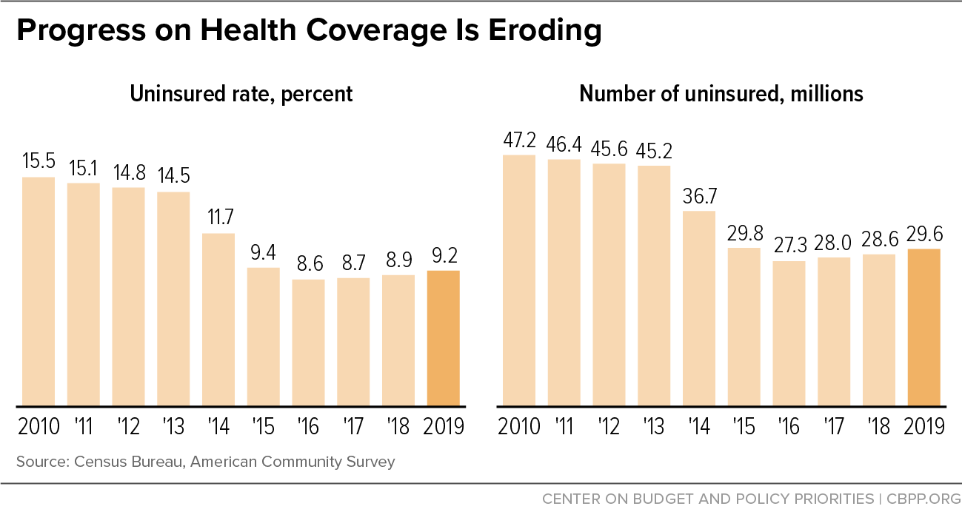
Impact of Trump on Obamacare
Notes:
Source: https://www.cbpp.org/progress-on-health-coverage-is-eroding Sept 2020 https://www.cbpp.org/research/health/uninsured-rate-rose-again-in-2019-further-eroding-earlier-progress?campaign_id=9&emc=edit_nn_20210128&instance_id=26537&nl=the-morning&regi_id=120139650&segment_id=50580&te=1&user_id=f8fda73b93abf2d282cd2859817a19cd#:~:text=Some%209.2%20percent%20of%20Americans,according%20to%20the%20ACS%20data

Slide 186
Property and Casualty Insurance
Property Insurance: earliest form of insurance; protects businesses and owners from the risk associated with owning property. Includes replacement and loss of earnings from income-producing property as well as financial losses to the owners of residential property
Named-peril policies: insures against any losses only from perils specifically named in the policy (e.g. flood insurance)
Open-peril policies: insures against any losses except from perils specifically named in the policy (e.g. homeowners insurance)
Casualty/Liability Insurance: protects against financial losses because of a claim of negligence (e.g. physician insurance; D&O liability insurance; product liability insurance against defects).
In the US liability premiums have risen considerably due to litigation (juries awarding high liability awards).
Source: Mishkin/Eakins
Notes:
Liability risk exposure is difficult to determine. It can have long lag times (“tails”): a liability claim can be filed long after the policy expires.

Slide 187
Summary
Life Insurance
Definitions
Classes and product categories, in particular
term life (as purest form of life insurance)
annuities
Health Insurance
Obamacare - purpose
Property and Casualty Insurance
D&O insurance

Slide 188
Test Your Understanding
What was the goal of Obamacare?
Ensuring that all Americans had health insurance
Ensuring that all Americans had life insurance
Ensuring that insurance companies were properly regulated in the US
Which type of insurance premiums has gone up significantly in the US due to corporate fraud?
Health insurance
Life insurance
D&O insurance

Slide 189

Reinsurance
Reinsurance = insurance for insurance companies
Allocates a portion of the risk to another company in exchange for a portion of the premium
Started in 17th century with Lloyds of London
Key issues in reinsurance: impact of catastrophic losses such as Katrina
One of the recent trends has been the crossover from reinsurance into capital markets (catastrophe bonds, mortality bonds) with growing role of hedge funds as investors
Source: http://www.freefoto.com
Notes:
The Lloyd's Building was designed by Richard Rogers, the same architect that designed the Pompidou Centre in Paris. Opened in 1986, it is one of the most well known modern buildings in London.
In the over-the-counter market, investment banks are acting as intermediaries to structure tailor-made longevity hedging strategies for sellers, which include pension funds and insurance companies Buyers of longevity risks include reinsurance companies and hedge funds, many of which already trade in other insurance-based securities such as mortality bonds. Mortality bonds are short-term coupons linked to occurrences such as natural disasters or disease outbreaks that cause people to die earlier than actuarially predicted.
David Blake, director of the Pensions Institute at Cass Business School in London who helped JPMorgan develop LifeMetrics. “We want this market to get started.” a platform, dubbed LifeMetrics, that has three components — the longevity index, different forecasting models that can be used to adapt to the population of a particular pension fund and hedging tools including derivatives and structured products. JPMorgan plans to expand it to other European countries and Canada.
Mr. Blake has been lobbying the U.K. government to issue longevity bonds to seed a capital market in longevity derivatives. The idea is similar to inflation-linked bonds, but following a longevity index. Payments would therefore rise as longevity increases, Mr. Blake said.
“Government-issued longevity bonds would help to set the risk-free term structure for longevity risks,” he said. “The government already does this in the inflation risk market as well as the fixed-income market.”
Reinsurance Reinsurance is essentially insurance for insurance companies. It is a way for primary insurers to protect against unforeseen or extraordinary losses. Reinsurance also serves to limit liability on specific risks, to increase individual insurers’ capacity to write business and to help insurers stabilize their business in the face of the wide swings in profit and loss margins that are inherent in the insurance business.
Reinsurance is an international business. According to the Reinsurance Association of America, 53.1 percent of the reinsurance purchased by U.S insurance companies was written by foreign reinsurance companies in 2006. If the domicile of the reinsurance company's parent is taken into account, foreign (or foreign-owned) reinsurance companies accounted for 84.5 percent of the market. This is because many U.S. reinsurance companies are owned by foreign firms.

Slide 190
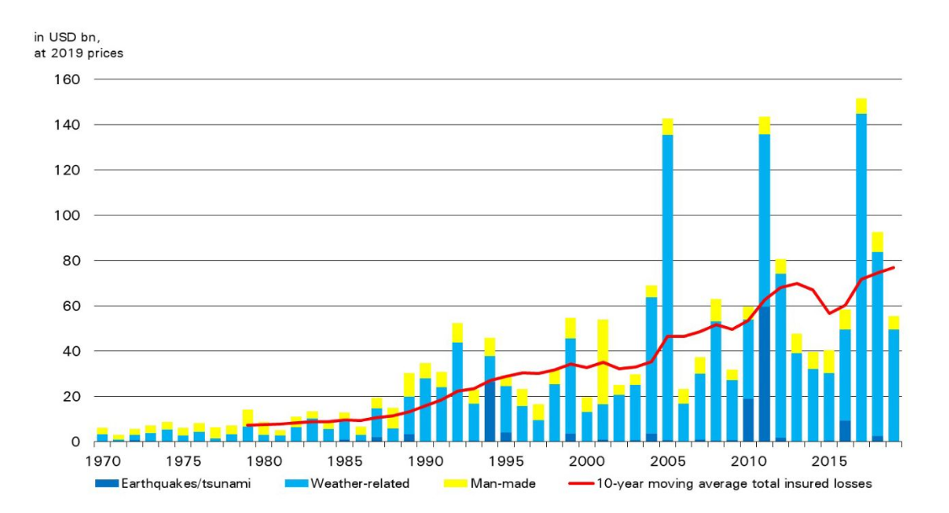
Catastrophic risk and insurance
Hurricanes Harvey, Irma and Maria, wildfires
Katrina
Fukushima
Notes:
Source: Swiss Re https://www.swissre.com/media/news-releases/nr-20191219-global-catastrophes-estimate.html
https://www.swissre.com/media/news-releases/2018/nr20180410_sigma_global_insured_loses_highest_ever.html
Total global economic losses from natural disasters and man-made catastrophes were USD 337 billion in 2017
Global insured losses from disaster events in 2017 were USD 144 billion, the highest ever on sigma records
Hurricanes Harvey, Irma and Maria resulted in combined insured losses of USD 92 billion, equal to 0.5% of US GDP
Insured losses from all wildfires in the world totalled USD 14 billion in 2017, the highest ever in a single year
More than 11 000 people died or went missing in disaster events in 2017

Slide 191
From insurance to capital markets: convergence product: ILS
Insurance Linked Securities (ILS) are fixed-income securities through which the insurance industry passes on pure insurance risk to the financial markets.
They are issued by insurance and reinsurance companies as protection in the event of extreme insurance losses, for instance following severe natural catastrophes or a potential pandemic disease outbreak.
The risk assumed by investors is related to a specific insurance loss (such as earthquake, mortality or airplane crash).
Prior to the maturity of a cat bond, two scenarios may develop:
as long as no major natural catastrophes have occurred, cat bonds are redeemed at 100% on the maturity date.
Alternatively, if a catastrophic event of a pre-defined peril and within a specified region does occur, the bonds may default, and part or all of the capital is immediately transferred to the insurance buyer under the bond. The insurance buyer then uses this capital to pay its claims to policyholders.

Slide 192
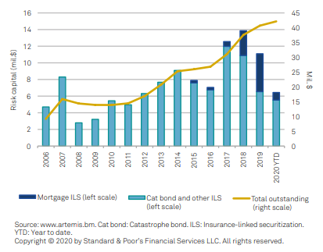
Cat Bonds & ILS
Source: S&P Global reinsurance Report 2020
Notes:
Source: S&P Global reinsurance Report 2020

Slide 193
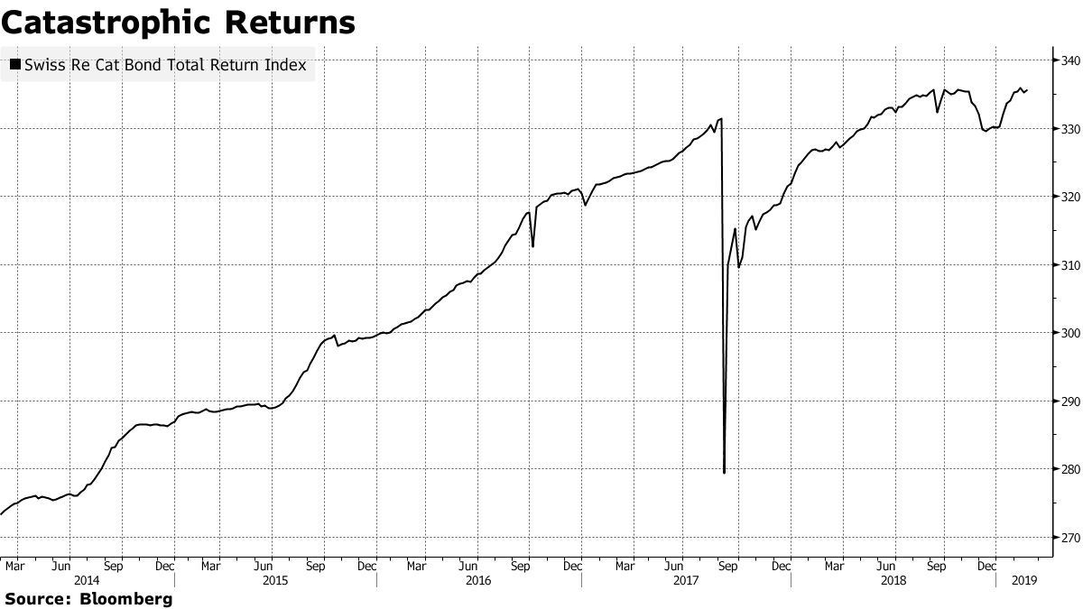
Cat Bond Returns
Source Bloomberg 27 Feb 19
Notes:
Source Bloomberg 27 Feb 19 https://www.bloomberg.com/news/articles/2019-02-26/first-terror-bond-sale-opens-new-high-yield-catastrophe-market

Slide 194
Summary
Reinsurance definition
ILS (insurance Linked Securities)
Cat Bond

Slide 195
Test Your Understanding
Imagine that HKSAR Government issues a Cat Bond linked to a severe earthquake. What will happen to investors if the earthquake takes place (meeting the criteria of the bonds)
Investors will get the coupons and principal
Investors will get the principal
Investors will lose the principal

Slide 196
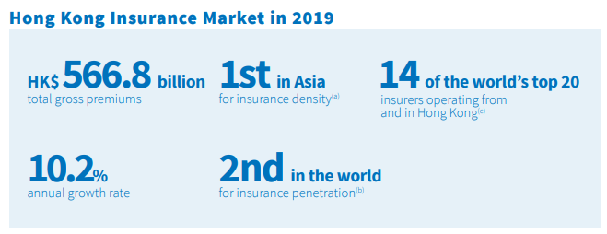
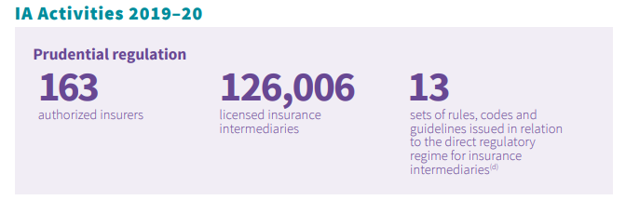
Insurance in HK
Source: IA report 2019
Notes:
Source: IA annual report 2019-2020 https://www.ia.org.hk/en/infocenter/files/IA_Annual_Report_2019_20_Eng.pdf

Slide 197
Insurance in HK: from self regulated to the IA
“In respect of the insurance regulatory structure, we are setting up an Insurance Authority that is not part of the government, as mandated in ICP 2.
We are also abolishing our current self-regulatory system for intermediaries to strengthen the conduct regulatory regime.
We are establishing a Policyholders’ Protection Fund to provide another safety net for policyholders.
We issued new requirements on underwriting unit-linked policies, following the cradle-to-grave approach adopted in ICP19 on Fair Treatment of Customers.
We also introduced a new intermediaries’ remuneration disclosure system to enhance transparency.
Together with the banking and securities regulators, we have enacted a new legislation on anti-money laundering and are working on a resolution regime for financial institutions.
Just two days ago, we issued a consultation paper on a risk-based capital framework for Hong Kong.” Annie Choi, CI, 18 Sept 14 at the FT Insurance Summit in Hong Kong
Notes:
Source: http://www.oci.gov.hk/download/sp_20140918.pdf

Slide 198
Regulation: Independent Insurance Authority (IA) in Hong Kong
The IA, a statutory body established by the Insurance Companies (Amendment) Ordinance 2015 (Amendment Ordinance), is a new insurance regulator independent of the Government.
Since end of 2016 the IA has replaced the OCI and has taken over the regulation of insurance intermediaries from the three Self-Regulatory Organisations (SROs) through a statutory licensing regime. The IA has fully taken over the supervision of insurance intermediaries from the SROs.
Notes:
Source: http://www.info.gov.hk/gia/general/201512/28/P201512280307.htm

Slide 199
Organisation structure of the IA

Slide 200
Current issues in Insurance
Growth of insurance in Asia
The rise of InsurTech
Automation
Digitization
Virtual Insurance
Increased competition from China (Zhong An, Ping An…)
IFRS 17 and other accounting changes
Solvency II and regulatory changes

Slide 201
Summary
Insurance regulation in HK

Slide 202
Current issues in Insurance
Insurance in Asia: what is the penetration level of insurance in Asia? Compare to Europe and US - why the differences? Implications? (Group 13)
Video
https://www.peak-re.com/insights/increasing-insurance-penetration-in-asia/
Article
https://www.asiainsurancereview.com/Magazine/ReadMagazineArticle?aid=40294

Slide 203
Course Map
Overview
Financial Institutions
Sell Side
Buy Side
Insurance Companies
Pension Funds and Retirement Schemes
Mutual Funds and Fund Management
Commercial Banking
Traditional Institutional Investors
Investment Banking

Slide 204
Pensions and Retirement Funds
Definition
Public pensions: social security and mandatory retirement plans
Private pensions: 401K and IRAs
Regulation
Pensions & retirement funds in Asia
Current issues

Slide 205
Multi-pillar retirement system
In 1994, the World Bank recommended a three-pillar framework to address the issue of old-age protection; this was expanded to a five-pillar framework In 2005 based on operational experience:
Pillar 0: a non-contributory, publicly financed and managed system that provides a minimal level of protection for retirement;
Pillar 1: a mandatory, contributory and publicly managed system
Pillar 2: a mandatory, privately managed, fully funded contribution system;
Pillar 3: voluntary savings (e.g. personal savings and insurance); and
Pillar 4: informal support (e.g. family support), other formal social programmes (e.g. health care and housing) and other individual assets (e.g. home ownership).
public
private
205

Slide 206
The retirement resource pyramid (US)
Source: Investment Company Factbook 2019
Notes:
Source: ICI Factbook 2019 Retirement Resource Pyramid
The retirement resource pyramid has five layers, which draw from government programs, compensation deferred until retirement, and other savings and assets (Figure 7.1):
Social Security
homeownership
employer-sponsored retirement plans (private-sector and government employer plans, including both defined benefit [DB] and defined contribution [DC] plans)
individual retirement accounts (IRAs), including rollovers
other assets
While the importance of each layer differs by household, together they have enabled recent generations of retirees, on average, to maintain their standard of living in retirement.
The construction of each household’s pyramid varies with age and income. Younger households are more likely to save primarily for reasons other than retirement, such as a home purchase, family needs, or education (Figure 7.2). By contrast, older households are more likely to save primarily for retirement, as many already have reached their other savings goals. The tendency of younger workers to focus less on saving for retirement is consistent with economic models of life-cycle consumption predicting that most workers delay saving for retirement until later in their careers. Lower-income households also focus less on saving for retirement, reflecting the fact that Social Security benefits replace a higher share of pre-retirement earnings for workers with lower lifetime earnings.
Social Security, the base of the U.S. retirement resource pyramid, is the largest component of retiree income and the primary source of income for lower-income retirees. Social Security benefits are funded through a payroll tax equal to 12.4 percent of earnings of covered workers (6.2 percent paid by employees and 6.2 percent paid by employers) up to a maximum taxable earnings amount ($117,000 in 2014). The benefit formula is highly progressive, with benefits representing a much higher percentage of earnings for workers with lower lifetime earnings. By design, Social Security is the primary means of support for retirees with low lifetime earnings and a substantial source of income for all retired workers. For individuals born in the 1950s, the Congressional Budget Office (CBO) projects that mean first-year Social Security benefits will replace 85 percent of average inflation-indexed lifetime earnings for the bottom 20 percent of retired workers ranked by lifetime household earnings (Figure 7.3). The mean replacement rate drops to 64 percent for the second quintile of households, and then declines more slowly as lifetime household earnings increase. For even the top 20 percent of lifetime earners, Social Security benefits are projected to replace a considerable portion (34 percent) of earnings.
For many near-retiree households, homeownership is the second most important retirement resource after Social Security. Older households are more likely to own their homes; more likely to own their homes without mortgage debt; and, if they still have mortgages, more likely to have small mortgages relative to the value of their homes. Retired households typically access this resource simply by living in their homes rent-free.
Employer-sponsored retirement plans and IRAs, which complement Social Security benefits and are important resources for households regardless of income or wealth, increase in importance for households for whom Social Security replaces a smaller share of earnings. In 2013, about eight out of 10 near-retiree households had accrued benefits in employer-sponsored retirement plans—DB and DC plans sponsored by private-sector and government employers— or IRAs

Slide 207
Total US Retirement Market Assets 1995-2019, Trillions of $, year-end
Source: Investment Company Factbook 2020

Slide 208
Pensions in the US
Definition: A pension plan is an asset pool that accumulates over an individual’s working years and is paid out during the nonworking years
Developed as Americans began relying less on children for care during their later years
Also became popular as life expectancy increased
Source: Mishkin/Eakins
Notes:
Source: http://www2.iii.org/financial-services-fact-book/retirement-assets/retirement-funds-iras-and-401ks.html
68 percent of all U.S. households had retirement plans through work or individual retirement accounts (IRAs) in 2009.
In 2009 nearly two-thirds of retirement assets (64.8 percent) were in an employer-sponsored retirement plan (including government and private plans). About one-quarter (26.4 percent) of such assets were in individual retirement accounts and 8.8 percent were in annuities.

Slide 209
Defined Benefit vs. Defined Contribution Pension Funds
Defined-Benefit Pension Plans:
Defined-Contribution Pension Plan:
A plan where the sponsor promises the employee a specific benefit when they retire
E.g. Annual Retirement Payment = 2% × average of final 3 years’ income × years of service
A plan where a set amount is invested for retirement, but the benefit payout is uncertain
Defined-Benefit Pension Plans place a burden on the employer to properly fund the expected retirement benefit payouts.
Fully funded: sufficient funds are available to meet payouts
Overfunded: funds exceed the expected payout
Underfunded: funds are not expected to meet the required benefit payouts
Notes:
Types of Retirement Plans
(Source: http://www.iii.org/financial2/asset/assets/)
There are two basic types of pension funds: Defined benefit and defined contribution plans.
In a defined benefit plan, the income the employee receives in retirement is guaranteed, based on predetermined benefits formulas. Typically, benefits are based on a percentage of the participant’s “terminal earnings,” i.e., earnings at retirement.
In a defined contribution plan, a type of savings plan in which taxes on earnings are deferred until funds are withdrawn, the amount of retirement income depends on the contributions made and the earnings generated by the securities purchased. The employer generally matches the employee contribution up to a certain level and the employee selects investments from among the options the employer’s plan offers. 401(k) plans fall into this category, as do 403(b) plans for nonprofit organizations.
Other types of retirement funds include profit sharing plans, in which employers contribute to accounts based on their profits, and Keogh plans for the self-employed and employees of small businesses. Some workers who do not fall into these categories may make limited contributions to an individual retirement account (IRA). IRAs allow individuals to save money without paying taxes until they withdraw it. With the Roth IRA, a plan created in 1998 for individuals earning below specified income levels, individuals pay taxes on the money before it is saved and withdraw funds without paying federal taxes. Beginning in 2010 people with traditional IRAs will be able to convert them to Roths. Roth 401(k)s were introduced in 2001 and made permanent by federal law in 2007

Slide 210
Defined Contribution Plan Assets by Type of Plan Trillions of $, year-end, 1995-2018
Source: Investment Company Factbook 2019

Slide 211
US - Public Pension Funds
Any pension plan set up or sponsored by a government body; funds administered by a federal, state, or local government
2 types:
State or local government pension funds
set up for state or local government employees
funded on a “pay as you go” basis
state and local pension funds held most of their assets in corporate equities (58.13% in 2004)
Federal government pension funds - two types
federal government employees, civil service employees, military and railroad employees not covered by The Federal Old Age and Disability Insurance Program (“Social Security”)
Social Security
funded on a “pay as you go” basis
Projected number of workers is falling while projected number of retirees is increasing, which will cause problems in years to come if not corrected
Social security contributions are invested in relatively low-risk, low-return Treasury securities
“Pay as you go” means that money that workers contribute today pays benefits to current recipients. Future generations will be called on to pay benefits to current contributors.
Notes:
“Pay as you go” basis, where current funding is used (partially) to pay current benefits
Solutions to SS problems: increase retirement age (from 65 to 67 for example: measure passed in mid 90s), increase contributions (from 6.2% in 98 to 7.65% in 05); public funding to supplement resources; diversification of assets to higher yielding instruments (e.g. alternative investments)
Definition of 'Pay As You Go Pension Plan'
A retirement scheme where the plan beneficiaries decide how much they want to contribute either by having the specified amount regularly deducted from their paycheck or by contributing the desired amount in a lump sum. A pay as you go pension plan is similar to a 401k. The employee can choose among the various investment options and decide on whether they want a higher return by investing in a more risky fund or a safer fund which provides steady returns Read more: http://www.investopedia.com/terms/p/pay-as-you-go-pension-plan.asp#ixzz1oxoh0ZoI
Investopedia explains 'Pay As You Go Pension Plan'
When retirement age comes along, the beneficiary can choose to either receive the benefits in a lump sum or as a lifetime annuity where the benefits are spread in monthly payments throughout the beneficiary's lifetime. This is different from a fully funded pension where the company fully funds, manages and distributes the benefits at retirement. Read more: http://www.investopedia.com/terms/p/pay-as-you-go-pension-plan.asp#ixzz1oxorlLvb
DEFINITION of 'Social Security‘: http://www.investopedia.com/terms/s/socialsecurity.asp#ixzz3XMaNjJar
A United States federal program of social insurance and benefits developed in 1935. The Social Security program's benefits include retirement income, disability income, Medicare and Medicaid, and death and survivorship benefits. Social Security is one of the largest government programs in the world, paying out hundreds of billions of dollars per year.
Based on the year someone was born, retirement benefits may begin as early as age 62 and as late as age 67. The amount of income received is based on the average wages earned over the worker's lifetime, with a maximum calculable amount of $102,000 as of 2008. Spouses are also eligible to receive Social Security benefits, even if they have limited or non-existent work histories.
The original program was part of President Franklin D. Roosevelt's New Deal plan to lift the U.S. out of the Great Depression. Today, the program is funded through payroll taxes collected by employees and companies; monies are placed into the Social Security Trust Fund and payments are managed by the government along with the Federal Reserve Board.
Social Security has faced serious solvency issues for many decades; today's payments are made from current payroll contributions by workers who may not have money available for them when they retire. Social security reform, whether through legislation, tax law changes, or privatization, has been a major political issue that draws strong opinions from different demographic segments.
Social Security faces the real threat of becoming insolvent because of factors such as longer life expectancies, a large baby boomer population currently entering retirement age, and inflation.

Slide 212
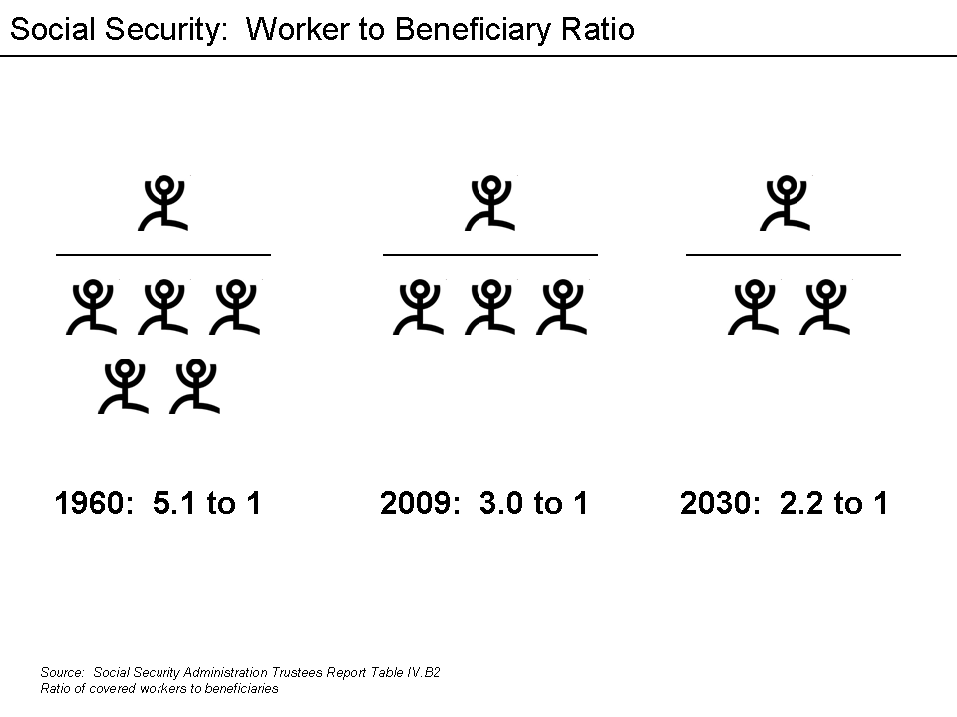
Social security in the US
Notes:
Source: Wikipedia http://upload.wikimedia.org/wikipedia/en/e/e1/Social_Security_Worker_to_Beneficiary_Ratio.png

Slide 213
US - Private pension funds; types of retirement plans
Any pension plan set up by employers, groups, or individuals; funds administered by a private corporation (e.g., insurance company, mutual fund)
Increasingly dominated by defined contribution plans
Types of private pension plans
401(k) and 403(b): employer sponsored plans that supplement a firm’s basic retirement plan
individual retirement accounts (IRA’s) and Roth IRAs
Keogh accounts (for self employed and SME employees)
Notes:
401(k) and 403(b): employer sponsored plans that supplement a firm’s basic retirement plan, allowing for both employee and employer contributions. 401(k) plans are offered to employees of taxable firms while 403(b) plans are for employees of certain tax-exempt employers (e.g. hospitals and educational institutions). Contributions to these plans are taken on a pretax basis and thus reduce the employee’s taxable salary. Both the contributions and earnings then grow tax deferred until they are withdrawn. Most of these plans are movable to another 401(k) or 403(b) or an IRA if the employee changes jobs. Participants in 401(k) and 403(b) generally make their own choice of the allocation of assets from both employee and employer contributions
The IRA is a tax-deductible savings plan for those who are self-employed, or whose earnings are below a certain level or whose employers do not offer retirement plans. They are self-directed retirement accounts set up by employees who may also be covered by employer-sponsored pension plans as well as self-employed individuals. Contributions to the IRA are made strictly by the employee. IRAs were first allowed in 1981 as a method of creating a tax-deferred retirement account to supplement an employer-sponsored plan. As of 2004 a maximum of US$4,000- may be contributed to an IRA per year; non-working couples can contribute an additional $4,000- if couple’s adjusted gross income is less than $150,000- and neither is covered by an employer-sponsored plan. IRAs may also be used by employees changing jobs: any funds held by an employee in the old employer’s pension fund may be invested in a tax-qualified IRA to maintain the tax deferred status.
Other types of retirement funds include profit-sharing and Keogh plans for the self-employed and employees of small businesses. Some people not in those categories may make limited IRA contributions on a tax-deferred basis. The Roth IRA, a special kind of retirement account created in 1997, may offer greater tax benefits to certain individuals. Unlike a regular IRA, the Roth IRA contributions are taxed in the year of contribution and withdrawals are tax free (as long as account holder is at least 59 ½ and funds have been invested >5Y).
An increasing number of retirement plans give participants the option of opening up an account with a brokerage firm of their choice through the plan. These self directed accounts can afford access to a wide variety of investment options. Most IRA contributions are invested in mutual funds purchased through brokers or a mutual fund company.
Keogh account is a retirement account available to self-employed individuals. Contributions may be deposited in a tax-deferred account administered by a life insurance company, bank of other FIs. As with 401(k), participants are given some discretion as to how the funds are to be invested.
2 types of Keogh accounts are
Profit sharing Keogh: contributions can vary by year
Money sharing plans require a mandatory contribution at a constant % of the employee’s income per year whether the individual has profits or not
Major advantage of Keogh plans is high level of max contributions: money sharing plans: the lesser of $41,000- or 25% of self-employment income; profit-sharing up to $41K and 20% of income.
Types of Retirement Plans
There are two basic types of pension funds: defined benefit and defined contribution plans.
In a defined benefit plan, the income the employee receives in retirement is guaranteed, based on predetermined benefits formulas. Typically, benefits are based on a percentage of the participant’s “terminal earnings,” i.e., earnings at retirement. Several other options have also been developed.
In a defined contribution plan, a type of savings plan in which taxes on earnings are deferred until funds are withdrawn, the amount of retirement income depends on the contributions made and the earnings generated by the securities purchased. The employer generally matches the employee contribution up to a certain level and the employee selects investments from among the options the employer’s plan offers. 401(k) plans fall into this category, as do 403(b) plans for nonprofit organizations. Other types of retirement funds include profit sharing plans, in which employers contribute to accounts based on their profits, and Keogh plans for the self-employed and employees of small businesses. Some workers who do not fall into these categories may make limited contributions to an individual retirement account (IRA). IRAs allow individuals to save money without paying taxes until they withdraw it. With Roth IRAs, a plan created in 1998 for individuals earning below specified income levels, individuals pay taxes on the money before it is saved and withdraw funds without paying federal taxes. Beginning in 2010 people with traditional IRAs will be able to convert them to Roths. Roth 401(k)s were introduced in 2001 and made permanent by federal law in 2007. Unlike traditional 401(k) plans, Roth 401(k)s are funded with after tax dollars.

Slide 214
IRA assets
Source: Investment Company Factbook 2020

Slide 215
US households have other retirement assets besides Social Security (% of households, 2019)
Notes:
Source: ICI Factbook 2020

Slide 216
Summary
Multi-pillar retirement system and the retirement pyramid
Pensions & retirement Plans in the US
Defined-benefit v. defined contribution
Public v private pension fund
Social Security
Types of private retirement plans in the US

Slide 217
Test Your Understanding
Demographic trends and changes in retirement patterns suggest that Social Security funding problems will ease over the next few decades.
TRUE / FALSE
In the US, Social Security is a ________
fully funded pension plan.
federally insured private pension plan.
government sponsored private pension plan.
“pay-as-you-go” system.

Slide 218
US Regulation of Pension Plans
1949 U.S. Supreme Court decision → pension benefits are a legitimate part of collective bargaining
The number of plans increased from this as unions negotiated for such plans
Employee Retirement Income Security Act of 1974 (ERISA)
Does NOT mandate that employers establish pension funds for their employees
Established guidelines for funding: contributions to pension funds must be sufficient to cover all annual costs & expenses and to fund any unfunded historical liabilities over a 30 year period; any new underfunding arising from low investment returns have to be funded over a 15 year period.
Allowed plan credit to transfer with employees
Established vesting requirements to gain plan benefits
Increased disclosure requirements
Assigned regulatory oversight to the Department of Labor
Source: Mishkin/Eakins
Notes:
Prior to ERISA there were no statutory requirement forcing defined benefits fund administrators to adequately fund their pension funds.

Slide 219
US Regulation of Pension Plans
ERISA also established the Pension Benefit Guarantee Corporation to insure pension benefits if an underfunded pension plan is unable to meet its obligations.
Accounting makes it difficult to assess funding status of a plan
May be in trouble as plans appear underfunded
Pension reform Act of 1978 authorized individual retirement accounts (IRAs)
Enjoy a preferential tax treatment
Keogh plans are similar plans for self-employed individuals
SIMPLE IRAs are simplified retirement plans for small businesses.

Slide 220
The Pension Protection Act 2006
2006 Pension Protection Act signed 17 August 2006
Strengthens the federal pension insurance system
Allows companies to phase out their Traditional Defined Benefit or other pension plan and automatically enroll employees in 401(k) plans, as well as set investment guidelines
makes tax breaks for retirement plans and accounts which were scheduled to expire in 2010 permanent
gives taxpayers the option of direct depositing portions of their tax refunds into IRAs
permits 401(k) and similar plans to offer investment advice
Gives employers seven years to fully fund their plans (some airlines in bankruptcy proceedings got 10 years)
Notes:
In 2006 Congress passed the Pension Protection Act, landmark pension reform legislation enacted to close shortfalls in employers’ funding of defined benefit pension plans. The act gave employers seven years to fully fund their plans but gave some airlines in bankruptcy proceedings an extra 10 years to meet their obligations.
The Pension Protection Act of 2006 makes it easier for workers to start and contribute to a retirement savings plan in these ways:
Encouraging employers to enroll workers automatically in 401(k) or 403(b) savings plans. It's estimated that at least 12 million workers eligible for such plans haven't signed up. Until now, workers have had to proactively start retirement plans; now more will have to go out of their way to opt out of one. The law allows employers to earmark 3 percent of a worker's salary into a 401(k) and as much as 6 percent over time to help workers save more.
Giving taxpayers the option of depositing portions of their federal tax refund directly into an IRA. "It's really a painless way to make a contribution to an IRA," says Sallie Olson, a CPA and retirement plan specialist with Aldrich Kilbride & Tatone of Portland, Ore.
Permitting 401(k) and other similar plan providers to offer face-to-face, personally tailored investment advice to help workers manage their retirement savings plans. The goal is to ease anxiety for workers not used to making investment decisions. The law takes several steps to prevent adviser conflicts-of-interest.
As a result of the new law, several retirement savings incentives - originally passed by Congress in 2001 but set to disappear after 2010 - now become permanent. Retirement specialists expect the changes to make long-range retirement planning more predictable and provide older workers enhanced options to beef up their nest eggs. These changes include the following:
Allowing workers in employer-sponsored 401(k), 403(b) and other similar plans to put up to $15,000 this year in pretax income in 2006, and higher amounts each year - based on inflation - beginning in 2007. Individuals with a regular IRA or Roth IRA - plans funded with after-tax money allowed to grow tax-free - can contribute up to $4,000 in 2006 and 2007, $5,000 in 2008, and even more in later years to reflect inflation. If you are 50 or older, you may increase these amounts by $1,000 each year.
Continuing to let workers 50 and older in 401(k) and similar retirement plans sock away, on a tax-deferred basis, an additional $5,000 this year and more in following years, based on inflation. That's $20,000 that an older worker can set aside pre-tax for retirement. "This especially helps those who have finally finished paying for college," says Alice Orzechowski, a Frederick, Md., CPA. "They now have a few years to beef up their own retirement accounts."
Making permanent the so-called Saver's Credit - which would have disappeared after Dec. 31 - which provides up to a 50 percent tax credit for low- and moderate-income families that contribute up to $2,000 a year to a retirement plan. "The Saver's Credit, if you ask me, is the equivalent of a government match" to your retirement savings, Yeager says. "Credits are much better than deductions; that's money in your pocket."
Increasing the ease of transferring money between plans, including portability of after-tax contributions. For example, starting in 2008 it becomes easier to roll money from an IRA to a Roth IRA, and the new law gives employers enhanced options to offer Roth 401(k) retirement plans.
Changes for Giving, Saving, Planning
The reform law also contains several nonretirement changes.
Donating to charities: "The law dramatically changes certain rules," Orzechowski says. "No deduction is allowed for cash, check or other monetary donations unless the taxpayer has a bank record or written acknowledgement from the charity." No deduction either for clothing and household donations, unless they are in "good" condition, a term Congress did not define. A good change: Those 70½ and older in 2006 and 2007 can make tax-free distributions from their IRA directly to a charity. "This new rule benefits taxpayers who do not itemize, as well as those who would be adversely affected by the normal restrictions and limitations on charitable contributions," Orzechowski adds.
Saving for college: The law permanently extends the rules and tax benefits of the Section 529 college-savings plans popular with those saving for their children's and grandkids' educations.
Planning for long-term care: Beginning in 2010, the law allows individuals who have built up cash value in an annuity or life insurance policy to buy long-term-care insurance coverage without declaring the premium payments from the policy as income for tax purposes, and receive long-term-care benefits tax-free.
The Pension Protection Act Strengthens The Federal Pension Insurance System. The legislation:
Requires companies that under-fund their pension plans to pay additional premiums;
Extends a requirement that companies that terminate their pensions provide extra funding for the pension insurance system;
Requires that companies measure the obligations of their pension plans more accurately;
Closes loopholes that allow under-funded plans to skip pension payments;
Raises caps on the amount that employers can put into their pension plans, so they can add more money during good times and build a cushion that can keep their pensions solvent in lean times; and
Prevents companies with under-funded pension plans from digging the hole deeper by promising extra benefits to their workers without paying for those promises up front.
President Bush Has Sent A Clear Message To Businesses Across America That They Must Keep Their Promises To Workers. Businesses that offer a private pension plan to their employees have a duty to set aside enough money now, so their workers get what they have been promised when they retire.
The Pension Protection Act Also Contains Provisions To Help American Workers Who Save For Retirement Through Defined Contribution Plans, Like IRAs And 401(k)s. Defined contribution plans are helping Americans build a society of ownership and financial independence, and this legislation makes it easier for workers to participate in these plans. The legislation:
Removes barriers that prevent companies from automatically enrolling their employees in defined contribution plans;
Ensures that workers have more information about the performance of their accounts;
Provides greater access to professional advice about investing for retirement;
Gives workers greater control over how their accounts are invested; and
Makes permanent the higher contribution limits for IRAs and 401(k)s that were passed in 2001, enabling more workers to build larger retirement nest eggs.

Slide 221
Retirement product convergence: Annuities
There are several types of annuities: deferred/immediate and fixed/variable
Annuities are typically sold by insurance companies

Slide 222
Summary
US regulation of pension plans:
Regulator
ERISA
Pension Reform Act 1978
Pension Protection Act 2006

Slide 223
Test Your Understanding
which government entity regulates the pension sector in the US?
The Fed
The SEC
The Department of Labor
If a private pension plan fails in the US, what happens to workers pensions?
They lose all their pensions
Pension liabilities are taken over by the PBGC
Pension liabilities are taken over by the Fed

Slide 224
Pension Funds in HK: the Mandatory Provident Fund
Established 1 December 2000. Privately managed, employment related scheme.
Regulation: MPFS Ordinance August 1995. Regulator: MPFSA (Mandatory Provident Fund Schemes Authority) set up in September 1998
Mandatory:
Employees (> 60 days continued employment) have to contribute 5% of their wages to the MPF; contributions are matched by employer (total 10%)
Members choice:
Means employee can choose where contributions are invested, within the array of choices available under the plan
Contributions not available until retirement age (65)
Portable plan:
When changing jobs, employee can transfer to new employer plan or to own MPF
Trustee set-up:
MPF funds must be in a trust structure to ensure maximum protection of scheme members’ assets
Notes:
Source: http://www.mpfa.org.hk/english/abt_mpfs/abt_mpfs_bgd/abt_mpfs_bgd.html
In August 1995, Hong Kong took a major step in enacting the Mandatory Provident Fund Schemes Ordinance to provide a formal system of retirement protection. The ordinance provides the framework for the establishment of a system of privately managed, employment-related MPF schemes to accrue financial benefits for members of the workforce when they retire.
The Mandatory Provident Fund Schemes Authority (MPFA) was established in September 1998 to regulate, supervise and monitor the operation of the MPF System. The MPF System came into operation on December 1, 2000.
The 15-year-old MPF System has grown alongside Hong Kong, and has contributed significantly to building up the retirement savings of the people of Hong Kong. At present, around 85% of Hong Kong
workers are covered by the MPF System, or by some other forms of retirement scheme. By international standards, this level of coverage is excellent. As at the end of October 2015, the total assets of the
MPF System amounted to almost $600 billion. This means the annualized rate of return from the inception of the MPF System to October 2015 was 3.4%, higher than the 1.8% inflation rate over the same period.

Slide 225
Pensions in HK: Regulatory Structure
Before the MPF System was launched (in 2000), retirement schemes set up voluntarily by employers for their employees were regulated under the Occupational Retirement Schemes Ordinance (ORSO).
Government of Hong Kong
MPF Schemes Authority
MPF Schemes
Occupational Retirement Schemes
MPF Trustees
MPF Intermediaries (in coordination with HKMA, Insurance Authority and Securities and Futures Commission)
MPF Schemes and Products (in coordination with Securities and Futures Commission)
The MPFA is now responsible for regulating both MPF schemes and ORSO schemes, under the MPFSO and the ORSO respectively
Notes:
Source: http://www.mpfa.org.hk/english/abt_mpfa/abt_mpfa_rs/abt_mpfa_rs.html
Before the MPF System was launched (in 2000), retirement schemes set up voluntarily by employers for their employees were regulated under the Occupational Retirement Schemes Ordinance (ORSO). These ORSO schemes were exempted from MPF requirements as long as they met certain conditions, but the MPFA is now responsible for regulating both MPF schemes and ORSO schemes, under the MPFSO and the ORSO respectively. This regulatory work is carried out on the basis of the relevant legislation, as well as guidelines and codes covering these schemes, under the regulatory structure shown here

Slide 226
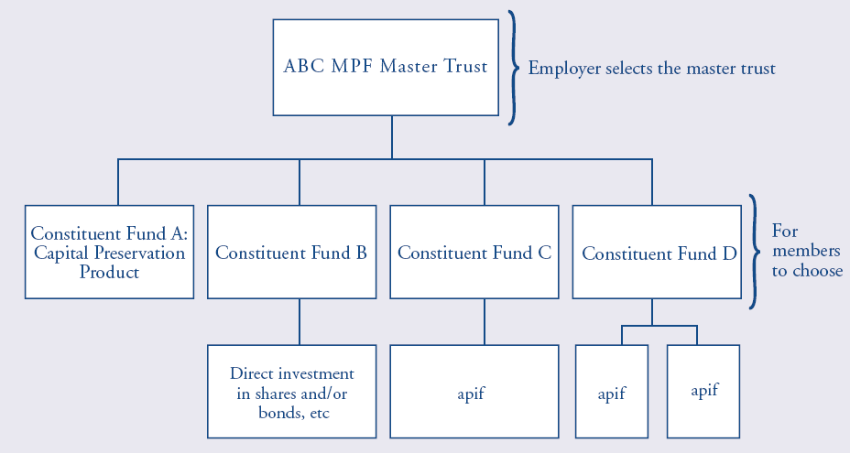
MPF Structure: Constituent Funds
approved pooled investment funds (“apif”) can be a unit trust or an insurance policy
Source: http://www.hkifa.org.hk/eng/download/fundinfo/mpf/HKIFA_Edu_E.pdf
Notes:
Member choice means that employees (who are members of an MPF scheme) can have the right to choose MPF constituent funds. However, member choice is limited to the choice offered by the master trust(s) chosen by the employer.
Employees choose constituent fund(s). A constituent fund invests in one or more approved pooled investment funds (“apif”) or invests directly. An apif can be a unit trust or an insurance policy.

Slide 227
Employee Choice Arrangement
The Employee Choice Arrangement (ECA) started on 1 November, 2012. From that date, employees are allowed to transfer their accrued benefits, i.e. the accumulated contributions and investment returns, which arise from the employee mandatory contributions made during their current employment to another MPF trustee and scheme of their own choice once every calendar year; or not to make any change by retaining the accrued benefits in the MPF scheme they are currently enrolled in.
In addition, the minimum and maximum levels of relevant income have been adjusted to HKD 7,100 and HKD 30,000 respectively (as of October 2014)
Notes:
http://www.mpfa.org.hk/english/quicklinks/quicklinks_eca/eca.html
http://www.mpfa.org.hk/english/quicklinks/quicklinks_ri/quicklinks_minmax.html
http://www.mpfa.org.hk/eng/mpf_system/system_features/contributions/index.jsp

Slide 228
Withdrawal choice arrangement
Introduction of choice of withdrawal by installments instead of lump sum (effective 1 Feb 16) : Scheme members who have reached the age of 65, or who have reached the age of 60 and have decided to early retire can choose to either :
withdraw their MPF benefits by installments or
withdraw all their MPF benefits in a lump sum, or
retain all their MPF benefits in their accounts for continuous investment.

Slide 229
Default Investment Strategy
To address the problems of high fees and difficulty in making choices associated with some MPF schemes, the Government and the MPFA propose to require each trustee to provide, in each scheme, a Default Investment Strategy (DIS). The Government introduced the amendment bill to the Legislative Council on 25 November 2015, and the was launched by the end of 2016.
MPF members who don’t select any options will by default contribute into the DIS.
Notes:
Source: MPFA http://www.mpfa.org.hk/eng/information_centre/publications/mpfa_newsletter/files/Newsletter_21.pdf

Slide 230
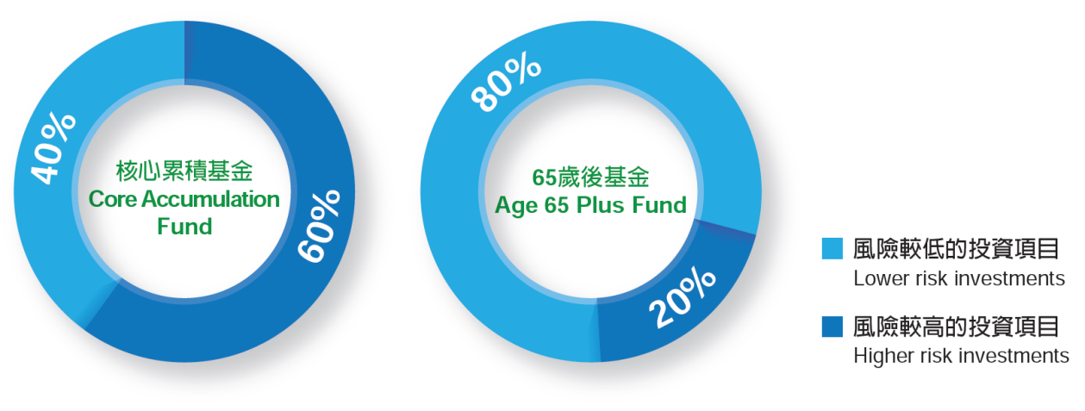
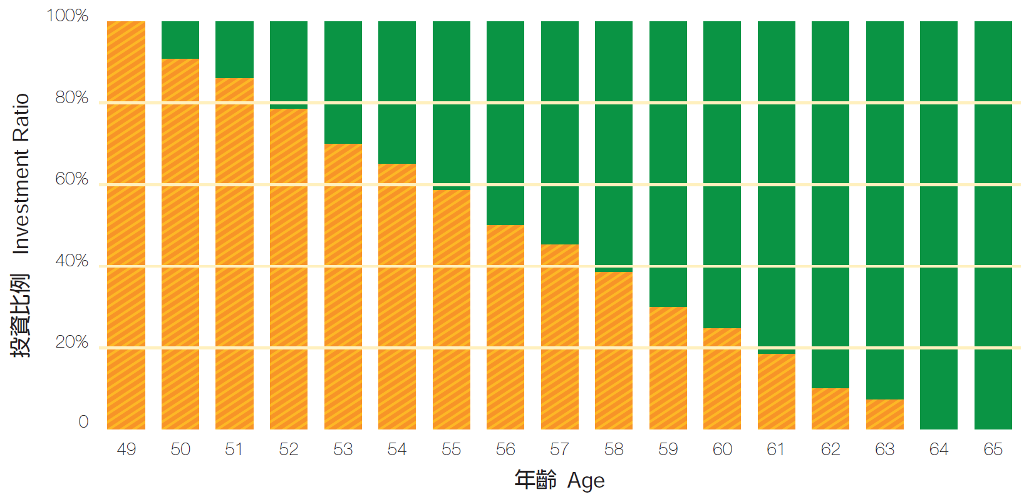
Default Investment Strategy
2 globally diversified funds : Core accumulation Fund and Age 65 Plus Fund
Principle of age de-risking:
<50: 100% invested in the Core Accumulation Fund.
50-64: MPF benefits in the Core Accumulation Fund gradually switched to the Age 65 Plus Fund every year, so that the ratio of higher risk investments in the investment portfolio will fall by around 2.6% every year.
65+: all MPF benefits will be invested in the Age 65 Plus Fund.
Fee controls: management fees capped at 0.75% p.a.
Notes:
In short, the DIS is a highly standardized and fee-controlled MPF investment strategy designed to be consistent with the objective of building up long-term retirement savings. If scheme members do not make any choices for their MPF investments, their MPF contributions will be invested according to the DIS of their respective scheme. Scheme members can also choose to opt for the DIS
The key features of the DIS are described below:
Made up of two constituent funds (“CFs”)
To balance potential risks and returns, the DIS will be made up of two mixed asset CFs, namely the Core Accumulation Fund and the Age 65 Plus Fund. The CFs will invest in a globally diversified manner. The Core Accumulation Fund will adopt a more aggressive investment strategy and invest more in higher risk investments (e.g. global equities), while the Age 65 Plus Fund will adopt a more conservative investment strategy and mainly invest in lower risk investments (e.g. global bonds). The investment ratios of these two CFs are shown in the diagram below:
Investment principles:
1) Age-based de-risking
As the scheme member approaches retirement age, the investment strategies will be adjusted by reducing the investment in higher risk assets accordingly:
Aged below 50: all MPF benefits will be invested in the Core Accumulation Fund.
Aged 50 to 64: MPF benefits in the Core Accumulation Fund will be gradually switched to the Age 65 Plus Fund every year, so that the ratio of higher risk investments in the investment portfolio will fall by around 2.6% every year.
Aged 65: all MPF benefits will be invested in the Age 65 Plus Fund.
2) Globally diversified
Investment markets are often affected by factors such as the geopolitical and economic situations in different countries. To diversify risk, the CFs will invest in both local and overseas markets in a diversified manner.
Fee controls
Management fees must not exceed an annual rate of 0.75% of the net asset value of the CFs and this figure of 0.75% is just a starting point.
Fees covered within the fee cap include all fees for services provided by trustees, administrators, investment managers, custodians, sponsors and promoters, as well as similar fees chargeable to the underlying investment funds.

Slide 231
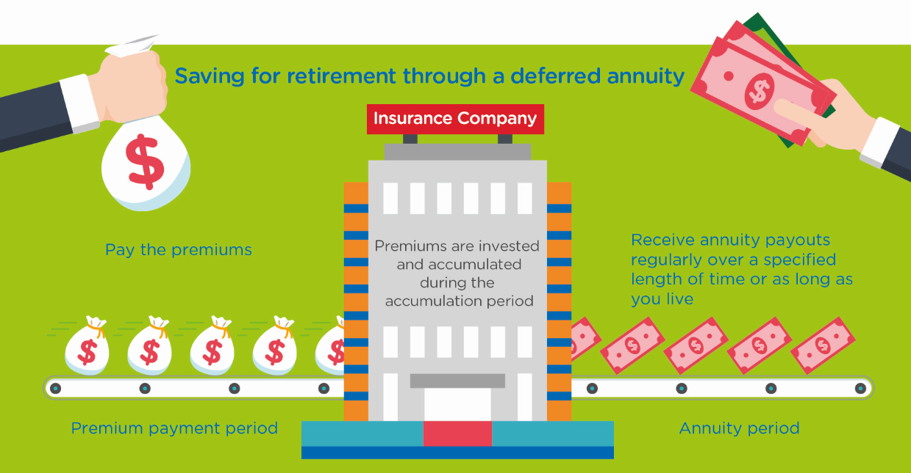
Launch of Tax Deductions for Annuity Premiums and MPF Voluntary Contributions
The amendment ordinance (2019) provides tax deductions for qualifying deferred annuity premiums (QDAP) and tax deductible MPF voluntary contributions (TVC) under salaries tax and personal assessment.
The deduction cap is $60,000 per year, which is an aggregate limit for both qualifying deferred annuity premiums and TVC
Notes:
Source: HK Government https://www.gov.hk/en/residents/taxes/salaries/allowances/deductions/annuity.htm and https://www.ifec.org.hk/web/en/moneyessentials/qdap-tvc/what-is-qdap.page#lightbox

Slide 232
Qualifying Deferred Annuity Policy (“QDAP”)
For relevant premiums to qualify for tax deductions, a deferred annuity product must comply with the guideline issued by the Insurance Authority, including:
Minimum total premiums of $180,000 and minimum payment period of 5 years
Minimum annuity period of 10 years
Annuitization at the age of 50 or beyond
Disclosure of the internal rate of return of the product to facilitate evaluation and comparison
Clear presentation of the guaranteed and non-guaranteed annuity payouts
Clear separation of premiums of all riders (e.g. critical illness, hospitalisation cash, etc.) from the qualifying deferred annuity premiums
Notes:
Source: https://www.ifec.org.hk/web/en/moneyessentials/qdap-tvc/what-is-qdap.page

Slide 233
Summary
HK’s Mandatory Provident Fund
Characteristics
regulatory structure
constituent funds
ECA
DIS
WCA
tax deductions
QDAP

Slide 234
Test Your Understanding
The MPF is a
Defined benefits plan
Defined contributions plan
Under the Employee Choice Arrangement (ECA), employees can:
Change their allocation choices within the employer plan
Transfer their contributions to another MPF plan of their choice
Transfer both their employers and their own contributions to another MPF plan
The Withdrawal Choice Arrangement allows employees to
Take their contributions in cash at any time
At retirement, choose to get a lump sum or an annuity or keep the money in the MPF longer

Slide 235
Current issues: MPF
MPF in HK: what are the issues? What are the possible solutions?(Group 15)
Video
http://cdhkdata.chinadailyhk.com/retirement-system-upgraded
Article
http://cdhkdata.chinadailyhk.com/retirement-system-upgraded

Slide 236
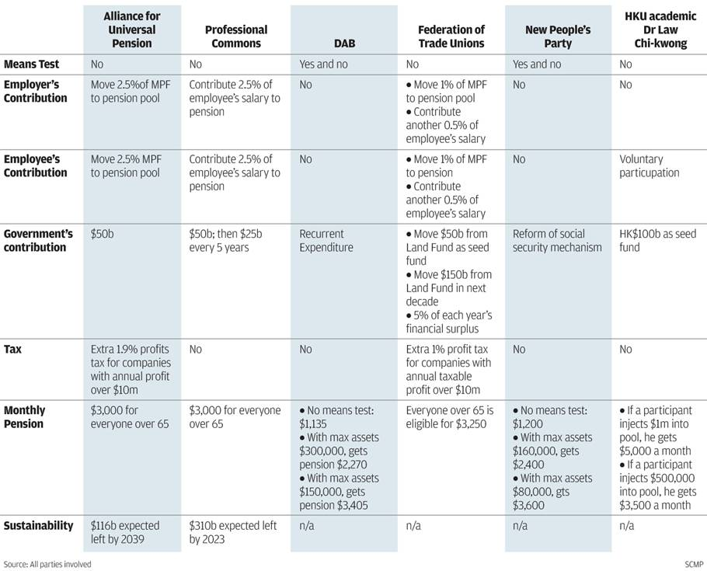
Current Issue: Proposals for pension plan in HK
Source: SCMP 20 August 2014
Notes:
Source: SCMP 20 August 2014 http://www.scmp.com/news/hong-kong/article/1578006/advocates-universal-pension-offer-choice-plans
The Commission on Poverty is currently conducting a public consultation on retirement protection, which has generated much discussion about how to improve Hong Kong's retirement protection. Regardless
of how the retirement protection framework develops in future, the MPF System will continue to play a vital role in helping members of the working population accumulate savings for retirement.

Slide 237
Current Issue: MPF fees & performance
Comparison of fees across different pensions systems
Notes:
Source: PWC – 2017_ recommendations for MPF

Slide 238
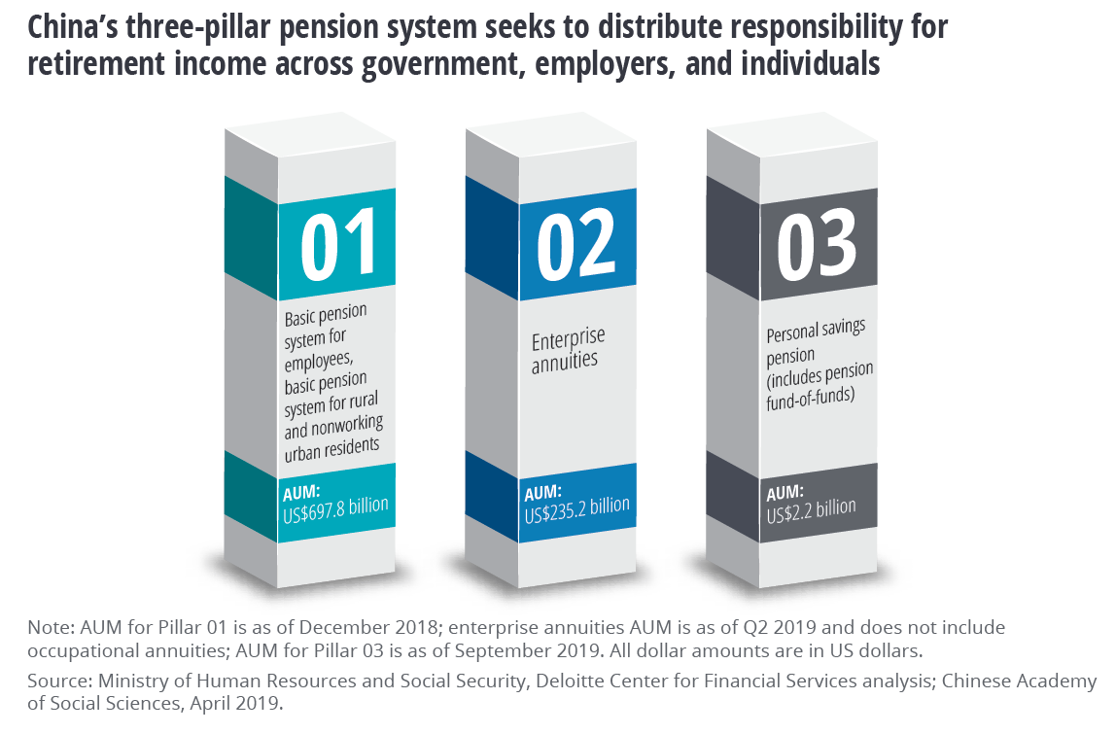
China’s Pension and Retirement System

Slide 239
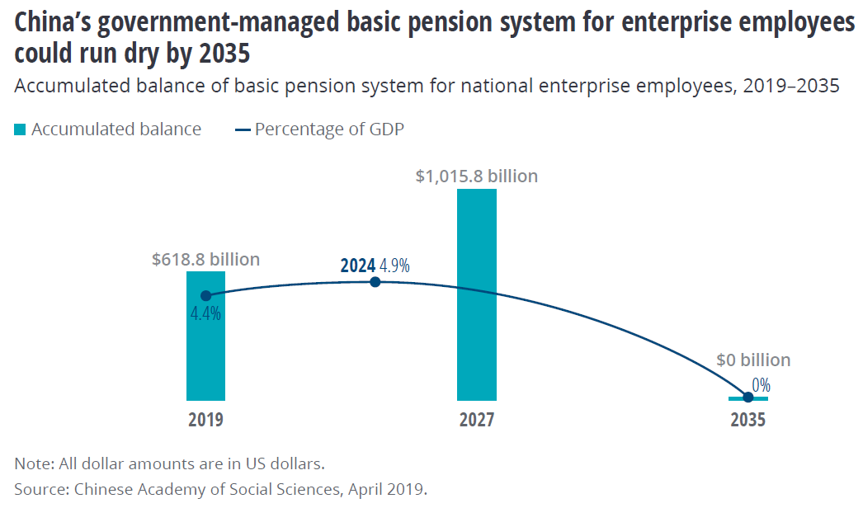
China’s Pension and Retirement System

Slide 240
Current issues: Retirement funds and pension funds in Asia: which country has the most advanced system? What is the situation in China? Implications? (Group 14)
Video Link
https://www.youtube.com/watch?v=eTzoLp5FIy0
Article
https://www.pensionfundsonline.co.uk/content/country-profiles/singapore

Slide 241
Current Issues for Pension Funds and Retirement Plans
Impact of crisis
Ageing of population presents critical issues for public pension funds – particularly Social Security plans
Longevity risk: Increase in life expectancy raises the question of retirement age
Changes in accounting for pensions driving a change in asset allocations
Rising trend of quest for yield driving increased participation of pension and retirement funds in alternative investments, raising issues of risk
“If I were a DB plan sponsor, I’d certainly be concerned about longevity risks. In the recent 20 years or so, we haven’t projected as rapid improvements (in lifespans) as what was actually happening. That is having huge repercussions on the actual cost of providing pensions.” Samuel Cox, Thomas P. Bowles Jr. chair of actuarial science at Georgia State University, Atlanta
Notes:
There are no known statistics showing the extent to which U.S. pension funds are underestimating the cost of providing pensions due to longevity risks. But according to analysis by Paternoster U.K. Ltd., London, U.K. defined benefit funds may come up short by £75 billion ($147 billion) to £175 billion because longevity risks have not been fully factored into the total pension liability, which stands about £1 trillion nationwide.

Slide 242
Total US Retirement Assets and Unfunded Defined Benefit Plan Liabilities Trillions of $, year-end
Source: Investment Company Factbook 2019

Slide 243
Size of Retirement Savings Gap $ trillions, 2015
Source: WEF, 2019 report

Slide 244
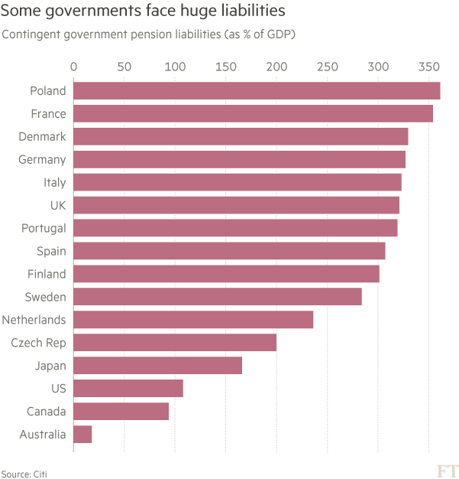
Government pension liabilities
Source: FT 24 August 2016
Notes:
Source: FT 23 Aug 2016 “Pensions: low yields, high stress” https://www.ft.com/content/8a54a0c6-648b-11e6-a08a-c7ac04ef00aa?ftcamp=crm/email//nbe/Analysis/product

Slide 245
Summary
Key issues affecting the pension and retirement industry

Slide 246
Course Map
Overview
Financial Institutions
Sell Side
Buy Side
Insurance Companies
Pension Funds and Retirement Schemes
Mutual Funds and Fund Management
Commercial Banking
Traditional Institutional Investors
Investment Banking
Spring 10

Slide 247
Mutual Funds & Collective Investment Schemes
Overview
Market
Pros & Cons of Collective Investment Schemes
Mutual Funds
Growth of mutual funds
Mutual funds structure & organization
Types of funds
Fee structure
Regulation
Mutual funds and asset management in HK and Asia

Slide 248
Worldwide Regulated Open-End Fund Assets - Trillions of U.S. dollars, 2010-2019 – by assets
Source: IC Fact Book 2020
Notes:
Source: IC Fact Book 2020 https://ici.org/pdf/2020_factbook.pdf

Slide 249
Total Net Assets of Worldwide Regulated Open-End Funds – by region Trillions of U.S. dollars, 2010-2019
Source: IC Fact Book 2020
Notes:
Source: IC Fact Book 2020 https://www.ici.org/pdf/2020_factbook.pdf

Slide 250
Percentage of Worldwide Regulated Open-End Fund Assets – YE 2019
Source: IC Fact Book 20189
Notes:
Source: IC Fact Book 2020 https://www.ici.org/pdf/2020_factbook.pdf
Source: ICI What Are Regulated Funds?
ICI, following standards set by the International Investment Funds Association (IIFA), defines regulated funds as collective investment pools that are substantively regulated, open-end investment funds.*
Open-end funds generally are defined as those that issue new fund shares (or units) or redeem existing shares (or units) on demand. Such funds are typically regulated with respect to disclosure, the form of organization (for example, as either corporations or trusts), custody of fund assets, minimum capital, valuation of fund assets, and restrictions on fund investments, such as limits on leverage, types of eligible investments, and diversification of portfolio investments.
In the United States, regulated funds include mutual funds and exchange-traded funds (ETFs).†
In Europe, regulated funds include Undertakings for Collective Investment in Transferable Securities (UCITS)—ETFs, money market funds, and other categories of similarly regulated funds—and alternative investment funds, commonly known as AIFs.
In many countries, regulated funds also may include institutional funds (funds that are restricted to being sold to a limited number of non-retail investors), funds that offer guarantees or protection of principal (those that offer a formal, legally binding guarantee of income or capital), and open-end real estate funds (funds that invest directly in real estate to a substantive degree).

Slide 251
Investment Company Industry Employment Estimated number of employees of fund sponsors and their service providers, thousands, selected years
Source: IC Fact Book 2018
Notes:
Source: IC Fact Book 2018 https://www.ici.org/pdf/2018_factbook.pdf

Slide 252
Investment Company Industry Employment by Job Function (US) % of employees of fund sponsors and their service providers, March 2017
Source: IC Fact Book 2018
Notes:
Source: IC Fact Book 2018 https://www.ici.org/pdf/2018_factbook.pdf

Slide 253
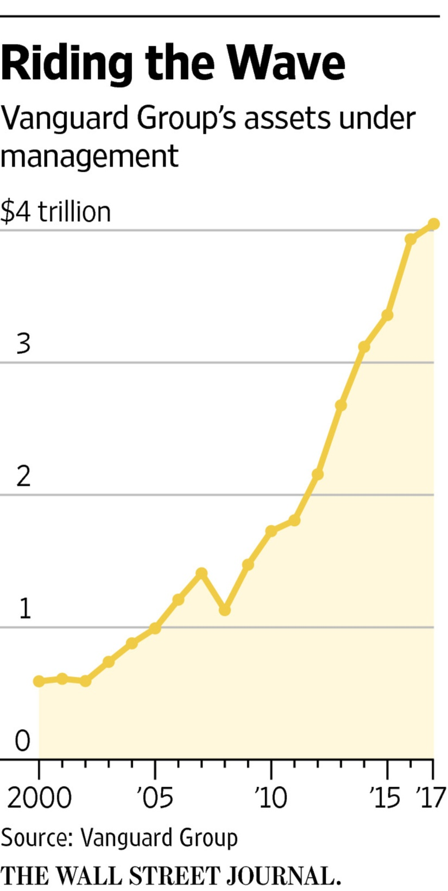
Vanguard’s AuM
Vanguard, which started the first index mutual fund for individual investors 40 years ago, is No. 2 in the asset-management world behind New York-based BlackRock Inc., another money-management giant benefiting from shifting investor tastes.
BlackRock topped $5 trillion in assets late last year for the first time. It has a larger international business than Vanguard.
Source: WSJ 10 Feb 17 “Vanguard Reaches $4Trillion for First Time”
Notes:
Source: WSJ 10 Feb 17 “Vanguard Reaches $4Trillion for the First Time” https://www.wsj.com/articles/vanguardreaches-4-trillion-for-first-time-1486745349

Slide 254
Five principal benefits of collective investment
Liquidity intermediation: investors can quickly convert investments into cash while still allowing the fund to invest for the long term.
Denomination intermediation: investors can participate in equity and debt offerings that, individually, require more capital than they possess.
Diversification: investors immediately realize the benefits of diversification even for small investments.
Cost advantages: the mutual fund can negotiate lower transaction fees than would be available to the individual investor.
Managerial expertise: many investors prefer to rely on professional money managers to select their investments.
Source: Mishkin/Eakins

Slide 255
Disadvantages of Collective Investments
Costs Despite Negative Returns: Fees and expenses are due regardless of how the fund performs.
Lack of Control: Investors typically cannot ascertain the exact make-up of a fund's portfolio at any given time, nor can they directly influence which securities the fund manager buys and sells or the timing of those trades.
Price Uncertainty: Unlike common stocks, the price at which you purchase or redeem shares in a mutual fund will typically depend on the fund's NAV, which the fund might not calculate until many hours after you've placed your order. In general, mutual funds must calculate their NAV at least once every business day, typically after the major U.S. exchanges close.
Source: SEC
Notes:
Costs Despite Negative Returns - Investors must pay sales charges, annual fees, and other expenses (which we'll discuss below) regardless of how the fund performs. And, depending on the timing of their investment, investors may also have to pay taxes on any capital gains distribution they receive - even if the fund went on to perform poorly after they bought shares.
Lack of Control - Investors typically cannot ascertain the exact make-up of a fund's portfolio at any given time, nor can they directly influence which securities the fund manager buys and sells or the timing of those trades.
Price Uncertainty - With an individual stock, you can obtain real-time (or close to real-time) pricing information with relative ease by checking financial websites or by calling your broker. You can also monitor how a stock's price changes from hour to hour - or even second to second. By contrast, with a mutual fund, the price at which you purchase or redeem shares will typically depend on the fund's NAV, which the fund might not calculate until many hours after you've placed your order. In general, mutual funds must calculate their NAV at least once every business day, typically after the major U.S. exchanges close.

Slide 256
Investment Companies Channel Investment to securities markets % of total market securities held by investment companies, year-end 2015–2018
Source: Investment Company Factbook 2019

Slide 257
Summary
Pros and cons of collective investment

Slide 258
Test Your Understanding
Investors in mutual funds benefit most from denomination intermediation when they seek to invest in
Small Stocks
Bonds
One of the disadvantages of investing through mutual funds is
No control over investments
Costs irrespective of performance
Dependence on other investors behavior
All of the above
None of the aboe

Slide 259
Distinguishing Features of Mutual Funds
Investors purchase mutual fund shares from the fund itself (or through a broker for the fund) instead of from other investors on a secondary market, such as the New York Stock Exchange or Nasdaq Stock Market
The price = the fund's per share net asset value (NAV) plus any shareholder fees that the fund imposes at the time of purchase (such as sales loads)
Mutual fund shares are "redeemable," meaning investors can sell their shares back to the fund (or to a broker acting for the fund)
Mutual funds generally create and sell new shares to accommodate new investors. In other words, they sell their shares on a continuous basis, although some funds stop selling when, for example, they become too large
The investment portfolios of mutual funds typically are managed by separate entities known as "investment advisers" that are registered with the SEC
Source: SEC

Slide 260
Mutual Fund Structure
Closed-End Fund: a fixed number of nonredeemable shares are sold through an initial offering and are then traded in the OTC market. Price for the shares is determined by supply and demand forces.
Open-End Fund: investors may buy or redeem shares at any point, where the price is determined by the net asset value of the fund.
Source: Mishkin/Eakins

Slide 261
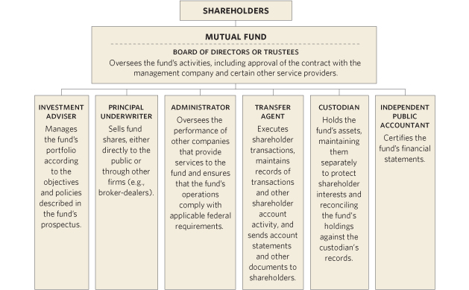
The Organizational Structure of a Mutual Fund
Source: ICI
Notes:
Source: http://www.icifactbook.org/fb_appa.html#organization
The shareholders, or owners, of the mutual fund are the investors.
The board of directors oversees the fund’s activities, hires the investment advisor, an underwriter, etc., to manage the day to day operations of the fund.
In theory, the board can fire the fund manager and hire anyone they choose.
For instance, the board for the Fidelity Magellan Fund can fire Fidelity. Of course, if the board hires a non-Fidelity management team, the fund will probably lose its name, and its reputation along with it
The Organization of a Mutual Fund
Individuals and institutions invest in a mutual fund by purchasing shares issued by the fund. It is through these sales of shares that a mutual fund raises the cash used to invest in its portfolio of stocks, bonds, and other investments. Each investor owns a pro rata share of the fund’s investments and shares in the returns from the fund’s portfolio while benefiting from professional investment management, diversification, and liquidity. Mutual funds may offer other benefits and services, such as asset allocation programs or check-writing privileges on money market fund accounts.
A mutual fund is organized under state law either as a corporation or a business trust (sometimes called a “statutory trust”). Mutual funds have officers and directors or trustees. In this way, mutual funds are like any other type of operating company, such as Exxon or Google. Unlike other companies, however, a mutual fund is typically externally managed; it is not an operating company and it has no employees in the traditional sense. Instead, a fund relies upon third parties or service providers that are either affiliated organizations or independent contractors to invest fund assets and carry out other business activities. The diagram below shows the primary types of service providers usually relied upon by a fund.
Although it typically has no employees, a fund is required by law to have its own written compliance program, overseen by an individual designated as a chief compliance officer. This compliance program establishes detailed procedures and internal controls designed to ensure compliance with all relevant laws and regulations.
How a Fund Is Created
Setting up a mutual fund is a complicated process performed by the fund’s sponsor, typically the fund’s investment adviser, administrator, or principal underwriter (also known as its distributor).
The fund sponsor has a variety of responsibilities. For example, it must assemble the group of third parties needed to launch the fund, including the persons or entities charged with managing and operating the fund. The sponsor provides officers and affiliated directors to oversee the fund, and recruits unaffiliated persons to serve as independent directors.
Some of the major steps in the process of starting a mutual fund include organizing the fund under state law as either a business trust or corporation, registering the fund with the SEC as an investment company pursuant to the Investment Company Act of 1940, and registering the fund shares for sale to the public pursuant to the Securities Act of 1933. Unless otherwise exempt from doing so, the fund must also make filings and pay fees to each state (except Florida) in which the fund’s shares will be offered to the public. The Investment Company Act also requires that each new fund have at least $100,000 of seed capital before distributing its shares to the public; this capital is usually contributed by the adviser or other sponsor in the form of an initial investment.

Slide 262
Unit Trusts vs. Mutual Funds
 | Unit Trusts | Mutual Funds
Form of establishment | Trust | Limited liability company
Beneficiary | Unit holder | Shareholder
Governing law | Trust law | Company law
Legal document in which the rules are laid down | Trust deed | Company’s articles/bye laws & custodian agreements
Who protects investor interests | Trustee | Custodian (but according to the custodian agreement and articles/bye laws)
Who owns or holds the fund assets | Trustee holds the assets for the benefit of the investors | The mutual fund company owns the assets and investors are shareholders of the company
Who is liable | Trustee | The company has limited liability; directors can be liable
Source: http://www.hkifa.org.hk/eng/download/about_publications/E_FundInv.pdf
Notes:
The key difference between unit trusts and mutual funds lie in the legal structure. Both are the same from an investment perspective, and in HK both are SFC regulated.

Slide 263
Types of Mutual Funds
Mutual Funds
Short Term
Taxable MMMF
Tax-Exempt MMMF
Medium/Long Term
Bond Funds
Equity Funds
Index Funds
Hybrid Funds
Specialised funds
Notes:
Short Term
Money market funds
Medium & Long Term
Stock (Equity) funds
Bond funds
Warrants & derivatives funds
Hybrid funds (Asset Allocation Funds)

Slide 264
In the US, Equity Mutual Funds Held More Than Half of Mutual Fund and ETFs Total Net Assets Percentage of total net assets, year-end 2019
Source: Investment Company Factbook 2020
Notes:
Source: IC Fact Book 2020 https://www.ici.org/pdf/2020_factbook.pdf

Slide 265
Money Market Mutual Funds
Money market funds are a type of mutual fund registered under the Investment Company Act of 1940 and regulated under rule 2a-7 of the Act.
Money market funds pay dividends that reflect prevailing short-term interest rates, are redeemable on demand, and, unlike other investment companies, seek to maintain a stable NAV, typically $1.00. This combination of principal stability, liquidity and payment of short-term yields has made money market funds popular cash management vehicles for both retail and institutional investors.
There are many kinds of money market funds, including ones that invest primarily in government securities, tax-exempt municipal securities, or corporate debt securities.
Money market funds that primarily invest in corporate debt securities are referred to as prime funds.
Source: ICI
Notes:
Source: http://www.ici.org/faqs/faqs_money_funds
Money market funds have relatively low risks, compared to other mutual funds (and most other investments). By law, they can invest in only certain high-quality, short-term investments issued by the U.S. government, U.S. corporations, and state and local governments. Money market funds try to keep their net asset value (NAV) — which represents the value of one share in a fund — at a stable $1.00 per share. But the NAV may fall below $1.00 if the fund's investments perform poorly. Investor losses have been rare, but they are possible.
Money market funds pay dividends that generally reflect short-term interest rates, and historically the returns for money market funds have been lower than for either bond or stock funds. That's why "inflation risk" — the risk that inflation will outpace and erode investment returns over time — can be a potential concern for investors in money market funds.

Slide 266
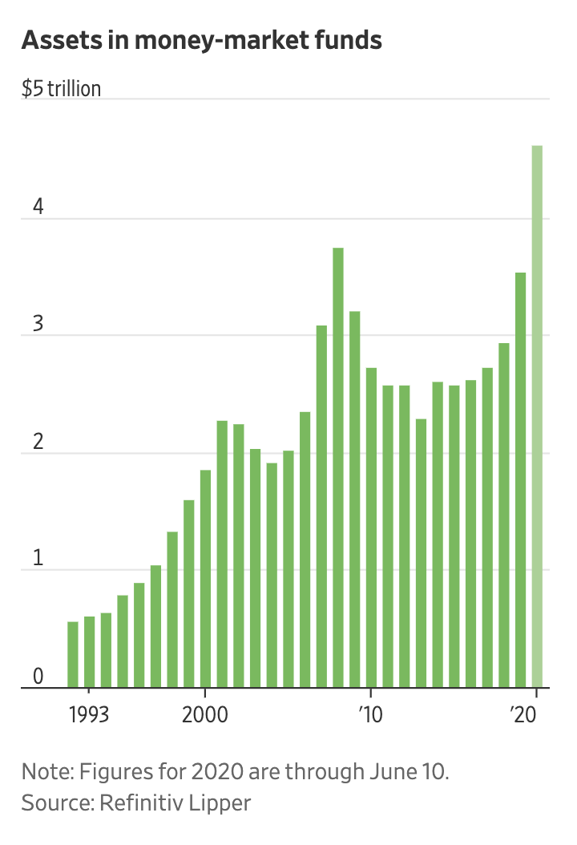
Assets in MMF
Assets in MM funds recently swelled to about $4.6 trillion, the highest level on record, according to data from Refinitiv Lipper going back to 1992.
Assets in money-market funds have grown by about $1 trillion this year, pushing assets in these funds above the prior high of roughly $3.8 trillion reached during the last financial crisis.
Notes:
Source: Aug 20 https://ritholtz.com/wp-content/uploads/2020/06/cashpile.png and WSJ https://www.wsj.com/articles/investors-are-sitting-on-the-biggest-pile-of-cash-ever-11592299801
Like many other investors, Mr. Cunnison has been struggling to reconcile the divergences between the deteriorating economy and the improving stock market.
“It does justify some higher level of caution and resilience in portfolios than you otherwise would have,” Mr. Cunnison said. “We’re still comfortable with a slightly higher level of cash.”
Jeremy Grantham of GMO LLC, who earned acclaim with his calls ahead of Wall Street busts in 2000 and 2008, wrote in a quarterly letter that stock-market valuations are among the highest they have been historically, while the U.S. economy is about as abysmal as it has been.
“Everyone can see and feel that this is different and can sense the bizarre nature of the market response: we are in the top 10% of historical price earnings ratio for the S&P on prior earnings and simultaneously are in the worst 10% of economic situations,” Mr. Grantham wrote in his letter to investors.

Slide 267
MMF vs. MMDA
A money market fund is a type of mutual fund. It is not guaranteed or FDIC insured. When you buy shares in a money market fund, you should receive a prospectus.
A money market deposit account is a bank deposit. It is guaranteed and FDIC insured. When you deposit money in a money market deposit account, you should receive a Truth in Savings form.
Notes:
Are “enhanced cash management” products the same as money market funds?
Source: http://www.ici.org/faqs/faqs_money_funds
No. An enhanced cash fund generally refers to a fund that is typically not registered with the SEC and that seeks yields slightly higher than those of money market funds by investing in a wider array of securities that tend to have longer maturities and lower credit quality. In seeking those yields, however, enhanced cash funds are not subject to and therefore need not abide by the SEC rule restrictions imposed on money market funds governing the credit quality, liquidity, diversification, and maturity of investments. Enhanced cash funds target a $1.00 NAV, but have much greater potential exposure to fluctuations in their portfolio valuations. Enhanced cash funds are privately offered to institutions, wealthy clients, and certain types of trusts. They may also be referred to as "money market plus funds," "money market-like funds," "enhanced yield funds," or "3(c)(7) funds" (after the legal exception from regulation under the Investment Company Act of 1940, upon which they rely).

Slide 268
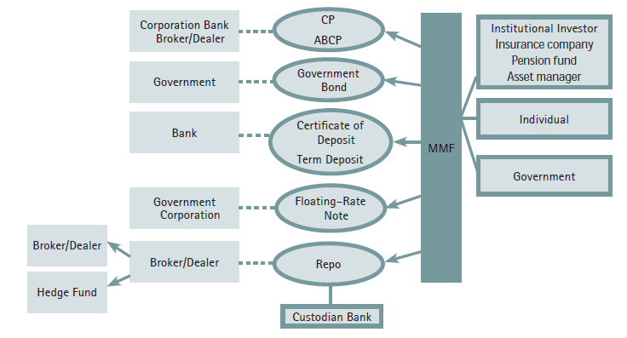
The Basic Functioning of a MMF in the United States
Source: IIF report on Shadow Banking
Notes:
Source: IIF report on Shadow Banking http://www.iif.com/regulatory/

Slide 269
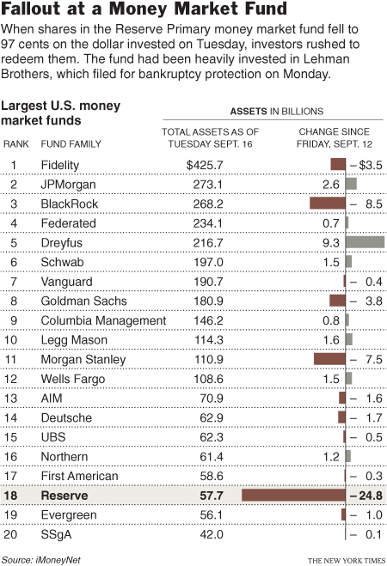
Breaking the buck – what is safe?
“It used to be O.K. to have money in a CD, but now you have to worry, ‘Is my bank going to go under?’ ” he added. “You used to be able to buy a guaranteed annuity from an insurance company, but now you have to worry, ‘Is my insurance company going to go under?’ Or, you can have auction-rate preferred securities, but now there is no market.”
Source: New York Times 17 September 2008: “Money Market Funds Enter a World of Risk “
Notes:
Source: http://www.nytimes.com/2008/09/18/business/yourmoney/18money.html?_r=1&em&oref=slogin
Money Market Funds Enter a World of Risk
Source: http://www.ici.org/faqs/faqs_money_funds
What does it mean when I hear that a money market fund “broke the dollar” (or “broke the buck”)?
If an adverse event—such as the downgrade or default of a portfolio security or a sudden sharp increase in short-term interest rates—pushes the market value of a fund's portfolio below $0.9950 per share and the fund's board decides to discontinue the use of the amortized cost method of valuation, the fund is said to "break the dollar," or "break the buck." When a fund breaks the dollar, shares are redeemed and investors are repaid at the fund's NAV, calculated on the day investors place their redemption order.
This has happened twice since the inception of money market funds. In 1994, a small institutional money fund broke the dollar; investors ultimately received 96 percent of their principal. On September 16, 2008, a money market fund announced that its NAV that day was 97 cents, due to a sharp write-down in some securities the fund held. That fund would later be liquidated. In September 2009, the SEC and the fund’s independent trustees estimated that investors would recover approximately 99 percent of their principal, or 99 cents per share.
What happens to investors when a money market fund closes and liquidates?
If a fund has broken the dollar, or is at imminent risk of breaking the dollar, it may close to new investors, suspend redemptions, and distribute its assets to investors, in accordance with a plan of liquidation. A fund might do this to provide equitable treatment to all investors in the face of significant redemption pressure that might lead to a forced sale of the fund’s assets.

Slide 270
MMF Regulations - 2010
Money market funds are strictly regulated by the SEC, both as mutual funds generally and pursuant to Rule 2a-7 under the Investment Company Act of 1940.
Rule 2a-7 includes several conditions that limit risk in a money market fund’s portfolio by governing the credit quality, liquidity, diversification, and maturity of money market fund investments.
The Securities and Exchange Commission (SEC) in January 2010 approved amendments to Rule 2a-7 under the Investment Company Act of 1940. The amendments tighten fund liquidity requirements, impose stricter quality requirements, address reliance on rating agencies, impose stricter maturity limits, require enhanced disclosure of portfolio holdings and address issues that arise when a money market fund experiences market challenges.
Funds that meet Rule 2a-7's risk-limiting provisions are allowed to value their securities at amortized cost, rather than at market value. This allows the fund to value its shares at a fixed price (usually $1.00) under a wide range of market conditions.
Source: ICI
Notes:
Source: https://www.ici.org/mmfs/current/16_mmf_reg_summ
Money market funds are strictly regulated by the SEC, both as mutual funds generally and pursuant to Rule 2a-7 under the Investment Company Act of 1940. Rule 2a-7 includes several conditions intended to help a fund stabilize its share price at $1.00. These conditions limit risk in a money market fund’s portfolio by governing the credit quality, liquidity, diversification, and maturity of money market fund investments.
Money market funds are required to regularly calculate their portfolios’ per-share value at market prices, also known as their “shadow price.” While money market funds have routinely calculated shadow prices for decades, and disclosed them semi-annually, the SEC’s 2010 amendments to Rule 2a-7 now require funds to disclose these shadow prices on a monthly basis (with a 60-day lag) to four decimal places (e.g., $1.0005 or $0.9995). For more information, please see ICI's Frequently Asked Questions About Pricing of U.S. Money Market Funds.
The Securities and Exchange Commission (SEC) in January 2010 approved amendments to Rule 2a-7 under the Investment Company Act of 1940, the rule that governs the operations of money market funds. 1 The amendments tighten fund liquidity requirements, impose stricter quality requirements, address reliance on rating agencies, impose stricter maturity limits, require enhanced disclosure of portfolio holdings and address issues that arise when a money market fund experiences market challenges. The amendments are designed to make money market funds more resilient to certain short-term market risks, and to provide greater protections for investors in a money market fund that is unable to maintain a stable net asset value (NAV) per share.
In January 2010, the SEC approved amendments to Rule 2a-7 that would strengthen money market funds by:
tightening standards for credit quality of fund assets;
shortening portfolio maturities;
enhancing disclosure;
requiring funds to meet explicit standards for holding liquid assets; and
requiring stress testing and “know your customer” procedures to help funds to be prepared for redemption pressure in a market crisis.
The new rules also permit a money market fund that has broken the dollar, or that is at imminent risk of breaking the dollar, to suspend redemptions and liquidate to ensure that all investors—regardless of who is first through the door—are treated fairly.

Slide 271
Regulation of MMMF
Credit Quality: At least 97 % of a money market fund’s assets must be invested in securities that receive the highest short-term rating or securities of comparable quality (known as “First Tier Securities”).
Liquidity: all taxable funds must maintain 10 % of assets in “daily liquid assets,” which means cash, U.S. Treasuries, or securities that mature or are subject to a demand feature within one business day. All funds also must have 30 % of assets in “weekly liquid assets,” which means cash, U.S. Treasuries, other government securities with remaining maturities of 60 days or less, or securities that mature or are subject to a demand feature within five business days.
Diversification: money market funds may not invest more than 5 % of assets in the securities of any single issuer. The limit is set at 0.5 % if the issuer has received ratings in the second highest short-term rating category .
Maturity: Money market funds cannot acquire a portfolio security with a remaining maturity of greater than 397 days . Money market funds are required to maintain a dollar-weighted average maturity of 60 days or less and a weighted average life maturity of 120 days or less without consideration of interest rate reset dates on variable-or floating-rate securities.
Source: ICI
Notes:
Credit Quality: Money market funds are required to hold high-quality securities that pose minimal credit risks and have received ratings in the top two categories from two nationally-recognized statistical rating organizations (NRSROs) (unless only one NRSRO rates the security or issuer of debt), or are securities of comparable quality. At least 97 percent of a money market fund’s assets must be invested in securities that receive the highest short-term rating or securities of comparable quality (known as “First Tier Securities”).
Liquidity: Money market funds must maintain sufficient portfolio liquidity to meet reasonably foreseeable redemption requests. The rule also includes a requirement that all taxable funds maintain 10 percent of assets in “daily liquid assets,” which means cash, U.S. Treasuries, or securities that mature or are subject to a demand feature within one business day. All funds also must have 30 percent of assets in “weekly liquid assets,” which means cash, U.S. Treasuries, other government securities with remaining maturities of 60 days or less, or securities that mature or are subject to a demand feature within five business days.
Diversification: Money market funds must maintain a diversified portfolio. This requirement limits a fund’s economic exposure to any single issuer. In general, money market funds may not invest more than 5 percent of assets in the securities of any single issuer. Rule 2a-7 makes exceptions to the 5 percent limit for certain securities, including those issued by the federal government or its agencies. The limit is set at 0.5 percent if the issuer has received ratings in the second highest short-term rating category (known as “Second Tier Securities”).
Maturity: Money market funds must invest in securities that are considered “short-term.” Money market funds cannot acquire a portfolio security with a remaining maturity of greater than 397 days (though exceptions are made for certain types of securities—including variable and floating rate securities—that have an interest rate reset of no more than 397 days or a demand feature). In addition, a money market fund’s weighted average maturity (WAM)—an average of the maturities of all securities held in the portfolio, weighted by each security’s percentage of net assets—must not exceed 60 days and 120 days, determined without reference to exceptions for interest rate readjustments.
Funds that meet Rule 2a-7's risk-limiting provisions are allowed to value their securities at amortized cost, rather than at market value. This allows the fund to value its shares at a fixed price (usually $1.00) under a wide range of market conditions.

Slide 272
2014 amendments (effective 2016)
The new rules :
require a floating net asset value (NAV) for institutional prime money market funds, which allows the daily share prices of these funds to fluctuate along with changes in the market-based value of fund assets These funds no longer will be allowed to use the special pricing and valuation conventions that used to permit them to maintain a constant share price of $1.00.
provide non-government money market fund boards new tools – liquidity fees and redemption gates – to address runs.
Notes:
Source: SEC http://www.sec.gov/News/PressRelease/Detail/PressRelease/1370542347679

Slide 273
Current issues about money market funds
Regulators worry about the impact of MMF in the financial system particularly whether the funds present systemic risk
The European crisis has caused many funds to pull out of the European market, severely impacting Eurozone banks funding capacity
Funds have suffered from low interest rate environment with investors pulling money out of the funds;
NIRP is affecting the business model

Slide 274
Summary
Mutual Funds
Features
Structure
Organisation
Money Market Funds
Definitions
Regulations
Understanding the Reserve Fund crisis and consequences

Slide 275
Index Funds and the shift to passive investing
Index Funds
Seek to replicate the performance of a given benchmark (index). For example, an S&P 500 index fund would hold the equities comprising the S&P 500.
Offers benefits of traditional mutual funds without the fees of the professional money manager.

Slide 276
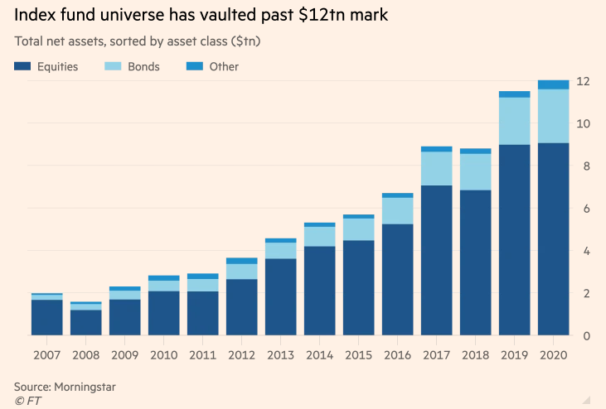
Index Funds
Source: FT 28 Dec 2020
Notes:
Source: FT 28 Dec 2020 https://www.ft.com/content/bd8ce72b-6104-4d1c-a4a9-78cd815c68b1?segmentId=114a04fe-353d-37db-f705-204c9a0a157b

Slide 277
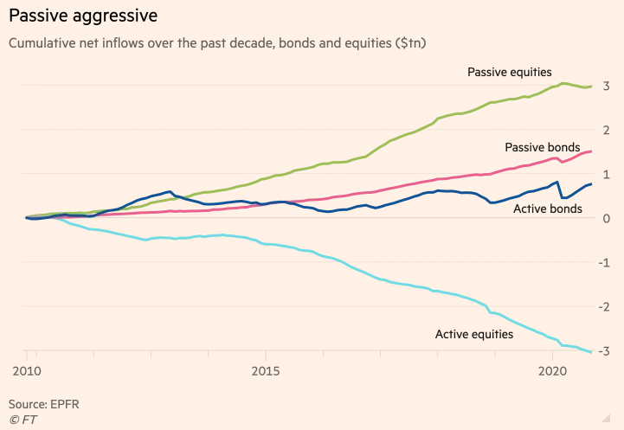
Passive v. Active
Source: FT 28 Dec 2020
Notes:
Source: FT 28 Dec 2020 https://www.ft.com/content/bd8ce72b-6104-4d1c-a4a9-78cd815c68b1?segmentId=114a04fe-353d-37db-f705-204c9a0a157b
Source: FT 28 Dec 2020 https://www.ft.com/content/bd8ce72b-6104-4d1c-a4a9-78cd815c68b1?segmentId=114a04fe-353d-37db-f705-204c9a0a157b

Slide 278
Index Funds Have Grown as a Share of the Fund Market Percent, year-end 2009 and 2019
Source: Investment Company Factbook 2020
Notes:
Source: IC Fact Book 2020 https://www.ici.org/pdf/2020_factbook.pdf

Slide 279
Total Net Assets and Number of Index Mutual Funds Have Increased in Recent Years Billions of dollars; year-end, 2009–2019
Source: Investment Company Factbook 2020

Slide 280
Exchange Traded Funds (ETFs)
ETFs are investment funds generally designed to track a particular index (generally stock index e.g. Footsie)
Investors buy shares in the ETF
Open-ended → fund grows and shrinks with purchase/sale
ETF shares are traded on the stock exchange
shares bought/sold through brokers – investors pay commissions on the trades
No premium/discount
shares reflect the value of the investment in the fund
there is a small spread (bid/offer prices)
an annual management charge is deducted from the fund
No stamp duty on purchases (unlike other shares)
ETFs in the US: "Exchange-traded funds" (ETFs) are a type of investment company that aims to achieve the same return as a particular market index. They can be either open-end companies or UITs. But ETFs are not considered to be, and are not permitted to call themselves, mutual funds.
Source: SIIUK
Notes:
Exchange-Traded Funds — a type of an investment company (either an open-end company or UIT) whose objective is to achieve the same return as a particular market index. ETFs differ from traditional open-end companies and UITs, because, pursuant to SEC exemptive orders, shares issued by ETFs trade on a secondary market and are only redeemable from the fund itself in very large blocks (blocks of 50,000 shares for example).
Tracking error is the difference between the ETF’s return and that of the index it’s supposed to duplicate. Funds that track the big indices rarely go far astray; the misfires happen when ETFs try to match more esoteric indices. Foreign ETFs in particular often veer off the track, because the fund can’t buy all the locally listed shares it needs. Sometimes regulatory barriers affect a fund’s performance: for example, securities regulations bar a fund from having more than ¼ of its assets in a single company’s stock, which is a problem when the index the fund tries to replicate has high concentration of one stock.
The job of an ETF manager is to manage vs. the index. The only source of errors should be fees.
What Is an ETF?
(Source: http://www.icifactbook.org/fb_ch3.html)
An ETF is an investment company, typically a mutual fund or unit investment trust, whose shares are traded intraday on stock exchanges at market-determined prices. Investors may buy or sell ETF shares through a broker just as they would the shares of any publicly traded company.
ETFs are a relatively recent innovation to the investment company concept. The first ETF—a broad-based domestic equity fund tracking the S&P 500 index—was introduced in 1993 after a fund sponsor received U.S. Securities and Exchange Commission (SEC) exemptive relief from various provisions of the Investment Company Act of 1940 that would not otherwise allow the ETF structure. Until 2008, SEC exemptive relief was granted only to ETFs that tracked designated indexes. These ETFs, commonly referred to as index-based ETFs, are designed to track the performance of their specified indexes or, in some cases, a multiple of or an inverse (or multiple inverse) of their indexes.
In early 2008, the SEC first granted exemptive relief to several fund sponsors to offer fully transparent actively managed ETFs that meet certain requirements. These actively managed ETFs must disclose each business day on their publicly available websites the identities and weightings of the component securities and other assets held by the ETF. Actively managed ETFs do not seek to track the return of a particular index. Instead, an actively managed ETF’s investment adviser, like that of an actively managed mutual fund, creates a unique mix of investments to meet a particular investment objective and policy.
By the end of 2009, the total number of index-based and actively managed ETFs had grown to 797, and total net assets were $777 billion. Of these, 22 were actively managed ETFs with about $1.0 billion in total net assets.
ETFs and Mutual Funds
A registered ETF is similar to a mutual fund in that it offers investors a proportionate share in a pool of stocks, bonds, and other assets. It is most commonly structured as an open-end investment company and is governed by the Investment Company Act of 1940 like other mutual funds. For example, like a mutual fund, an ETF is required to post the mark-to-market net asset value (NAV) of its portfolio at the end of each trading day. Despite these similarities, key features differentiate ETFs from mutual funds.
Key Differences
One major difference is that retail investors buy and sell ETF shares on a stock exchange through a broker-dealer, much like they would any other type of stock. In contrast, mutual fund shares are not listed on stock exchanges. Rather, retail investors buy and sell mutual fund shares through a variety of distribution channels, including through a financial adviser, broker-dealer, or directly from a fund company.
Pricing also differs between mutual funds and ETFs. Mutual funds are “forward priced,” which means that although investors can place orders to buy or sell shares throughout the day, all orders placed during the day will receive the same price—the NAV—the next time it is computed. Most mutual funds calculate their NAV as of 4:00 p.m. eastern time because that is the time U.S. stock exchanges typically close. In contrast, the price of an ETF share is continuously determined on a stock exchange. Consequently, the price at which investors buy and sell ETF shares may not necessarily equal the NAV of the portfolio of securities in the ETF. In addition, two investors selling the same ETF shares at different times on the same day may receive different prices for their shares, both of which may differ from the ETF’s NAV.
ETFS FAQS : https://www.ici.org/pubs/faqs/faqs_etfs
What is an ETF?
An exchange-traded fund (ETF) is a pooled investment vehicle with shares that trade intraday on stock exchanges at a market-determined price. Investors may buy or sell ETF shares through a broker or in a brokerage account, just as they would the shares of any publicly traded company.
Unlike traditional mutual fund shares, ETF shares are created by “authorized participants” or APs—typically, large financial institutions—providing a specified basket of securities, cash, or both—often called a “creation basket”—to the ETF. In return, the AP receives a fixed amount of ETF shares, called a “creation unit.” Some or all of these shares may then be sold on a stock exchange. An AP may redeem ETF shares in creation unit increments in exchange for a “redemption basket” of securities, cash, or both.
Retail investors can only buy and sell the ETF shares on an exchange, much as they can buy or sell any listed equity security. Unlike an AP, a retail investor cannot purchase or redeem shares directly from the ETF, as with a traditional mutual fund.
How are ETFs regulated?
The vast majority of exchange-traded funds are registered with the SEC and, like mutual funds, must comply with the applicable provisions of the Investment Company Act of 1940 and exemptive orders issued under that Act. Different regulations apply to commodity-based ETFs, which hold about 3 percent of ETF assets. Those commodity-based ETFs that invest in commodity futures are regulated by the Commodity Futures Trading Commission (CFTC), while those that invest solely in physical commodities are regulated by the SEC under the Securities Act of 1933.

Slide 281
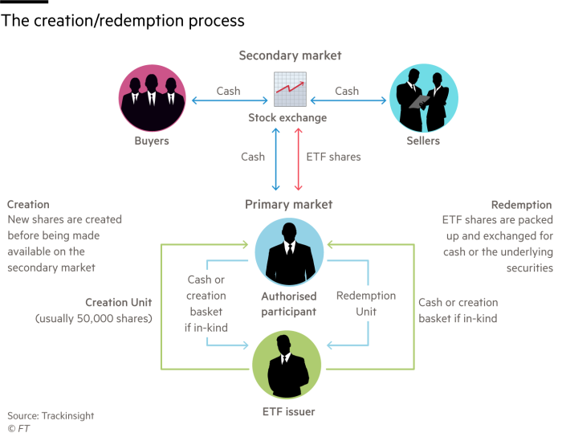
ETF
Notes:
Source: FT 8 October 2020 https://www.ft.com/content/f2685757-2639-424f-8f1e-0f4f981dadb9?segmentId=114a04fe-353d-37db-f705-204c9a0a157b

Slide 282
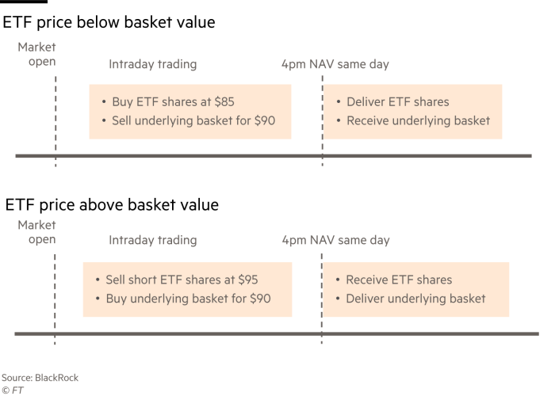
ETF – creation-redemption process
Notes:
Source: FT 8 October 2020 https://www.ft.com/content/f2685757-2639-424f-8f1e-0f4f981dadb9?segmentId=114a04fe-353d-37db-f705-204c9a0a157b

Slide 283
ETFs v. MFs 1996-2017
Source: SIFMA and ICI
Notes:
Source: SIFMA and ICI

Slide 284
The United States Has the Largest ETF Market Percentage of total net assets, year-end 2019
Source: Investment Company Factbook 2020
Notes:
Source: IC Fact Book 2020 https://www.ici.org/pdf/2020_factbook.pdf

Slide 285
Total Net Assets and Number of ETFs Billions of $, year end
Source: Investment Company Factbook 2020
Notes:
ICI Fact Book 2020

Slide 286
Top 10 ETF Managers

Slide 287
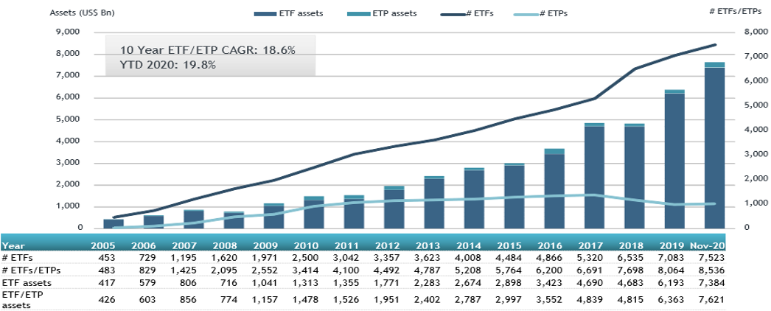
Growth of ETFs and ETPs
Source: ETFGI Dec 2020
Notes:
Source: ETFGI Dec 2020 https://etfgi.com/news/press-releases/2020/12/etfgi-reports-assets-invested-etfs-and-etps-listed-globally-reached-new
assets invested in ETFs and ETPs listed globally reached new records of US$7.62 trillion and net inflows reached a new record of US$670.57 billion at the end of November.
The Global ETF/ETP industry had 8,536 ETFs/ETPs, with 16,983 listings, assets of $7.62 Tn, from 501 providers listed on 74 exchanges in 60 countries at the end of November.

Slide 288
Key Issues with ETFs
Because shares in ETFs are traded like stocks, the prices reflect supply/demand not just the underlying value of the funds assets
Just like stocks, it is possible to buy options on ETFs or go short ETFs
As a result, in days of volatile trading, the share price of an ETF can diverge from the price of the assets it is tracking
ETF investors who sell in volatile markets may get significantly less than the assets are worth
Problems with synthetic ETFs where investors take risk on the ETF provider
Source: AWSJ, 19 March 2007 “Fast money folks embrace ETFs adding risk for smaller investors”

Slide 289
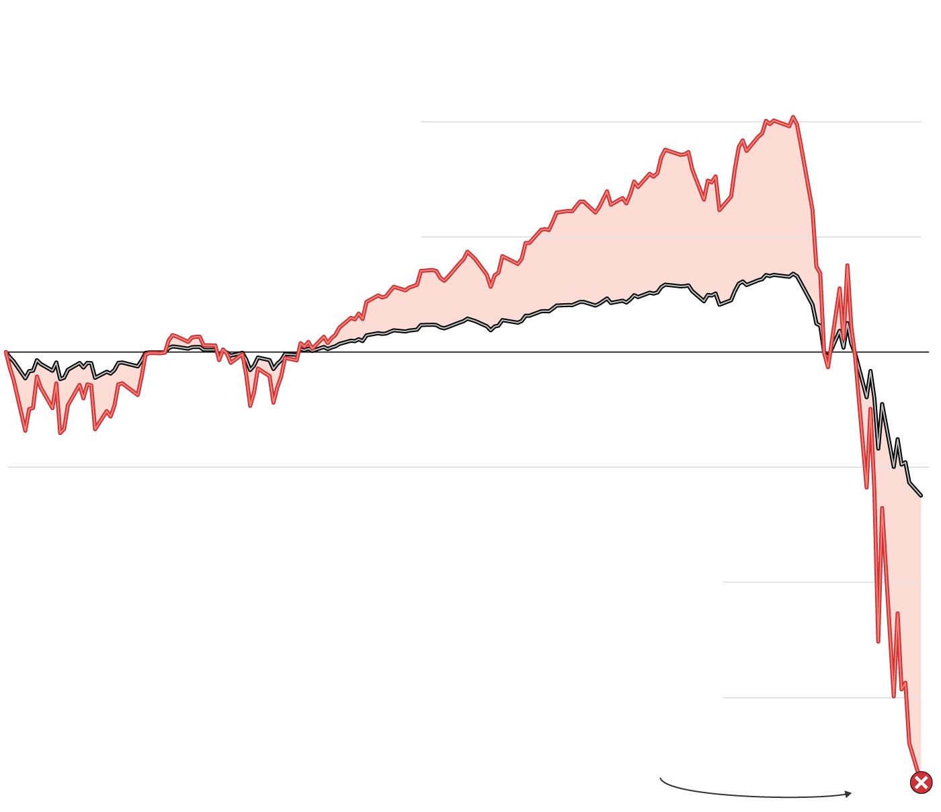
Leveraged ETNs
Investing on Steroids
Leveraged exchange-traded notes are complex financial instruments that use debt to amplify returns, which also increases risk.
When a bank issues a typical ETN, the security tracks the value of an underlying asset, such as crude oil or the S&P 500. As markets move, the value of the ETN changes in tandem.
3x leveraged ETN
Underlying asset
With a leveraged ETN,
the bank purchases
derivatives, often options,
with borrowed money to
increase the ETN’s
returns. An ETN with
three-times leverage
would triple any gains—
but also triple losses.
ETN holders can collect dividend payments if
the underlying assets increase in value, and they can buy or sell the notes on an exchange
If an ETN falls below a certain price, the bank has the option to redeem the note, often paying investors just a fraction of what they originally paid
Source: WSJ June 2020
Notes:
Source: WSJ https://www.wsj.com/articles/bankrupt-in-just-two-weeksindividual-investors-get-burned-by-collapse-of-complex-securities-11591020059?mod=trending_now_1

Slide 290
Summary
Index Funds
ETFs
Understanding key issues

Slide 291
Current issues: ETF (Exchange Traded Funds) development in HK - why so few? (Group 12)
Video ( 00:35-04:43)
https://www.etftv.net/hong-kong-stock-exchange-has-enhanced-market-making-in-etps-to-boost-liquidity/
Article
https://fundselectorasia.com/what-hong-kongs-etf-market-lacks/

Slide 292
Mutual Fund Prospectuses and Objectives
In the US, SEC regulations require mutual fund managers to specify the investment objectives of their funds in a prospectus
A mutual fund’s statutory prospectus describes the fund’s investment goals and objectives, fees and expenses, investment strategies and risks, and informs investors how to buy and sell shares.
mutual funds and ETFs may elect to provide investors with a short “summary prospectus” containing certain key information instead of the full statutory prospectus. If funds use a summary prospectus, the full statutory prospectus and additional information must be available on the Internet and in paper upon request.
As of 1998, SEC requires key sections of a fund prospectus to be written in ‘plain’ English
Notes:
Shareholders
Source: http://www.icifactbook.org/fb_appa.html#organization
Investors are given comprehensive information about the fund to help them make informed decisions.
A mutual fund’s statutory prospectus describes the fund’s investment goals and objectives, fees and expenses, investment strategies and risks, and informs investors how to buy and sell shares. The SEC requires a fund to provide a prospectus either before an investor makes his or her initial investment or together with the confirmation statement of an initial investment.
Beginning in 2009, mutual funds and ETFs may elect to provide investors with a short “summary prospectus” containing certain key information instead of the full statutory prospectus. If funds use a summary prospectus, the full statutory prospectus and additional information must be available on the Internet and in paper upon request.
In addition, periodic shareholder reports, which are provided to investors at least every six months, discuss the fund’s recent performance and include other important information, such as the fund’s financial statements. By examining these reports and other publicly available information, an investor can learn if a fund has been effective in meeting the goals and investment strategies described in the fund’s prospectus.
Like shareholders of other companies, mutual fund shareholders have specific voting rights. These include the right to elect directors at meetings called for that purpose (subject to a limited exception for filling vacancies). Shareholders must also approve material changes in the terms of a fund’s contract with its investment adviser, the entity that manages the fund’s assets. For example, a fund’s management fee cannot be increased unless a majority of shareholders vote to approve the increase. Furthermore, funds seeking to change investment objectives or fundamental policies must first obtain the approval of the holders of a majority of the fund’s outstanding voting securities

Slide 293
Performance of Mutual Funds
The definition of risk is different for a mutual fund manager than it is for investors
For a fund manager, risk is defined as deviation from the index
For an investor, risk is defined as losing money
Problem arises from diverging interests:
There is no incentive for a fund manager to deviate from the herd
Chances of winning vs. losing their job
Performance is measured against an index not in absolute returns
Notes:
Source: Irrational world of institutionalized money managers, Mark sellers, FT 24 Aug 07 http://www.ft.com/cms/s/2/b5dc62d4-524c-11dc-a7ab-0000779fd2ac.html
If you are a manager at one of the large mutual fund companies and deviate much from the index, it might be in the wrong direction. You might underperform your benchmark for a couple of years, or three, even if you are one of the best managers. And the fund marketing people will not allow that, assets will get pulled out or at least stop coming in, the Morningstar star rating goes down making it hard to advertise the fund and so it is risky for a mutual fund manager to try and outperform the market by deviating from the index.
The definition of risk is different for a mutual fund manager than it is for investors. For a manager, risk is defined as deviation from the index. for an investor, risk is defined as losing money. the root cause of the conflict is communication. The marketing people don’t tell investors that they have this conflict, and so investors naively assume their interests and those of the fund manager are aligned.

Slide 294
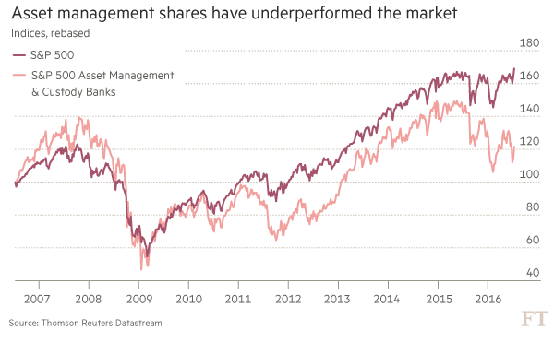
Active fails
Source: FT 17 July 2016 “Actively failing”
Notes:
Source: FT 17 July 2016 “Actively failing” https://next.ft.com/content/f50852ea-4812-11e6-8d68-72e9211e86ab?ftcamp=crm/email//nbe/Analysis/product

Slide 295
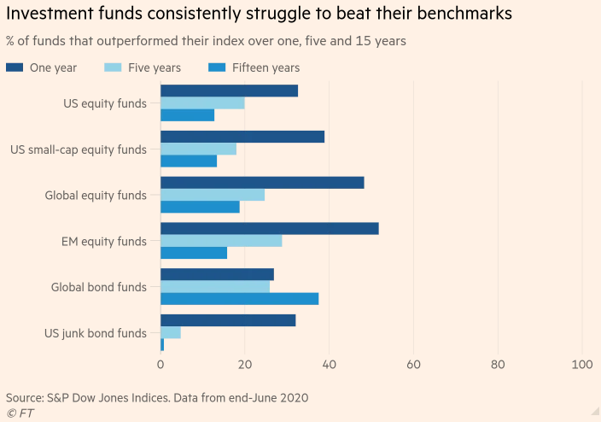
Index outperformance is hard to maintain
Source: FT 11 November 2020
Notes:
Source: FT 11 November 2020 “Active managers struggle to prove their worth” https://www.ft.com/content/621d51de-f732-48e3-b3e3-be83f42baec3?emailId=5fae92e9c672000004d2bbb9&segmentId=b24b7365-3058-3306-740e-9eeee4834a62

Slide 296
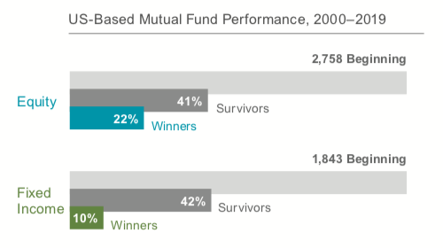
Performance of US stock mutual funds
Surprisingly, the vast majority of active managers did not even survive! They performed so poorly they went out of business or merged with other funds. Only 41% of stock mutual funds and 42% of bond mutual funds were still around after 20 years. Of the survivors, only 22% of stock funds and 10% of bond funds beat their index. The vast majority -- 78% and 90%, respectively, did worse
Notes:
Source: https://www.servowealth.com/blog/are-index-funds-the-best-way-to-invest
The chart below is from a study doneby Dimensional Fund Advisors. It looked at all US stock and bond mutual funds that were in business in 2000, then tracked their returns over the next two decades. Surprisingly, the vast majority of active managers did not even survive! They performed so poorly they went out of business or merged with other funds. Only 41% of stock mutual funds and 42% of bond mutual funds were still around after 20 years. Of the survivors, only 22% of stock funds and 10% of bond funds beat their index. The vast majority -- 78% and 90%, respectively, did worse.

Slide 297

Performance of US stock mutual funds
Only 21% and 29% of stock and bond funds who out-performed managed to stay on top during the following five years. You'd expect similar results if you picked funds out of a hat
Notes:
Source: https://www.servowealth.com/blog/are-index-funds-the-best-way-to-invest
But what about the winners? Some outperformed, why not just invest in those instead of settling for index returns? Because we know who the out-performers have been, but we don't know who they will be. The DFA study also looked at the top performing 25% of stock and bond funds over all five-year periods, and then followed their returns over the subsequent five-years. Guess what they found? Previous winners don't repeat by any more than we'd expect by chance. Only 21% and 29% of stock and bond funds who out-performed managed to stay on top during the following five years. You'd expect similar results if you picked funds out Performance of US stock mutual fundsof a hat

Slide 298
Mutual Fund Costs
When you buy shares, you pay the current NAV per share plus any fee the fund assesses at the time of purchase, such as a purchase sales load or other type of purchase fee
When you sell your shares, the fund will pay you the NAV minus any fee the fund assesses at the time of redemption, such as a deferred (or back-end) sales load or redemption fee
Investors incur fees and/or expenses
Upfront and back-end fees
Load funds (class A shares) charge an upfront fee for buying the shares
No-load funds do not charge this fee
Deferred load (class B shares) funds charge a fee when the shares are redeemed
If the particular fund charges no front or back end fees, it is referred to as class C shares
Fund Operating Expenses
Notes:
A fund's NAV goes up or down daily as its holdings change in value.
Shareholders Fees:
Sales Charge (Load) on Purchases — the amount you pay when you buy shares in a mutual fund. Also known as a "front-end load," this fee typically goes to the brokers that sell the fund's shares. Front-end loads reduce the amount of your investment. For example, let's say you have $1,000 and want to invest it in a mutual fund with a 5% front-end load. The $50 sales load you must pay comes off the top, and the remaining $950 will be invested in the fund. According to NASD rules, a front-end load cannot be higher than 8.5% of your investment.
Purchase Fee — another type of fee that some funds charge their shareholders when they buy shares. Unlike a front-end sales load, a purchase fee is paid to the fund (not to a broker) and is typically imposed to defray some of the fund's costs associated with the purchase.
Deferred Sales Charge (Load) — a fee you pay when you sell your shares. Also known as a "back-end load," this fee typically goes to the brokers that sell the fund's shares. The most common type of back-end sales load is the "contingent deferred sales load" (also known as a "CDSC" or "CDSL"). The amount of this type of load will depend on how long the investor holds his or her shares and typically decreases to zero if the investor holds his or her shares long enough.
Redemption Fee — another type of fee that some funds charge their shareholders when they sell or redeem shares. Unlike a deferred sales load, a redemption fee is paid to the fund (not to a broker) and is typically used to defray fund costs associated with a shareholder's redemption.
Exchange Fee — a fee that some funds impose on shareholders if they exchange (transfer) to another fund within the same fund group or "family of funds.“
Account fee — a fee that some funds separately impose on investors in connection with the maintenance of their accounts. For example, some funds impose an account maintenance fee on accounts whose value is less than a certain dollar amount.
Annual Fund Operating Expenses
Management Fees — fees that are paid out of fund assets to the fund's investment adviser for investment portfolio management, any other management fees payable to the fund's investment adviser or its affiliates, and administrative fees payable to the investment adviser that are not included in the "Other Expenses" category (discussed below).
Distribution [and/or Service] Fees ("12b-1" Fees) — fees paid by the fund out of fund assets to cover the costs of marketing and selling fund shares and sometimes to cover the costs of providing shareholder services. "Distribution fees" include fees to compensate brokers and others who sell fund shares and to pay for advertising, the printing and mailing of prospectuses to new investors, and the printing and mailing of sales literature. "Shareholder Service Fees" are fees paid to persons to respond to investor inquiries and provide investors with information about their investments.
Other Expenses — expenses not included under "Management Fees" or "Distribution or Service (12b-1) Fees," such as any shareholder service expenses that are not already included in the 12b-1 fees, custodial expenses, legal and accounting expenses, transfer agent expenses, and other administrative expenses.
Total Annual Fund Operating Expenses ("Expense Ratio") — the line of the fee table that represents the total of all of a fund's annual fund operating expenses, expressed as a percentage of the fund's average net assets. Looking at the expense ratio can help you make comparisons among funds.
A Word About "No-Load" Funds Some funds call themselves "no-load." As the name implies, this means that the fund does not charge any type of sales load. But, as discussed above, not every type of shareholder fee is a "sales load." A no-load fund may charge fees that are not sales loads, such as purchase fees, redemption fees, exchange fees, and account fees. No-load funds will also have operating expenses.
A Word About Breakpoints Some mutual funds that charge front-end sales loads will charge lower sales loads for larger investments. The investment levels required to obtain a reduced sales load are commonly referred to as "breakpoints.“ The SEC does not require a fund to offer breakpoints in the fund's sales load. But, if breakpoints exist, the fund must disclose them. In addition, a NASD member brokerage firm should not sell you shares of a fund in an amount that is "just below" the fund's sales load breakpoint simply to earn a higher commission.

Slide 299

Calculating a Mutual Fund’s Net Asset Value (NAV)
NAV is the current market value of all the fund’s assets, minus liabilities (e.g., fund expenses), divided by the total number of outstanding shares
Calculation of NAV on an Open-End Mutual Fund
$$NAV=\frac{Total market value of assets −liabilities}{Number of mutual fund shares outstanding}$$
Notes:
HK: NAV (Net asset value) is derived by subtracting the liabilities of a fund from its total assets, and then divided it by the number of shares outstanding. Valuation of a fund is usually calculated daily and the NAV will fluctuate in line with the securities that the fund holds.
At present, there are primarily two methods of quotation, namely by net asset value ("NAV") or by bid/offer. Under NAV, fund prices are shown net of the subscription charges. You would redeem at NAV, and if you subscribe for the fund, you have to add the subscription charge to the NAV. As for bid and offer, the spread between the bid and offer prices represents the subscription charges. You would buy at the offer price and sell at the bid price.
Example:
Assume that for a fund:
Net asset value of the fund: US$50 million
Outstanding number of units: 10 million
Net asset value per unit: US$5
Initial charge: 5%
Then:
Bid price is US$5
Offer price is US$5 x 1.05 = US$5.25
(Source: http://www.icifactbook.org/fb_appa.html#organization
Fund Pricing: Net Asset Value and the Pricing Process)
By law, investors are able to redeem mutual fund shares each business day. As a result, fund shares are very liquid investments. Most mutual funds continually offer new shares to investors. Many fund companies also allow shareholders to transfer money—or make “exchanges”—from one fund to another within the same fund family. Mutual funds process investors’ sales, redemptions, and exchanges as a normal part of daily business activity and must ensure that all transactions receive the appropriate price.
The price per share at which shares are redeemed is known as the net asset value (NAV). NAV is the current market value of all the fund’s assets, minus liabilities (e.g., fund expenses), divided by the total number of outstanding shares (see illustration below). This calculation ensures that the value of each share in the fund is identical. An investor may determine the value of his or her pro rata share of the mutual fund by multiplying the number of shares owned by the fund’s NAV.
Federal law requires that a fund’s NAV be calculated at least once each trading day.
The price at which a fund’s shares may be purchased is its NAV per share plus any applicable front-end sales charge (the offering price of a fund without a sales charge would be the same as its NAV per share).
The 1940 Act requires “forward pricing,” meaning that shareholders who purchase or redeem shares must receive the next computed share price (NAV) following the fund’s receipt of the transaction order. Under forward pricing, orders received prior to 4:00 p.m. receive the price determined that same day at 4:00 p.m.; orders received after 4:00 p.m. receive the price determined at 4:00 p.m. on the next business day.
The NAV must reflect the current value of the fund’s securities. The value of these securities is determined either by a market quotation for those securities in which a market quotation is readily available, or if a market quotation is not readily available, a fair value as determined in good faith.

Slide 300
Fee Structure of Investment Funds
Other fees charges by mutual funds include:
Contingent deferred sales charge: A back end fee that may disappear altogether after a specific period
Redemption fee: Another name for a back end load
Exchange fee: A fee (usually low) for transferring money between funds in the same family
Account maintenance fee: Charges if the account balance is too low.
12b-1 fee: Fee to pay marketing, advertising, and commissions
Source: Mishkin/Eakins
Notes:
Exchanging Shares
A "family of funds" is a group of mutual funds that share administrative and distribution systems. Each fund in a family may have different investment objectives and follow different strategies.
Some funds offer exchange privileges within a family of funds, allowing shareholders to transfer their holdings from one fund to another as their investment goals or tolerance for risk change. While some funds impose fees for exchanges, most funds typically do not. To learn more about a fund's exchange policies, call the fund's toll-free number, visit its website, or read the "shareholder information" section of the prospectus.
Bear in mind that exchanges have tax consequences. Even if the fund doesn't charge you for the transfer, you'll be liable for any capital gain on the sale of your old shares — or, depending on the circumstances, eligible to take a capital loss. We'll discuss taxes in further detail below.
12b-1 Fees — fees paid by the fund out of fund assets to cover the costs of marketing and selling fund shares and sometimes to cover the costs of providing shareholder services. "Distribution fees" include fees to compensate brokers and others who sell fund shares and to pay for advertising, the printing and mailing of prospectuses to new investors, and the printing and mailing of sales literature. "Shareholder Service Fees" are fees paid to persons to respond to investor inquiries and provide investors with information about their investments.

Slide 301

Funds Total Expense Ratio (TER)
“The established metric is the total expense ratio (TER), which includes charges such as the annual management fee, administration and legal fees and distribution fees. It does not include dealing costs, entry or exit fees (front-end and back-end loads) or performance fees.”
Source: “Call to reveal true fund costs to investors’”, FT 01.11.2009
Notes:
Source: Call to reveal true fund costs to investors
By Sophia Grene FT Published: November 1 2009 10:40 | Last updated: November 1 2009 10:40 http://www.ft.com/cms/s/0/ac01bb98-c585-11de-9b3b-00144feab49a,dwp_uuid=db00e994-f1d5-11dc-9b45-0000779fd2ac.html#
The established metric is the total expense ratio (TER), which includes charges such as the annual management fee, administration and legal fees and distribution fees. It does not include dealing costs, entry or exit fees (front-end and back-end loads) or performance fees.
Mr Miller proposes all funds should publish a table displaying the TER including dealing costs, front-end and back-end load, and any performance fee. It would not be sufficient to show these costs as percentages, so Mr Miller suggests a calculation of returns to the investors in a number of scenarios.
Ignoring the question of where one would draw the line in terms of scenarios – the impact of a 5 per cent front end load is different on an investment held for a year from one held for 10 years – this implies a very complicated set of information for investors to digest.
The UK does currently require funds to display a calculation called “reduction in yield” based on exactly the sort of scenario calculation Mr Miller likes, but without the inclusion of dealing costs.
Given that the Committee of European Securities Regulators (Cesr) has just decided that even the term TER is too difficult for investors to grasp and should be replaced by the phrase “ongoing management charges”, Mr Miller’s proposal loses some of its consumer-protection strength.
Simplicity is not the only reason to defend the TER, according to other industry commentators. A significant defence of the TER is that “of all data points in the fund industry, it has the most predictive power”, in the words of Russell Kinnel, director of mutual fund research at Morningstar.
This means the expense ratio achieved last year is likely to be repeated next year, with minor variations. Trading costs, on the other hand, are both less predictable and less easy to pin down.
In the US, the brokerage costs, which include just the commission paid for a transaction, not its market impact, are routinely disclosed.
Lipper Fitzrovia, which has been campaigning for the TER to be given greater prominence in Europe since 1993, uses this definition of portfolio turnover rate, but the current European Ucits regulations call for a different version.
However, perhaps because of this confusion in how to calculate it, the new key information document (Kid) for Ucits IV that will replace the simplified prospectus will no longer include portfolio turnover, again on the grounds that investors were not interested or did not understand the meaning of the figure.
Trading costs, however arrived at, are also going to be left out of the Kid, even though Cesr admits they have an impact on the investment performance of funds. This brings us back to another advantage of the TER – that it is robustly comparable across different asset classes and different jurisdictions. In Europe, where the authorities in Brussels are attempting to build a single market in financial services across 27 countries, this is a significant advantage.

Slide 302
Mutual Fund Expense Ratios Tend to Fall as Fund Assets Rise Share classes of actively managed domestic equity mutual funds continuously in existence since 2000
ICI Fact Book 2020

Slide 303
Expense Ratio of Actively Managed and Index Mutual Funds Have Fallen Percent, 2000-2019
ICI Fact Book 2020
Notes:
ICI Fact Book 2020

Slide 304

Fund fees in decline
Source: Bloomberg
Notes:
Source: Bloomberg https://www.bloomberg.com/news/articles/2020-12-08/money-managers-record-low-fees-are-about-to-sink-even-lower?cmpid=BBD120820_MKT&utm_medium=email&utm_source=newsletter&utm_term=201208&utm_campaign=markets&sref=INmNRPZ9

Slide 305
Returns from Mutual Funds
You can earn money from your investment in three ways:
Dividend Payments — A fund may earn income in the form of dividends and interest on the securities in its portfolio. The fund then pays its shareholders nearly all of the income (minus disclosed expenses) it has earned in the form of dividends.
Capital Gains Distributions — The price of the securities a fund owns may increase. When a fund sells a security that has increased in price, the fund has a capital gain. At the end of the year, most funds distribute these capital gains (minus any capital losses) to investors
Increased NAV — If the market value of a fund's portfolio increases after deduction of expenses and liabilities, then the value (NAV) of the fund and its shares increases. The higher NAV reflects the higher value of your investment.
With respect to dividend payments and capital gains distributions, funds usually will give you a choice: the fund can send you a check or other form of payment, or you can have your dividends or distributions reinvested in the fund to buy more shares (often without paying an additional sales load).
Source: SEC

Slide 306
Summary
Mutual Funds (ct’d):
Disclosure requirements
Performance (absolute v. relative returns)
Costs , expenses and TER
NAV
returns

Slide 307
Test Your Understanding
One key issue for investors in collective investment funds is the costs involved. One of the metrics used to compare funds is the TER (Total Expense Ratio). Which of the following costs is not included in the TER?
Annual management fee
Dealing costs
Administration and legal fees
Distribution fees
In the US “breaking the buck” refers to a situation where:
the Euro spot price (EUR/USD) falls below 1 USD
a Money Market Mutual Fund (MMMF)’s NAV (Net Asset Value) goes below $1
the NAV of a mutual fund exceeds $1 per share

Slide 308
Collective Investments Schemes in Hong Kong
Regulation: Protection of Investors Ordinance; Regulator: the SFC; SFC’s Code on Unit Trusts & Mutual Funds details the requirements applicable to such schemes in Hong Kong
Licensing and registration: only entities registered with the SFC can distribute mutual funds and unit trusts in HK ; licenses are required to distribute funds (registered dealer or advisor)
The SFC reviews and authorizes offering documents of retail investment products, pursuant to the SFO or the Companies Ordinance.
Information requirements include: prospectus, audited annual report, unaudited semi-annual report and other pertinent information; after investments, regular statements (monthly/quarterly) have to be provided to investors including valuation as well as number of units
Notes:
The most important piece of legislation in relation to the marketing of investment products is the Protection of Investors Ordinance. The Ordinance prescribes that unless authorized by the SFC, no advertisements can be issued in Hong Kong. Selling unauthorized funds to the general public will constitute an infringement of law which involves fines and/or imprisonment.
What role does SFC assume in the regulation of funds?
Investment products:
Approves fund managers, in connection with authorized funds
Authorizes funds
Licensing:
Licenses financial intermediaries (including fund managers) which carry on a business of dealing in or advising on securities in Hong Kong
Intermediaries supervision:
Inspects the activities of licensed financial intermediaries (including fund managers) in Hong Kong
To be "authorized", a fund must satisfy the following requirements:
Clear and full disclosure in English and Chinese:
Appropriate safeguards: The fund must appoint an independent and qualified trustee or custodian which holds the fund's assets in trust for investors, and monitors the investments made by the fund managers. Also, the SFC will check the background of the fund manager to ensure that he has the necessary expertise, experience and is "fit and proper" to manage the funds.
Presence of a Hong Kong representative: If a fund is promoted or managed by an overseas fund manager, it must appoint a Hong Kong representative with which Hong Kong investors can deal.
Diversified investment policy: To be authorized, the fund must adhere to certain investment restrictions and guidelines. The basic principle is that the fund must be liquid and diversified.
Accurate adverts and marketing materials: All adverts and marketing materials have to be vetted by the SFC before publication. The SFC will ensure that they do not contain false, biased or misleading information.
Other structural requirements: There are other structural and operational requirements imposed on a fund, e.g. preparation of semiannual and audited annual financial reports, and limitations on the types of fees which may be charged to a fund.
Over 95% of the authorized funds are not domiciled in Hong Kong, but in other jurisdictions such as Luxembourg, the Channel Islands, Cayman Islands, Bermuda or Bahamas. The reason for these locations are either because they tend to be tax-free places or places where a fund, once established, can be widely marketed around the world.
SFC allows non-HK domiciled funds to be authorized here, but they still are required to meet the SFC standards as would apply to a locally domiciled fund. Most of the jurisdictions referred to above have their own securities commissions, and apply high standards to the fund before it is allowed to be offered to the public.

Slide 309
Collective Investments Schemes in Hong Kong
The SFC does not approve retail investment products: it reviews and authorizes offering documents of retail investment products
Assessment of whether a recommendation is suitable for an individual investor must be done by the selling intermediary at the point of sale, taking into consideration the investor’s personal circumstances including his or her investment objectives and risk appetite.
SFC Authorized Retail Funds Include Unit Trusts & Mutual Funds
Notes:
Source: http://www.sfc.hk/sfc/doc/EN/speeches/public/sfc_guide/WhoWeAreWhatWeDo.pdf

Slide 310
Operation of Mutual Funds and Unit Trusts in HK
Source: HKIFA
Notes:
Both trustees and custodians have fiduciary responsibilities, meaning that they are entrusted to properly represent the interests of investors by standing between the fund manager and the investors. Under law, a trustee owes a higher degree of care than a custodian in that it is responsible to perform a supervisory role in overseeing the fund operation. The trustee must ensure that the fund manager is fit and proper to act in its capacity, that the fund is being administered in accordance with the trust deed and any other regulations, that the assets are under the trustee's control, that the fund is being priced correctly and that distributions made to investors are properly handled and monitored.
The custodian's primary responsibilities include safekeeping of the fund's assets, settling of trades and collecting dividends.
In Hong Kong, the SFC requires the custodian of an authorized mutual fund to provide the same level of care as a trustee. Therefore, investors in authorized funds are offered the same level of protection whether investing in a unit trust or a mutual fund.

Slide 311

Fee Structure for Funds in HK
Source: HKIFA
Notes:
When you invest in a fund, there are basically two types of fees you have to pay:
Initial subscription charge or the front-end fee; and
Annual management fee
In addition, some funds may charge a redemption fee (especially for no-load funds) and performance fees (mainly for funds that invest in very sophisticated instruments.) Moreover, each fund would have fees charged by service providers, e.g. the trustee/custodian, administrator, etc. There are also other out-of-pocket expenses directly charged to the fund.
How much are these fees?
The fees are generally computed based on the net asset value of the fund.
The table is for reference only and investors should refer to the fund prospectus for detailed costs.
The initial subscription charge is paid up-front, i.e. you have to pay when you subscribe. For example, if you invest US$1,000 in a fund,
the fund company will either:
Deduct 5% from your investment, and the net investable amount would be US$950; or:
Gross up the amount so that the total you have to pay would be US$1,050; and your investable amount would be US$1,000.
On the annual management fee, you don't have to pay out-of-pocket separately. The fund will accrue it on a daily or a weekly basis, and deduct it from the pool of the money before the returns are divided amongst investors. The net asset value quoted is already net of the
annual fee.
As for redemption fees, they are usually computed based on the NAV, and are charged on exit, based on a sliding scale. This fee is usually charged if no-front-end is levied. Usually, the longer you invest, the lower the redemption fees you will have to pay.

Slide 312
Current issues:Mutual Funds in Asia: industry development and main issues. Practical examples in HK?(Group 11)
Video
https://www.youtube.com/watch?v=nasqlcXp0no
Article
https://www.pwc.com/gx/en/industries/financial-services/asset-management/publications/asset-management-insights/set-for-growth/the-future-of-funds-distribution-in-asia.html

Slide 313

China’s asset management industry
AuM in China’s fund industry rose by 87% in 2015 to more than RMB 8Tr (US$1.2Trn), driven primarily by a 109% rise in assets of MMF to US$684BN
China now has the 2nd largest MMF sector in the world after the US and ahead of Ireland, with 14% of AuM.
Source: FT “China’s fund management industry almost doubles in 2015” 1 July 2016
Notes:
Source: FT “China’s fund management industry almost doubles in 2015” 1 July 2016 https://next.ft.com/content/d5a06cc2-3eca-11e6-8716-a4a71e8140b0?ftcamp=crm/email//nbe/FTfm/product

Slide 314
US Households Have More of Their Wealth in Regulated Funds; Chinese Households Have a Lower Share Percentage of households’ financial wealth, 2017

Slide 315

The rise of MMF in China
Demand for MMF was driven by 6 interest rate cuts from Nov 14 to Oct 15, slashing deposit rates from 3% to 1.5%; currently savings account deposit rates quoted by large banks is 0.3 to 0.35%
By contrast Yu’e Bao yields 2.4%
Source: FT “China’s fund management industry almost doubles in 2015” 1 July 2016
Notes:
Source: FT “China’s fund management industry almost doubles in 2015” 1 July 2016 https://next.ft.com/content/d5a06cc2-3eca-11e6-8716-a4a71e8140b0?ftcamp=crm/email//nbe/FTfm/product

Slide 316
Net Sales of Money Market Funds in the Asia-Pacific Region Are Related to Chinese Money Market Instrument Returns Annual, 2008–2017

Slide 317

Mutual Fund Fees in Asia (2019)
Source: Morningstar
Notes:
Source: Morningstar https://fundselectorasia.com/hong-kongs-fund-fees-too-high/

Slide 318
Current issues in mutual funds and asset management
Regulators focus on “shadow banking” possible systemic role
The floating v. stable NAV debate
Capital reserve requirement
Growth of ETFs
ETFs v. ETPs – the issue of counterparty risk
Collateral requirements
Performance and returns
The active v. passive debate
The great rebalancing?

Slide 319

Growth in asset management
Source: FT 17 July 2016 “Actively failing”
Notes:
Source: FT 17 July 2016 “Actively failing” https://next.ft.com/content/f50852ea-4812-11e6-8d68-72e9211e86ab?ftcamp=crm/email//nbe/Analysis/product

Slide 320
Summary
collective investments schemes in HK
Regulation
Suitability standard (v. fiduciary duty)
Regulatory concerns in asset management

Slide 321
Test Your Understanding
In Hong Kong, the SFC is responsible for
Approving retail investment products
Authorizing offering documents of retail investment products
Assessing whether a product is suitable for individual investors
why does the SFC (and other regulators) worry about the rapid growth of synthetic ETFs?
They don’t understand the products
They worry that investors don’t realize they are taking counterparty exposure
They worry about systemic risk

Slide 323
FINA 1303 THE SHADOW MARKET: ALTERNATIVE INVESTMENTS
Veronique Lafon-Vinais
Associate Professor of Business Education - Department of Finance

Slide 324
Course Map
Overview
Foundations
of
Interest Rates
Financial Institutions
Pricing of Financial Assets
Regulations
DCF
Sell Side
Buy Side
Stock
Valuation
Banking Regulation
Basics of
Interest
Rates
Commercial
Banking
Traditional Institutional Investors
Monetary Policy
Investment Banking
Alternative Investors
324

Slide 325
Course Map
Overview
Financial Institutions
Sell Side
Buy Side
Sovereign Wealth Funds
Private Equity and Venture Capital
Hedge Funds
Commercial Banking
Traditional Institutional Investors
Investment Banking
Alternative Investors

Slide 326

Definition of SWFs
http://www.swfinstitute.org/sovereign-wealth-fund/
Three key elements define an SWF:
Ownership: SWFs are owned by the general government, which includes both central government and subnational governments.
Investments: The investment strategies include investments in foreign financial assets, so it excludes those funds that solely invest in domestic assets.
Purposes and Objectives: Established by the general government for macroeconomic purposes, SWFs are created to invest government funds to achieve financial objectives, and (may) have liabilities that are only broadly defined, thus allowing SWFs to employ a wide range of investment strategies with a medium- to long-term timescale. SWFs are created to serve a different objective than, for example, reserve portfolios held only for traditional balance of payments purposes. While SWFs may include reserve assets, the intention is not to regard all reserve assets as SWFs.
Source: IMF, Santiago Principles
Source: The City UK SWF 2015
Notes:
Three key elements define an SWF
(Source: http://www.iwg-swf.org/pubs/eng/santiagoprinciples.pdf)
Ownership: SWFs are owned by the general government, which includes both central government and sub-national governments.41 41 Note that the use of the word arrangements as an alternative to funds allows for a flexible interpretation of the legal arrangement through which the assets can be invested. SWFs vary in their institutional arrangements, and the way they are recorded in the macroeconomic accounts may differ depending on their individual circumstances. See also the IMF’s Government Finance Statistics Manual, 2001.
Investments: The investment strategies include investments in foreign financial assets, so it excludes those funds that solely invest in domestic assets.
Purposes and Objectives: Established by the general government for macroeconomic purposes, SWFs are created to invest government funds to achieve financial objectives, and (may) have liabilities that are only broadly defined, thus allowing SWFs to employ a wide range of investment strategies with a medium- to long-term timescale. SWFs are created to serve a different objective than, for example, reserve portfolios held only for traditional balance of payments purposes. While SWFs may include reserve assets, the intention is not to regard all reserve assets as SWFs.42 42 Likewise, the intention is not to exclude all assets on the books of central banks: SWFs can be on the books of central banks if they also are held for purposes other than balance of payments purposes (e.g., as intergenerational wealth transfer)
Furthermore, the reference in the definition that SWFs are “commonly established out of balance of payments surpluses, official foreign currency operations, the proceeds of privatizations, fiscal surpluses, and/or receipts resulting from commodity exports” reflects both the traditional background to the creation of SWFs—the revenues received from mineral wealth - and the more recent approach of transferring “excess reserves.”
From The City UK “SWFs” 2012: http://www.thecityuk.com/research/our-work/reports-list/sovereign-wealth-funds-2012/
Definition of SWFs
SWFs are defined as special purpose investment funds or arrangements, owned by the general government. Created by the government for macroeconomic purposes, SWFs hold, manage, or administer assets to achieve financial objectives, and employ a set of investment strategies which include investing in foreign financial assets. SWFs’ assets are commonly established out of balance of payments surpluses , official foreign currency operations, the proceeds of privatisations, fiscal surpluses, and receipts
resulting from commodity exports

Slide 327
SWFs global presence (AuM)
Source: Prequin SWF 2018 report

Slide 328

Top SWFs by AuM as of Aug 18
Notes:
Source: Statistica https://www.statista.com/statistics/276617/sovereign-wealth-funds-worldwide-based-on-assets-under-management/

Slide 329
Concerns about SWFs
Size & market impact
Growth of sector
Political issues: national security concerns and protectionism
Disclosure & transparency:
the International Working Group of Sovereign Wealth Funds (IWG) was formed in May 2008, with the IMF providing support in the form of a secretariat.
In October 2008, the Group published a set of 24 voluntary Principles, the Generally Accepted Principles and Practices for Sovereign Wealth Funds, known as the Santiago Principles
The IWG reached a consensus in April 2009 on the establishment of the International Forum of Sovereign Wealth Funds to follow up on the work undertaken in the context of the Santiago Principles. The Forum is a voluntary group of SWFs which meets at least once a year to exchange views on issues of common interest, facilitate an understanding of the Santiago Principles and SWFs activities, and encourage cooperation with investment recipient countries.
Notes:
Source: http://www.thecityuk.com/research/our-work/reports-list/sovereign-wealth-funds-2015/
International policy issues
SWFs bring significant benefits to global capital markets in terms of increasing market liquidity and financial resource allocation. Some governments however have expressed reservations about SWFs because of the limited disclosure and transparency of some SWFs. Another concern is that SWFs may invest to secure control of strategically important businesses or sectors for political rather than commercial reasons, and could use these investments to advance their own national interests.
In response to these concerns the International Working Group of Sovereign Wealth Funds (IWG) was formed in May 2008, with the IMF providing support in the form of a secretariat. In October 2008, the Group published a set of 24 voluntary Principles, the Generally Accepted Principles and Practices for Sovereign Wealth Funds, known as the Santiago Principles. Initial indications are that some SWFs have made progress in improving transparency, with more publishing annual reports and disclosing their assets under management. For example the Abu Dhabi Investment Authority published its first annual report and accounts in March 2010. But there remains a wide dispersion in the extent of transparency. Typically Asian SWFs achieved a higher rate of compliance while some Middle Eastern SWFs are lagging in initiatives to improve compliance. The IWG reached a consensus in April 2009 on the establishment of the International Forum of Sovereign Wealth Funds to follow up on the work undertaken in the context of the Santiago Principles. The Forum is a voluntary group of SWFs which meets at least once a year to exchange views on issues of common interest, facilitate an understanding of the Santiago Principles and SWFs activities, and encourage cooperation with investment recipient countries.
On the recipient country side, the OECD published guidance in 2008 on recipient country policies towards SWFs. Recipient countries should strive to avoid protectionism and uphold fair and transparent investment frameworks.
A forum for public-private sector interactions, the Official Monetary and Financial Institutions Forum (OMFIF), held its inaugural meeting at the beginning of 2010, to facilitate discussions between Western central banks and the SWF community.
Source: http://www.swfinstitute.org/swf.php
Current Trends
Size and Growth Since 2005, at least 17 sovereign wealth funds have been created. As other countries grow their currency reserves they will seek greater returns. Their growth has also been skyrocketed by rising commodity prices especially oil & gas, especially between the years of 2003 - 2008.
Transparency & Protectionism
Has anyone ever heard of UAE's Dubai World's Port Deal or China's CNOOC's bid for Unocal? Or how about the latest foreign bailout for the largest US Financial Institutions such as Citigroup, Morgan Stanley, and Merrill Lynch? Many SWFs are non-transparent, meaning they do not report their holdings or strategies to the Public. Some experts say they are passive investments, while others fear they are a matter of national security. These are causes for concern for many people, investors, and governments; and will eventually fuel the fires of protectionism. Learn more about the Linaburg Maduell Transparency Index
Sovereign Wealth Enterprise (SWE)
Another interesting trend is the development of sovereign wealth enterprises (SWE) which are investment vehicles that are owned and controlled by sovereign wealth funds. These vehicles allow greater flexibility for SWFs.
Source: http://www.ifsl.org.uk/upload/CBS%20Sovereign%20Wealth%20Funds%202010.pdf

Slide 330
Current issues: Sovereign Wealth Funds in Asia: example of recent investments and controversy surrounding it(Group 18)
Videos:
https://www.youtube.com/watch?v=1ePFLkf0KMw
Articles:
https://news.sky.com/story/softbank-and-abu-dhabi-fund-eye-government-tilt-at-satellite-group-oneweb-12019739

Slide 331
SUMMARY
Key elements in the definition
Concerns
Santiago Principles

Slide 332
Test Your Understanding
Which of the following is NOT a key element of SWFs:
Owned by the general government
Invests solely in domestic assets
Invests to achieve financial objectives
Invests on a global basis
Which voluntary code of conduct did major SWFs sign?
Equator Principles
Santiago Principles
Basel Principles
New York Principles

Slide 333
Course Map
Overview
Financial Institutions
Sell Side
Buy Side
Sovereign Wealth Funds
Private Equity and Venture Capital
Hedge Funds
Commercial Banking
Traditional Institutional Investors
Investment Banking
Alternative Investors

Slide 334
Venture Capital and Private Equity: agenda today
Definition of VC
Definition of PE
PE vs. VC?
Investment stages
Current issues
Notes:
Venture capital is a means of providing long term equity funding to young fast growing companies. It is often called "direct investment" or "private equity investment". There are three main types of private equity transactions: startup venture capital, development capital and buyouts.
Companies require funds to develop their business. Financial support can take the form of loans and/or equity capital. A company not listed on a stock exchange can obtain funds from banks or by issuing shares to private investors. Venture capital companies inject funds into the company in exchange for a proportion of its equity.
Venture capital firms are prepared to assume considerably higher risk by investing at the early stages of a company's development in the hope that they can reap higher returns if the company meets or exceeds its projections.
Venture capital firms realize their returns when an investee company has built a successful track record to qualify for listing on the stock exchange. Other means of exiting from investments are management buy-backs through put options based on a pre-determined formula, private placements to interested third parties or an outright or partial trade sale
Source: http://www.hkvca.com.hk/2004/m2-set.htm Hong Kong Venture capital Association

Slide 335
SOURCES OF CAPITAL FOR STARTUPS
ICOs
Family Offices
Angel Investors
Venture Capital Firms
Incubators/Accelerators
Corporates
Private Equity
Capital Markets
Venture Debt
Source: courtesy of Nick Adams and Differential Ventures

Slide 336
Angel Investors
Individuals – not funds
Invest their own money – not OPM
Typically HNWI and successful entrepreneurs
Hunt alone or in groups (angel groups, angel networks)
Motivation generally beyond pure financial returns
Investment horizon could be very long
Typically very early stage investing: seed money, start-ups….

Slide 337
Venture Capital (VC)
Venture capital is money provided by professionals who invest alongside management in young, rapidly growing companies that have the potential to develop into significant economic contributors. Venture capital is an important source of equity for start-up companies.
Professionally managed venture capital firms generally are private partnerships or closely-held corporations funded by private and public pension funds, endowment funds, foundations, corporations, wealthy individuals, foreign investors, and the venture capitalists themselves.
Source: NVCA (National Venture Capital Association)

Slide 338
Venture Capital (VC) (Cont’d)
Venture capitalists generally:
Finance new and rapidly growing companies
Purchase equity securities
Assist in the development of new products or services
Add value to the company through active participation
Take higher risks with the expectation of higher rewards
Have a long-term orientation
Source: NVCA (National Venture Capital Association)
Notes:
Venture capital (VC) is financial capital provided to early-stage, high-potential, growth startup companies. The venture capital fund makes money by owning equity in the companies it invests in, which usually have a novel technology or business model in high technology industries, such as biotechnology, IT, software, etc. The typical venture capital investment occurs after the seed funding round as growth funding round (also referred as Series A round) in the interest of generating a return through an eventual realization event, such as an IPO or trade sale of the company.
In addition to angel investing and other seed funding options, venture capital is attractive for new companies with limited operating history that are too small to raise capital in the public markets and have not reached the point where they are able to secure a bank loan or complete a debt offering. In exchange for the high risk that venture capitalists assume by investing in smaller and less mature companies, venture capitalists usually get significant control over company decisions, in addition to a significant portion of the company's ownership (and consequently value).
Venture capital is also associated with job creation (accounting for 21% of US GDP),^{[1]} the knowledge economy, and used as a proxy measure of innovation within an economic sector or geography. Every year there are nearly 2 million business created in the USA, and only 600-800 get venture capital funding. According to the National Venture Capital Association 11% of private sector jobs come from venture backed companies and venture backed revenue accounts for 21% of US GDP.

Slide 339
WHAT DOES A VC DO?
Raise capital from LPs
Source deals and invest capital
Manage our portfolio companies and follow-on investments
Generate returns through liquidity events
Meeting accredited investors
Family offices
Institutional investors [future funds]
VC partnerships
Angel investors
Investment banks
Service providers
Networking events
Founder network
Corporate partnerships
Constant ‘hustle’
Board representation
Full service operational support
Global expansion
Introduce corporate partners and customers
Help raise additional capital
Early identification of M&A partners
Manage liquidity opportunities through secondary markets, M&A and IPO
Source: courtesy of Nick Adams and Differential Ventures

Slide 340
Structure of a generic Venture Capital Fund
Venture Capital Firm
(General Partner)
Limited Partners (Investors)
(public pension funds, corporate pension funds, insurance companies, high net-worth individuals, family offices, endowments, foundations, fund-of-funds, sovereign wealth funds, etc.)
Ownership of the Fund
Fund/Investment
Management
Venture Capital Fund
(Limited Partner)
The Fund’s ownership of the portfolio investments
Investment
Investment
Investment
Notes:
Source: Wikipedia http://en.wikipedia.org/wiki/Venture_capital
Roles
Within the venture capital industry, the general partners and other investment professionals of the venture capital firm are often referred to as "venture capitalists" or "VCs". Typical career backgrounds vary, but broadly speaking venture capitalists come from either an operational or a finance background. Venture capitalists with an operational background tend to be former founders or executives of companies similar to those which the partnership finances or will have served as management consultants. Venture capitalists with finance backgrounds tend to have investment banking or other corporate finance experience.
Although the titles are not entirely uniform from firm to firm, other positions at venture capital firms include:
Venture partners – Venture partners are expected to source potential investment opportunities ("bring in deals") and typically are compensated only for those deals with which they are involved.
Principal – This is a mid-level investment professional position, and often considered a "partner-track" position. Principals will have been promoted from a senior associate position or who have commensurate experience in another field such as investment banking or management consulting.
Associate – This is typically the most junior apprentice position within a venture capital firm. After a few successful years, an associate may move up to the "senior associate" position and potentially principal and beyond. Associates will often have worked for 1–2 years in another field such as investment banking or management consulting.
Entrepreneur-in-residence (EIR) – EIRs are experts in a particular domain and perform due diligence on potential deals. EIRs are engaged by venture capital firms temporarily (six to 18 months) and are expected to develop and pitch startup ideas to their host firm (although neither party is bound to work with each other). Some EIR's move on to executive positions within a portfolio company.
Structure of the funds
Most venture capital funds have a fixed life of 10 years, with the possibility of a few years of extensions to allow for private companies still seeking liquidity. The investing cycle for most funds is generally three to five years, after which the focus is managing and making follow-on investments in an existing portfolio. This model was pioneered by successful funds in Silicon Valley through the 1980s to invest in technological trends broadly but only during their period of ascendance, and to cut exposure to management and marketing risks of any individual firm or its product.
In such a fund, the investors have a fixed commitment to the fund that is initially unfunded and subsequently "called down" by the venture capital fund over time as the fund makes its investments. There are substantial penalties for a Limited Partner (or investor) that fails to participate in a capital call.
It can take anywhere from a month or so to several years for venture capitalists to raise money from limited partners for their fund. At the time when all of the money has been raised, the fund is said to be closed and the 10 year lifetime begins. Some funds have partial closes when one half (or some other amount) of the fund has been raised. "Vintage year" generally refers to the year in which the fund was closed and may serve as a means to stratify VC funds for comparison. This free database of venture capital funds shows the difference between a venture capital fund management company and the venture capital funds managed by them

Slide 341
HOW VENTURE CAPITAL WORKS
FUND STRUCTURE
M&A
Co. 1
General Partners
(GPs)
IPO
Limited Partners
(LPs)
Co. 2
Exit?
2nd Market
Co. 3
RIP
Co. n
Paid y%*.8 of proceeds
Paid y%*.2 of proceeds
Paid x% of proceeds
Source: courtesy of Nick Adams and Differential Ventures

Slide 342

VC IN THE PRIVATE EQUITY MATRIX
Source: courtesy of Nick Adams and Differential Ventures

Slide 343
Private Equity
Definition: Equity investments in nonpublic companies
Equity capital that is made available to companies or investors, but not quoted on a stock market. The funds raised through private equity can be used to develop new products and technologies, to expand working capital, to make acquisitions, or to strengthen a company's balance sheet.
By extension, any investment in equity other than publicly listed equity
Currently private equity refers mainly to buy-out funds
Pricing in private markets is different than public markets as there should be a premium for illiquidity → PE should be more expensive
Notes:
Private equity - Private equities are equity securities of unlisted companies. Private equities are generally illiquid and thought of as a long-term investment. Private equity investments are not subject to the same high level of government regulation as stock offerings to the general public. Private equity is also far less liquid than publicly traded stock.
Source: http://www.angelscorner.com/glossary/venture-capital.htm
Equity securities of companies that have not "gone public" (are not listed on a public exchange). Private equities are generally illiquid and thought of as a long-term investment. As they are not listed on an exchange, any investor wishing to sell securities in private companies must find a buyer in the absence of a marketplace. In addition, there are many transfer restrictions on private securities. Investors in private securities generally receive their return through one of three ways: an initial public offering, a sale or merger, or a recapitalization.
Source: http://vcexperts.com/vce/library/encyclopedia/glossary_view.asp?glossary_id=89
Equity capital that is made available to companies or investors, but not quoted on a stock market. The funds raised through private equity can be used to develop new products and technologies, to expand working capital, to make acquisitions, or to strengthen a company's balance sheet.
Source: http://www.answers.com/private+equity&r=67
Private equity, in finance, is an asset class consisting of equity securities in operating companies that are not publicly traded on a stock exchange.^{[1]}
Most common investment strategies in private equity are: leveraged buyouts, venture capital, growth capital, distressed investments and mezzanine capital.

Slide 344
Definition of PE
Source: McKinsey Global Private Markets review 2017
Notes:
From McKinsey Global Private Markets review 2017

Slide 345
Private Equity - Industry
Growth
Buyout
Distress
Mez
Venture
Global
Regional
Country
Sector
Control
Strategy
Focus
Partner-
ship
Dictator
Corporate
Direct
Secondary
Fund-of- Fund
Level
Organisation
Source: HKVCA

Slide 346
Private Equity: Fee structure and performance
Fee structure
High “friction costs” (various fees, operating costs and inefficiencies that reduce return on investment) of around 11% per year
Typical fee structure:
2% fee on committed capital and 4% on average invested capital;
20% of profits;
acquisition fees, disposal fees, fees charged to companies and legal fees add probably another 2%
However leverage reduces the impact of friction costs
Performance

Slide 347
Private Equity Glossary
Leveraged buyout: Also called LBO or buyout, this is a strategy financial sponsors employ to acquire a majority stake in a company, business unit or business assets from the current shareholders, typically using a combination of equity and debt. The target companies involved in these transactions are typically mature and generate healthy operating cash flows.
Venture capital: This is an equity investment made to finance the launch, early development or expansion of a business. Venture investing is most often found in the application of new technology, new marketing concepts and new products that have yet to be proven, and it usually involves acquiring a minority stake in the business.

Slide 348
Private Equity Glossary (Cont)
Growth capital: This is an equity investment made most often to acquire a minority position in a relatively mature company that is looking to expand or restructure operations, enter new markets or finance a major acquisition without ceding control of the business.
Distressed investments: Distressed, or special, situations are a broad category referring to investments into financially troubled companies. Investors may acquire debt securities in anticipation of taking control of the company’s equity after a corporate restructuring. Investors may also provide “rescue financing” typically a combination of debt and equity to companies undergoing operational or financial challenges.
Notes:
Source: The social and economic impact of PE in China, Bain & Co, 2009 survey
Private equity glossary
The most common investment strategies in private equity include leveraged buyouts, venture capital, growth capital, distressed investments.
Leveraged buyout: Also called LBO or buyout, this is a strategy financial sponsors employ to acquire a majority stake in a company, business unit or business assets from the current shareholders, typically using a combination of equity and debt. The target companies involved in these transactions are typically mature and generate healthy operating cash flows.
Venture capital: This is an equity investment made to finance the launch, early development or expansion of a business. Venture investing is most often found in the application of new technology, new marketing concepts and new products that have yet to be proven, and it usually involves acquiring a minority stake in the business.
Growth capital: This is an equity investment made most often to acquire a minority position in a relatively mature company that is looking to expand or restructure operations, enter new markets or finance a major acquisition without ceding control of the business.
Distressed investments: Distressed, or special, situations are a broad category referring to investments into financially troubled companies. Investors may acquire debt securities in anticipation of taking control of the company’s equity after a corporate restructuring.
Investors may also provide “rescue financing” typically a combination of debt and equity to companies undergoing operational or financial challenges.
Limited Partner (LP): A LP is an investor in a fund. It has a share of ownership in a private equity partnership but takes no part in managing it. LPs are liable only up to the amount of their original investment in the partnership.
General Partner (GP): A GP is a fund manager. He takes part in the daily operations of the private equity partnership and is personally responsible for its liabilities.
Fund of Funds: It is a pool of capital that invests in several private equity funds. Its own investors are large institutional investors like pension funds or insurance companies. High net worth individuals and relatively small institutional investors participate in a fund of funds to minimize the effort and costs related to managing their portfolio.

Slide 349
LBO Diagram
Bank debt/ Senior credit facility
Target Company
Existing lenders and bondholders
Financial Sponsor (GP)
Limited Partners
High yield/ Mezzanine debt
LBO
Purchase
Price
Proceeds
Selling
Shareholders
Private Equity
(Preferred/ Common Stock)
Private Equity Fund (Limited Partnership)
Notes:
Source: http://en.wikipedia.org/wiki/File:Leveraged_Buyout_Diagram.png
Leveraged buyout, LBO or Buyout refers to a strategy of making equity investments as part of a transaction in which a company, business unit or business assets is acquired from the current shareholders typically with the use of financial leverage. The companies involved in these transactions are typically mature and generate operating cash flows.
Leveraged buyouts involve a financial sponsor agreeing to an acquisition without itself committing all the capital required for the acquisition. To do this, the financial sponsor will raise acquisition debt which ultimately looks to the cash flows of the acquisition target to make interest and principal payments. Acquisition debt in an LBO is often non-recourse to the financial sponsor and has no claim on other investment managed by the financial sponsor. Therefore, an LBO transaction's financial structure is particularly attractive to a fund's limited partners, allowing them the benefits of leverage but greatly limiting the degree of recourse of that leverage. This kind of financing structure leverage benefits an LBO's financial sponsor in two ways: (1) the investor itself only needs to provide a fraction of the capital for the acquisition, and (2) the returns to the investor will be enhanced (as long as the return on assets exceeds the cost of the debt).
As a percentage of the purchase price for a leverage buyout target, the amount of debt used to finance a transaction varies according the financial condition and history of the acquisition target, market conditions, the willingness of lenders to extend credit (both to the LBO's financial sponsors and the company to be acquired) as well as the interest costs and the ability of the company to cover those costs. Historically the debt portion of a LBO will range from 60%–90% of the purchase price, although during certain periods the debt ratio can be higher or lower than the historical averages.^{[5]} Between 2000–2005 debt averaged between 59.4% and 67.9% of total purchase price for LBOs in the United States.

Slide 350
Stages of Investment (PE/VC)
Seed
The business is still in idea stage and needs money to conceive and prove its product/service
Startup/ Development
The service or product is produced at this stage, but it but needs additional funds to sell commercially in a larger scale
Expansion
Additional funds for further business expansion (e.g. additional markets or additional product/service offerings)
Mezzanine
Buyouts
Covers need to restructure financing in preparation for listing on the stock exchange.
Also an endorsement by a reputable venture capital firm will attract greater investor interest
The acquisition of control over a business either through the purchase of shares or the assets and trading liabilities of the business. Types include:
Management Buyout (MBO)
Leveraged Buyout (LBO)
Management Buy In (MBI)
or a combination of all three
Some in the investment industry use the term "private equity" to refer only to buyout fund investing
Startup
Development
Buyout
Source: HKVCA http://www.hkvca.com.hk/2004/m2-set.htm
Notes:
Most successful companies follow a similar pattern of growth. They pass through several phases of development and each phase requires financing of a different size and structure.
Seed A business idea is conceived and the initial concept of the business is formed. The project is initially funded by the entrepreneur's own resources.
Startup/Development The service or product is produced at this stage, but it has not been sold commercially. Investment in fixed assets and equipment for commercial production is now necessary. As the product has not been widely marketed and tested, its success is still in question. The risk is highest at this stage as funding commitment is large and the rate of failure is high.
Expansion The company is now established. Its products or services have been successfully sold and a track record has been built. The company is ready to expand and additional funds are required. At this stage, bank loans may be available but will likely require a level of collateral, which is beyond the means of a young company. As the company is growing rapidly and is branching out to new markets, it may require a series of fund raising. Equity investment at this stage is sometimes termed "expansion or developmental capital".
Mezzanine The company has now built a track record over a few years with a trend for continuing success. In preparing for listing on the stock exchange, there may be a need to restructure and strengthen its balance sheet. At the same time, an endorsement by a reputable venture capital firm will attract greater investor interest. This is the last stage of venture capital investment where the risks are relatively lower.
Buyouts A buyout is the acquisition of control over a business either through the purchase of shares or the assets and trading liabilities of the business. There are various types of buyouts: Management Buyout (MBO), Leveraged Buyout (LBO), Management Buy-in (MBI), or a combination of all three. Buyouts are usually only applicable for existing businesses with sustainable cash flows. In a buyout, the venture capitalists will own the majority of the share capital and have strategic control over the company, leaving the day-to-day operations to management. (Source: Wikipedia, “Financing stages”)
There are typically six stages of financing offered in Venture Capital, that roughly correspond to these stages of a company's development
Seed Money: Low level financing needed to prove a new idea (Often provided by "angel investors")
Start-up: Early stage firms that need funding for expenses associated with marketing and product development
First-Round: Early sales and manufacturing funds
Second-Round: Working capital for early stage companies that are selling product, but not yet turning a profit
Third-Round: Also called Mezzanine financing, this is expansion money for a newly profitable company
Fourth-Round: Also called bridge financing, 4th round is intended to finance the "going public" process
Between the first round and the fourth round, venture backed companies may also seek to take "venture debt".

Slide 351
Summary
Angel Investors definition
VC:
definition
role
Fund Structure
PE
Definition
Industry organization
Fee structure and performance
PE Glossary
LBO Diagram
PE/VC Stages of investment

Slide 352
Test Your Understanding
When a HNWI invests in young companies to help them grow we call this
Angel investing
VC fund
PE fund
A fund that invests in very young companies that only have a prototype is typically called
VC fund
PE fund
A fund that invests in companies to take them private is typically called
VC fund
PE fund

Slide 353

Private Equity’s J-Curve
Investors chip-in capital calls early during fund lifecycle: distributions typically come during mid-to-later years
Source: HKPEFA

Slide 354
Investment process
Initial Evaluation
Evaluate RFF (request for financing) and business plan
Very high rejection rate
Initial Negotiation
Discuss and negotiate general terms and structure of investment with entrepreneur/company before submission to investment committee for approval
Due Diligence
Sign Memorandum of Understanding (MOU)
Independent investigation of information
Final Negotiation and Completion
Key points include price, structure and role of the VC investor
Legal documentation to be signed
Monitoring
Exit
Generally 3-5 years after initial investment by IPO or to strategic partner
Source: HKVCA http://www.hkvca.com.hk/2004/m2-set.htm
Notes:
The investment process, from the initial evaluation stage to completion of documentation, usually takes a minimum of three to six months.
Initial Evaluation The request for financing, business plan (for companies already in operations) and audited financial statements must first be submitted to the venture capital firm which will then determine the merits of the proposal. During this process, many applications for funds will be turned down, as they do not fit into the venture capital firm's investment criteria.
Initial Negotiation Where a venture capitalist is interested in the project, he will discuss and negotiate the general terms and structure of the investment with the entrepreneur. He will then submit his recommendation to his Investment Committee for initial approval.
Due Diligence When the initial investment proposal is approved, a Memorandum of Understanding on the broad terms and structure will be agreed upon. It will be necessary at this stage for the venture capitalist to verify the facts and assumptions presented in the proposal. They will conduct further independent investigation on the product and its technology; the market and its competitors; and, the distribution network. Often the help of outside consultants and market research are sought. The financials plans are reviewed rigorously. During this process, full disclosure by the company is important, and the company's staff, suppliers, customers, banks, accountants and lawyers may be interviewed.
Final Negotiation and Completion Many issues will be covered, but the key points may be:
Price Using the data and insight obtained during the due diligence process, the venture capitalist will undertake a "valuation" of the company by application of price to earnings multiples, asset valuation and other required return calculations.
Structure The decision will be made on the amount of investment and whether it should take the form of equity, quasi-equity or other hybrid instruments (common shares, preferred shares, convertible loans, warrants, options). In buyouts it is normal for a new company to be formed to acquire the assets and trading liabilities. Debt financing if available will be simultaneously injected into the transaction at completion.
Role The extent of the venture capital investor's participation in the affairs of the company will be determined. This could involve representation at the board level, the appointment of a financial controller or other key management personnel, disclosure requirements, minority shareholders' protection and rights.
Upon formal approval of the investment by the venture capitalist's investment committee, legal documents will be prepared and signed. The shareholders' agreement will spell out the rights and obligations of both parties covering the terms of the investment, voting rights, sale arrangements, dividend policy, and venture capitalist's approval on matters that may affect the business plan.
Monitoring The venture capital firm's representatives on the company's board will be able to participate actively on all major decisions. The venture capitalist will also monitor its investment closely through regular reviews of financials and operations with management. It is usual in buyouts that the venture capital firm will control the board of the company.
Exit Venture capitalists typically exit the investment between 3-5 years after the investment date. Entrepreneur should be clear that venture capitalists require that an exit strategy be agreed with the entrepreneur before the investment is made and that this is constantly reviewed during the investment holding period.

Slide 355
The VC pipeline
10
investments
500 face to face meetings
1,200 initial reviews
(network introductions, conferences, in-bound inquiries, proactive efforts, portfolio company referrals, and seed investors)
50 due diligence
1% investment rate
Notes:
Source: “Here’s a look inside a typical VC’s pipeline (a must-read for entrepreneurs)” April 19, 2014 4:35 PM Sean Jacobsohn, Emergence Capital
http://venturebeat.com/2014/04/19/heres-a-look-inside-a-typical-vcs-pipeline-a-must-read-for-entrepreneurs/

Slide 356

Top 20 reasons why start-ups fail
December 2015
Notes:
Source: CB Insights December 2015 https://www.cbinsights.com/blog/startup-failure-post-mortem/?utm_source=CB+Insights+Newsletter&utm_campaign=163e5221be-UnicornLeaks_12_06_2015&utm_medium=email&utm_term=0_9dc0513989-163e5221be-86659521&goal=0_9dc0513989-163e5221be-86659521

Slide 357

The Life Cycle of a PE Fund
Integration : Private Equity Process of Value Creators
Source: HKPEFA
357

Slide 358
Current Issues in PE and VC
A very public debate: “locusts” or public benefactors? Video: Other People’s Money https://www.youtube.com/watch?v=xJRhrow3Jws
Performance and fee structure
Disclosure and corporate governance issues
Growing participation of unsophisticated investors in PE (indirectly through pension funds and mutual funds)
Competition from corporate (CVC) and family offices
The shrinking IPO
Large amounts of dry powder => capacity to invest? Impact on valuations

Slide 359
SUMMARY
PE’s J-curve
PE/VC Investment process
Life Cycle of funds
Performance
CVC

Slide 360
Test Your Understanding
Your friend, who is in his final year of engineering studies at HKUST, has discovered a way of making tele-transportation work. He is now looking to build a prototype of his machine, and asks for your guidance in seeking funding to start his new business. Which type of financial institution would you recommend he try?
A commercial bank
A hedge fund
A seed (venture capital) fund
A mutual fund

Slide 361
Current issues: Private Equity Funds in Asia: what is the trend? What is happening in China? In India? What are the issues? Implications?(Group 17)
Videos
https://www.brightmc.org/post/5-trends-for-private-equity-venture-capital-in-asia
Articles
https://www.bcg.com/publications/2020/navigating-growing-asia-pacific-private-equity-market

Slide 362
Course Map
Overview
Financial Institutions
Sovereign Wealth Funds
Private Equity and Venture Capital
Hedge Funds
Sell Side
Buy Side
Commercial Banking
Traditional Institutional Investors
Investment Banking
Alternative Investors

Slide 363
What is a Hedge Fund?
Surprisingly, there is no official legal definition.
Some examples of definitions:
“a limited partnership, which can take long and short positions, use leverage, and pay to the manager (principal partner) 20% of their profit. The manager has usually invested his own money”. (Alfred Winslow Jones)
“a mutual fund that employs leverage and uses various techniques of hedging”. (G. Soros)
“all investment funds with an absolute return goal”. (TASS)
“a risky investment pool, generally open only to well-heeled investors, that seeks very high returns by taking very great risks”. (Money Central Investor)
Source: Prof F.S. Lhabitant

Slide 364
What is a hedge fund?
A hedge fund constitutes an investment program whereby the managers or partners seek absolute returns by exploiting investment opportunities while protecting principal from potential financial loss. The first hedge fund was indeed a hedged fund.
The reason the term “hedge fund” is perceived as a misnomer is because there are no hedge funds that hedge all risks. If all risks were hedged, so would be the returns.
This definition highlights two important aspects of hedge funds: the attempt to generate positive absolute returns by taking risk and, at the same time, trying to control losses and avoid negative compounding of capital. Their investment philosophy is materially different from the investment philosophy of a manager who is tied to a market benchmark.
The hedge funds/alternative investment moniker is a description of what an investment fund is not rather than what it is. The universe of alternative investments is just that – the universe.
Source: AIMA Roadmap to Hedge Funds Nov 08
Notes:
Source: http://www.aima.org/en/knowledge_centre/education/aimas-roadmap-to-hedge-funds.cfm

Slide 365
Hedge Funds Characteristics
Actively managed – returns driven by manager skills (“alpha”).
No benchmarks, no relative weights, no relative returns.
Flexible investment policies.
Often located “offshore”.
Limited liquidity.
Performance fees – the 2+20 system
Run by partners, not employees
Secretive
Source: Prof F.S. Lhabitant

Slide 366
Who are the investors?
Originally, for PE and HF, investors were primarily HNWI and family offices
Over time, the role of institutional investors has increased
The flow of money from institutionals increased due to the search for yield post-GFC
Recently, hedge funds under-performance has caused many withdrawals from key investors, particularly US pension funds

Slide 367

Sources of underlying capital directed to HF industry
Notes:
Source: Citibank’s 6th annual survey of asset managers June 15

Slide 368
Key Features of Hedge Funds
Organizational structure: private partnership in US: limited partners (investors) v. general partners (manager)
Fee structure: 2/20: management fee and performance fee, hurdle rate, high water mark
Term structure: lock up and redemption features; side pockets
Strategy diversity: global macro; directional (inc. long/short); event-driven; relative value…
Notes:
Redemptions and Lockup Periods
Redemptions are restricted by lock-up periods and required notices well before the redemption. Hedge funds restrict redemptions so that the fund manager is not forced to sell or close out positions when it would be detrimental simply because investors are panicking. Sometimes the hedge funds can borrow the money to pay for redemptions, but if there are too many at one time, then the fund will have less collateral for loans, and therefore, will need to close out positions to generate the cash for redemptions. Sometimes, the banks won’t accept the collateral as is occurring now (Aug, 2007) with assets based on subprime mortgages. Because funds of hedge funds invest in these hedge funds, they, too, are required to give adequate notice of redemptions, and so they must require similar notices from their own customers. In most cases, however, funds of hedge funds allow monthly or quarterly redemptions.
Hedge funds typically have an initial 1- to 5-year lockup period during which the investor cannot redeem any shares, although most funds have a lockup period of less than 3 years. Only the best performing hedge funds can demand the longer lockup periods. Some hedge funds have a lock-up period of 2 years or longer so that the managers can avoid registering with the SEC. A new SEC rule—in force since February, 2006—requires that all managers of hedge funds with a lock-up period of less 2 years to register as investment advisers. The 2-year rule was added so that venture capitalists and managers of private equity funds wouldn’t have to register as investment advisers.
Longer lockups benefit the hedge fund because it offers greater stability, and a guaranteed cash flow generated by the asset management fee, which allows the funds to attract top managers by offering better pay. Longer lockups also allow a fund to invest in illiquid assets that may take time to generate good returns, such as investments in private equity.
After the lock-up period, some hedge funds limit redemptions to once a quarter, and most hedge funds require a 15- to 90-day notice for redemptions.
Many funds offer different classes of shares with different lockup periods, notice requirements for redemptions, or redemption fees.
Redemptions may reduce the performance of the fund, especially in a down market, because the fund may be forced to sell securities at a loss, and because of leverage, it may be forced to sell more securities than would otherwise be necessary to maintain its margin maintenance requirement. Redemptions may cascade into more redemptions as nervous investors bail out of the market. Losses may also mount because the hedge funds use similar methods in deciding what to buy and sell, so if 1 hedge fund needs to liquidate to pay for redemptions or because it is overleveraged, it may cause market signals that cause other hedge funds to sell or close their positions also.
Another factor that can accelerate redemptions is if investors of funds of hedge funds want to redeem their shares. Doing so, forces these funds of hedge funds to redeem their shares in the hedge funds that they invested in, which forces the hedge funds to redeem more shares and liquefy their portfolios to pay for the redemption.
There are usually many investment opportunities in a major sell-off. Only hedge funds with longer lockup periods who don’t have to worry about customer redemptions can take advantage of these opportunities.
Source: http://thismatter.com/money/funds/hedge-funds/hedge-funds.htm
Side pockets
Where a hedge fund holds assets that are hard to value reliably or are relatively illiquid (in comparison to the redemption terms of the fund itself), the fund may employ a "side pocket". A side pocket is a mechanism whereby the fund segregates the illiquid assets from the main portfolio of the fund and issues investors with a new class of interests or shares which participate only in the assets in the side pocket. Those interests/shares cannot be redeemed by the investor. Once the fund is able to sell the side pocket assets, the fund will generally redeem the side pocket interests/shares and pay investors the proceeds.
Side pockets are designed to address issues relating to the need to value investors' holdings in the fund if they choose to redeem. If an investor redeems when certain assets cannot be valued or sold, the fund cannot be confident that the calculation of his redemption proceeds would be accurate. Moreover, his redemption proceeds could only be obtained by selling the liquid assets of the fund. If the illiquid assets subsequently turned out to be worth less than expected, the remaining investors would bear the full loss while the redeemed investor would have borne none. Side pockets therefore allow a fund to ensure that all investors in the fund at the time the relevant assets became illiquid will bear any loss on them equally and allow the fund to continue subscriptions and redemptions in the meantime in respect of the main portfolio. A similar problem, inverted, applies to subscriptions during the same period.
Side pockets are most commonly used by funds as an emergency measure. They were used extensively following the collapse of Lehman Brothers in September 2008, when the market for certain types of assets held by hedge funds collapsed, preventing the funds from selling or obtaining a market value for the assets.
Specific types of fund may also use side pockets in the ordinary course of their business. A fund investing in insurance products, for example, may routinely side pocket securities linked to natural disasters following the occurrence of such a disaster. Once the damage has been assessed, the security can again be valued with some accuracy.
Source: http://en.wikipedia.org/wiki/Hedge_fund
The legal entity
Limited partnerships are principally used for hedge funds aimed at US-based investors who pay tax, as the investors will receive relatively favorable tax treatment in the US. The general partner of the limited partnership is typically the investment manager (though is sometimes an offshore corporation) and the investors are the limited partners. Offshore corporate funds are used for non-U.S. investors, which would otherwise be subject to more complex tax issues by investing in a tax-transparent entity such as a partnership, and U.S. entities that do not pay tax such as pension funds, which would otherwise be subject to unrelated business income tax in the United States. Unit trusts are sometimes used to market to Japanese investors. Other than taxation, the type of entity used does not have a significant bearing on the nature of the fund.
Many hedge funds are structured as master-feeder funds. In such a structure, the investors will invest into a feeder fund, which will, in turn, invest all of its assets into the master fund. The assets of the master fund will then be managed by the investment manager in the usual way. This allows several feeder funds (e.g. an offshore corporate fund, a U.S. limited partnership and an entity established for a particular investor) to invest into the same master fund, allowing an investment manager the benefit of managing the assets of a single entity while giving all investors the best possible tax treatment. The master fund will be tax-transparent for US tax purposes.
The investment manager, which will have organized the establishment of the hedge fund, may retain an interest in the hedge fund, either as the general partner of a limited partnership or as the holder of “founder shares” in a corporate fund. Founder shares typically have no economic rights, and voting rights over only a limited range of issues, such as selection of the investment manager. The fund’s strategic decisions are taken by the board of directors of the fund, which is independent but generally loyal to the investment manager.

Slide 369
HF Glossary
Alpha: Measures the value that an investment manager produces, by comparing the manager’s performance to that of a risk-free investment (usually a Treasury bill).
Beta: Gauges the risk of a fund by measuring the volatility of its past returns in relation to the returns of a benchmark, such as the S&P 500 index.
High-water mark: A provision serving to ensure that a fund manager only collects incentive fees on the highest net asset value previously attained at the end of any prior fiscal year - or gains representing actual profits for each investor. A high water mark means that, where the net asset value (NAV) of the fund drops below its peak, no performance fee can be charged on any subsequent profit until the NAV reaches its previous high.
Sources: BNA International/AIMA

Slide 370
HF Glossary (Cont)
Hurdle rate: The minimum return necessary for a fund manager to start collecting incentive fees. The hurdle is usually tied to a benchmark rate such as Libor or the one-year Treasury bill rate plus a spread.
The deployment of a hurdle rate in a hedge fund means that a hedge fund manager cannot charge a performance fee until the fund’s performance exceeds a pre-determined target. So, for example, if a fund sets a hurdle of 5% and returns 15%, performance fees would only apply to the 10% above the hurdle. This target can be pre-specified as a fixed percentage (anything between 0.1% and 10%) or an index based benchmark (usually LIBOR or LIBOR plus a spread).
Sources: BNA International & AIMA
Notes:
Alpha: Measures the value that an investment manager produces, by comparing the manager’s performance to that of a risk-free investment (usually a Treasury bill). For example, if a fund had an alpha of 1.0 during a given month, it would have produced a return during that month that was one percentage point higher than the benchmark Treasury. Alpha can also be used as a measure of residual risk, relative to the market in which a fund participates
Beta: Gauges the risk of a fund by measuring the volatility of its past returns in relation to the returns of a benchmark, such as the S&P 500 index. A fund with a beta of 0.7 has experienced gains and losses that are 70 percent of the benchmarks changes. A beta of 1.3 means the total return is likely to move up or down 30 percent more than the index. A fund with a 1.0 beta is expected to move in sync with the index.
High-water mark: A provision serving to ensure that a fund manager only collects incentive fees on the highest net asset value previously attained at the end of any prior fiscal year - or gains representing actual profits for each investor. For example, if the value of an investors contribution falls to, say, USD$750,000 from USD $1 million during the first year, and then rises to USD $1.25 million during the second year, the manager would only collect incentive fees from that investor on the USD $250,000 that represented actual profits in year-two.
Hurdle rate: The minimum return necessary for a fund manager to start collecting incentive fees. The hurdle is usually tied to a benchmark rate such as Libor or the one-year Treasury bill rate plus a spread. If, for example, the manager sets a hurdle rate equal to 5 percent, and the fund returns 15 percent, incentive fees would only apply to the 10 percent above the hurdle rate.
Incentive fee (performance fee): The charge - typically 20 percent - that a fund manager assesses on gains earned during a given 12-month period. For example, if a fund posts a return that is 40 percent above its hurdle rate, the incentive fee would be 8 percent (20 percent of 40 percent) - provided that the high-water mark does not come into play.
Management fee: The charge that a fund manager assesses to cover operating expenses. Investors are typically charged separately for costs incurred for outsourced services. The fee generally ranges from an annual 0.5 percent to 2 percent of an investors entire holdings in the fund, and it is usually collected on a quarterly basis.
General partner: The individual or firm that organizes and manages a limited partnership, such as a hedge fund. The general partner assumes unlimited legal responsibility for the liabilities of a partnership
Limited partnership: Many hedge funds are structured as limited partnerships, which are business organizations managed by one or more general partners who are liable for the funds debts and obligations. The investors in such a structure are limited partners who do not participate in day-to-day operations and are liable only to the extent of their investments.
Sortino ratio: Also called the “upside potential ratio.” Similar to the Sharpe ratio, it was developed by the Pension Research Institute to determine the amount of “good” volatility that a funds investment portfolio possesses - that is, it seeks to define the amount by which the investment pool’s value may increase, based on expected pricing fluctuations
Soft dollars: Credits that can be used to pay for research and other services that brokerage firms provide to hedge funds and other investor clients in return for their business. Those credits are accumulated through soft-dollar brokers, which channel trades to multiple securities brokers.
R-squared: A measure of the degree to which a hedge funds returns are correlated to the broader financial market. A figure of 1 would be a perfect correlation, while 0 would be no correlation and minus-1 would be a perfect inverse correlation. Any figure below 0.3 is considered non-correlated. The result is used to determine whether a hedge fund follows a market-neutral investment strategy. Sometimes referred to as “R.”
Sharpe ratio: A measure of how well a fund is rewarded for the risk it incurs. The higher the ratio, the better the return per unit of risk taken. It is calculated by subtracting the risk-free rate from the fund’s annualized average return, and dividing the result by the funds annualized standard deviation. A Sharpe ratio of 1:1 indicates that the rate of return is proportional to the risk assumed in seeking that reward. Developed by Prof. William R. Sharpe of Stanford University.

Slide 371


97% of HF managers use high water mark, 1/3 use hurdle rates
High
Water
Mark
Hurdle
Rate
Source: AIMA Survey Sept 2016
Notes:
Source: AIMA Survey Sept 2016 https://www.aima.org/en/document-summary/index.cfm/docid/85FCC93E-D908-4B71-89DD763CDF7F88AF

Slide 372
HF Glossary (Cont)
Incentive fee (performance fee): The charge - typically 20 percent - that a fund manager assesses on gains earned during a given 12-month period.
Management fee: The charge that a fund manager assesses to cover operating expenses. Investors are typically charged separately for costs incurred for outsourced services. The fee generally ranges from an annual 0.5 percent to 2 percent of an investors entire holdings in the fund, and it is usually collected on a quarterly basis.
Lock Up: Investors cannot redeem capital for a certain period. the committed capital gives greater freedom to the hedge fund manager who does not need to hold as much cash on hand to meet potential redemption requests.
Sources: BNA International/AIMA

Slide 373
SUMMARY
HF definition
HF Characteristics & Key Features
HF Glossary

Slide 374
Test Your Understanding
Which of the following are common characteristics of both hedge funds and private equity funds?
Organizational structure as partnerships
Fee structure with a combination of management fee and performance fee
High denomination
High portfolio diversification
A, b and c
B c and d
A c and d
A b and d
All of the above
None of the above

Slide 375
Top Hedge Fund Managers by AuM as of June 2018
Source: Prequin

Slide 376
Hedge Funds launched, by strategy

Slide 377
Funds of Hedge Funds
"Funds of hedge funds," a relatively new type of investment product, are investment companies that invest in hedge funds.
Some, but not all, register with the SEC and file semi-annual reports.
They often have lower minimum investment thresholds than traditional, unregistered hedge funds and can sell their shares to a larger number of investors.
Like hedge funds, funds of hedge funds are not mutual funds.
Unlike open-end mutual funds, funds of hedge funds offer very limited rights of redemption.
And, unlike ETFs, their shares are not typically listed on an exchange.
If you invest in hedge funds through a fund of hedge funds, you will pay two layers of fees: the fees of the fund of hedge funds and the fees charged by the underlying hedge funds.
Source: SEC
Notes:
"Hedge fund" is a general, non-legal term used to describe private, unregistered investment pools that traditionally have been limited to sophisticated, wealthy investors. Hedge funds are not mutual funds and, as such, are not subject to the numerous regulations that apply to mutual funds for the protection of investors - including regulations requiring a certain degree of liquidity, regulations requiring that mutual fund shares be redeemable at any time, regulations protecting against conflicts of interest, regulations to assure fairness in the pricing of fund shares, disclosure regulations, regulations limiting the use of leverage, and more.
"Funds of hedge funds," a relatively new type of investment product, are investment companies that invest in hedge funds. Some, but not all, register with the SEC and file semi-annual reports. They often have lower minimum investment thresholds than traditional, unregistered hedge funds and can sell their shares to a larger number of investors. Like hedge funds, funds of hedge funds are not mutual funds. Unlike open-end mutual funds, funds of hedge funds offer very limited rights of redemption. And, unlike ETFs, their shares are not typically listed on an exchange.

Slide 378
Current Issues about Hedge Funds
Impact of crisis
Need for regulation of HF?
Investors in HFs
New regulations post-crisis: Dodd-Frank Act 2010 and Private Fund Investment Advisers Registration Act of 2010 (US); Alternative Investment Fund Directive 2010 (EU)
Performance results and fee structure
Are hedge funds the new mutual funds?
Confidence and withdrawals
Impact of Madoff scandal: are HFs just a Ponzi scheme?
Impact on feeder funds and funds of funds
Impact on results and performance
Notes:
Title IV of the Dodd-Frank Wall Street Reform and Consumer Protection Act, referred to as the Private Fund Investment Advisers Registration Act of 2010, requires certain private fund advisers previously exempt from SEC registration to register as investment advisers under the Investment Advisers Act of 1940. The Act defines "private funds" as those funds relying on Sections 3(c)(1) or 3(c)(7) of the Investment Company Act of 1940 to avoid registration and as such generally encompasses hedge funds, private equity funds and venture capital funds. The Act eliminates the previous private adviser exemption, which generally exempted from SEC registration advisers with fewer than 15 clients and which did not hold themselves out publicly as advisers. The Act also eliminates a private fund adviser's ability to avoid registration under the "intrastate adviser" exemption found in Section 203(b)1 of the IAA. It should be noted that most of the Act's provisions will not become effective until a year after enactment, giving private fund advisers time to prepare for the new regulatory framework.
The Alternative Investment Fund Managers Directive 2009/0064/COM is a proposed European Union law which will put hedge funds and private equity funds under the supervision of an EU regulatory body. These kinds of business vehicle have not been subject to the same rules to protect the investing public as mutual and pension funds. Lack of financial regulation is widely seen to have contributed to the severity of the global financial crisis. The European Parliament voted through a final text of the Directive on 11 November 2010.
The AIFMD proposal includes the following reforms.
A private equity fund must appoint an independent valuer and an independent custodian.
Private equity fund with EU investors must disclose its business plan for a portfolio company to that company, its other shareholders and employees and make that information public.
Investors would not be able to invest outside the EU unless it was under an "equivalent" regime
Imposes limit to leverage for one time the amount of capital across a fund.
The think tank Open Europe has estimated that the hedge fund and private equity industry contribute €9.2 billion in tax revenues to the EU economy every year, which would come under threat if the EU's AIFM directive would have been passed in its original flawed form.^{[2]}
Source: http://europa.eu/rapid/pressReleasesAction.do?reference=MEMO/10/572&format=HTML&aged=0&language=EN&guiLanguage=en
What is an Alternative Investment Fund Manager (‘AIFM’)?
An AIFM is a manager of an alternative investment fund. The term alternative investment fund encompasses a wide range of investment funds that are not already regulated at European level by the UCITS Directive (IP/10/869). They include hedge funds, private equity funds, real estate funds and a wide range of other types of institutional fund. The AIFMD is therefore much more than a ‘hedge fund directive’.
The AIFMD will not apply to entities such as governments managing funds supporting social security and pension systems; supranational institutions, such as the World Bank and member organizations of the World Bank Group; and other entities expressly excluded from its scope.
What are the objectives of the AIFMD?
The overarching objective of the AIFMD is to create, for the first time, a comprehensive and secure framework for the supervision and prudential oversight of AIFM in the EU. Once the AIFMD enters into force, all AIFM will be required to obtain authorisation and will be subject to ongoing regulation and supervision. In this way, the AIFMD will:
Increase the transparency of AIFM towards investors, supervisors and the employees of the companies in which they invest;
Equip national supervisors, the European Securities Markets Agency (‘ESMA’) and the European Systemic Risk Board (‘ESRB’) with the information and tools necessary to monitor and respond to risks to the stability of the financial system that could be caused or amplified by AIFM activity;
Introduce a common and robust approach to the protection of investors in these funds;
Strengthen and deepen the single market, thereby creating the conditions for increased investor choice and competition in the EU, subject always to high and consistent regulatory standards; and
Increase the accountability of AIFM holding controlling stakes in companies (private equity) towards employees and the public at large.
Have the United States introduced new rules for this sector?
Effective regulation of the financial markets requires consistent and effective action to be taken in all major jurisdictions. In this and other areas, the commitments made by the G20 leaders provide the framework for this action.
In accordance with these G20 commitments, as in Europe, the United States have acted to strengthen regulation in this area. New rules on hedge funds and private equity were adopted in July as part of the Dodd-Frank Act. These rules will require the registration of managers of private equity and hedge funds with the Securities and Exchange Commission. Managers will be subject to substantive regulatory requirements and will be required to report regularly to supervisors for the purposes of systemic risk by the newly-created Financial Stability Oversight Council.
The objectives and approach of these reforms are consistent with those of the AIFMD
What is the 'passport'?
The AIFMD introduces for the first time a genuine ‘single market framework’ for this sector, which will allow AIFM to ‘passport’ their services throughout the EU on the basis of a single authorisation.
Specifically, once an AIFM is authorised under the AIFMD in one Member State and complies with the rules of the directive, this manager will be entitled upon notification to manage or market funds to professional investors throughout the EU.
By creating a single regulatory and supervisory regime for all AIFM active in the EU, the AIFMD will help market participants to overcome the barriers and inefficiencies created by the current patchwork of national regulation. This will help to increase choice and competition, to the benefit of European investors.
When will the passport be made available to non-EU managers and funds?
Alternative investments are a global industry and it is important that European investors have access to the best that the global market has to offer. At the same time, it is imperative that all AIFM active in the EU are subject to the same high standards of transparency and conduct, irrespective of where they, or the funds they manage, are located.
Following a limited transition period of two years, and subject to the conditions set out in the AIFMD, the passport will be extended to the marketing of non-EU funds, managed both by EU AIFM and AIFM based outside the EU. In accordance with the principle of ‘same rights, same obligations’, this approach will ensure a level playing field and a consistently high level of transparency and protection of European investors.
The phased introduction of the third country passports will allow European supervisors to ensure that the appropriate controls and cooperation arrangements necessary for the effective supervision of non-EU AIFM are operating effectively.
Before the third country passport is introduced and for a period of three years thereafter, national regimes will remain available subject to certain harmonized safeguards. Once this period has elapsed and on the basis of conditions set out in the AIFMD, a decision will be taken to eliminate the parallel national regimes. At this point, all AIFM active in the EU will be subject to the same high standards and will enjoy the same rights.

Slide 379
Current issues: hedge fund performance

Slide 380
Current issues: Hedge Funds in Asia: what is the trend? What is the performance? What are the issues?(Group 16)
Videos
https://www.youtube.com/watch?v=j5GJa3o4C30
Articles
https://home.kpmg/cn/en/home/news-media/press-releases/2020/09/asia-hedge-funds-continue-to-hire-in-2020-despite-covid19.html

Slide 381
Hedge Funds in Hong Kong
The number of hedge funds managed by SFC-licensed hedge fund managers in Hong Kong increased from 676 in 2012 to 778 as of 30 September 2014.
The total hedge fund AUM in Hong Kong expanded from US$87.1 billion in 2012 to US$120.9 billion as of 30 September 2014, an increase of 38.8%. The total hedge fund AUM in Hong Kong surpassed its peak in 2008 and represented over 13 times the US$9.1 billion AUM in 2004, the earliest year covered by our surveys
Equity long/short strategies and multi-strategies remained the most popular. For multi-strategies, the most common underlying strategies were equity long/short, event driven (equity special situations) and equity hedge (market neutral).
Investments remained focused on the Asia Pacific markets, which accounted for 63.9% of the total hedge fund AUM. Hong Kong and mainland China accounted for 31.7%.
American and European Union investors represented 61.3% of the total AUM managed in Hong Kong while Hong Kong-based investors accounted for 7.9%.
Major investor type was institutional investors, (66.9%) such as funds of funds, financial institutions, pension funds, endowments/foundations, sovereign wealth funds and government-related entities.
Source: SFC
Notes:
Source: Report of the Survey on Hedge Fund Activities of SFC-licensed Managers/Advisors SFC March 15
http://www.sfc.hk/web/EN/files/ER/Reports/HF%20Survey%20Report%202015_En.pdf

Slide 382

HF AuM in Asia
Notes:
Source: Bloomberg 29 Oct 19 https://mail.google.com/mail/u/0/#inbox/FMfcgxwDrvDcMXPHlcbLlBFNfXVWVchT?projector=1

Slide 383
SUMMARY
Funds of Hedge Funds

Slide 384
FINA 1303 FINANCIAL REGULATION & MONETARY POLICY
Veronique Lafon-Vinais
Associate Professor of Business Education - Department of Finance

Slide 385
Course Map
Overview
Foundations of
Interest Rates
Financial Institutions
Pricing of Financial Assets
Regulations
DCF
Sell Side
Buy Side
Stock
Valuation
Banking Regulation
Basics of
Interest Rates
Commercial Banking
Traditional Institutional Investors
Monetary Policy
Investment Banking
Alternative Investors
385

Slide 386
Course Map
Overview
Regulations
Goals of Financial Regulation
Banking Regulation
Financial Regulation in Hong Kong
Banking Regulation
Monetary Policy
386

Slide 387
Class discussion
What are the objectives and goals of financial regulation?

Slide 388
Goals of Financial Regulation
Ensure adequate consumer protections.
Because financial institutions’ incentives to maximize profits can in some cases lead to sales of unsuitable or fraudulent financial products, or unfair or deceptive acts or practices, U.S. regulators take steps to address informational disadvantages that consumers and investors may face, ensure consumers and investors have sufficient information to make appropriate decisions, and oversee business conduct and sales practices to prevent fraud and abuse.
Ensure the integrity and fairness of markets.
Because some market participants could seek to manipulate markets to obtain unfair gains in a way that is not easily detectable by other participants, U.S. regulators set rules for and monitor markets and their participants to prevent fraud and manipulation, limit problems in asset pricing, and ensure efficient market activity.
Source: US GAO report on US Financial Regulation, Jan 2009

Slide 389
Goals of Financial Regulation (Cont)
Monitor the safety and soundness of institutions.
Because markets sometimes lead financial institutions to take on excessive risks that can have significant negative impacts on consumers, investors, and taxpayers, regulators oversee risk-taking activities to promote the safety and soundness of financial institutions.
Act to ensure the stability of the overall financial system.
Because shocks to the system or the actions of financial institutions can lead to instability in the broader financial system, regulators act to reduce systemic risk in various ways, such as by providing emergency funding to troubled financial institutions.
Source: US GAO report on US Financial Regulation, Jan 09
Notes:
1. Increase Information to Investors
A. Decreases adverse selection and moral hazard problems
B. SEC forces corporations to disclose information
2. Ensuring the Soundness of Financial Intermediaries
A. Prevents financial panics
B. Chartering, reporting requirements, restrictions on assets and activities, deposit insurance, and anti-competitive measures
3. Improving Monetary Control
A. Reserve requirements
B. Deposit insurance to prevent bank panics

Slide 390

Fair and effective markets
Source: Bank of England - Fair and Effective Market Review -Oct 14
Notes:
Source: Bank of England Consultation on Fair and effective market review_Oct 14 http://www.bankofengland.co.uk/markets/Pages/fmreview.aspx and http://www.bankofengland.co.uk/markets/Documents/femr/consultation271014.pdf

Slide 391
Regulation of Financial Sector
Banking Authorities
Securities Regulators
Banks
Exchanges
Broker
Dealers
Self
Regulating
Industry
Bodies
Self
Regulating
Industry
Bodies
Fund
Managers
Laws
Insurance
Co

Slide 392
Financial Regulation in the US and Abroad
Major developed countries implement similar financial regulation
Financial reporting for corporations is required
Financial intermediaries are heavily regulated
There are different models of financial regulation and different approaches
Major characteristic of US financial regulation is the high number of regulatory agencies and the fragmentation of regulation of the financial industry
Notes:
Source: FT Lack of consensus dogs US regulators By Jeremy Grant http://www.ft.com/cms/s/0/b7e53ab6-5430-11dc-9a6e-0000779fd2ac.html Published: August 27 2007 03:00
Anyone looking for a case study of what is fragmented in the way the US regulates its financial services need only have been in a Chicago courtroom exactly a week ago. There, a judge hastily called a crisis hearing. At stake: a request by the Securities and Exchange Commission for a temporary restraining order related to Sentinel, an investment management company that caused ripples in global markets by revealing it was unable to meet client redemptions. It was a heated affair. However, far from witnessing seamless co-operation between the two main US financial watchdogs - the SEC and Commodity Fu-tures Trading Commission - the presiding judge was shocked to hear lawyers for each regulator take opposing views on the crisis surrounding Sentinel. "Why doesn't this agency of the government go over and talk to this [other] agency of the government and get your act together, for crying out loud," said Judge Matthew Kennelly, according to a transcript.
The case shows that, even as hundreds of millions of dollars were at stake in one of the largest collapses of an investment company, these US regulators were unable to agree a common approach to a crisis that, at one point, had global dimensions. The case could fuel recent calls for an overhaul of financial regulation in the US. High-level reports on the threats to New York as a financial centre have highlighted what they see as a weakness of the US system: too many regulators often with contradictory agendas, rooted in different congressional mandates. Indeed, some have held up the UK‘s Financial Services Authority, where regulation is under one roof, as a model. In the Sentinel case, the CFTC's priority was to preserve the integrity of the futures markets, which it regulates. But the SEC, which regulates securities firms, investment managers and brokers, was focused on investor protection. The agendas clashed, with painful consequences for some hedge funds.
Source: FT Bankruptcy trustee to take control at Sentinel By Jeremy Grant in Washington http://www.ft.com/cms/s/0/dec3d644-51c2-11dc-8779-0000779fd2ac.html Published: August 23 2007 22:57
The collapse of the Chicago-based firm caused ripples in global credit markets.
It has become a test of the ability of the two main financial regulators – the Securities and Exchange Commission and Commodity Futures Trading Commission – to work together in tackling a financial crisis involving an entity that is overseen by both. Some investors with funds at Sentinel have complained that other funds holders, mostly futures brokers, were compensated for their losses before them, as futures regulators rushed to head off any disruption to the futures industry. A bankruptcy judge in Chicago granted Sentinel’s request that its affairs be handed to a trustee, yet to be named, so that its accounts could be clarified before any further disbursement of funds was possible to creditors. Sentinel was this week hit with an SEC lawsuit alleging that it fraudulently moved $460m of clients’ funds to its own “house” account.

Slide 393
Governance and Compliance…
…THEN
…and NOW
Industry specialization
National boundaries
Early days of computers and internet
Relatively simple, “one size fits all” models of banking regulation – Basel I
National regulators vs. global finance
Principles vs. rules based regulation
Single vs. multiple regulators
Stakeholders vs. shareholders
Catch me if you can: regulation and financial innovation – impact of current crisis?

Slide 394
Regulatory Pendulum: CRIC
Who’s to blame?
Response
Improvement
Crisis
Complacency

Slide 395

Cost of the GFC
Source: Bloomberg 15 Aug 18
Notes:
Source: Bloomberg 15 Aug 18 Barry Ritzhold https://mail.google.com/mail/#inbox/16538815c74a9709?projector=1

Slide 396

Effect of the GFC

Slide 397

…not that easy
Notes:
Source:

Slide 398

The regulatory landscape
Source: Institutional Investor Sept 12
Notes:
Source: Institutional Investor Sept 12 http://www.institutionalinvestor.com/Article/3088137/New-Rules-Old-Risks.html

Slide 399

EU financial supervision framework
The European Authorities have the power to: - draw up specific rules for national authorities and financial institutions; - develop technical standards, guidelines and recommendations. - monitor how rules are being enforced by national supervisory authorities (NSAs) - take action in emergencies, including the banning of certain products; - mediate and settle disputes between national supervisors, - ensure the consistent application of EU law, and - where necessary, the new Authorities have the possibility of settling disagreements between national authorities, in particular in areas that require cooperation, coordination or joint decision-making by supervisory authorities from more than one Member State.
Source: ESRB
Notes:
Source: ESRB http://european-systemic-risk-board.com/European_Systemic_Risk_Board_2.html

Slide 400

Notes:
Source: http://www.financialregulationforum.com/wpmember/e-learning-interactive-graphic-the-new-uk-twin-peaks-regulatory-structure-6486/
The current system – which shares responsibility for financial stability between the Treasury, the Bank of England and the Financial Services Authority (FSA) – is being replaced with a new system, and the FSA will cease to exist in its current form. The legislation to implement the reforms will establish a Financial Policy Committee (FPC) in the Bank of England with a dedicated focus on identifying and managing macroeconomic and other risks to the stability of the financial services sector. It will also create a new Prudential Regulation Authority (as a subsidiary of the Bank of England), responsible for the day-to-day prudential supervision of financial institutions, and a Financial Conduct Authority (FCA) with responsibility for the conduct of all financial services firms.

Slide 401
Snapshot of Dodd-Frank Act 2010
In reforming the financial system, the Dodd-Frank Act introduces new regulators and extends regulation over new markets, entities, and activities.
Regulators get expanded authority to define which financial firms are systemic — those which by their size, scope, and interconnectedness with other institutions can pose risks to the entire system.
Corporate end-users should monitor the development of rules on over-the-counter derivatives that could affect their hedging activities.
The Act emphasizes stronger consumer and investor protections and begins to address the orderly resolution of large failures in ways that limit losses to taxpayers.
Source: PWC – 10 minutes on US Financial Reform – July 2010

Slide 402
Snapshot of Dodd-Frank Act 2010
Source: PWC – 10 minutes on US Financial Reform – July 2010
Notes:
Source: http://www.pwc.com/us/en/10minutes/assets/10-minutes-on-us-financial-reform.pdf
The Wall Street Reform and Consumer Protection Act (the Dodd-Frank Act or the Act) 2010

Slide 403

US financial industry regulatory web
Notes:
Source: The Economist

Slide 404
Global Regulation
The long arm of US law:
Issues with Patriot Act: the case of Banco Delta Macau
Issues with jurisdictional choice: US as “global court” with the “f-cubed” concept
Issues with FCPA/extradition treaties: the case of the Nat West Three
Conflicts with foreign laws: FATCA (secrecy laws v. US Revenue) , the case of Deloitte China (SEC v. China secrecy laws)
“f-cubed” concept: US courts use the “conduct and effects” test to accept jurisdiction over cases where foreign shareholders sue foreign companies whose shares were traded primarily through foreign exchanges
Notes:
Source: Shrinking World Litigious European investors are multiplying, but the U.S. continues to hang onto its status as a "global court." Tony McAuley and Jason Sumner, CFO Europe December 12, 2006 http://www.cfo.com/printable/article.cfm/8405103/c_2984288?f=options
Are European shareholders closing the gap in terms of legal redress against wayward management, or is the US firming up its status as a kind of “global court” for class actions? For Ralph Stone, partner in Shalov, Stone & Bonner, the scales are tipping towards Europe. “There is an erosion of investor rights in the US at precisely the time the Europeans are enhancing them,” he says. Stone points to developments in several European countries, including German corporate law reform and findings by the German Federal Court (BGH) on cases involving fraud by companies listed on the now-defunct Neuer Markt, which have helped define shareholders’ legal rights.
However, Europe remains untested compared with the US. German law extending shareholders’ access to courts (UMAG) sets high thresholds—for example, shareholders must try to induce the supervisory board to sue before they apply to court. The law is “aimed to avoid a lawyer-driven stream of corporate litigation with doubtful benefits for shareholders as exists in the US,” according Ulrich Noack, a law professor at Heinrich Heine University in Dusseldorf.
For similar reasons, “the judgments of the BGH don’t open the gates for lawsuits from dissatisfied investors,” according to Dirk Reidenbach, a researcher at the Banking Law Institute, Goethe University in Frankfurt.
Also, notwithstanding rumblings about tort reform and talk in November from the new US Treasury secretary, ex-Goldman Sachs CEO Henry Paulson, about the need to move from a hyper-legal approach to a more “prudential” system, the US is still the legal destination of choice for shareholders and other aggrieved parties.
This is borne out by the latest international litigation figures from law firm Fulbright & Jaworski, which show that a quarter of non-US companies surveyed had class actions pending against them in the US in 2006, up from just 6% in 2005.
For shareholder class actions, a record was set early in 2006 with the $1.1 billion (€800m) settlement by Dutch retailer Royal Ahold, “in what will surely be chilling news to non-US issuers already wary of being embroiled in US litigation,” according to a report by National Economic Research Associates, a New York consulting firm.
Indeed, US courts have extended the “f-cubed” concept, whereby they accept jurisdiction over cases where foreign shareholders sue foreign companies whose shares were traded primarily through foreign exchanges. Important precedents were set in the New York federal court, where judge Lewis Kaplan has defined “conduct and effects” tests that determine US jurisdiction in suits against advisors and bankers to failed Italian dairy company Parmalat. The concept of a “worldwide class” of shareholder will be further tested in 2007.
As Lista Cannon, London senior partner in Fulbright & Jaworski, points out, “Increasingly, judges are recognising that while US securities laws may not expressly permit foreign shareholders to sue, applying the conduct and effects tests in the world of global business may well provide a proper basis for US jurisdiction.”
US market regulator revises its foreign policy
Source: Jeremy Grant, Financial Times, Published: 15.03.2007
When Charlie McGreevy, European Union internal markets commissioner, stepped inside the glass atrium of the securities and exchange commission's headquarters in Washington yesterday, he was treading a path to the world's most powerful market regulator well worn by foreign officials. But instead of coming as an outsider, he and the other European officials in town for annual meetings with us regulators and bankers were here as increasingly valued equals. That is because a subtle, but significant, shift has taken place in the sec's attitude to the outside world in the past year. One sign is that sec staff members are pushing a radical idea: that foreign brokers and exchanges would no longer have to submit to sec regulation to service clients in the us. Instead, the commission might be prepared to rely on overseas regulators to oversee foreign brokers and exchanges as they sought to service clients in the us. If adopted, the idea would break with the last 74 years of sec policy towards us investor protection, forged in the post-wall street crash years of the 1930s. For years, there was little need to deal with foreign jurisdictions as stock trading was overwhelmingly a national affair. But the us investors' appetite for foreign assets, cross-border stock-exchange consolidation and advances in trading technology that have all but eliminated physical barriers to global market access have convinced many decision makers at the sec that collaboration, not isolation, must guide sec policy.
A flurry of co-operation deals have been struck with foreign regulators, from china to the UK's financial services authority. Christopher Cox, sec chairman, has stressed the need for regulators to work together - a marked change for one that was often perceived as dealing only reluctantly with its foreign counterparts. The development will be welcomed by businesses and regulators abroad, many of which have occasionally felt treated as second-class citizens by the sec. Harvey Pitt, a former sec chairman, says: "i think what we're clearly seeing is a very enlightened view of the need for global cooperation and the recognition that the us, which has been and remains a leader in principles of market regulation, is not the only country with a handle on how regulations should proceed." Susan Milligan, senior vice-president of government relations at the options clearing corporation, which clears trades for the six us options exchanges regulated by the SEC, welcomes the shift: "previously, there was a wall and a big moat around the united states." Recent months have seen plenty of action backing up the shift, as evidenced by the globe-trotting of the Mr. Cox. He admits the "imperative of rapid globalization has forced me to conduct my responsibilities far differently than my predecessors". In December, the sec addressed a long-standing bone of contention for non- us companies by making it easier for them to delist from us stock exchanges and deregister from the sec, thus escaping Sarbanes-Oxley. The same month, fresh guidance emerged on Sarbanes-Oxley that should make it easier for us and foreign companies with us listings to implement its contentious section 404 clause.
However, the biggest impetus for the changed thinking at the sec has come as a result of the recent purchase of euronext-liffe, the pan-european stock and derivatives exchange, by the New York stock exchange, and the failed bid for the London Stock Exchange by NASDAQ. This led to a flurry of contact between us and European regulators as they figured out how regulators should respond to the prospect of exchanges operating across multiple time zones. For Mr. Cox, the events were "significant manifestations of this shrinking world". He says that two years ago there was "very little focus on the integration of securities exchanges across borders, or the impact of the 'retailisation' of international investment, or the consequences of international cybercrime for securities law enforcement". He warns that in an environment in which investors can easily choose where they want to trade, governments face strains on their ability to impose securities regulations. "It is the job of national regulators to wade into this fray - to protect investors, and to promote the market integrity that capital formation depends upon. We really have no choice. After all, there's no global regulator who can do the job for us." Some question whether the sec's motives in leading the charge towards more regulation convergence are driven by a desire to ensure the us has a stake in getting its standards adopted abroad. However, Mr. McGreevy sees a lesson in the shift for Europe. "It is very important for Europe to be able to get our own house in order. We have great difficulty getting harmonization of regulations among our 27 member states. I think it is heartening to see what is happening in the us."

Slide 405
International organisations concerned with financial stability
Basel Committee on Banking Supervision – est. 1975; Objective: supervision of international banks
International Organisation of Securities Commission (IOSCO) - from 1990; objective: supervision of securities firms
International Association of Insurance Supervisors (IAIS) – est. 1974; objective: supervision of insurance firms
International Accounting Standards Committee (IASC) – est. 1973; objective: harmonize accounting rules worldwide; set up IASB to implement global standards
International Accounting Standards Board (IASB) – est. 2001; objective: implement a set of global accounting standards
Financial Stability Forum (FSF) – est. 1999; objective: identify & take action on vulnerabilities in international financial system; improve coordination, information flows between members
Source: Heffernan
Notes:
Source: Modern Banking, Shelagh Heffernan, 2005 Wiley

Slide 406
SUMMARY
Goals of financial regulation
Regulation framework of the financial sector
CRIC
Financial supervision/regulatory framework in EU & UK
Key regulators
Dodd-Frank Act 2010
f-cubed concept

Slide 407
Test Your Understanding
Which US regulator oversees systemic risk?
The Fed
The SFC
The FSOC
The FSB
Which is its equivalent in the EU?
ECB
ESMA
ESRB
Which entity overlooks banking capitalisation rules?
FSB
BCBS

Slide 408
Course Map
Overview
Regulations
Goals of Financial Regulation
Banking Regulation
Financial Regulation in Hong Kong
Banking Regulation
Monetary Policy
Spring 10

Slide 409
Basic Categories of Banking Regulation
Bank supervision: Licensing/chartering and bank examination
Disclosure requirements & Consumer protection
Restrictions on asset holdings
Restrictions on competition
Prudential ratios:
Liquidity & reserve requirements
Capital requirements (Basel guidelines)
Government safety net
Deposit insurance
Lender of last resort

Slide 410
Bank Supervision: Chartering and Examination
Chartering and licensing reduce adverse selection by making it more difficult for crooks to set up banks
US: different types of charters (national/state)
Bank examination and on-site visits reduce moral hazard by verifying information provided
CAMELS ratings
Focus on processes and new emphasis on risk management: 4 elements of risk management and control:
Quality of board and senior management oversight
Adequacy of policies limiting risk activity
Quality of risk measurement and monitoring
Adequacy of internal controls to prevent fraud
In the US banks are regulated through a dual banking system:
both federal and state authorities have significant regulatory powers
Notes:
Reduces the adverse selection problem of risk-takers or crooks owning banks to engage in highly speculative activities. Charters may simply not be granted.
Dual banking system: national banks are regulated at the federal level by the OCC; state banks are regulated by the state banking authorities. In addition the Fed has regulatory authority over state member banks
Examinations assign a CAMEL rating to a bank, which can be used to justify cease and desist orders for risky activities.
Period reporting (call reports) and frequent (sometimes unannounced) examinations allow regulators to address risky / questionable practices in a prompt fashion.
Restrictions on Entry
Regulators have created very tight regulations as to who is allowed to set up a financial intermediary
Individuals or groups that want to establish a financial intermediary, such as a bank or an insurance company, must obtain a charter from the state or the federal government
Only if they are upstanding citizens with impeccable credentials and a large amount of initial funds will they be given a charter.
In the US, the system was designed to give the states closer control over industries operating within their borders, but also, through federal legislation, to ensure that banks would be treated fairly by individual states and local communities as their activities expanded across state lines.
Guidelines for the management of interest rate risk:
Bank board of directors required to establish interest rate risk limits
Board has to appoint officials of the bank to manage interest rate risk
Board has to monitor the IR risk exposure
Senior management has to develop formal risk management policies and procedures to ensure that the board’s risk limits are not violated and to implement internal controls to monitor IR risk and compliance with the board’s objectives

Slide 411
Bank Supervision
CAMELS Ratings
Capital Adequacy
Asset Quality
Management
Earnings
Liquidity
Sensitivity to Risk
If CAMELS rating is too high, the bank regulators can issue a “cease and desist” order to the bank to change its behavior, or close the bank
Bank examiners give a separate risk management rating (1 (best) to 5 (worst)) that feeds into the overall management rating as part of the CAMELS system
Why do banks care about CAMELS ratings? Deposit insurance premiums are based on CAMELS; poor ratings lead to closer monitoring by the regulators
Notes:
Bank examiners carry unannounced on-site visits. Depending on findings, a bank can be pronounced “problem bank”subject to close monitoring and frequent examination
The components of a bank's condition that are assessed:
(C)apital adequacy
(A)ssets
(M)anagement Capability
(E)arnings
(L)iquidity (also called asset liability management)
(S)ensitivity (sensitivity to market risk, especially interest rate risk)
Ratings are given from 1 (best) to 5 (worst) in each of the above categories.
The rating system is designed to take into account and reflect all significant financial and operational factors examiners assess in their evaluation of an institutions performance. Institutions are rated using a combination of specific financial ratios and examiner qualitative judgments.

Slide 412
Disclosure Requirements & Consumer Protection
Disclosure Requirements
Better information reduces both moral hazard and adverse selection problems
Stringent reporting requirements for financial intermediaries
Their bookkeeping must follow certain strict principles,
Their books are subject to periodic inspection,
They must make certain information available to the public.
Consumer Protection
“Truth in Lending” Consumer Protection Act 1969 and Fair Billing Act 1974 → full disclosure of exact financing terms on comparable basis (annual percentage rate APR)
Equal Credit Opportunity Act 1974/1976 and Community Reinvestment Act 1977 → Prevent discrimination and “redlining”
Regulation Z
Regulation B
Under Pdt Trump, these restrictions have been loosened under bank lobbying influence
Notes:
Disclosure requirements:
Regulators require that banks adhere to certain standard accounting principles and disclose a wide range of information to help the public assess the risk of the banks’ porfolio and sum of banks’ exposure to risk
Consumer protection:
Truth in Lending” Consumer Protection Act 1969 requires all lenders to provide information to consumers about the cost of borrowing inclusive of a standardized interest rate (annual percentage rate APR) and total finance charges for the loans
Fair Billing Act 1974 requires creditors, specially credit card issuers, to provide information on the method of assessing finance charges and requires that complaints be handled quickly
Equal Credit Opportunity Act 1974/1976 forbids lenders to discriminate based on race, gender, marital status, age or national origin
Community Reinvestment Act 1977  Prevent “redlining” e.g. lenders refusing to lend in a particular geographic area  banks are required to lend in all areas in which they take deposits

Slide 413
Restrictions on Competition
Branching restrictions, which reduced competition between banks
Limits on interstate branching
Separation of banking and securities industries: Glass-Steagall Act
In other words, preventing nonbanks from competing with banks
Source: Mishkin/Eakins
Notes:
Although the evidence that unbridled competition among financial intermediaries promotes failures that will harm the public is extremely weak, it has not stopped the state and federal governments from imposing many restrictive regulations.
In the past, banks were not allowed to open up branches in other states, and in some states banks were restricted from opening additional locations.
Competition has also been inhibited by regulations that impose restrictions on interest rates that can be paid on deposits.
These regulations were instituted because of the widespread belief that unrestricted interest-rate competition helped encourage bank failures during the Great Depression.
Later evidence does not seem to support this view, and restrictions on interest rates have been abolished.

Slide 414
Restriction on Assets Holdings
Restrictions on banks’ assets holdings and activities are designed to reduce moral hazard by preventing banks from engaging in risky activities
Types of restrictions include:
Restrictions on holding certain assets
E.g. holdings of common stock of non financial companies
Concentration and diversification rules and prudential ratios
E.g. limits on how exposure a bank can take on a single customer
Notes:
There are restrictions on what financial intermediaries are allowed to do and what assets they can hold.
Before you put your funds into a bank or some other such institution, you would want to know that your funds are safe and that the bank or other financial intermediary will be able to meet its obligations to you
One way of doing this is to restrict the financial intermediary from engaging in certain risky activities
Another way is to restrict financial intermediaries from holding certain risky assets, or at least from holding a greater quantity of these risky assets than is prudent

Slide 415
SUMMARY
basic categories
chartering and examination
CAMELS ratings
Regulations Z/B
Glass-Steagall

Slide 416
Test Your Understanding
CAMELS ratings are used in:
Bank licensing
Bank chartering
Bank examinations
In the US, Reg Z is intended to:
Protect the banks from default
Protect customers against discrimination
Provide customers with easily comparable information

Slide 417
Prudential ratios - liquidity & reserve requirements
Banking authorities may require banks to maintain certain prudential ratios such as liquidity ratio, capital adequacy ratio, reserve requirement and others (for example, concentration limits)
Liquidity requirements: Most regulators require some form of liquidity or reserve requirements such as:
Reserve requirement : in the US, banks are required to hold 10% of the amount of transaction deposits in cash or in reserves at the Fed
Liquidity ratio: in Hong Kong, there is no reserve requirement but banks have to maintain Basel III’s liquidity ratios (LCR and NSFR)
This requirement was suspended due to the pandemic

Slide 418
Prudential ratios - capital requirements
Banks are required to hold a certain level of capital (book equity) that depends on the type of assets that the bank holds
Reduces moral hazard
In the US, higher capital means more collateral for FDIC
3 types of capital requirements in US:
Leverage ratio = bank capital/total assets >5%
Capital adequacy ratio (BIS or Basel I/ II/III… ratio) = capital/ (total risk weighted assets & other risk-related exposure) >8% with “core” (or Tier 1) capital > 4%
Capital requirement on trading activities (Basel 1996 Market Risk Amendment) for banks engaging in such => based on banks’ own models, calculate max loss over ten day period and provide additional capital (Tier 3) covering 3 times that amount.
In the US banks are classified into 5 groups based on their CAR. FDIC has to take prompt corrective action for groups 3 - 5
Notes:
Banks are also subject to capital requirements
Banks are required to hold a certain level of capital (book equity) that depends on the type of assets that the bank holds
Reduces moral hazard: banks have more to lose when have higher capital (bank capital prevents bank failure)
In the US, higher capital means more collateral for FDIC (since FDICIA => higher capitalized banks allowed more flexibility in pursuit of new activities)
3 types of capital requirements in US:
leverage ratio = bank capital/total assets >5%
CAR (Basel I) capital adequacy ratio (BIS ratio) = capital/(total risk weighted assets & other risk-related exposure) >8% with “core” (or Tier 1) capital > 4%
capital requirement on trading activities for banks engaging in such => based on banks’ own models, calculate max loss over ten day period and provide additional capital (Tier 3) covering 3 times that amount.
Capital Adequacy Management
Bank capital is a cushion that prevents bank failure
Amount of K affects returns to shareholders: higher is bank capital, lower is return on equity
ROA = Net Profits/Assets
ROE = Net Profits/Equity Capital
EM = Assets/Equity Capital
ROE = ROA x EM
Capital ↑, EM ↓, ROE ↓
Banks need to hold capital to meet capital requirements
Strategies for Managing Capital:
Sell or retire stock
Change dividends to change retained earnings
Change asset growth
Group 1 = well capitalized; well exceed CAR=> these banks earn privileges such as insurance on brokered deposits and ability to do securities underwriting
Group 2 = adequately capitalized
Group 3 = undercapitalized, banks don’t meet CAR, FDIC has to take prompt corrective action measures e.g. require bank to submit capital restoration plan, restrict asset growth, seek regulatory approval to open new branches or new lines of business
Group 4 = severely undercapitalized; serious measures have to be taken; not allowed to pay interest on deposits at rates higher than average
Group 5 = critically undercapitalized; not allowed to pay interest on deposits at rates higher than average; FDIC has to take steps to close down the bank

Slide 419
Calculating the Leverage Ratio
Leverage Ratio = Capital/Assets
= $7m/$100m
= 7%
Bank is well capitalized
Total assets
$ 100 m
Source: Mishkin/Eakins

Slide 420
Capital Structure and BIS Ratio (Basel I)
Core
Capital
Tier 1 no less than 4%
Tier 2
Tier 3 (market risk)
Debt
at least 8%
Notes:
For regulatory purposes international regulators have divided a bank’s capital into three tiers, reflecting the extent to which instruments meet the key underlying principles of capital, loss absorbency and permanence.
Tier 1 is the highest quality form of capital and so can be included without limit in a bank’s capital for regulatory purposes. Tier 2 and Tier 3 capital include features that conform less closely with the underlying principles and are therefore limited to a proportion of the Tier 1 held.
Innovative Tier 1 instruments (which were only partly defined by Basel) are limited to 15% of total Tier 1 capital. As banks have moved closer to their limit of 15% in innovative Tier 1 instruments, the focus has increasingly turned to the boundary between non-innovative (core) and innovative Tier 1.
Tier 3 capital was created by the Basle Committee on Banking Supervision to provide capital cushion for the price risks to which banks are exposed, particularly those arising from their trading activities. To qualify as tier 3 capital, securities must be subordinated, unsecured, and subject to a minimum maturity of two years. They are not repayable prior to maturity without the consent of regulators. Also, they are subject to a 'lock-in' clause that allows regulators to prevent payment of interest and principle if payment would cause the issuing bank to fall below minimum capital requirements. In analyzing tier 3 issues of highly rated banks ('AA' category or better), Fitch expects there to be little or no rating differential between existing subordinated debt and new tier 3 issues. For institutions of lower credit quality ('A' or lower), Fitch may place a wider gap between senior credit ratings and tier 3 ratings, due to a higher probability of the lock-in being invoked and the possibility of ultimate default.

Slide 421
Capital Adequacy Ratio “BIS ratio” Basel I
Banks in all participating nations must have a minimum Capital Adequacy Ratio (CAR) of total capital to sum of risk-weighted assets and other related risk-exposed items of 8%
CB = Capital Base
RWA = Risk Weighted Assets
Notes:
Two components to denominator:
Risk-weighted assets and
Risk-weighted off-balance sheet items
RWA:
Total risk-weighted assets (on bank’s balance sheet) + total risk-weighted off-balance sheet items
Risk-weighted assets are to be determined by classifying each of a bank’s assets listed on its balance sheet into four categories based on each asset’s degree of risk exposure and multiplying the volume of assets in each category by a fractional risk weight ranging from 0 to 1.
Off-balance sheet commitments are first assigned a credit-equivalent percentage that converts them to on-balance sheet items and then assigned into the same four categories of risk weighting.
Examples of off balance sheet commitments: SBLCs, undrawn committed facilities and lines of credit, loans sold with recourse, derivatives

Slide 422
Capital Adequacy Ratio “BIS Ratio” Basel I (Continued)
Tier 1 or “core” (permanent) capital
Tangible equity including common stock +
Non cumulative preferred stocks + other hybrid equity instruments +
Surplus plus retained earnings +
Minority interest in consolidated subsidiaries+
Capital reserves less intangibles
Tier 2 or “supplemental” capital (Upper Tier 2 and Lower Tier 2)
Subordinated capital notes & debentures > 5 years to maturity +
Limited-life preferred stock + cumulative perpetual preferred stock
Loan loss reserves
Notes:
A. Tier 1 capital, including:
Common stockholder’s equity
Noncumulative perpetual preferred stock
Capital reserves (except the appreciation reserves of fixed assets)
Retained earnings (deducting the insufficiency of operation reserves and loan loss provisions)
Minority interest
Cumulative effect of equity adjustments
Less: goodwill and treasury stock
B. Tier 2 capital, including:
Cumulative Perpetual preferred stock
Appreciation reserves of fixed assets
45% of unrealized holding gains of long-term equity investments
Operation reserves
Convertible debt securities
Allowance for loan and lease losses (except the reserves created against identified losses)
Long-term subordinated debt and long-term non-perpetual preferred stock

Slide 423
Capital Adequacy Ratio “BIS ratio” Basel I (Continued)
Risk Weights | Four Categories
0.00 | Items that have little default risk e.g. cash; OECD government securities
0.20 | Some degree of minimal risk e.g. other types of government securities; claims on banks in OECD countries; interbank deposits
0.50 | Secured/collateralized loans e.g. residential mortgage loans, government revenue bonds, selected types of mortgage-backed securities
1.00 | Maximum degree of risk e.g. commercial and consumer unsecured loans and other assets of the highest risk exposure
Notes:
Korea is OECD, HK and Singapore are not.

Slide 424
Capital Adequacy Ratio “BIS ratio” Basel I (Continued)
Off balance sheet instruments such as:
Letters of credit
Futures
Swaps
FX agreements
Are converted into “credit risk equivalents” and weighted by the type of counterparty to a given claim according to the risk weight categories (e.g. OECD governments : 0%)

Slide 425
Calculating the BIS Ratio (Basel I CAR)
Assets |  | Liabilities
Reserves | $ 3 m | Checkable deposits | $ 20 m
Treasury securities | $ 10 m | Non transactions deposits | $ 60 m
Gov. agency securities | $ 7 m | Borrowings | $ 11 m
Municipal bonds | $ 10 m | Loan loss reserves | $ 2 m
Residential mortgages | $ 10 m | Bank capital | $ 7 m
Real estate loans | $ 20 m
C&I loans | $ 35 m
Fixed assets | $ 5 m
Total Assets | $ 100 m | Total Liabilities and Equity | $ 100m
Off balance sheet: SBLC $ 20 million
Source: Mishkin/Eakins

Slide 426
Calculating Risk-Adjusted Requirements
Little default risk: 0%
Risk Adjusted Assets =
0 x $ 3 million (Reserves)
+ 0 x $10 million (Treasury securities)
+ .20 x $ 7 million (Agency securities)
+ .50 x $10 million (Municipal bonds)
+ .50 x $10 million (Residential mortgages)
+1.00 x $20 million (Real estate loans)
+1.00 x $35 million (Commercial loans)
+1.00 x $ 5 million (Fixed assets)
+1.00 x $20 million (SBLCs)
$91.4 million (Total risk-adjusted assets)
Other type of government securities: 20%
Secured/ collateralized loans: 50%
Unsecured loans: 100%
Notes:
Source: Mishin/Eakins
The first step is to allocate each of the assets on the balance sheet to one of the four risk categories in order to determine the appropriate risk-weight. Reserves and Treasury Securities are put in the lowest risk category and so have a zero weight, government agency securities are in the next lowest risk category and have a weight of 20%; municipal bonds and residential mortgages are considered riskier and so are put in a category with a 50% risk weight, while real estate loans and commercial loans and fixed assets like a bank building are considered the riskiest of all and carry 100% risk weight. The next step is calculating the risk-based capital requirement for the off balance sheet activities of the bank. FNB has $20 million of stand by letters of credit. Those SBLCs are assigned a 100% “credit-equivalent” percentage because they are considered fully equivalent to a commercial loan.

Slide 427
Calculating Basel I (BIS) Ratio
Core Capital Requirement (Tier 1)
Total Capital Requirement
= 4% x risk-adjusted assets
= 4% x $91.4m
= $3.66m
< $7m of core capital
= 8% x risk-adjusted assets
= 8% x $91.4m
= $7.31m
< $9m of total capital
= $7m of core + $2m of loan loss reserves
The bank exceeds the minimum capital requirements of Basel I on both counts
Source: Mishkin/Eakins

Slide 428
SUMMARY
Prudential ratios: liquidity & reserve / capital requirements
US leverage ratio
Capital adequacy ratio
Rationale
Basel I (BIS ratio) ratio
How to compute Basel I

Slide 429
Test Your Understanding
The increased integration of financial markets across countries and the need to make the playing field equal for banks from different countries led to the Basel agreement (Basel I) to
standardize bank capital requirements internationally.
reduce, across the board, bank capital requirements in all countries.
sever the link between risk and capital requirements.
do all of the above

Slide 430
1996 Market Risk Amendment
1996 Market Risk Amendment to the Basel Agreement set minimum capital requirements for risks in banks trading accounts (effective from 1998)
Capital requirements for large banks that have substantial trading businesses adjusted to incorporate general market risk
Capital requirements are based on banks’ own assessment of risk when applying a value-at-risk (VAR) model and generally complemented by stress-testing
Notes:
Capital requirements for large banks that have substantial trading businesses (inc. derivatives, FX derivatives & underwriting services) were adjusted to incorporate general market risk, which reflects exposure to movements in markets forces such as interest rates, stock prices, and exchange rates.
Capital requirements are based on banks’ own assessment of risk when applying a value-at-risk (VAR) model and generally complemented by stress-testing
In general, a bank defines VAR as the estimated potential loss from its trading businesses for a specific time interval that could result form adverse movements in market prices, using a 99% confidence level (meaning that there is a 99% *chance that the loss on a given day will be more favorable than the VAR estimate; actual loss should not exceed VAR estimate more than 1 out of every 100 times).
Validity of VAR tested by backtests = comparing actual trading gains/losses over a particular period with VAR estimates for such period  banks/regulators will be concerned if backtests show banks underestimated trading losses
Stress-testing  estimates what losses the bank would incur in response to adverse market events
Some use 95% some use 99%
Stress-testing: For example, test today’s trading positions with past market scenarios such as 1987, 1994, 1998
Backtests: Prove how reliable bank models are

Slide 431
The Second Basel Capital Accord (Basel II)
Recognition that Basel I no longer adequate for current banking environment in particular because it doesn’t require that banks hold capital against risks such as operational risk
Proposal June 1999 to expand and revise the 1988 accord in 4 main areas:
Expand number of risk categories and use external credit ratings
Use own credit risk models : banks can choose their own approach
Internal management procedures subject to supervisory review
Increased disclosure
Credit ratings are the result of a continuous assessment of a borrower’s solvency. This assessment leads to the award of a credit rating reflecting an opinion about the risk of a borrowing. Credit ratings can be internal (by banks themselves) or external (rating agencies or credit insurers)
Notes:
Proposal June 1999 to expand and revise the 1988 accord in 4 main areas:
Expand the number of risk categories and by using credit ratings provided by commercial credit rating agencies or by banks themselves to assign assets in these categories
Banks will be able to use their own credit risk models for setting capital requirements
Internal management procedures banks use to decide how much capital to hold subject to supervisory review, after which banks could be required to hold more capital
Increased disclosure of banks capital requirements and risk exposure.
Limitations of the 1988 accord became apparent because regulatory measures of bank risk can differ substantially from actual risk (e.g. loan to top quality borrower = same risk weight as loan to non-investment grade borrower) 
Initial deadline was : Comments requested by 2001, committee to adopt new recommendations in 2002 and implement by 2004.
In fact after much debate and amendments a revised proposal was issued in 2004 which is due to be implemented by end 2006
Credit ratings are the result of a continuous assessment of a borrower’s solvency by a specialized rating agency (Moody's, Standard & Poor's, Fitch), by banks for internal purposes to ensure that they meet prudential ratios, and by credit insurers (e.g. Coface, Hermes, etc.; see credit insurance). This assessment leads to the award of a credit rating reflecting an opinion about the risk of a borrowing. Credit ratings can be investment grade or speculative grade. Credit ratings are also called ratings.

Slide 432
The Second Basel Capital Accord (Basel II)
2 new objectives added in revised proposal:
Provide banks with impetus and incentive for enhanced risk measurement and management
Promote market discipline by way of improved disclosure
Key areas: identification, quantification and measurement of risk. Basel II aims to relate the capital requirement not only to the amount of risk that banks undertake, but also how well they manage that risk
Focus on the management of risk as well as the measurement of risk
Basel II adopted a “3 Pillar” structure
Notes:
Basel II has a 3-pillar structure:
Pillar 1 is essentially an upgrade of the Basel I CAR that captures credit & market risks, but extended to operational risk;
Pillar 2 focuses on the supervisory review process of banks and requires banks to have in place sound internal processes to assess their capital adequacy against risks including reputational risk and interest rate risk in the banking book which are not covered in Pillar 1; and
Pillar 3 covers market discipline through public disclosure of bank’s key information on capital, risk exposures and risk assessment.
Menu of approaches to measure risk under Pillar 1:
Credit risk
Standardised Approach
Internal Ratings-Based (IRB) Approach
Foundation IRB Approach
Advanced IRB Approach
Operational risk
Basic Indicator Approach
Standardised Approach
Advanced Measurement Approaches (AMA)
Market risk
Standardised Approach
Internal Models Approach

Slide 433

Basel II (Three-pillar structure)
Pillar 3: Requires a bank
to enhance its public
disclosures on its risk
profile, capital adequacy
and key financial
information
Pillar 1: Sets out minimum
capital requirement for a
bank’s credit, market and
operational risks
Pillar 2: Deals with other risks not covered under Pillar 1; requires banks to hold capital to cover these risks; and requires supervisors to review banks’ capital planning
Source: HKMA, 05.2006
Notes:
Source: HKMA, May 2006
Basel II has a 3-pillar structure:
Pillar 1 is essentially an upgrade of the Basel I CAR that captures credit & market risks, but extended to operational risk
Pillar 2 focuses on the supervisory review process of banks and requires banks to have in place sound internal processes to assess their capital adequacy against risks including reputational risk and interest rate risk in the banking book which are not covered in Pillar 1
Pillar 3 covers market discipline through public disclosure of bank’s key information on capital, risk exposures and risk assessment
Menu of approaches to measure risk under Pillar 1:
Credit risk
Standardised Approach
Internal Ratings-Based (IRB) Approach
Foundation IRB Approach
Advanced IRB Approach
Operational risk
Basic Indicator Approach
Standardised Approach
Advanced Measurement Approaches (AMA)
Market risk
Standardised Approach
Internal Models Approach

Slide 434
Basel II implementation issues
A more complex set of regulations
Comprehensive discussion process with industry resulted in significant changes and delays in implementation
Significant divergence of opinion between US and Europe
US the only big developed financial market to have delayed implementation at biggest banks until 2009
EU clear implementation timetable : 2007 to 2008
most Asian countries implemented between 2007 and 2010
Current issues: US had only partially implemented Basel II as crisis unfolded so transition not complete
Notes:
U.S. Regulatory Issues
Delay in Implementation – QIS-4/QIS-5 RESULTS
Basel II vs. Basel IA: 24 vs. 8,000
The NPR states that core banks (defined as banks having consolidated total assets of $250 billion or more, as reported on the most recent yearend regulatory reports; or consolidated total on-balance sheet foreign exposure of $10 billion or more at the most recent year-end) must report regulatory capital using AIRB and AMA. The rest are expected to be opt-in banks.
Basel IA: Will, in its final form, be the set of calculations that most U.S. banks use to calculate their required capital levels. Basel IA increases the number of weighted asset categories from 5 to 9.
EU: Basel II Interpretation is the capital requirements directive (CRD)
Timelines are firm and understood although they will differ from country to country and institution to institution
NON-U.S. – NON-EU: Differing timelines and differing requirements
Issue of procyclicalit

Slide 435
4Q08 Survey of US Banking Executives: Do you Expect Your Capital Requirements to Rise Under Basel II?
All Companies
Small Companies
Large Companies
“I think Basel II will be totally re-visited as a result of the credit crisis.”
Source: American Banker/Greenwich Associates Executive Forum 4Q 2008
Notes:
Source: http://www.americanbanker.com/article.html?id=200812237RYHWJAQ , “Executive Forum 4Q '08 Special Report”, American Banker, December 29, 2008
About the Executive Forum Survey
The Financial Services Executive Forum Survey is a joint undertaking of American Banker and Greenwich Associates LLC, a consulting and research firm. The report is based on the responses of 308 banking and financial services executives who are qualified members of American Banker's online panel. For the breakdowns between small and large institutions, there were 213 respondents from institutions with under $10 billion of assets and 42 from institutions with over $10 billion (and some whose assets were unspecified). The online survey took place in October. We hold panel member information in strict confidence.

Slide 436
Basel III – response to GFC
Stricter eligibility rules
Deductions from capital
Targets increased overall, but specially minimum core equity more than doubled; additional capital for SIFIs
Counter-cyclical buffer
Qualifying Capital
Minimum required ratio
Risk weighted assets
Increased risk weighting for many assets, but particularly securitization
http://www.ft.com/intl/cms/s/0/9b0eb606-97b9-11e2-97e0-00144feabdc0.html?ftcamp=crm/email/201341/nbe/FinancialServices/product#axzz2PYHfmVvo
Notes:
FT video explanation of basel III http://www.ft.com/intl/cms/s/0/9b0eb606-97b9-11e2-97e0-00144feabdc0.html?ftcamp=crm/email/201341/nbe/FinancialServices/product#axzz2PYHfmVvo

Slide 437

Comparison of Basel regimes
Source: PWC – Oct 10
Notes:
Source: The New Basel III Framework: Navigating Changes in Bank Capital Management - PWC – October 2010

Slide 438
Basel III – New Leverage Ratio
The new (proposed) leverage ratio is similar to that used in the US, with a minimum set at 3% (US: 5%)
the capital base (qualifying capital) will most likely be Tier 1 only
the gross asset value includes:
All assets held including cash and liquid assets
Repos
The value of
Lending commitments
Trade finance commitments
SBLCs and guarantees
Even if
Guarantee or collateral available
Netting available

Slide 439

How to measure banks
Under U.S. accounting rules, banks offset many derivative holdings against others to come up with a net asset number. So while J.P. Morgan reports $1.7 trillion in gross derivative assets in notes to its financial statements, it includes just $85.5 billion on its balance sheet.
International rules require banks to show gross derivative values on their balance sheet with less netting allowed. That makes European banks appear larger than they would under U.S. rules.
Notes:
Source: WSJ “Deriving the True Size of U.S. Megabanks Is Far From Simple “ 23 Sept 12
http://online.wsj.com/article/SB10000872396390443890304578010573777776536.html?mod=dist_smartbrief

Slide 440
Basel III – New Liquidity Policy
On 17 December 2009 the BCBS published its paper titled ‘International framework for liquidity risk measurement, standards and monitoring’ for consultation. The paper proposes to set common minimum international standards for mitigating liquidity risk by using the following two ratios:
A liquidity coverage ratio (LCR) would require banks to hold a sufficient amount of high quality liquid assets to survive a severe stress for a period of 30 days. Outflows can only be met by generating liquidity from high quality government bonds and central bank deposits; and
A net stable funding ratio (NSFR) that measures stable funding relative to the liquidity of the assets funded, and the potential draw on off-balance sheet commitments over a one-year period
Source: FSA
Notes:
Source: http://www.fsa.gov.uk/pubs/plan/financial_risk_outlook_2010.pdf

Slide 441

Basel III – new Liquidity and Funding Ratios
Source: PWC – 10/2010
Notes:
Source: The New Basel III Framework: Navigating Changes in Bank Capital Management - PWC – October 2010

Slide 442
Issues with Basel III
Basel guidelines are not directly enforceable
Each local regulator publishes implementation rules
Significant divergence of views between different regulators
Implementation timetable very long
Possibility of another crisis arising and delaying? (eg Basel II)
Ability of banks to raise substantial amounts of capital in crisis (e.g. European banks)
Local markets may prevent some of the rules from being directly implemented
e.g. Asian markets do not offer deep pools of liquid assets to use for liquidity coverage ratio
Significant impact of Basel rules on entire sectors such as trade finance, project finance, securitization
“Basel IV” and the “floor” to RWA
Implementation suspended due to pandemic

Slide 443
Central Banking in Asia: what are the most recent developments?
Group 20
Video link
https://www.youtube.com/watch?v=O7xePbiM0Og
Article link
https://assets.kpmg/content/dam/kpmg/xx/pdf/2018/12/basel-4-an-overview.pdf

Slide 444
Summary
1996 Market Risk Amendment
Basel II: 3-pillar structure; current issues
Basel III: leverage; liquidity; funding; issues
Comparison of Basel regimes

Slide 445

Test Your Understanding
Under Basel I what amount of capital do the banks have to maintain as a proportion of their risk weighted assets?
5%
3%
8%
12%
which type of risk was added in the coverage of capital requirement under Basel II?
Credit risk
Market risk
Operational risk
Systemic risk
Counterparty risk

Slide 446
Important other regulatory issues
Trump administration de-regulatory push and the regulatory pendulum
IFRS 9 implications – “fair value” accounting
IBOR transition
Balkanisation of regulation?

Slide 447

Impact of banking regulation: stronger global banks
Source: IMF Global Financial Stability Report 2014
Notes:
Source: IMF Global Financial Stability Report 2014

Slide 448

How banks got there
Source: IMF Global Financial Stability Report 2014

Slide 449

Result: Less profitable global banks
Source: IMF Global Financial Stability Report 2014

Slide 450

Domestic banks Tier 1 capital to risk-weighted assets
Source: Charles Schwab, Bloomberg data as of 8/15/2018
Notes:
Source: Charles Schwab “where will the next crisis come from” 20 August 2018 https://www.schwab.com/resource-center/insights/content/where-will-next-crisis-come-from#

Slide 451
Government Safety Net: deposit insurance and lender of last resort
PBOC implements Deposit Insurance Act on 1 May 15
Deposit insurance provides protection for the depositor and can increase confidence in the banking system
Can create moral hazard if implemented in an environment with weak institutions
Problem of “too big to fail” doctrine
Another form of government safety net is government support to depository institutions
Significant moral hazard
Common in many emerging markets
Current issue: bank ratings
Funding or liquidity support by the government can take 3 forms:
Provision of intraday or overnight liquidity to alleviate short term cash flow shortages
Lender of last resort support to banks experiencing funding difficulties on a short term basis
Provision of longer term liquidity and/or capital support
Notes:
PBOC implements China’s first national deposit insurance
One day after announcing its details, the People’s Bank of China will implement its Deposit Insurance Act, on May 1. All deposit-taking financial institutions in China, excluding branch offices of foreign banks in China, will be covered by the act. National deposit insurance will cover a maximum of Rmb500,000 per depositor per bank, including equivalent foreign currency deposits. The PBOC estimates the new system will provide full protection for 99.63% of depositors;
Prior to FDIC insurance, bank failures meant depositors lost money, and had to wait until the bank was liquidated to receive anything. This meant that “good” banks needed to separate themselves from “bad” banks, which was difficult for banks to accomplish.
The inability of depositors to assess the quality of a bank’s assets can lead to panics. If depositors fear that some banks may fail, their best policy is to withdraw all deposits, leading to a bank run, even for “good” banks. Bank panics did occur prior to the FDIC, with major panics in 1819, 1837, 1857, 1873, 1884, 1907, and 1930-1933.
By providing a safety net, depositors will not flee the banking system at the first sign of trouble. Indeed, between 1934 and 1981, fewer than 15 banks failed each year.
The FDIC handles failed banks in one of two ways: the payoff method, where the banks is permitted to fail, and the purchase and assumption method, where the bank is folded into another banking organization.
Implicit insurance is available in some countries where no explicit insurance organization exists.
The FDIC insurance creates moral hazard incentives for banks to take on greater risk than they otherwise would because of the lack of “market discipline” on the part of depositors.
The FDIC insurance creates adverse selection. Those who can take advantage of (abuse) the insurance are mostly likely to find banks attractive.
Regulators are reluctant to let the largest banks fail because of the potential impact on the entire system. This is known as the “Too Big to Fail” doctrine. This increases the moral hazard problem for big banks and reduces the incentive for large depositors to monitor the bank.
Consolidation has created many “large” banks, exasperating the too-big-to-fail problem. Further, banks now engage in more than just banking, which may inadvertently extend FDIC to such activities as underwriting.

Slide 452
Current issues in regulation
Regulatory tsunami and Balkanisation of regulation
Regulation of global financial institutions: whose responsibility? Home host? Subsidiarization?
Regulation of internet based financial services: security? Privacy? Whose responsibility?
New focus of regulators: market conduct and competition. Impact on market practices?
Cost of compliance and unintended consequences: problems of liquidity
Revolving door

Slide 453

The revolving door issue: independence of regulators?
In the US and elsewhere, many regulators are headed by former financial industry top staff
Top regulators leave for a career in institutions they use to regulate…
..Or in law firms representing them
“Government Sachs” is but one example (alumni include “Super Mario at ECB and the Super Mario at Bank of Italy)

Slide 454
Course Map
Overview
Regulations
Goals of Financial Regulation
Banking Regulation
Financial Regulation in Hong Kong
Banking Regulation
Monetary Policy
Spring 10

Slide 455
HK Financial Services Regulation
Financial Secretary
MPFA
HKMA
IA
SFC
Pension Funds
Banks
Insurance
Securities Firms
Fund Managers
Notes:
The Financial Secretary, assisted by the Secretary for Financial Services and the Treasury, has responsibility for policies for maintaining the stability and integrity of Hong Kong’s financial system and the status of Hong Kong as an international financial centre.
In support of these policies, the Monetary Authority is responsible, among other things, for:
Promoting the general stability and effective working of the banking system
Promoting the development of the debt market, in co-operation with other relevant bodies
Matters relating to the issuance and circulation of legal tender notes and coins
Promoting the safety and efficiency of the financial infrastructure through the development of payment, clearing and settlement systems and, where appropriate, the operation of these systems
Seeking to promote, in co-operation with other relevant bodies, confidence in Hong Kong’s monetary and financial systems, and appropriate market development initiatives to help strengthen the international competitiveness of Hong Kong’s financial services.
The Securities and Futures Commission (SFC) is an independent statutory body established by the Securities and Futures Commission Ordinance (SFCO). The SFCO and nine other securities and futures related ordinances were consolidated into the Securities and Futures Ordinance (SFO), which came into operation on 1 April 2003.
SFC is responsible for administering the laws governing the securities and futures markets in Hong Kong and facilitating and encouraging the development of these markets.
SFC’s statutory regulatory objectives as set out in the SFO are:
To maintain and promote the fairness, efficiency, competitiveness, transparency and orderliness of the securities and futures industry;
To promote understanding by the public of the operation and functioning of the securities and futures industry;
To provide protection for members of the public investing in or holding financial products;
To minimise crime and misconduct in the securities and futures industry;
To reduce systemic risks in the securities and futures industry; and
To assist the Financial Secretary in maintaining the financial stability of Hong Kong by taking appropriate steps in relation to the securities and futures industry.
The SFC is divided into four operational divisions: Corporate Finance, Intermediaries and Investment Products, Enforcement, and Supervision of Markets. The Commission is supported by the Legal Services Division and Corporate Affairs Division The relevant legal framework for the regulation of insurers is provided by the Insurance Companies Ordinance (Cap.41), and its subsidiary legislation including Insurance Companies (Determination of Long Term Liabilities) Regulation, Insurance Companies (Margin of Solvency) Regulation and Insurance Companies (General Business) (Valuation) Regulation. The same Ordinance also provides a legal backing for the self-regulatory system of insurance intermediaries. The Commissioner of Insurance, in his role as the Insurance Authority, is responsible for the regulation of the insurance industry.
The principal function of the IA is to regulate the insurance industry for the protection of existing or potential policy holders and the promotion of the general stability of the insurance industry. He is however not involved with the daily operations of an insurer, including determination of the terms and conditions of insurance policies or the fixing of premium rates. The IA works closely with the insurance industry to encourage the provision of better services to the insuring public and greater transparency in an insurer's operations. For example, the IA has been working closely with the insurance industry to implement the Insurance Intermediaries Quality Assurance Scheme with a view to enhancing the professional standard of insurance intermediaries. Under the Scheme, insurance intermediaries, their responsible officers/chief executives and technical representatives are required to pass the Insurance Intermediaries Qualifying Examination conducted by the Vocational Training Council, unless otherwise exempted, before they can be registered or authorized as such. Thereafter, they are required to attend continuing professional development programmes.
As at 31 December 2006, 181 insurers (approximately 64% general business insurers, 26% long term business (or life) insurers and 10% composite insurers) were authorized in Hong Kong. Of these insurers, 91 were companies incorporated in Hong Kong while the rest come from 22 different countries/regions, with the US (17) taking the lead, to be followed by Bermuda (15) and the UK (12).
In August 1995, Hong Kong took a major step in enacting the Mandatory Provident Fund Schemes Ordinance to provide a formal system of retirement protection. The ordinance provides the framework for the establishment of a system of privately managed, employment-related MPF schemes to accrue financial benefits for members of the workforce when they retire.
The Mandatory Provident Fund Schemes Authority (MPFA) was established in September 1998 to regulate, supervise and monitor the operation of the MPF System. The MPF System came into operation on December 1, 2000.

Slide 456







Who is who in HK financial services regulation?
3
2
1
4
5
6
7
Notes:
Paul Chan, Financial Secretary Source (Jan 17): http://www.fso.gov.hk/eng/index.htm
Christopher Hui, Secretary for Financial Services and the Treasury (April 020) http://www.gov.hk/en/about/govdirectory/po/sfst.htm
Eddie Yue Chief Executive HKMA from 2020 https://www.hkma.gov.hk/eng/about-us/the-hkma/the-chief-executives-committee/
Clement Cheung, CEO, Insurance Authority https://www.ia.org.hk/en/aboutus/welcome/CEO_message.html
Ashley Alder, CEO of the SFC http://www.sfc.hk/sfc/html/EN/aboutsfc/structure/commission (2011 to present, appointment expires Sept 23)
David Wong, Chairman MPFA http://www.mpfa.org.hk/engmpfa/organizational_structure/board_supporting_committees/management_board/index.jsp
Nicolas Aguzin, Chief Executive, HKEx appointment starts 24 may 21 (replaced Charles Li) https://www.hkex.com.hk/News/News-Release/2021/210209news?sc_lang=en

Slide 457
Role of the HKMA
Established 1993 by merger of the Office of the exchange Fund and the Office of the Commissioner of Banking the Hong Kong Monetary Authority (HKMA) is Hong Kong’s central banking institution
Functions & objectives:
Maintain currency stability
Promote safety and stability of the banking system
Enhance the efficiency, integrity & development of the financial system
Managing Hong Kong’s official reserves
Unlike other central banks, HKMA does not:
Issue banknotes
Act as banker to the Government: this function is historically carried out by commercial banks
Notes:
Established in April 1993, the Hong Kong Monetary Authority (HKMA) is the government authority in Hong Kong responsible for maintaining monetary and banking stability.
The HKMA’s policy objectives are
To maintain currency stability, within the framework of the Linked Exchange Rate system, through sound management of the Exchange Fund, monetary policy operations and other means deemed necessary
To promote the safety and stability of the banking system through the regulation of banking business and the business of taking deposits, and the supervision of authorized institutions
To enhance the efficiency, integrity and development of the financial system, particularly payment and settlement arrangements.
The Hong Kong Monetary Authority is Hong Kong’s central banking institution. The HKMA has four main functions: maintaining the stability of the Hong Kong dollar; promoting the safety of Hong Kong’s banking system; managing Hong Kong’s official reserves; and maintaining and developing Hong Kong’s financial infrastructure.
The HKMA is accountable to the people of Hong Kong through the Financial Secretary, who appoints the Monetary Authority, and through the laws passed by the Legislative Council that set out the Monetary Authority’s powers and responsibilities.

Slide 458
Monetary Policy in Hong Kong
The Financial Secretary is responsible for determining the monetary policy objective and the structure of the monetary system of Hong Kong
The Monetary Authority is on his own responsible for achieving the monetary policy objective, including determining the strategy, instruments and operational means for doing so. He is also responsible for maintaining the stability and integrity of the monetary system of Hong Kong.
The monetary policy objective of Hong Kong is currency stability. This is defined as a stable external exchange value of the Hong Kong dollar in terms of its exchange rate against the US dollar at around HK$7.80 to one US dollar. The monetary policy objective is achieved through the Linked Exchange Rate system, which has been implemented since 17 October 1983.
Notes:
The Financial Secretary is responsible for determining the monetary policy objective and the structure of the monetary system of Hong Kong: a letter from the Financial Secretary to the Monetary Authority dated 25 June 2003 specifies that these should be currency stability defined as a stable exchange value at around HK$7.80 to one US dollar maintained by Currency Board arrangements. The Monetary Authority is on his own responsible for achieving the monetary policy objective, including determining the strategy, instruments and operational means for doing so. He is also responsible for maintaining the stability and integrity of the monetary system of Hong Kong.
The Linked Exchange Rate System
The monetary policy objective of Hong Kong is currency stability. This is defined as a stable external exchange value of the Hong Kong dollar in terms of its exchange rate against the US dollar at around HK$7.80 to one US dollar. The monetary policy objective is achieved through the Linked Exchange Rate system, which has been implemented since 17 October 1983. The Linked Exchange Rate system plays an important part in supporting Hong Kong’s role as a trading, service and financial centre.

Slide 459
HKMA initiatives : SVFs
STORED VALUE FACILITIES (SVFs)
SVF usage continued to grow in Q4 2019:
Accounts in use: 63.1 million (+12.5% year-on-year (yoy))
Average daily transaction value: HK$576 million (+10.1% yoy)
SVF licensees continue to extend their business reach, e.g. cross-border retail payments, public transport and small merchants
Continue to oversee six designated RPSs
Source: HKMA LegCo presentation April 2020
Notes:
https://www.hkma.gov.hk/media/eng/doc/about-the-hkma/legislative-council-issues/20200504e1.pdf

Slide 460
HKMA initiatives: Virtual Banks in Hong Kong
Introduction of Virtual Banking
Eight licenses awarded by April 2020
Relatively onerous requirements (min HKD 300M capital requirement and at least one physical presence)
AIRSTAR BANK LIMITED
ANT BANK (HONG KONG) LIMITED
FUSION BANK LIMITED
LIVI VB LIMITED
MOX BANK LIMITED
PING AN ONECONNECT BANK (HONG KONG) LIMITED
WELAB BANK LIMITED
ZA BANK LIMITED
Notes:
Source: HKMA https://www.hkma.gov.hk/eng/key-functions/banking/banking-regulatory-and-supervisory-regime/virtual-banks/

Slide 462
Latest FinTech Initiatives
Notes:
Fintech Career Accelerator Scheme – Gap year placement programme • FCAS is a talent development scheme initiated by the HKMA since 2016 to nurture fintech talents in Hong Kong. Its gap year placement programme offers full-time, semester-based internship positions for university students to work on fintech projects at banks or stored value facility operators. • In the current intake of 2020/21, the HKMA, 22 banks (including four virtual banks) and one stored value facility operator offered around 150 internship positions, attracting over 1,000 applications.
Connection of PBoC Trade Finance Platform and eTradeConnect • eTradeConnect was developed by a consortium of 12 banks in Hong Kong. • In November 2019, a Memorandum of Understanding was signed between the operators of eTradeConnect and People’s Bank of China Trade Finance Platform to conduct a Proof-of-Concept trial on connecting the two platforms. • The HKMA will continue to facilitate the development of eTradeConnect and its connection with platforms in other regions.
Cybersecurity Fortification Initiative • The CFI was first launched in 2016. Due to changes in the global cybersecurity landscape, the HKMA considers that there is a need to enhance the existing CFI framework. • In January 2020, the HKMA began a consultation to seek the industry’s feedback on the proposed enhancements

Slide 463
HKMA measures to respond to pandemic
Notes:
Source: HKMA Report to Legco 4 May 2020 https://www.hkma.gov.hk/eng/data-publications-and-research/legislative-council-issues/

Slide 464
Fighting the Virus and Supporting the Economy
Notes:
Source: HKMA Report to Legco 4 May 2020 https://www.hkma.gov.hk/eng/data-publications-and-research/legislative-council-issues/

Slide 465
Summary
HK Financial Services Regulation Framework
Role and objectives of HKMA
Monetary policy in HK

Slide 466
Test Your Understanding
In HK, which is the banking regulator?
SFC
MPFA
HKMA
ICAC
Which is the primary objective of the HKMA?
Make HK great again
Protect the peg
Keep banks safe

Slide 467
China’s Financial Regulators (pre-reform)
State Council
Special institutions directly under the State Council (1)
Organizations directly under the State Council (19)
Ministries and Commissions under the State Council (28)
Institutions directly under the State Council (14)
China Banking Regulatory Commission (CBRC)
China Securities Regulatory Commission (CSRC)
China Insurance Regulatory Commission (CIRC)
National Council for Social Security Fund
Ministry of Foreign Affairs
National Development and Reform Commission
Ministry of Finance
Ministry of Labor and Social Security
Ministry of Commerce
People’s Bank of China
General Administration of Customs
State Administration of Taxation
State Administration for Industry and Commerce
SAFE
State-owned Assets Supervision and Administration Commission
Working Orangs of the State Council (4)
Overseas Chinese Affairs Office of the State Council
Hong Kong and Macao Office of the State Council
Legislative Affairs Office of the State Council
Research Office of the State Council
New system introduced to coordinate financial regulation
Notes:
Source: http://www.ibtimes.co.uk/articles/500178/20130820/china-financial-sector-coordination-group-pboc.htm
China's government will create a new agency, led by the central bank, in a bid to coordinate financial supervision and bolster regulation in the financial sector.
According to a statement by China's State Council, dated 15 August, the new body will coordinate monetary and financial supervisory policies as well as supervise legislation without changing the roles of the country's incumbent watchdogs.
The body will consist of the heads of the banking, securities, insurance and foreign-exchange regulatory bodies, according to the statement.
The members are the People's Bank of China (PBoC), the China Banking Regulatory Commission (CBRC), the China Securities Regulatory Commission (CSRC), the China Insurance Regulatory Commission (CIRC) and the State Administration of Foreign Exchange (SAFE).
Zhou Xiaochuan, the governor of the PBoC will act as the head of the group, while the CBRC, CSRC, CIRC and SAFE will be represented by Shang Fulin, Xiao Gang, Xiang Junbo and Yi Gang, respectively.
The group will meet on a regular basis but won't replace the authority of the cabinet or the existing industry watchdogs, the statement added. It will report to the cabinet and will not function as a policy maker.
If needed, the new agency can also invite the National Development and Reform Commission (NDRC), China's most powerful economic planner, and the Ministry of Finance to its meetings.

Slide 468
China’s Financial Regulators (post-reform)
Financial Stability Development Committee (FSDC), a cabinet-level “super regulator”, is meant to oversee and coordinate China’s four existing financial regulators.
FSDC
The People’s Bank of China (PBOC) assumes responsibility for drafting key regulations and prudential oversight in banking and insurance to address systemic risk
PBOC
The insurance regulator, the China Insurance Regulatory Commission (CIRC), and the banking regulator, the China Banking Regulatory Commission (CBRC), merge into the China Banking Insurance Regulatory Commission (CBIRC).
CSRC
CBIRC
Notes:
On 13 March 2018, the National People’s Congress announced a plan to continue the overhaul of China’s financial regulatory system. The key changes are as follows:
• The insurance regulator, the China Insurance Regulatory Commission (CIRC), and the banking regulator, the China Banking Regulatory Commission (CBRC), will merge into the China Banking Insurance Regulatory Commission (CBIRC). This merger is meant to resolve problems relating to cross-regulation and an unclear delineation of responsibilities; and
• The newly created CBIRC will cede some authority to China’s central bank, the People’s Bank of China (PBOC), which will assume responsibility for drafting key regulations and prudential oversight in banking and insurance.
These reforms are meant to address the high systemic risk which has plagued China’s financial system in recent years and which many observers have linked to the fragmentary nature of its regulatory system.
The State Council took the first major step in addressing this problem in July of 2017, when it announced the establishment of the Financial Stability Development Committee (FSDC), a cabinet-level “super regulator” meant to oversee and coordinate China’s four existing financial regulators.
Though the precise workings of this new regulatory system are yet to be revealed, we now know its basic structure. The Pre- and Post-Reform structures are summarized in Figures 1 and 2 below:
The placing of each of the four regulators on a level horizontal plane is deliberate, as they tend to function independently, though the PBOC does have greater powers in terms of drafting financial reforms and ensuring financial stability. People’s Bank of China (PBOC) China Securities Regulatory Commission (CSRC) China Insurance Regulatory Commission (CIRC) China Banking Regulatory Commission (CBRC) Post-Reform Looking forward, we expect that China’s new regulatory framework will implement stricter regulations that will put the nation’s financial system on a sounder footing. This will be a continuation of an ongoing trend towards increased regulation and stricter oversight. As discussed in our 2017 China Insurance Review, this trend has been particularly pronounced in China’s insurance sector.
Ultimately, this should be propitious to foreign investors, which, relative to their Chinese counterparts are more experienced in dealing with a heavy compliance burden. As well, one of the stated goals of the FSDC is to coordinate efforts to further open China’s financial sector to foreign investment.

Slide 469
Summary
Key regulators in China

Slide 470
Course Map
Overview
Regulations
Banking Regulation
1. The Federal Reserve System
2. Foreign Central Banks
3. Monetary Policy
Monetary Policy
Spring 10

Slide 471
Banking Regulation and Monetary Policy (in normal times – pre-pandemic)
Central Bank’s tools of monetary policy:
Tools of banking regulation:
Open market operations (central banks purchase/sale of financial assets, generally government securities)
Discount rate/loans (banks borrowing from central bank)
Reserve requirements
Restrictions on asset holdings
Capital requirement
Liquidity requirement
Disclosure requirements
Bank supervision
Deposit insurance
Consumer protection
Restriction on competition
Notes:
1. Restrictions on Asset Holdings (e.g. portfolio diversification obligations)
Reduces moral hazard of too much risk taking
2. Capital Requirement
Leverage ratio
Capital adequacy ratio
Capital requirement on trading activities
3. Liquidity requirement
Generally expressed as minimum liquidity ratio/reserve requirement
May include other ratios such as transformation ratio
4. Disclosure Requirements
Better info reduces asymmetric info problem
5. Bank Supervision: Chartering and Examination (licensing of banks by central authority)
A. Reduces adverse selection problem of risk takers or crooks owning banks
B. Reduces moral hazard by preventing risky activities
C. New trend: assessment of risk management
6. Government Safety Net and Deposit Insurance
A. Prevents bank runs due to asymmetric info: depositors can't tell good from bad banks
B. Creates moral hazard incentives for banks to take on too much risk
C. Creates adverse selection problem of crooks and risk-takers wanting to control banks
D. Too-Big-to-Fail increase moral hazard incentives for big banks and is unfair
7. Consumer Protection
A. Standardized interest rates (APR)
B. Prevent discrimination: e.g., CRA
8. Restrictions on Competition to Reduce Risk-Taking
A. Branching restrictions
B. Separation of banking and securities industries: Glass-Steagall

Slide 472

Central Banking
Central bank = Government entities in charge of monetary policy
Central bank actions affect
Interest rates
Amount of credit
Money supply
These actions impact
Financial markets
Aggregate output
Inflation
The Bank of England is one of the oldest central banks. It was founded in 1694 and nationalized in 1946.
Source: Wikipedia

Slide 473

Purpose of the Fed
The Federal Reserve System (the “Fed”) is the central bank of the US
It was set up in 1913 by Congress (Federal Reserve Act 1913)
The Fed structure was a result of a compromise (fear of central government v. need for stability in the system) and was designed to give the Fed a broad perspective on the economy
The Federal Reserve headquarters in Washington, DC
Photograph taken by Dan Smith. Source: Wikipedia
Notes:
Historically Americans are hostile to banks and particularly central banks because they fear concentration of power in Washington and worry about representation of local regional views  Resisted installation of central bank. Fear of centralized power guided central bank activities in the 19th century.
The First Bank of the U.S. was disbanded in 1811. The Second Bank of the U.S. was disbanded in 1836 when President Andrew Jackson vetoed its renewal. As a result, banking panics became regular events, culminating in the panic of 1907. Widespread bank failures and depositor losses convinced the U.S. that a central bank was needed. Fear of a “central authority” was rampant - people worried that powerful Wall Street interests would manipulate the system. Questions arose as to whether such a monetary authority would be private or a government institution. Federal Reserve Act of 1913 was a compromise that created the Federal Reserve System including checks and balances.

Slide 474
Responsibilities of the Fed
Today, the Federal Reserve's responsibilities fall into four general areas.
Conducting the nation's monetary policy by influencing money and credit conditions in the economy in pursuit of full employment and stable prices.
Supervising and regulating banks and other important financial institutions to ensure the safety and soundness of the nation's banking and financial system and to protect the credit rights of consumers.
Maintaining the stability of the financial system and containing systemic risk that may arise in financial markets.
Providing certain financial services to the U.S. government, U.S. financial institutions, and foreign official institutions, and playing a major role in operating and overseeing the nation's payments systems.
Notes:
Source: Fed https://www.federalreserve.gov/faqs.htm

Slide 475
Formal Structure of the Federal Reserve System
Design was intended to diffuse power along the following dimensions:
Regions of the U.S.
Government and private sector interests
Needs of bankers, businesses, and the public
The system as it exists now includes:
12 Federal Reserve Banks
Member Banks (~ 3,600)
Board of Governors (BOG) of the Federal Reserve System
Federal Open Market Committee (FOMC)
Federal Advisory Council (FAC)
Source: Mishkin/Eakins

Slide 476

Formal Structure of the Federal Reserve System
Source: Mishkin/Eakins

Slide 477
Twelve Federal Reserve Banks
Each district has a main Federal Reserve Bank and at least one branch office
The banks are “quasi-public”; they are not government agencies nor private banks
Owned by member commercial banks in the district, who collect a 6% dividend
Fed Bank presidents are not subject to congressional confirmation (designed to promote independence from politicians)
Member banks elect six directors, while three directors are appointed by the Board of Governors
Source: Mishkin/Eakins
Notes:
The Fed of NY is the most important as it has special functions. In addition it is the regulator of some of the largest banks in the world thus it has a special role.

Slide 478
Twelve Federal Reserve Banks (Cont)
Directors represent professional bankers, prominent business leaders, and public interests (three from each group)
Class A directors are elected by member banks and represent them
Class B directors are elected by member banks but represent the public; they cannot be officers or directors of banks
Class C directors represent the public but are picked by the Fed (Board of Governors) ; they cannot be officers or directors of banks AND cannot own shares of banks or bank holding companies
Current issue: conflicts of interest at the Fed: composition of the board of the NY Fed raises issues of corporate governance - Jamie Dimon urged to resign from the board (June 2012)
Source: Mishkin/Eakins
Notes:
The Fed of NY is the most important as it has special functions. In addition it is the regulator of some of the largest banks in the world thus it has a special role.
http://www.bloomberg.com/news/print/2012-06-13/regional-feds-need-directors-not-tied-to-banks.html The Regional Feds Need More Independence By Jonathan Reiss - Jun 13, 2012 Bloomberg
All the fuss about whether Jamie Dimon, the chief executive officer of JPMorgan Chase & Co., should remain on the New York Federal Reserve Bank board is missing a larger issue. The entire board is connected to the banking industry and needs reform.
It is imperative that the board include some directors who are independent of the banking industry because it performs many vital public functions, including selecting the president of the New York Fed, who also serves as vice chairman of the policy- making Federal Open Market Committee. Yet none of the current directors is entirely independent, not even the six who by law should represent the public.
Here’s how the board is supposed to be structured: The nine directors are divided into three classes, each containing three people. Class A directors are bankers, elected by the member banks. Dimon is one of these. Classes B and C are designated to represent the public and are specifically not allowed to be bankers. Nevertheless, Class B directors are also elected by the member banks. And this raises the question, whose interests are they likely to represent -- the public or the banks? Their independence would be enhanced if they were chosen in a different manner. Class C directors are appointed by the Fed governors, who could be careful to select independent people. Yet the three Class C directors now at the New York Fed are presidents of Columbia University, the Metropolitan Museum of Art and the Partnership for New York City. All three head nonprofit organizations that rely on contributions from financial corporations or their executives. They all report to boards partially occupied by financiers such as Jamie Dimon; Lloyd Blankfein, the CEO of Goldman Sachs Group Inc.; and Vikram Pandit, the CEO of Citigroup Inc.
To preserve their independence, the directors are not allowed to own a single share of bank stock, but apparently it is fine for them to accept millions in contributions from bankers on behalf of the institutions they run.
An Institutional Flaw at the Heart of the Federal Reserve By SIMON JOHNSON June 14, 2012, 11:37 am NY Times http://economix.blogs.nytimes.com/2012/06/14/an-institutional-flaw-at-the-heart-of-the-federal-reserve/
the Federal Reserve Act should be amended. The boards of regional Federal Reserve banks should become advisory groups. If local boards are retained in any fashion, they should be filled with distinguished experts toward the end of their careers – as is the case at the National Transportation Safety Board.
Columbia University should return the donations it received from JPMorgan and the JPMorgan Chase Foundation while Mr. Bollinger was a Class C director. And Mr. Dimon should resign from the board of the New York Fed.

Slide 479

Federal Reserve Banks
The Fed Banks of NY, Chicago and San Francisco are the largest; together they hold > 50% of the assets of the Fed
Source: Mishkin
Notes:
Each Federal Reserve district has a Federal Reserve Bank and the Bank may have different branches. The Fed of NY is the most important as it holds ~ ¼ of the assets of the Fed plus has several important functions (open market ops trading desk).

Slide 480

The Federal Reserve Bank of New York
Largest bank supervision group in the Fed system: Fed district of NY is home to some of the largest banks in the world
Houses the open market trading desk and the FX desk → key role in bond and FX markets
Only Fed bank to be a member of the BIS → NY Fed president together with Chairman of BOG represents the Fed at regular meetings with other central banks
Repository of large gold reserves (bigger than Fort Knox)
President of NY Fed is the only permanent member of the FOMC
The Federal Reserve Bank of New York, at 33 Liberty Street in Manhattan.
Source: Wikipedia
https://www.youtube.com/watch?v=-38idGW6bW8
Fun Trivia: The Bruce Willis 1995 movie “Die Hard with a Vengeance” features the Fed of NY and its gold reserves

Slide 481
Federal Reserve Bank Functions
General
Monetary Policy
Act as fiscal agent for the Federal Government
Clear checks, process electronic payments and issue, redeem and transfer US TSY securities
Issue currency
Check processing for depository institutions
Electronic payments (ACH)
Evaluate bank mergers and expansions
Lender to member banks
Liaison between local community and the Federal Reserve System
Perform bank examinations
Establish the “discount rate” at which member banks may borrow from the Federal Reserve Bank (subject to BOG review)
Determine which banks receive loans
Elect one member to the Federal Advisory Council
Five of the 12 bank presidents vote in the Federal Open Market Committee
Electronic payments surpass paper payments in volume: in 2003 6.8 Bn ACH transactions representing $16.8 Tr compared to 16 trillion checks representing $15.8 Tr
Source: Mishkin/Eakins
Notes:
The Federal Reserve Banks act as fiscal agents for the federal government:
Pay treasury checks
Process electronic payments
Issue, transfer and redeem US treasury securities
The Federal Reserve Banks provide services to other central banks and international agencies, including maintaining noninterest bearing accounts in US$, securities safekeeping accounts and accounts for safekeeping gold.
The Fed Banks clear checks for the banking system: in 2003 the reserve banks cleared 58% of interbank checks; the remainder is cleared by depository institutions among themselves.
The Fed developed the Automated Clearing House (ACH) together with the private sectors in the 70s as an alternative to paper payments.
The ACH is a nationwide system for processing credit and debit transfers electronically; payments are sent by banks and processed by the Fed Banks in batches. Currently the largest volume in payments is through ACH, although checks still represent a large portion of the number of transactions.

Slide 482
Member Banks
All national banks (banks chartered by the Office of the Comptroller of the Currency) are required to be members
State commercials banks may elect to join but are not required to
Prior to 1980, only member banks were required to maintain reserves as deposits with the Federal Reserve Banks. Non-member banks were subject to reserve requirements determined by their states
Depository Institutions Deregulation and Monetary Control Act 1980 → by 1987, all depository institutions became subject to the same reserve requirements to keep deposits at the Fed and all depository institutions were given access to the Federal reserve facilities such as the discount window and Fed check clearing
Currently few distinctions between member and non-member banks
Currently about 1/3 of the commercial banks in the US are members of the Fed
Source: Mishkin/Eakins

Slide 483
Board of Governors
The BOG is headquartered in Washington, DC
The seven governors are appointed by the President, and confirmed by the Senate, for 14-year non-renewable terms on a rotating schedule
All are members of the FOMC
Effectively set the discount rate
(since 2008) Sets the interest rate the Federal Reserve pays on reserve balances to help implement the FOMC's monetary policy decisions.
Serve in an advisory capacity to the President of the United States, and represent the U.S. in foreign economic matters
Other duties as established by legislation (e.g., Regulation Q)
Source: Mishkin/Eakins
Notes:
The seven members of the Board of Governors of the Federal Reserve System are nominated by the President and confirmed by the Senate. A full term is fourteen years. One term begins every two years, on February 1 of even-numbered years. A member who serves a full term may not be reappointed. A member who completes an unexpired portion of a term may be reappointed. All terms end on their statutory date regardless of the date on which the member is sworn into office. The Chairman and the Vice Chairman of the Board are named by the President from among the members and are confirmed by the Senate. They serve a term of four years. A member's term on the Board is not affected by his or her status as Chairman or Vice Chairman.
Once appointed, Governors may not be removed from office for their policy opinions.
The chairman and vice-chairman are chosen by the President from among the sitting Governors for four-year terms; these appointments are also subject to Senate confirmation. By law, the chairman reports twice a year to Congress on the Federal Reserve's monetary policy objectives. He or she also testifies before Congress on numerous other issues and meets periodically with the Treasury Secretary.
Under the provisions of the original Federal Reserve Act, the Federal Reserve Board was composed of seven members, including five appointive members, the Secretary of the Treasury, who was ex-officio chairman of the Board, and the Comptroller of the Currency. The original term of office was ten years, and the five original appointive members had terms of two, four, six, eight, and ten years respectively. In 1922 the number of appointive members was increased to six, and in 1933 the term of office was increased to twelve years.
The Banking Act of 1935, approved Aug. 23, 1935, changed the name of the Federal Reserve Board to the Board of Governors of the Federal Reserve System and provided that the Board should be composed of seven appointive members; that the Secretary of the Treasury and the Comptroller of the Currency should continue to serve as members until Feb. 1, 1936; that the appointive members in office on the date of that act should continue to serve until Feb. 1, 1936, or until their successors were appointed and had qualified; and that thereafter the terms of members should be fourteen years and that the designation of Chairman and Vice Chairman of the Board should be for a term of four years.
Date after words "Resigned" and "Retired" denotes final day of service.
Chairman and Vice Chairman were designated Governor and Vice Governor before Aug. 23, 1935.Governors are required to come from different Federal reserve districts to prevent the interests of one region from being overrepresented.

Slide 484






Current members of the BOG
Chair: Jerome H. Powell took office as Chairman of the Board of Governors of the Federal Reserve System on February 5, 2018, for a four-year term by President Trump.
Mr. Powell has served as a member of the Board of Governors since taking office on May 25, 2012, to fill an unexpired term. He was reappointed to the Board and sworn in on June 16, 2014, for a term ending January 31, 2028.
Vice Chairman: Richard Clarida (appointed by Trump began a four-year term on Sept 17, 2018, and took office as Board member to fill an unexpired term ending Jan 31, 2022)
Vice Chair for Supervision: Randall K. Quarles (appointed by Trump in 2017, to fill an unexpired term ending Jan 31, 2018; He was reappointed to the Board and sworn in on Jul 23, 2018, for a term ending Jan 31, 2032. His appointment as Vice Chair expires 13 Oct 2021)
Governor: Dr. Lael Brainard (appointed by Obama in 2014, to fill an unexpired term ending January 31, 2026)
Governor: Michelle Bowman (appointed by Trump on November 26, 2018, to fill an unexpired term ending Jan 31, 2020. She was reappointed to the Board on Jan 23, 2020, and sworn in on Jan 30, 2020, for a term ending Jan 31, 2034.)
Governor: Christopher Waller (appointed by Trump on Dec 18, 2020, to fill an unexpired term ending Jan 31, 2030.
Notes:
Source: Fed http://www.federalreserve.gov/aboutthefed/bios/board/boardmembership.htm
The Federal Reserve Board consisted of seven members, including the Secretary of the Treasury and the Comptroller of the Currency, who were members ex officio, meaning that they were members by virtue of their office. The President of the United States appointed the other five members, by and with the advice and consent of the Senate. Of the five appointed members, one was designated by the president as governor and one as vice governor. The governor of the Federal Reserve Board, subject to its supervision, was the active executive officer. The Banking Act of 1933 increased the number of appointed members from five to six.
The Banking Act of 1935, approved Aug. 23, 1935, changed the name of the Federal Reserve Board to the Board of Governors of the Federal Reserve System and provided that the Board should be composed of seven appointive members. That act also specified that the appointive members in office on the date of the act should continue to serve until Feb. 1, 1936, or until their successors were appointed and had qualified; and that thereafter the terms of members should be fourteen years, and that the designation of Chairman and Vice Chairman of the Board should be for a term of four years. The Banking Act of 1935 also specified that the Secretary of the Treasury and the Comptroller of the Currency should continue to serve as ex officio members until Feb. 1, 1936, but otherwise did not provide for ex-officio members of the Board. It also made the title of "Governor," previously reserved for the active executive officer, the title for all members of the Board, and designated the Chairman as the Board's active executive officer. The Federal Reserve Reform Act of 1977 required the President's designation of the Chairman and the Vice Chairman to be by and with the advice and consent of the Senate.

Slide 485





Chair of the Federal Reserve System
Spokesperson for the entire Federal Reserve System
Negotiates, as needed, with Congress and the President of the United States
Sets the agenda for FOMC meetings
With these, the chair has effective control over the system, even though he doesn’t have legal authority to exercise control over the system and its member banks.
Jerome Powell was confirmed as Chair of the Fed on February 5, 2018, for a four-year term. His predecessors were Janet Yellen Ben Bernanke (2006 to 2014); Alan Greenspan (1987 to 2006); and Paul Volcker (1979 to 1987).
Notes:
The Chairman of the Board of Governors of the Federal Reserve System is the head of the central banking system of the United States and one of the most important decision-makers in American economic policies. The Chairman is the "active executive officer" (see 12 U.S.C. § 242) of the Board of Governors of the Federal Reserve System, which is an independent agency of the United States Government created by statute (see 12 U.S.C. § 241), as part of the Federal Reserve System.
The position was created in 1914. The chairman is appointed for a four-year term by the President of the United States (subject to Senate confirmation). In practice, the chairman is often re-appointed several times. The chairman reports twice a year to Congress on the Federal Reserve's monetary policy objectives, testifies before Congress on numerous other issues, and meets periodically with the Secretary of the Treasury.
As of August 2006, the chairman is Ben Bernanke, appointed by George W. Bush and sworn into office on February 1, 2006 for a term lasting until 2010. Bernanke succeeded Alan Greenspan, who served for more than 18 years under four U.S. Presidents.
The law applicable to the Chairman and all other members of the Board provides (in part):
No member of the Board of Governors of the Federal Reserve System shall be an officer or director of any bank, banking institution, trust company, or Federal Reserve bank or hold stock in any bank, banking institution, or trust company; and before entering upon his duties as a member of the Board of Governors of the Federal Reserve System he shall certify under oath that he has complied with this requirement, and such certification shall be filed with the secretary of the Board.
Volcker's Fed is widely credited with ending the United States' stagflation crisis of the 1970s by limiting the growth of the money supply, abandoning the previous policy of targeting interest rates. Inflation, which peaked at 13.5% in 1981, was successfully lowered to 3.2% by 1983 and has remained low ever since [1]. The change in policy contributed to the significant recession the US economy experienced in the early 1980s, which included the highest unemployment levels since the Great Depression. From 1969 to 1974 Mr. Volcker served as under-secretary of the Treasury for international monetary affairs. He played an important role in the decisions surrounding the US decision to suspend gold convertibility in 1971, which resulted in the collapse of the Bretton Woods system. In general he acted as a moderating influence on policy, advocating the pursuit of an international solution to monetary problems. After leaving the US Treasury, he became president of the Federal Reserve Bank of New York from 1975 to 1979, leaving to take up the chairmanship of the Federal Reserve in August 1979.
Jerome H. Powell took office as Chairman of the Board of Governors of the Federal Reserve System on February 5, 2018, for a four-year term. Mr. Powell also serves as Chairman of the Federal Open Market Committee, the System's principal monetary policymaking body. Mr. Powell has served as a member of the Board of Governors since taking office on May 25, 2012, to fill an unexpired term. He was reappointed to the Board and sworn in on June 16, 2014, for a term ending January 31, 2028.

Slide 486
Federal Open Market Committee (FOMC)
Consists of: 7 members of the BOG + President of the Fed Bank of NY + 4 other Fed Bank presidents (in turns, the other 7 attend the meetings but don’t vote). The chair of the BOG is also the chair of this committee
Makes decisions regarding open market operations, to influence the monetary base
FOMC key focal point of the policymaking of the Fed given the key role of open market operations
Often referred to as “the Fed” in the press

Slide 487
Federal Open Market Committee (FOMC) (Cont)
Meet eight times each year (about every six weeks)
Important agenda items include
Reports on open market operations (foreign and domestic)
“Go-round” and review of green, blue and beige books
Discussion of monetary policy and directives, including views of each member
Formal policy directive made
Post-meeting announcements, as needed
FOMC issues directives to the trading desk at the Fed Bank of NY where open market operations are executed
Notes:
When the media says that “the Fed is meeting” they actually means the FOMC.
FOMC consists of the 7 members of the BOG + the president of the Fed of NY + presidents of 4 other fed Banks.

Slide 488
How Independent is the Fed?
Current issue: the level of independence of the Fed has been questioned again as result of the current crisis; and by President Trump publicly disagreeing with Chairman Powell over the direction of monetary policy
2 aspects of central bank independence:
Instrument Independence: the ability of the central bank to set monetary policy instruments.
Goal Independence: the ability of the central bank to set the goals of monetary policy.
Most economists argue that the Fed is free along both dimensions, although some disagree
Normally, the 14-year terms (non-renewable) limit incentives to curry favor with either the President or Congress.
The Fed is usually generates revenue in excess of its expenses, so it is not typically under appropriations pressure.
However, Congress can enact legislation to gain control of the Fed, a threat wielded as needed. For example, the House Concurrent Resolution 133 requires the Fed to announce its objective growth rate for the money supply.
Presidential appointment clearly sets the direction of the Fed.
Notes:
A broad question of policy for the Federal Reserve Systems is how free the Fed is from presidential and congressional pressure in pursuing its goals.
Instrument Independence: the ability of the central bank to set monetary policy instruments.
Goal Independence: the ability of the central bank to set the goals of monetary policy.
Evidence suggests that the Fed is free along both dimensions. Further, the 14-year terms (non-renewable) limit incentives to curry favor with either the President or Congress.
The Fed is usually generates revenue in excess of its expenses, so it is not typically under appropriations pressure.
However, Congress can enact legislation to gain control of the Fed, a threat wielded as needed. For example, the House Concurrent Resolution 133 requires the Fed to announce its objective growth rate for the money supply.
Presidential appointment clearly sets the direction of the Fed.
Why the Fed will struggle to stay above the fray
Source: Sylvester Eijffinger and Edin Mujagic, http://www.ft.com/cms/s/0/b4b23efa-b15a-11de-b06b-00144feabdc0.html?ftcamp=rss, Published: October 5 2009 03:00
Although many argue that the Fed is an independent central bank, we do not agree. The Fed is independent within government and, as such, only partially so. The Federal Reserve Act may be changed by a simple majority in the US Congress. The statutes of the European Central Bank, by contrast, can only be changed if all 27 European Union member states agree. This would surely be a complicated process as countries such as Germany and the Netherlands can be counted on always to resist such a move. In the first place, the nomination of Mr. Bernanke for a second term is not a cause for relief regarding threats to the Fed's independence; on the contrary, it is more a sign of distress. Under his leadership, the central bank's independence has suffered. Examples of this are the extreme quantitative easing by the Fed and the political pressure to continue with this. One might say that Mr. Bernanke was nominated because the positive effects on output are visible, while the negative effects on inflation are not.
Second, and perhaps more worrying, is the fact that Mr. Obama has the opportunity to appoint almost the entire board of governors at the Fed within his first term. The board consists of seven members or, more precisely, it should consist of seven members. Since April 2006 the Fed has been sailing though the rough waters of the financial and economic crisis with only five governors (…).
The consequence is that Mr. Obama can nominate two governors to the board instantly, if he so desires. But it does not stop there. The non-renewable term of Donald Kohn, vice-chairman, expires next June, meaning that Mr. Obama can soon start looking for his replacement. Another governor appointed by Mr. Bush, Elisabeth Duke, will leave the board in 2011 when her term expires. Given that Mr. Obama has already made one other appointment to the board, that of Daniel Tarullo in late January, the grand total of Obama nominees would then come to six out of seven governors, Mr. Bernanke included. Only one, the 39-year old Kevin Warsh, a former investment banker and former adviser to Mr. Bush, has a safe seat. His term does not expire until 2018.
Not only will Mr. Obama be able to nominate four governors, a majority, in his first two years, but the Obama-dominated board also has the final say in the appointments of the presidents of the 12 regional Federal Reserve banks (…).
That is worrying as research shows that when presidential popularity is declining, the incumbent is likely to influence the Fed to stimulate the economy by keeping interest rates low.

Slide 489
Summary
Link between banking regulations and monetary policy
What is central banking
The Fed:
Role and responsibilities
Federal Reserve System composition
Fed functions
Member banks;
Board of Governors
FOMC
Central banking independence

Slide 490
Test Your Understanding
The government organization responsible for the conduct of monetary policy in the United States is the U.S. Treasury.
True
False
The Federal Open Market Committee consists of
The five senior members of the seven-member Board of Governors.
The seven members of the Board of Governors and seven presidents of the regional Fed banks.
The seven members of the Board of Governors and five presidents of the regional Fed banks.
The twelve regional Fed bank presidents and the chairman of the Board of Governors.

Slide 491
Course Map
Overview
Regulations
Banking Regulation
1. The Federal Reserve System
2. Foreign Central Banks
3. Monetary Policy
Monetary Policy
Spring 10

Slide 492

European Central Bank
Who is the President of the ECB?
Founded on 1 June 1999 , HQ in Frankfurt
The ECB is governed by the Executive Board, headed by a President, and a Governing Council, consisting of the six members of the board and the governors of the national central banks of the 19 euro area countries.
The Executive Board consists of six members which are elaborating the strategies for the bank's policy. They are appointed by the European Council, acting by a qualified majority.
The Governing Council is the main decision-making body of the ECB; it formulates monetary policy for the euro area.
The most instrument and goal independent central bank in the world. It was given independence in the treaty, and that policy can only be changed by amending the treaty.
The ECB Tower in Frankfurt
Source: Wikipedia
Notes:
The Governing Council is the main decision-making body of the ECB. It consists of the six members of the Executive Board, plus the governors of the national central banks of the 19 euro area countries (source: ECB http://www.ecb.europa.eu/ecb/orga/decisions/govc/html/index.en.html )
http://www.ecb.europa.eu/ecb/orga/decisions/govc/html/index.en.html
European Central Bank (ECB)
(Source: Wikipedia)
Founded on 1 June 1999 by a treaty between the European Central Bank (ECB) and the European System of Central Banks (ESCB).
Board of directors consists of the president, vice president, and four members, all serving eight-year terms.
The policy group consists of the executive board and governors from the 19 member countries central banks.
The ECB is the most instrument and goal independent central bank in the world. It was given independence in the treaty, and that policy can only be changed by amending the treaty.
The European Central Bank (ECB) (also in other languages) is one of the world's most important central banks, responsible for monetary policy covering the 13 member countries of the Eurozone.
The ECB was established on June 1, 1998 and its headquarters are located in Frankfurt, Germany.
The organisation of the ECB is modelled on that of the German Bundesbank and Landesbanken.
President of the European Central Bank
(Source: Wikipedia article: List of Presidents of the European Central Bank)
In 1999 Wim Duisenberg, the former president of De Nederlandsche Bank, and former finance minister of the Netherlands became the first president of the ECB.
In November 2003 Jean-Claude Trichet succeeded and finished his term in 2011
Mario Draghi was chosen to become the next President of the ECB on the 24 June 2011.^{[8]}
He was succeeded by Christine Lagarde on 1 Nov 2019
European System of Central Banks
The European System of Central Banks (ESCB) is comprised of the European Central Bank (ECB), and the local Central banks of the 27 member states of the European Union. Only governors from national banks inside the eurozone take part and are responsible for the decision-making process.
Objectives
The primary objective of the ECB, and the wider ESCB, is "to maintain price stability" within the euro area, i.e., to keep inflation low. The present target is to keep inflation below, but close to, 2%.
In addition, and without prejudice to the objective of price stability, the bank has to support the economic policies of the European Union. These are designed to foster a high level of employment and sustainable and non-inflationary economic growth under Article 2 of the Treaty of the European Union (otherwise known as the Maastricht Treaty).
Tasks
The major task of the ECB is to maintain a monetary policy for the euro area in pursuit of the objectives set out above. The current monetary policy is published on the ECB website.
It has several tools for this purpose:
Main refinancing operations, in which money is injected into the banking system as an auction.
Deposit facility: private banks depositing overnight.
Marginal lending facility: ECB lending to private banks overnight.
In addition to monetary policy the ECB's other tasks are:
The conduct of foreign exchange operations and the holding and management of the official foreign reserves of the eurozone countries. Official reserves total over €40 billion of which over 30% are gold reserves of the Bundesbank and around 20% of the Banque de France. All gold and foreign exchange reserves of the national central banks remain their assets but, under the Maastricht treaty, are at the disposal of the ECB.
The promotion of the smooth operation of payment systems.
The following are described by the ECB as 'further tasks':
Banknotes: the ECB has the exclusive right to authorize the issuance of banknotes within the euro area.
Statistics: in cooperation with the National Central Banks, the ECB collects statistical information necessary for fulfilling the tasks, either from national authorities or directly from economic agents.
Financial stability and supervision: the Eurosystem contributes to the smooth conduct of policies pursued by the authorities in charge related to the prudential supervision of credit institutions and the stability of the financial system.
International and European cooperation: the ECB maintains working relations with relevant institutions, bodies and for both within the EU and internationally in respect of tasks entrusted to the Eurosystem.
There are two main criticisms of the ECB:
Inflation target
Many economists have stated the ECB should adopt a symmetrical inflation target, much like the one the Bank of England follows.[1] The Bank of England's inflation target is 2% plus or minus 1%, whilst the ECB's 'below but close to 2%', is less clearly defined.
Some critics think the objectives given to the ECB are inappropriate. The ECB sets interest rates in order to control inflation. Some feel this too narrow an objective, leading to decisions on interest rates that are inappropriate given the wider needs of the economy. This kind of criticism about what targets should be used, are made of many central banks and not just the ECB.
The low interest rates set by the ECB have been criticized as being inappropriate for regions of Europe with property bubbles. These low interest rates are a factor in the Irish property bubble. Low rates have been set to avoid deflation in the eurozone as a whole.
Independence
The ECB was established as a central bank designed to operate independently of political intervention. Its objectives and powers were politically established, but decisions on how those powers are best used to achieve the objectives are left in the hands of the ECB itself, this is known as operational independence. Many national banks in the EU are outside the eurozone and independent, e.g. the Danmarks Nationalbank or the Bank of England and also have similar arrangements.
There is a consensus amongst economists that an independent central bank is the best way to avoid manipulation of the macroeconomy for political purposes [citation needed].
Some see the ECB's independence as undemocratic and criticise the decision-making processes and objectives of the ECB, asserting that the ECB is hard-wired to be secretive and independent from most citizens of the European Union, and to be isolated from feedback mechanisms regarding the influence of the money economy on human rights violations or the natural environment.
The ECB does not publish or invite comments on its proposed decisions . After publication of its actions and decisions, ECB web pages do not solicit direct comments by citizens. It is thought that details of internal meetings are not made public in order not to reveal internal splits in the board of governors.
The ECB is accountable to the European Parliament and the Council of ministers. The council appoints the ECB president and vice-president and other members of the ECB's executive board. The nominees must be approved by Parliament first, and then by the council of ministers before they can assume their roles in the institution. It is required by law for the ECB president to present an annual report to the plenary sitting of Parliament. Furthermore, the ECB president or their deputy reports to the Parliament's monetary affairs committee four times a year; this can be more frequent at either the Parliament's or the ECB's request.
European citizens may influence the policy decisions of the ECB indirectly via the formal, national democratic electoral process. However, if changes in economic assumptions are expressed via formal democratic means, elected politicians may have little power to directly transmit these changes to the ECB.

Slide 493

Bank of England
Founded in 1694 the Bank of England was nationalized in 1946 and gained independence in 1997
The 1998 Bank of England Act provided the current organizational framework, consisting of:
The Court of Directors (the “Court”) manages the Bank’s affairs, other than monetary policy
Like BOG consists of the Governor, two Deputy Governors and 16 nonexecutive Directors
Source: www.freefoto.com

Slide 494
Bank of England (Cont)
Who is the current Governor of the BoE?
The NedCo is a sub-committee of Court consisting of all the non-executive directors and a chairman designated by the Chancellor of the Exchequer
The Monetary Policy Committee (“MPC”) has responsibility for monetary policy. The MPC meets at least monthly
Like FOMC consists of the Governor, Deputy Governors, two of the Bank’s Executive Directors, plus four members appointed by the Chancellor.
Source: www.freefoto.com
Notes:
The Bank of England is the central bank of the United Kingdom. Sometimes known as the 'Old Lady' of Threadneedle Street, the Bank was founded in 1694, nationalised on 1 March 1946, and gained independence in 1997. Standing at the centre of the UK's financial system, the Bank is committed to promoting and maintaining monetary and financial stability as its contribution to a healthy economy. The current governance and accountability framework is set by the 1998 Bank of England Act, which provides for a Court of Directors, a Committee on Non-executive Directors within Court, and a Monetary Policy Committee.
Governor is Andrew Bailey
The Court of Directors
Court consists of the Governor, two Deputy Governors and 16 Directors. The Directors are all non-executive. The Governors are appointed by the Crown for five years and the Directors for three years. Details of the current Court can be found in the Bank's Annual Report.
Under the Act, the responsibilities of Court are to manage the Bank's affairs, other than the formulation of monetary policy, which is the responsibility of the Monetary Policy Committee. This includes determining the Bank's objectives and strategy, and aiming to ensure the effective discharge of the Bank's functions and the most efficient use of the Bank's resources.
The Monetary Policy Committee (MPC)
The Bank of England Act establishes the MPC as a Committee of the Bank, subject to the oversight of NedCo, and sets a framework for its operations. Under the Act, the Bank's objectives in relation to monetary policy are to maintain price stability and, subject to that, to support the Government's economic policies, including its objectives for growth and employment. At least once a year, the Government specifies the price stability target and its growth and employment objectives. The MPC must meet at least monthly; its members comprise the Governor and Deputy Governors, two of the Bank's Executive Directors and four members appointed by the Chancellor. The MPC's decisions are announced after each monthly meeting and minutes of their meetings are published two weeks later. The quarterly Inflation Report includes the MPC's projections of inflation and output.
NedCo
The Act provides for a sub-committee of Court ("NedCo") consisting of all the non-executive Directors, with a chairman designated by the Chancellor of the Exchequer. The chairman of NedCo is also Deputy Chairman of Court. NedCo has responsibilities for reviewing the Bank's performance in relation to its objectives and strategy, and monitoring the extent to which the Bank's financial management objectives are met. NedCo is also responsible for reviewing the procedures of the MPC, and in particular whether the Committee has collected the regional, sectoral and other information necessary for formulating monetary policy. Other functions of NedCo - in which it is supported by the Audit, Risk and Remuneration Committees - include reviewing the Bank's internal controls and determining the Governor's and Deputy Governor's remuneration and the terms and conditions of service of the four members of the MPC appointed by the Chancellor. NedCo is required to make a report as part of the Bank's Annual Report.
Since 2004 the normal practice has been for the business of Court to be discussed in an extended meeting of NedCo, with the Executive present.
Formal decisions are then taken in Court. NedCo also holds meetings from time to time without the Executive, so that it can fulfil its reviewing role.

Slide 495

Bank of Canada
Who is the current Governor of the BoC?
Founded in 1934
Directors are appointed by the government for three-year terms, and they appoint a Governor for a seven-year term.
A governing council is the policy-making group comparable to the FOMC.
In 1967, ultimate monetary authority was given to the government. However, this authority has never been exercised to date.
Notes:
Tiff Macklem, Governor of Bank of Canada (http://www.bank-banque-canada.ca/en/about/council.html ) (2020 - present) mandate expires June 2027
The Bank of Canada is the nation's central bank. We are not a commercial bank and do not offer banking services to the public. Rather, we have responsibilities for Canada's monetary policy, bank notes, financial system, funds management. Our principal role, as defined in the Bank of Canada Act, is "to promote the economic and financial welfare of Canada."
A special type of Crown Corporation
The Bank was founded in 1934 as a privately owned corporation. In 1938, it became a Crown corporation belonging to the federal government. Since that time, the Minister of Finance has held the entire share capital issued by the Bank. Ultimately, the Bank is owned by the people of Canada.
The Bank is not a government department and conducts its activities with considerable independence compared with most other federal institutions. For example:
The Bank's Headquarters
The Bank's Ottawa headquarters were designed by renowned Canadian architect Arthur Erickson in 1969 ... more: http://www.bankofcanada.ca/en/about/hq.html
History
The Bank of Canada opened its doors in 1935 ... more: http://www.bankofcanada.ca/about/who-we-are/history/?page_moved=1

Slide 496

Bank of Japan
Who is the current Governor of the BoJ?
Founded in 1882
The Policy Board sets monetary policy, and consists of the Governor, two Vice Governors, and six outside members. All serve five-year terms.
The Bank of Japan Law (1998) gave the Bank considerable instrument and goal independence.
Japan’s Ministry of Finance can exert authority through its budgetary approval of the Bank’s non-monetary spending.
Headquarters of the Bank of Japan in Tokyo
Source: Wikipedia
Notes:
Haruhiko Kuroda, Governor of BoJ (http://www.boj.or.jp/en/type/list/pb_member/shirakawa.htm ) (2013 - present)
The Bank of Japan was founded in Meiji 15 (1882) and given a monopoly on controlling the money supply.
The Bank of Japan issued its first banknotes on Meiji 18 (1885), and despite some small glitches -- for example, it turned out that the konnyaku powder mixed in the paper to prevent counterfeiting made the bills a delicacy for rats -- the run was largely successful. In 1897 Japan joined the gold standard and in 1899 the former "national" banknotes were formally phased out.
The Bank of Japan has continued ever since, with the exception of a brief post-WW2 hiatus when the occupying Allies issued military currency and restructured the Bank into a more independent entity. However, despite a major 1997 rewrite of the Bank of Japan Law (日本銀行法) intended to give it more independence, the Bank of Japan has been criticized for lack of independence. A certain degree of dependence is enshrined in the Law itself, article 4 of which states:
In recognition of the fact that currency and monetary control is a component of overall economic policy, the Bank of Japan shall always maintain close contact with the government and exchange views sufficiently, so that its currency and monetary control and the basic stance of the government's economic policy shall be mutually harmonious.
According to its charter, the missions of the Bank of Japan are:
Issuance and Management of Banknotes
Implementation of Monetary Policy
Providing Settlement Services and Ensuring the Stability of the Financial System
Treasury and Government Securities-Related Operations
International Activities
Compilation of Data, Economic Analyses and Research Activities
The chief of the bank (総裁, sōsai) has considerable influence on the economic policy of the Japanese government. Toshihiko Fukui replaced Masaru Hayami as the governor of the Bank of Japan since March 2003.

Slide 497
Central Banking in Asia: what are the most recent developments?
Group 19
Video
https://www.youtube.com/watch?v=s4tSP9-o7ZQ
Article
https://asb.edu.my/2021/01/12/understanding-the-digital-currency-landscape-in-asia-and-beyond

Slide 498

People’s Bank of China
Established in 1948, became China’s central bank in 1983
The Law of the People's Republic of China on the People's Bank of China was adopted on March 18, 1995 by the 3rd Plenum of the 8th National People's Congress
PBOC reports to the State Council and to the Standing Committee of the National People’s Congress
The top management of the PBC is composed of the governor and a certain number of deputy governors.
The PBC headquarters in Beijing

Slide 499
People’s Bank of China (Cont)
The governor of the PBC is appointed into or removed from office by the President of the People's Republic of China. The candidate for the governor of the PBC is nominated by the Premier of the State Council and approved by the National People's Congress.
The deputy governors of the PBC are appointed into or removed from office by the Premier of the State Council.
The PBC headquarters in Beijing
Who is the current Governor of the PBC?
Notes:
Image Source: http://ca.ibtimes.com/articles/106427/20110128/china-surplus-to-fall-more-in-2011-pboc-aide-davos.htm
Source: http://www.pbc.gov.cn/english/
Yi Gang
The People's Bank of China (PBC) was established on December 1, 1948 based on the consolidation of the Huabei Bank, the Beihai Bank and the Xibei Farmer Bank. In September 1983, the State Council decided to have the PBC function as a central bank. The Law of the People's Republic of China on the People's Bank of China adopted on March 18, 1995 by the 3rd Plenum of the 8th National People's Congress has since legally confirmed the PBC's central bank status.
With the improvement of the socialist market economic system, the PBC, as a central bank, will play an even more important role in China's macroeconomic management. The amended Law of the People's Republic of China on the People's Bank of China, adopted by the 6th meeting of the Standing Committee of the 10th National People's Congress on December 27, 2003, provides that the PBC performs the following major functions:
Drafting and enforcing relevant laws, rules and regulations that are related to fulfilling its functions;
Formulating and implementing monetary policy in accordance with law;
Issuing the Renminbi and administering its circulation;
Regulating financial markets, including the inter-bank lending market, the inter-bank bond market, foreign exchange market and gold market;
Preventing and mitigating systemic financial risks to safeguard financial stability;
Maintaining the Renminbi exchange rate at adaptive and equilibrium level; Holding and managing the state foreign exchange and gold reserves;
Managing the State treasury as fiscal agent;
Making payment and settlement rules in collaboration with relevant departments and ensuring normal operation of the payment and settlement systems;
Providing guidance to anti-money laundering work in the financial sector and monitoring money-laundering related suspicious fund movement;
Developing statistics system for the financial industry and responsible for the consolidation of financial statistics as well as the conduct of economic analysis and forecast
Administering credit reporting industry in China and promoting the building up of credit information system;
Participating in international financial activities at the capacity of the central bank;
Engaging in financial business operations in line with relevant rules;
Performing other functions prescribed by the State Council.
Institutional Arrangement
Under the leadership of the State Council, the PBC implements monetary policy, performs its functions and carry out business operations independently according to laws and free from intervention by local governments, government departments at various levels, public organizations or any individuals.
The PBC needs to report to the State Council its decisions concerning the annual money supply, interest rates, exchange rates and other important issues specified by the State Council for approval before they are put into effect. The PBC is also obliged to submit work report to the Standing Committee of the National People's Congress on the conduct of monetary policy and the performance of the financial industry.
All capital of the PBC is invested and owned by the State.
Management and Organizational Structure
The top management of the PBC is composed of the governor and a certain number of deputy governors. The governor of the PBC is appointed into or removed from office by the President of the People's Republic of China. The candidate for the governor of the PBC is nominated by the Premier of the State Council and approved by the National People's Congress. When the National People's Congress is in adjournment, the Standing Committee of the National People's Congress sanctions the candidacy for the governor of the PBC. The deputy governors of the PBC are appointed into or removed from office by the Premier of the State Council.
The PBC adopts a governor responsibility system under which the governor supervises the overall work of the PBC while the deputy governors provide assistance to the governor to fulfill his or her responsibility.
The head office of the PBC is located in Beijing, the nation's capital and consists of 18 functional departments (bureaus).

Slide 500
China’s financial reforms: deposit insurance
PBOC implements China’s first national deposit insurance
The People’s Bank of China implemented its Deposit Insurance Act, on May 1, 2015.
All deposit-taking financial institutions in China, excluding branch offices of foreign banks in China, are covered by the act.
National deposit insurance covers a maximum of Rmb500,000 per depositor per bank, including equivalent foreign currency deposits.
The PBOC estimates the new system will provide full protection for 99.63% of depositors

Slide 501





Who is who?
1
2
3
5
4
Notes:
Andrew Bailey, Governor of BofE (https://www.bankofengland.co.uk/about/people/governors) (2020 - present) mandate expires March 2028
Tiff Macklem, Governor of Bank of Canada (http://www.bank-banque-canada.ca/en/about/council.html ) (2020 - present) mandate expires June 2027
Christine Lagarde, president of ECB (http://www.ecb.int/ecb/orga/decisions/eb/html/ebbig.en.html ) (2019- present)
Haruhiko Kuroda, Governor of BoJ (http://www.boj.or.jp/en/type/list/pb_member/shirakawa.htm ) (2013 - present)
Yi Gang, Governor, PBOC (https://en.wikipedia.org/wiki/Yi_Gang) (2018 - present)

Slide 502





Comparison of Asian central banks monetary policy goal & tool sets
Core Objectives (Goals) | Currency stability under the Linked Exchange Rate System | Economic growth Stable prices Increased employment BoP equilibrium Financial stability | Exchange rate stability
Independence
Regulator
Policy Tools Used In the Millennium | Exchange Fund Bills (in terms of tenders) Base rate adjustment Settlement facilities (Intraday Repo and Discount window) Regulated Capital Ratios | Open market operations(reverse repos, spot bond transactions, central bank bill, SLO, CBS) Reserve requirement Central bank lending(re-lending, rediscount) Interest rate policy Standing Lending Facility(SLF) Medium-term Lending Facility(MLF) Pledged Supplementary Lending(PSL) Targeted Medium-term Lending Facility(TMLF) | Exchange rate policy band adjustment (slope, width and level of policy band located) Liquidity Facilities MAS Bills MAS floating rate notes Emergency Liquidity Assistance Singapore overnight rate average

Slide 503


Comparison of Asian central banks monetary policy goal & tool sets
Tools deployed during Covid-19 | Reduced CCyB* by 1.5% to 1% Cut Regulatory Reserve by half Set up liquidity facilities Reduced Exchange Fund Bills issuance | Cut reserve requirement ratio (RRR) three times Used open market operations to inject short-term liquidity and reduced the reverse repo interest rate Carried out CBS operations continuously and issued central bank bills in Hong Kong on a regular basis Conducted SLF & MLF operations and lowered the relevant interest rates, fueling the drop of LPR Set up special re-lending and re-discount quotas and lowered the relevant interest rates | •Adjusted the slope and level of exchange rate policy band adjustment •Provided $US60 billion of liquidity to banks through swap facilities with US Fed Reserve •Lowered interest rate and deferred payment of principal on SME loans
Overlap between fiscal & monetary policy

Slide 504
Summary
Basic information about major foreign central banks
Goals of HKMA, MAS and PBOC

Slide 505
Test Your Understanding
Which of the following central banks has the greatest degree of independence?
Bank of England
European Central Bank
Bank of Japan
Federal Reserve System
Which of the following does not have currency stability as its main goal?
HKMA
MAS
PBOC

Slide 506
Course Map
Overview
Regulations
Banking Regulation
1. The Federal Reserve System
2. Foreign Central Banks
3. Monetary Policy
Monetary Policy
Spring 10

Slide 507
Fiscal & Monetary Policy
Government
Monetary
Policy
Fiscal
Policy
Financial
Authorities
Demand for
Goods and
services
Money
supply
Interest
rates
Inflation
Ultimate economic
goals
Notes:
This chart looks at the influence of government on ultimate economic goals through fiscal and monetary policy
Monetary Policy
Financial authorities, generally the central bank (may in some cases be “independent” from the government)
Control of interest rates
Control of money supply
Fiscal Policy
Government
Control of taxes
Monetary policy = the management of money and interest rates. Generally the Central Bank is responsible for monetary policy.
Goals of monetary policy may include: high employment, economic growth, price stability, interest rate stability, stability of financial markets and stability in FX markets
Monetary policy refers to the actions of central banks to achieve macroeconomic policy objectives such as price stability, full employment, and stable economic growth. Fiscal policy refers to the tax and spending policies of the federal government. Fiscal policy decisions are determined by the Congress and the Administration; the Fed plays no role in determining fiscal policy.
Price level and money supply generally move closely together  increase in money supply  increase in price level (inflation). Milton Friedman: “inflation is always and everywhere a monetary phenomenon”
Inflation is a continual increase in the aggregate price level. Inflation rate is the rate of change of the price level, measured as a percentage change per year.
Aggregate price level = average price of goods and services in the economy.
Measures of aggregate price level include the GDP deflator (nominal GDP divided by real GDP) and consumer price index or CPI which is measured by pricing a basket list of goods & services bought by a typical urban household over a given period. The CPI is also expressed as a price index with the base year equal to 100
Real versus Nominal:
Nominal = values measured using current prices;
Real = values measured in terms of fixed prices.
Nominal GDP = total value of final goods and services calculated using current prices
Real GDP = GDP measured using constant prices (in terms of prices for an arbitrary base year, in the US currently 1996).
Business cycles are upward and downward movements of aggregate output. Recessions are cycles when the aggregate output is declining; expansions are cycles when the aggregate output is increasing.
Aggregate (economic) output = total production of goods and services. Most common measures are GDP and GNP
GDP (gross domestic product, or value of final goods and services produced in an economy during the course of the year)
GNP (gross national product, or value of all final goods and services produced by domestically owned factors of production in a year).

Slide 508

Goals of Monetary Policy
Federal Reserve Act: “to promote effectively the goals of maximum employment, stable prices, and moderate long-term interest rates”
High employment
Economic growth
Price stability
Interest rate stability
Financial market stability
Foreign exchange market stability
Goals often conflict!
Notes:
The goals of monetary policy include the promotion of sustainable economic growth, full employment, and stable prices. Through monetary policy, the fed is most able to maintain stable prices, thereby promoting economic growth and maximum employment (from Fed’s website).
The goals of monetary policy are spelled out in the Federal Reserve Act, which specifies that the Board of Governors and the Federal Open Market Committee should seek “to promote effectively the goals of maximum employment, stable prices, and moderate long-term interest rates.” Stable prices in the long run are a precondition for maximum sustainable output growth and employment as well as moderate long-term interest rates. When prices are stable and believed likely to remain so, the prices of goods, services, materials, and labor are undistorted by inflation and serve as clearer signals and guides to the efficient allocation of resources and thus contribute to higher standards of living. Moreover, stable prices foster saving and capital formation, because when the risk of erosion of asset values resulting from inflation—and the need to guard against such losses - are minimized, households are encouraged to save more and businesses are encouraged to invest more.

Slide 509
Fed Goals (before pandemic)
The Committee’s policy decisions reflect its longer-run goals, its medium-term outlook, and its assessments of the balance of risks, including risks to the financial system that could impede the attainment of the Committee’s goals
Inflation (stable prices): The Committee reaffirms its judgment that inflation at the rate of 2 percent, as measured by the annual change in the price index for personal consumption expenditures, is most consistent over the longer run with the Federal Reserve’s statutory mandate
Employment: FOMC participants’ estimates of the longer-run normal rate of unemployment had a central tendency of 5.2 percent to 5.5 percent.
Source: Fed
Notes:
Source: Fed http://www.federalreserve.gov/monetarypolicy/files/FOMC_LongerRunGoals.pdf
(retrieved 15 April 15 at 5:42pm)

Slide 510
New Fed Goals (post-Pandemic)
Maximum employment
the highest level of employment or lowest level of unemployment that the economy can sustain while maintaining a stable inflation rate
the Fed seeks to mitigate shortfalls of employment from assessments of its maximum level.
Stable prices
the FOMC seeks to achieve inflation that averages 2 percent over time
The Federal Open Market Committee (FOMC) judges that inflation rate of 2 percent over the longer run, as measured by the annual change in the price index for personal consumption expenditures, is most consistent with the Federal Reserve’s mandate.
Notes:
Source: Fed https://www.federalreserve.gov/faqs/what-economic-goals-does-federal-reserve-seek-to-achieve-through-monetary-policy.htm#:~:text=The%20Federal%20Reserve%20works%20to,moderate%20long%2Dterm%20interest%20rates.
What economic goals does the Federal Reserve seek to achieve through its monetary policy?
The Federal Reserve works to promote a strong U.S. economy. Specifically, the Congress has assigned the Fed to conduct the nation’s monetary policy to support the goals of maximum employment, stable prices, and moderate long-term interest rates. When prices are stable, long-term interest rates remain at moderate levels, so the goals of price stability and moderate long-term interest rates go together. As a result, the goals of maximum employment and stable prices are often referred to as the Fed’s “dual mandate.”
Maximum employment is the highest level of employment or lowest level of unemployment that the economy can sustain while maintaining a stable inflation rate. Over the past few decades, experience has shown that it is possible to keep unemployment low and the jobs market strong without leading to an unwanted increase in inflation. For example, in the economic expansion following the Great Recession, as unemployment fell below estimates of what was thought to be sustainable, the jobs market proved remarkably adaptable. This resulted in many benefits and opportunities to families and communities that all too often had been left behind. Building on that, a low level of unemployment, absent other risks, will not by itself be a cause for concern. Of course, when unemployment is high, the Fed will actively seek to lower it. For this reason, the Fed seeks to mitigate shortfalls of employment from assessments of its maximum level.
Prices are considered stable when consumers and businesses don’t have to worry about rising or falling prices when making plans, or when borrowing or lending for long periods. The Federal Open Market Committee (FOMC) judges that inflation rate of 2 percent over the longer run, as measured by the annual change in the price index for personal consumption expenditures, is most consistent with the Federal Reserve’s mandate. To best achieve this longer-run goal, the FOMC seeks to achieve inflation that averages 2 percent over time. When households and businesses can reasonably expect 2 percent inflation over the longer run helps them make sound decisions regarding saving, borrowing, and investment, thus contributing to a well-functioning economy.

Slide 511
The Federal Reserve’s Balance Sheet
Monetary assets of the Fed
Monetary liabilities of the Fed
Government Securities
Discount Loans
Currency in circulation
Reserves
Conduct of monetary policy involves changes in the assets and liabilities of the Fed system
Source: Mishkin
Notes:
The conduct of monetary policy by the Federal Reserve involves actions that affect its balance sheet. This is a simplified version of its balance sheet, which we will use to illustrate the effects of Fed actions.
The monetary liabilities of the Fed include:
Currency in circulation: the physical currency in the hands of the public, which is accepted as a medium of exchange worldwide.
Reserves: All banks maintain deposits with the Fed, known as reserves. The required reserve ratio, set by the Fed (currently 10% of transaction deposit accounts), determines the required reserves that a bank must maintain with the Fed. Any reserves deposited with the Fed beyond this amount are excess reserves. Since the Fed does not pay interest on reserves, excess reserves are usually kept to a minimum.
Reserves are used to settle accounts between depository institutions when checks and wire transfers are cleared.
Reserve accounts influence the size of the money supply
The monetary assets of the Fed include:
Government Securities: These are the U.S. Treasury bills and bonds that the Federal Reserve has purchased in the open market. As we will show, purchasing Treasury securities increases the money supply.
Discount Loans: These are loans made to member banks at the current discount rate. Again, an increase in discount loans will also increase the money supply.

Slide 512
Balance Sheet of the Federal Reserve (in billions of dollars, 2004)
Assets |  |  | Liabilities and Equity
Gold and foreign exchange | $30.4 |  | Depository institution reserves | $29.6
SDR certificates | 2.2 |  | Vault cash of commercial banks | 43.4
Treasury currency | 36.0 |  | Deposits due to federal government | 6.3
Federal reserve float | 0.2 |  | Deposits due to rest of the world | 0.3
FR loans to domestic banks | 0.3 |  | Currency outside banks | 689.7
Security repurchase agreements | 33.5 |  | Miscellaneous liabilities | 29.3
U.S. Treasury securities | 687.4 |  | FR Bank stock | 9.2
U.S. Government securities | 0.0
Miscellaneous assets | 17.8
Total assets | $807.8 |  | Total liabilities and equity | $807.8
Discount loans
Monetary Base =
Reserves
+
Currency
Source: Saunders/Cornett and Fed
Notes:
Reserves = depository institutions reserve balances at the Fed (includes reserve requirements and excess reserves) plus vault cash
Currently reserve requirement = 10% of daily average net transaction accounts held by a bank over a two week computation period. Transaction accounts include all deposits on which an account holder may make withdrawals (eg demand depos, NOW accounts, share draft accounts)
Money base or monetary base of the fed = currency in circulation plus reserves
Treasury securities are the fed’s holdings of securities issued by the US treasury
The Fed holds Treasury Gold certificates which are redeemable at the US TSY for gold. It also holds small amount of TSY issued coinage and foreign denominated assets to assist in FX transactions or CCY swap agreements with central banks of other nations
Discount loans = loans to domestic banks. Banks can borrow at the Fed’s discount window. Since 2003 the discount rate is always higher than the fed funds rate a

Slide 513
Key role of reserves in monetary policy
Requirement on hold during pandemic
All banks are required to hold reserves at the Fed
Reserves = required reserves (10% of transaction accounts) + excess reserves
Required reserves fluctuate depending on level of transaction deposits
Excess reserves are a liquidity management tool for banks
Reserves are used to settle transactions between depository institutions
Banks with excess reserves lend these to banks in need of reserves = interbank transactions
Rate at which interbank transactions are done = Fed Funds Rate
Fed Funds rate is NOT determined by the Fed; it is a function of the supply and demand for Fed funds among banks and the effects of the Fed’s trading through the FOMC
The initial link in the chain between monetary policy and the economy is the market for balances held at the Federal Reserve Banks
Notes:
The initial link in the chain between monetary policy and the economy is the market for balances held at the Federal Reserve Banks. Depository institutions have accounts at their Reserve Banks, and they actively trade balances held in these accounts in the federal funds market at an interest rate known as the federal funds rate. The Federal Reserve exercises considerable control over the federal funds rate through its inf luence over the supply of and demand for balances at the Reserve Banks.
Some countries don't have reserve requirements. These countries include Canada, the United Kingdom, New Zealand, Australia, Sweden and Hong Kong. Money can't be created without limit, but instead, some of these countries must adhere to capital requirements, which is the amount of capital a bank or financial institution must hold as required by its financial regulator.

Slide 514
Objective of Monetary Policy
To influence the amount of reserves in the banking system…
which affects interest rates and availability of credit and…
ultimately affects the levels of employment, output, prices and inflation
Monetary policy = what the Fed does to influence the amount of money and credit in the US economy
Notes:
The term "monetary policy" refers to what the Federal Reserve, the nation’s central bank, does to influence the amount of money and credit in the U.S. economy. What happens to money and credit affects interest rates (the cost of credit) and the performance of the U.S. economy.
Open market operations are the primary tool used to regulate the supply of bank reserves. This tool consists of Federal Reserve purchases and sales of financial instruments, usually securities issued by the U.S. Treasury, Federal agencies and government-sponsored enterprises. Open market operations are carried out by the Domestic Trading Desk of the Federal Reserve Bank of New York under direction from the FOMC. The transactions are undertaken with primary dealers.
The Fed’s goal in trading the securities is to affect the federal funds rate, the rate at which banks borrow reserves from each other. When the Fed wants to increase reserves, it buys securities and pays for them by making a deposit to the account maintained at the Fed by the primary dealer’s bank. When the Fed wants to reduce reserves, it sells securities and collects from those accounts. Most days, the Fed does not want to increase or decrease reserves permanently so it usually engages in transactions reversed within a day or two. That means that a reserve injection today could be withdrawn tomorrow morning, only to be renewed at some level several hours later. These short-term transactions are called repurchase agreements (repos) – the dealer sells the Fed a security and agrees to buy it back at a later date.

Slide 515
Monetary Policy Tools, old and new
Open Market Operations
The Discount Rate and Discount Loans
Reserve Requirements
Quantitative Easing (I, II, ….) , Tapering and Normalization
Twist
Zero Lower Bound
Forward Guidance
Interest On Excess Reserves (IOER)
Overnight Reverse Repos Program (ORRP)
Traditional Tools
Notes:
On ONRRP: Source Fed: http://www.federalreserve.gov/econresdata/feds/2015/files/2015010pap.pdf

Slide 516
Tools of Monetary Policy: Open Market Operations
Open Market Operations
Advantages of Open Market Operations
Dynamic: Meant to change Reserves
Defensive: Meant to offset other factors affecting Reserves, typically uses repos
Fed has complete control
Flexible and precise
Easily reversed
Implemented quickly
Notes:
Open market operations are the primary tool used to regulate the supply of bank reserves. This tool consists of Federal Reserve purchases and sales of financial instruments, usually securities issued by the U.S. Treasury, Federal agencies and government-sponsored enterprises. Open market operations are carried out by the Domestic Trading Desk of the Federal Reserve Bank of New York under direction from the FOMC. The transactions are undertaken with primary dealers.
The Fed’s goal in trading the securities is to affect the federal funds rate, the rate at which banks borrow reserves from each other. When the Fed wants to increase reserves, it buys securities and pays for them by making a deposit to the account maintained at the Fed by the primary dealer’s bank. When the Fed wants to reduce reserves, it sells securities and collects from those accounts. Most days, the Fed does not want to increase or decrease reserves permanently so it usually engages in transactions reversed within a day or two. That means that a reserve injection today could be withdrawn tomorrow morning, only to be renewed at some level several hours later. These short-term transactions are called repurchase agreements (repos) – the dealer sells the Fed a security and agrees to buy it back at a later date.
Market Operations at the Trading Desk The staff reviews the activities of the prior day and issue forecasts of factors affecting the supply and demand for reserves.
This information is used to determine reserve changes needed to obtain a desired fed funds rate. Government securities dealers are contacted to better determine the condition of the market. Projections are compared with the Monetary Affairs Division of the BOG, and a course of action is determined. Once the plan is approved, the desk carries out the required trades, via the TRAPS system.
Advantages of Open Market Operations
Open market operations are initiated by the Fed, so the volume of these transactions is entirely under the control of the Board of Governors.
The operations are flexible and concise, useful for both small and large changes in the monetary base.
Unanticipated effects are easily reversed, if needed.
Once the course of action is approved, the policy is implements quickly, avoiding administrative delays.

Slide 517
Impact of Open Market Purchase from the public on Fed’s Balance Sheet
Public
Assets |  | Liabilities
Securities | -$100
Deposits | +$100
Fed
Assets |  | Liabilities
Securities | +$100 | Deposits | +$100
Banking System
Assets |  | Liabilities
Reserves | +$100 | Deposits | +$100
Result R ↑ $100, MB $100
Notes:
In the next two slides, we will examine the impact of open market operation on the Fed’s balance sheet and on the money supply. As suggested in the last slide, we will show the following:
Purchase of bonds increases the money supply
Making discount loans increases the money supply
Naturally, the Fed can decrease the money supply by reserving these transactions.

Slide 518
Tools of Monetary Policy: Discount Loans
The Fed’s discount loans are primarily of three types:
Primary Credit: Policy whereby healthy banks are permitted to borrow as they wish from the primary credit facility.
Secondary Credit: Given to troubled banks experiencing liquidity problems.
Seasonal Credit: Designed for small, regional banks that have seasonal patterns of deposits.
NEW: enhanced use of discount windows during GFC and pandemic to prevent liquidity crisis (TAF, broadened collateral, longer terms, wider coverage beyond depository institutions)

Slide 519
Tools of Monetary Policy: Discount Loans
Lender of Last Resort Function
To prevent banking panics - FDIC fund not big enough
Examples: Continental Illinois and Franklin National Bank
To prevent nonbank financial panics
1987 stock market crash
Bear Stearns and AIG bailouts (2008)
pandemic
Announcement Effect
Problem: signals
Notes:
Source: FT 18.03.2008
“Scramble to calm markets”
The US government has agreed to take on any credit losses suffered by the Fed on its $30Bn loan to Bear Stearns. The Fed will employ a private sector group to manage the collateral backing that loan.
“Experts speculate on unorthodox policy measures”
Sunday’s decision by the Fed to offer emergency financing to all its primary dealers – which follows the provision of emergency finance to Bear Stearns on an ad hoc basis - expands the central bank’s role as lender of last resort to cover all the big investments banks. It comes at the cost of exposing the Fed to additional credit risk. This move, and the accompanying halving of the penalty rate on emergency loans, will also make it more difficult for the Fed to manage the key overnight interest rate, the Fed Funds rate, owing to he uncertainty over how much the emergency facility will be used. The action reflects the new Fed doctrine that –a t least at a moment of extreme market fragility – some institutions are too interconnected to fail. This includes the main investment banks that are active participants in the bilateral credit derivatives markets and the triparty repo market. Fed officials note that, while the Fed does not regulate the primary dealers, they are all regulated entities. Officials would be reluctant to extend the provision of emergency facilities to unregulated hedge funds, although they decline to rule it out in all circumstances. The credit risk to the Fed comes mainly through the $30Bn secured, non-recourse loan to Bear Stearns. This is collateralized with some margin, based on marks to market on Friday. The Fed will seek to mitigate these risks by actively managing the collateral portfolio with the help of an unnamed private sector company. It is prepared to hold on to the portfolio for some time in order to get fair value for the collateral and unlike Bear cannot be forced into a fire sale. Fed officials hope the new facility will act as backstop to private markets encouraging primary dealers to continue to make markets in a wide range of securities. But this depends on whether the new facility will carry “stigma”. If investment banks feel that its use will be taken as signal that they are in trouble, they may avoid it, even though user names will not be disclosed. Larry Meyer, former Fed governor, said the Fed was running on a “half tank of gas” because it had already committed $426Bn of its $884Bn portfolio prior to the latest initiative. Fed officials believe that in what they currently see as the unlikely situation that liquidity operations would bump against the $884Bn ceiling they can find ways to bypass that limit. But a growing number of experts believe that the US authorities will have to go further and use public funds to intervene directly in the financial markets –either to guarantee Fannie Mae and Freddie Mac debt, provide large scale alternative guarantees through the Federal Housing Administration – or to purchase mortgages or homes directly. In theory, the Fed could itself intervene in private markets. But most experts believe outright intervention with taxpayers funds would be more properly conducted by the US Treasury.
“Fears of cross-border European crisis grow”
The Bear Stearns crisis has exposed the structural flaws left over from the Glass-Steagall’s regulatory separation of commercial and investments banks. The regulatory system has been evolving far slower than the financial sector – meaning that when crisis strikes, regulators and central banks are forced to create policy on the hoof. Sunday’s decision by the Fed to create an emergency finance facility for primary dealers exposes another problem: the impossibility of denying systemically important investment banks access to emergency liquidity at a time of market crisis. Moreover the current pattern of regulatory fragmentation in the US – another legacy of Glass-Steagall – means the moral hazard problems created by the move is amplified. The net result of Sunday’s decision is that the Fed is providing emergency liquidity to a set of institutions it doesn’t regulate.
“Shock widening in spreads of Fannie and Freddie debt”
Trading in US mortgage markets remained piecemeal yesterday in spite of the Fed’s support for the fire sale of Bear Stearns and its decision to lend directly to investment banks in return for any investment grade collateral. For the first time, securities dealers may borrow from the Fed on much the same terms as banks and in exchange for a broader range of collateral including investment grade corporate securities, municipal bonds, mortgage backed bonds and asset backed securities for which a price is available.

Slide 520
Impact of Discount Lending on the Federal Reserve Balance Sheet
Banking System
Assets |  | Liabilities
Reserves | +$100 | Discount Loans | +$100
Fed
Assets |  | Liabilities
Discount Loans | +$100 | Reserves | +$100
Result R ↑ $100, MB $100

Slide 521
Tools of Monetary Policy: Reserve Requirements
From 2009*, the Fed can pay interest on bank balances held at Reserve Banks
Advantages
Powerful effect
Disadvantages
Small changes have very large effect on Ms
Raising causes liquidity problems for banks
Frequent changes cause uncertainty for banks
Tax on banks
In response to the COVID-19 pandemic, the Federal Reserve reduced the reserve requirement ratio to zero across all deposit tiers, effective March 26, 2020. This aim of this reduction was to jump-start the economy by allowing banks to use additional liquidity to lend to individuals and businesses.
* Date was supposed to be 2016 but was moved forward as result of the crisis

Slide 522
Summary
Monetary v. fiscal policy
MP in the US:
Fed Goals: inflation; unemployment
Fed Balance Sheet
Monetary Base
Reserves
Fed Funds Rate
MP traditional tools
Open Market Operations
Discount Loans
Reserve Requirements

Slide 523
Test Your Understanding
When the Fed uses Open market Operations to buy securities it is planning to _____ interest rates:
Reduce
increase
When the PBOC increases the reserve requirement the interest rates:
Increase
decrease
The ECB is unwinding it asset purchases operations. This is expected to _____ interest rates:
Increase
decrease

Slide 524
Recent tools
Overnight Reverse Repos Program (ON RRP)
Interest On Required and Excess Reserves (IORR and IOER)
Deployed since 2014
The FOMC sets the overnight (ON) Reverse Repurchase (RRP) offering rate, the maximum interest rate the Federal Reserve is willing to pay in an ON RRP operation; the actual interest rate that a counterparty receives is determined through an auction process.
A reverse repurchase agreement “RRP,” is a transaction in which the Fed sells a security to an eligible counterparty with an agreement to repurchase that same security at a specified price at a specific time in the future.
The Federal Reserve conducts ON RRP operations with a wide range of entities
Deployed since 2011
The interest rate on required reserves (IORR rate) is determined by the Board and is intended to eliminate effectively the implicit tax that reserve requirements used to impose on depository institutions.
The interest rate on excess reserves (IOER rate) is also determined by the Board and gives the Federal Reserve an additional tool for the conduct of monetary policy.
The Federal Reserve intends to move the federal funds rate into the target range set by the FOMC primarily by adjusting the IOER rate.
Notes:
Source: Fed
https://www.federalreserve.gov/monetarypolicy/overnight-reverse-repurchase-agreements.htm and https://www.newyorkfed.org/markets/rrp_faq.html
https://www.federalreserve.gov/monetarypolicy/reqresbalances.htm

Slide 525

NIRP (not yet deployed in US)….

Slide 526

….although….
Notes:
Source: Bloomberg 8 May 2020
Every fed funds futures contract from December 2020 through January 2022 closed above par on Thursday, implying a potential for fractionally negative rates during that timeframe.

Slide 527
Tools deployed during GFC
 | Who | What | Collateral | Duration
TAF | Eligible Depository Institutions | Funds | Full Range of Discount Window Collateral | 28 - 84 days
TSLF | Primary Dealers (PD) | U.S Treasuries | US Treasuries, agencies, agency MBS, investment grade securities | 28 days Effective until April 09 (ext)
PDCF | Primary Dealer | Funds | Full range of tri-party repo | Overnight Effective until April 09 (ext)
MMIFF | Financial Institutions operating Money Market Funds | Funds | First Tier ABCP | ( ~ 3 mths)- Effective until April 09
CPFF | SPV set up by Fed to purchase eligible CP |  | N/A | Effective until April 30, 2009
AMLF | Banking entities | Funds to buy ABCP from MMMF | Eligible ABCP purchased with funds from facility | Effective April 09 (ext.)
TALF | US companies through PD | To enable holders to sell ABS | Investment grade ABS | 3 years Effective until April 09 (ext)
Source: Federal Reserve of New York
Notes:
AMLF = Asset Backed Commercial paper Money Market Mutual Fund Lending Facility
CPFF = Commercial Paper Funding Facility
MMIFF – Money Market Investor Funding Facility
On December 2, 2008, the Federal Reserve announced the extension through April 30, 2009, of three liquidity facilities: (1) the Primary Dealer Credit Facility (PDCF); (2) the Asset-Backed Commercial Paper Money Market Fund Liquidity Facility (AMLF); and, (3) the Term Securities Lending Facility (TSLF). These facilities were previously authorized through January 30, 2009. With the extension, the above facilities will now be consistent with other liquidity-related facilities such as the Commercial Paper Funding Facility (CPFF) and the Money Market Investor Funding Facility (MMIFF).
As a brief overview of the above liquidity-related facilities, the PDCF provides discount window loans to primary dealers. The AMLF provides loans to depository institutions to purchase asset-backed commercial paper from money market mutual funds. Under the TSLF, the Federal Reserve Bank of New York auctions term loans of Treasury securities to primary dealers. The CPFF provides liquidity backstop to U.S. issuers of commercial paper. Finally, the MMIFF supports a private-sector initiative to provide liquidity to U.S. money market investors.
Term Asset-Backed Securities Loan Facility
The Term Asset-Backed Securities Loan Facility (TALF) is a funding facility that will help market participants meet the credit needs of households and small businesses by supporting the issuance of asset-backed securities (ABS) collateralized by student loans, auto loans, credit card loans, and loans guaranteed by the Small Business Administration (SBA). Under the TALF, the Federal Reserve Bank of New York (FRBNY) will lend up to $200 billion on a non-recourse basis to holders of certain AAA-rated ABS backed by newly and recently originated consumer and small business loans. The FRBNY will lend an amount equal to the market value of the ABS less a haircut and will be secured at all times by the ABS. The U.S. Treasury Department--under the Troubled Assets Relief Program (TARP) of the Emergency Economic Stabilization Act of 2008--will provide $20 billion of credit protection to the FRBNY in connection with the TALF.

Slide 528
New new tools (pandemic)
Pandemic Tools
Primary Market Corporate Credit Facility
Secondary Market Corporate Credit Facility
Term Asset-Backed Securities Loan Facility
Paycheck Protection Program Liquidity Facility
Municipal Liquidity Facility
Main Street Lending Program
Temporary Foreign and International Monetary Authorities (FIMA) Repo Facility
Expansion of traditional tools
Expansion of recent tools
Interest on Required Reserve Balances and Excess Balances
Overnight Reverse Repurchase Agreement Facility
Revival of GFC tools
Central Bank Liquidity Swaps
Term Deposit Facility
Commercial Paper Funding Facility
Primary Dealer Credit Facility
Money Market Mutual Fund Liquidity Facility
Notes:
https://www.federalreserve.gov/monetarypolicy/policytools.htm

Slide 529

Current news & issues
China’s PBoC is in the process of shifting monetary policy tools to more Western-style
Reserve requirement no longer the main tool;
reserves requirement tailored to different institutions
Introduction of open market operations
The pandemic has opened the gate to Modern Monetary Theory and helicopter money

Slide 530
Monetary Policy in China: what is PBOC's policy? What instruments does it use? How is it evolving? Issues and implications?
Group 21
Video
https://www.youtube.com/watch?v=JqlkuSSdklo
Article
https://www.cnbc.com/2018/08/06/china-monetary-policy-how-pboc-controls-money-supply-interest-rate.html

Slide 531
Summary
IoER
ORPP
NIRP

